Slide 1
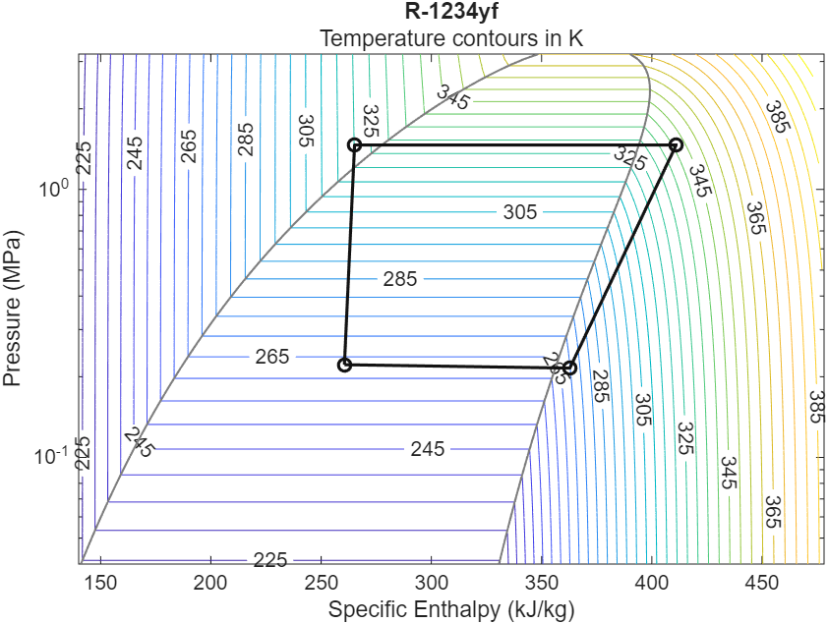
Thermal Management & Refrigeration Cycle Modelling
INTERNSHIP REPORT
MATLAB / Simulink (Simscape)
Perugu Venkata Aditya
Mechanical Engineering (Digital Manufacturing)
NoonRay Energy Pvt. Ltd, IIT Madras Industrial Park, Chennai | 24-12-2025
Notes:
Introduce yourself: name, Mechanical Engineering (Digital Manufacturing). Say this report has two parts done at NoonRay Energy: (I) battery temperature with conduction vs convection, (II) a closed-loop R-1234yf refrigeration cycle in Simulink. The picture is the P-H diagram that validated the cycle.

Slide 2
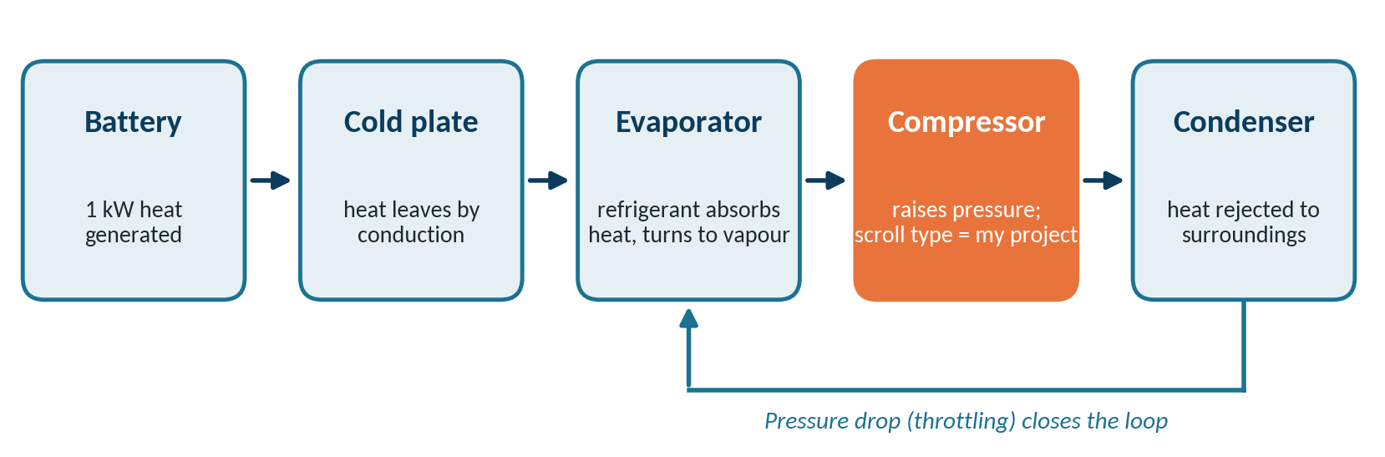
The big picture
Part I How battery temperature changes with conduction vs convection
Part II R-1234yf refrigeration cycle, checked on a P–H diagram
Notes:
Walk the diagram left to right: battery makes heat, the cold plate takes it by conduction, the evaporator absorbs it into the refrigerant, the compressor raises the pressure, the condenser rejects the heat, and a pressure drop closes the loop. The orange block is the compressor, and my project is a scroll compressor.

Slide 3
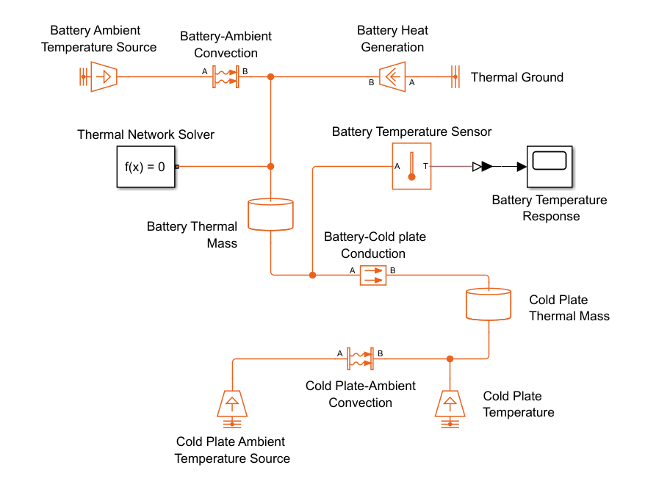
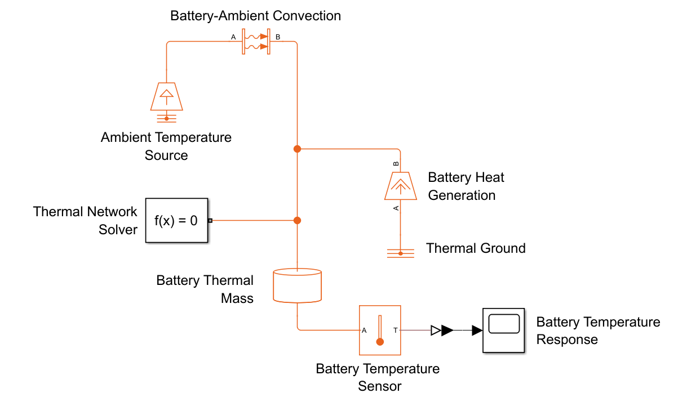
Part I: Two Simulink models of the battery
A. Convective model
B. Conductive model with cold plate
Battery loses heat straight to ambient air
Heat conducts into a cold plate, then convects away
Battery = one lumped thermal mass, 1 kW constant heat. Fluid flow and electrochemistry are not modelled.
Notes:
Point at the blocks: heat flow source (1 kW), battery thermal mass, convection or conduction block, temperature source (ambient or cold plate), temperature sensor, solver. The only difference between the two models is the cold plate path.

Slide 4
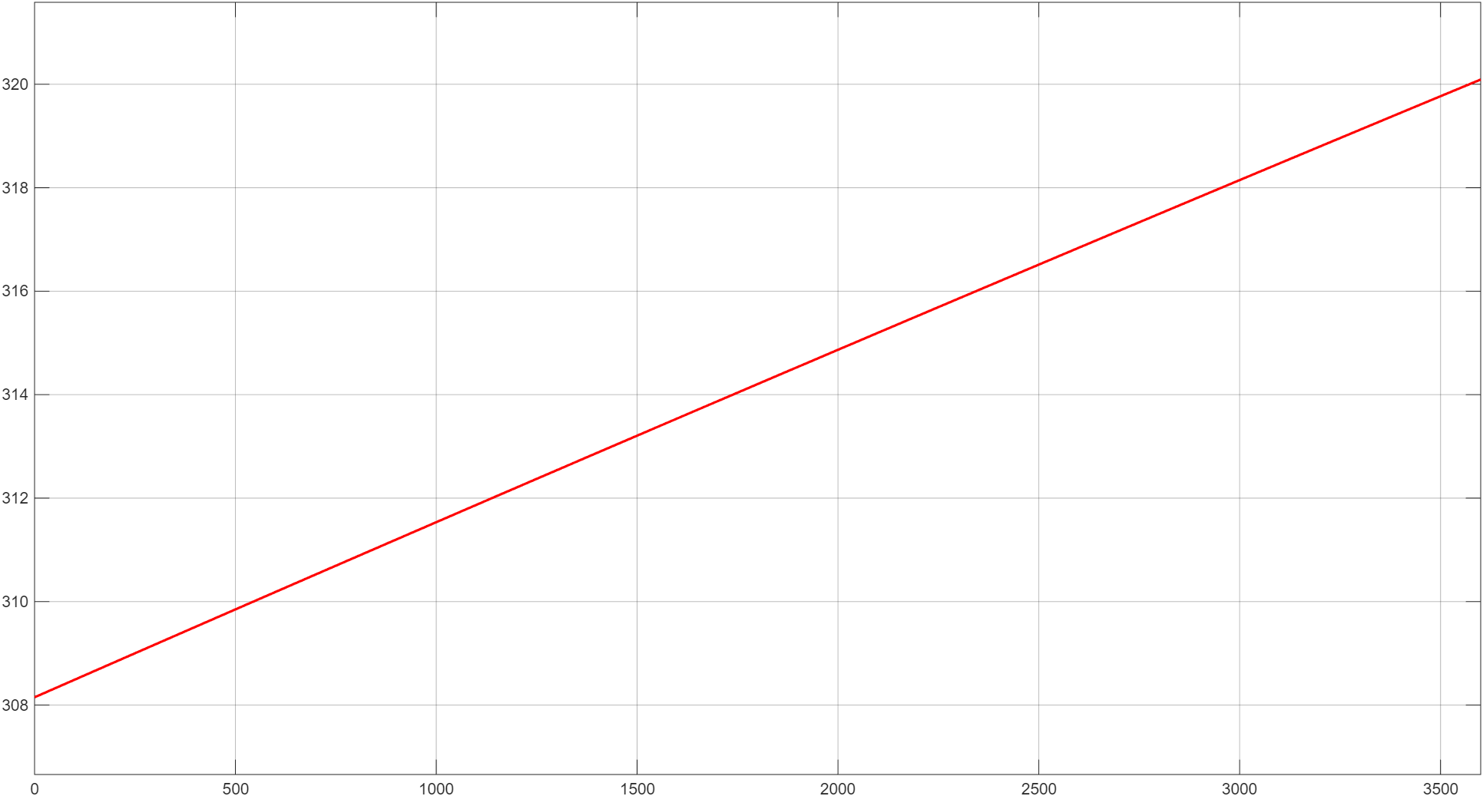
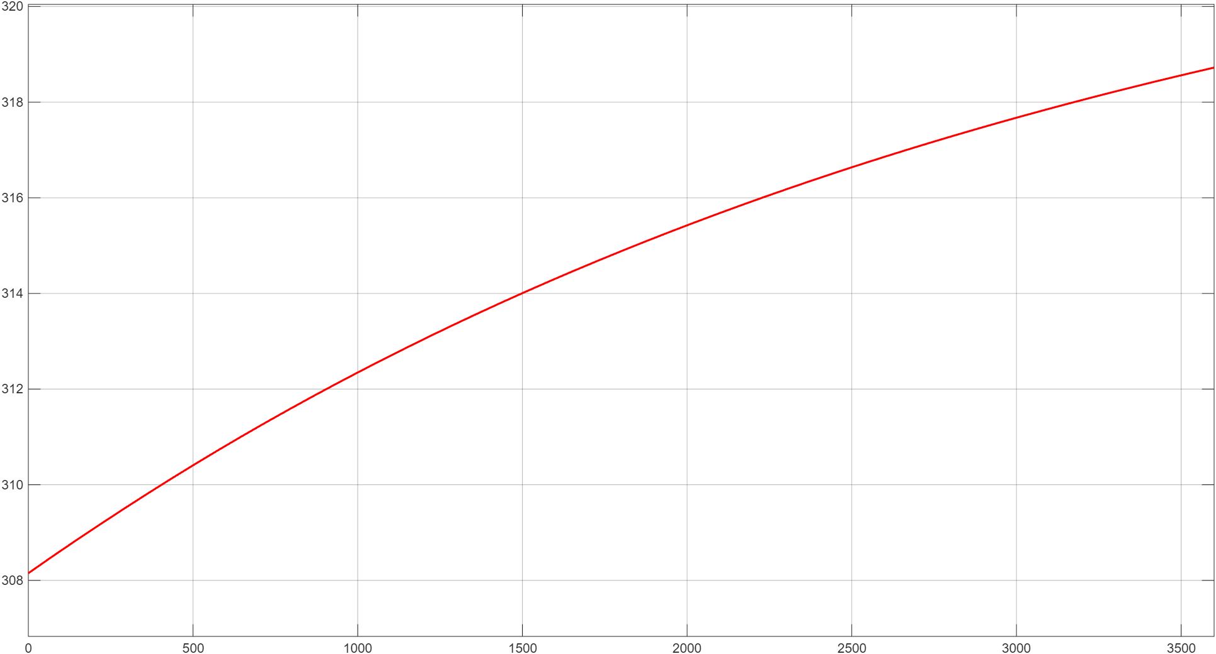
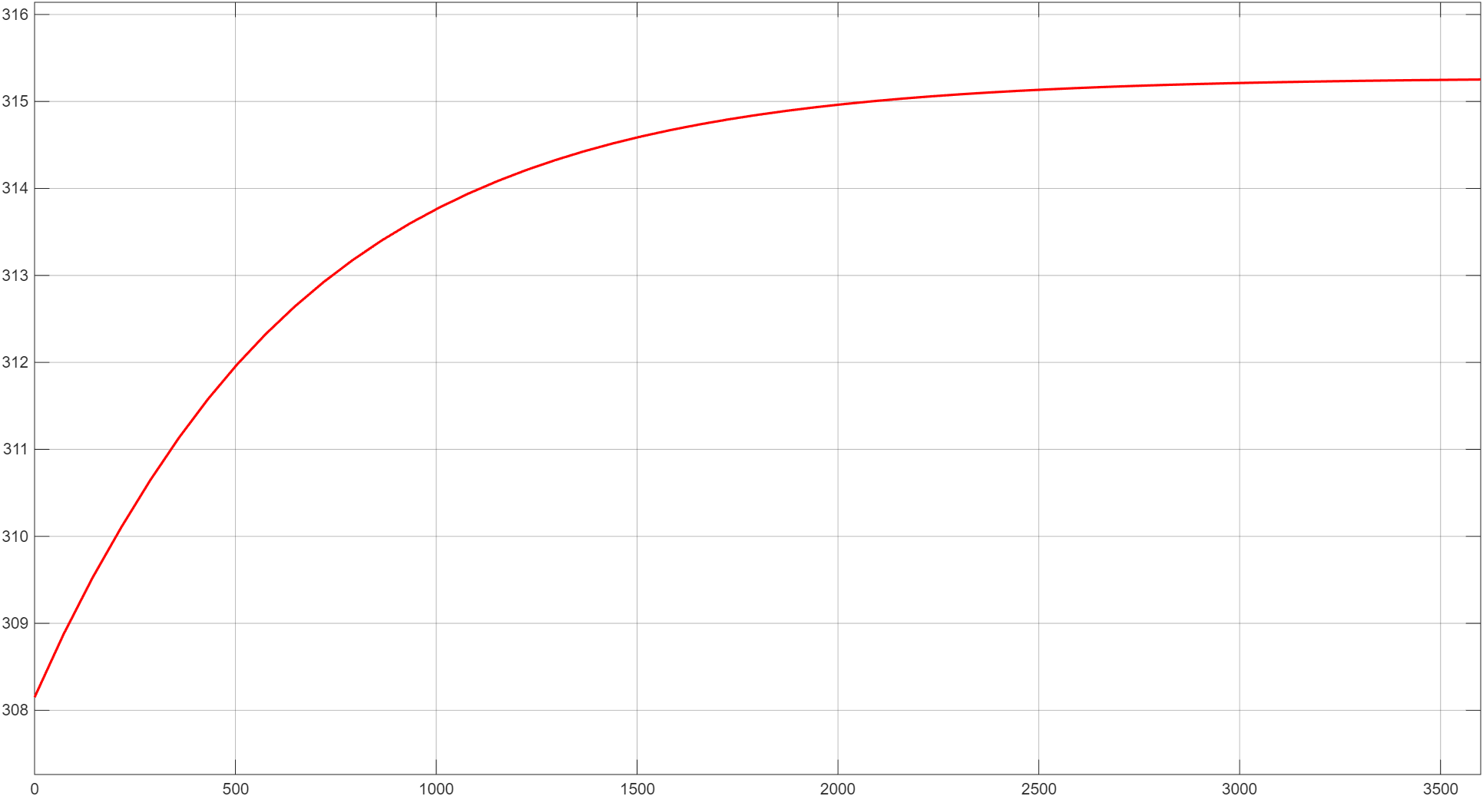
Part I: Convective cooling results
Ambient 313.15 K | Area 0.94 m² | 300 kg | Cp 1000 J/(kg·K) | 1 kW | 1 hour
h = 5 W/m²·K
h = 100 W/m²·K
h = 500 W/m²·K
308 → 320 K
308 → 318.7 K
308 → 315.2 K
Takeaway Higher convective coefficient h removes more heat, so the battery ends cooler. Low h gives the biggest rise.
Notes:
Same battery, same 1 kW. Only the convective coefficient changes. Low h: temperature keeps climbing almost linearly. High h: the curve flattens quickly at a lower temperature.

Slide 5
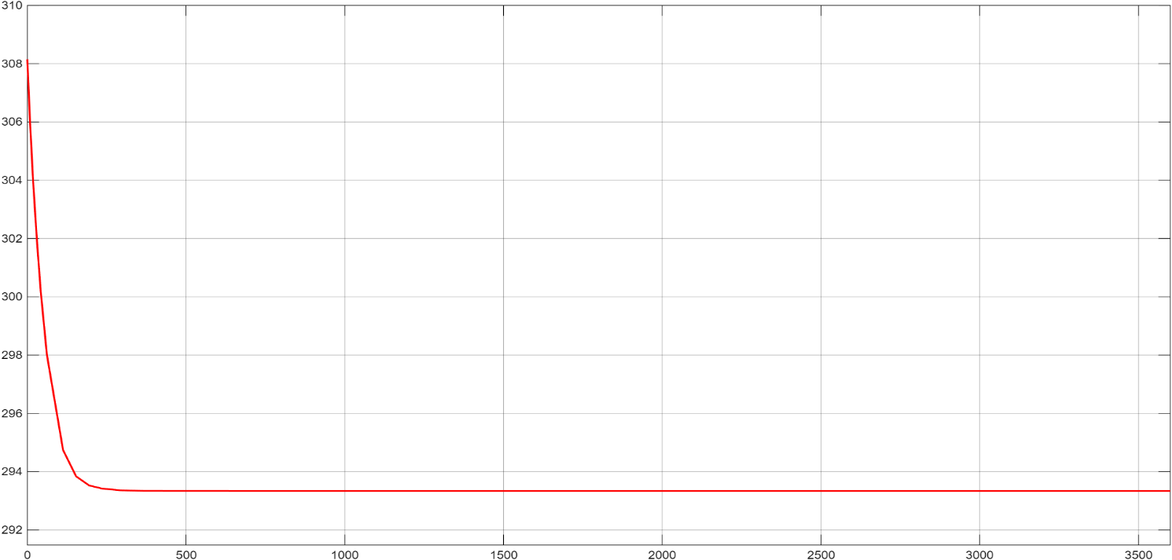
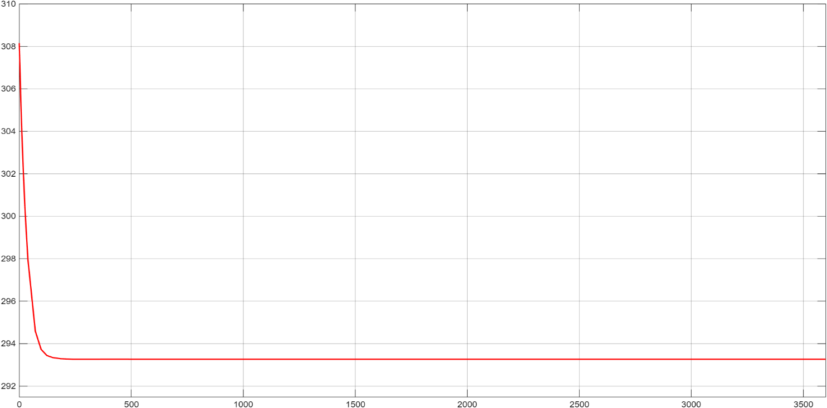
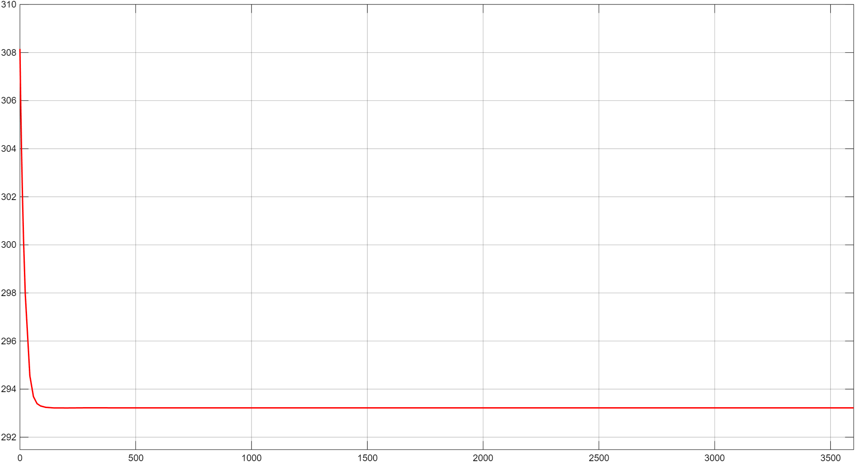
Part I: Conductive cooling results
Battery 500×400×300 mm | Cold plate 5 cm, 293.15 K | k = 237 W/(m·K) | Start 308.15 K | 1 kW
Layer = 8 mm
Layer = 5 mm
Layer = 3 mm
308 → 293.33 K
308 → 293.27 K
308 → 293.22 K
Takeaway Temperature drops fast and settles near the cold plate temperature. A thinner layer gives a quicker initial drop.
Notes:
In all three cases the battery falls rapidly and stabilises close to the cold plate temperature of 293.15 K. Thinner conductive layer means lower thermal resistance, so a faster initial drop and a tiny reduction in the final temperature.

Slide 6
Part I conclusion: conduction wins
Convective (direct to ambient)
Conductive (cold plate)
315–320 K
≈ 293 K
Slow, gradual rise
Set by the convective coefficient h
Rapid drop, then stable
Set by thermal resistance of the layer
Under the same 1 kW heat load, a cold plate cools the battery faster and to a lower temperature.
Notes:
Compare the two big numbers. Convection alone leaves the battery at 315 to 320 K. The cold plate brings it to about 293 K. That is why cold-plate cooling is the basis for battery thermal management and leads into Part II, where the heat is carried away by a refrigerant loop.

Slide 7
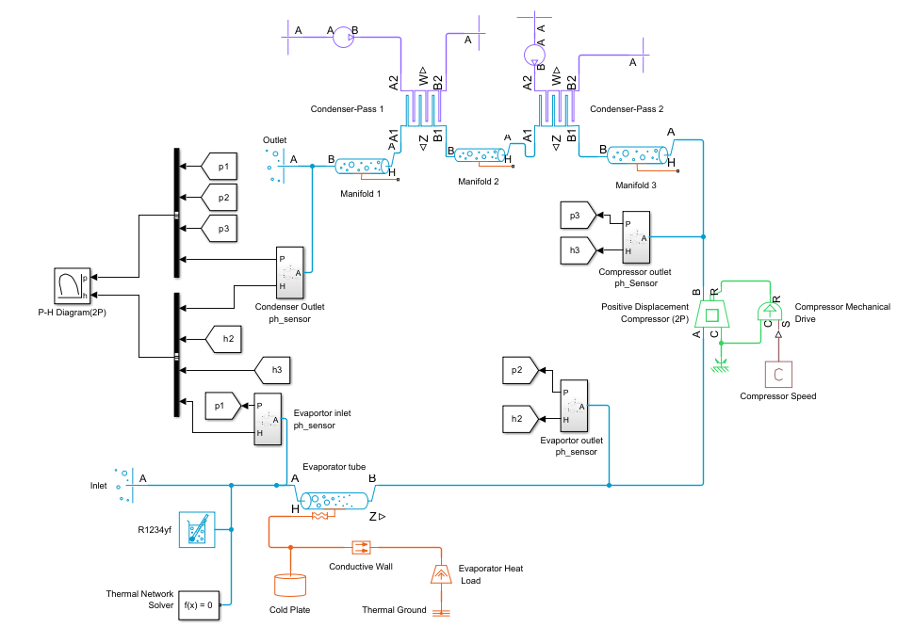
Part II: R-1234yf refrigeration cycle in Simulink
1
Evaporator
absorbs heat from the load
2
Compressor
raises pressure and enthalpy
3
Condenser (2 passes)
rejects heat to surroundings
4
p–h sensors
feed the P–H diagram for validation
Notes:
Closed refrigerant loop built from evaporator, positive displacement compressor and two condenser passes with manifolds. The refrigerant property block gives R-1234yf behaviour. The cold plate and heat load drive the evaporator. The p-h sensors read the state points and the P-H generator plots them.

Slide 8
Result: the cycle on the P–H diagram
Evaporation
Moves right to higher enthalpy: heat absorbed
Compression
Pressure and enthalpy jump: work added
Condensation
Enthalpy falls at near constant pressure: heat rejected
Pressure drop
Flow restrictions act as throttling
All four processes appear and the loop stays stable. Results match refrigeration theory.
Notes:
Trace the loop: evaporation to the right, compression upward, condensation to the left at nearly constant pressure, then the pressure drop back. The refrigerant leaves the evaporator superheated and the condenser outlet is sub-cooled liquid. No expansion valve is modelled, pressure drop in the manifolds and pipes acts as throttling. Future work: add an expansion valve control.

Slide 9
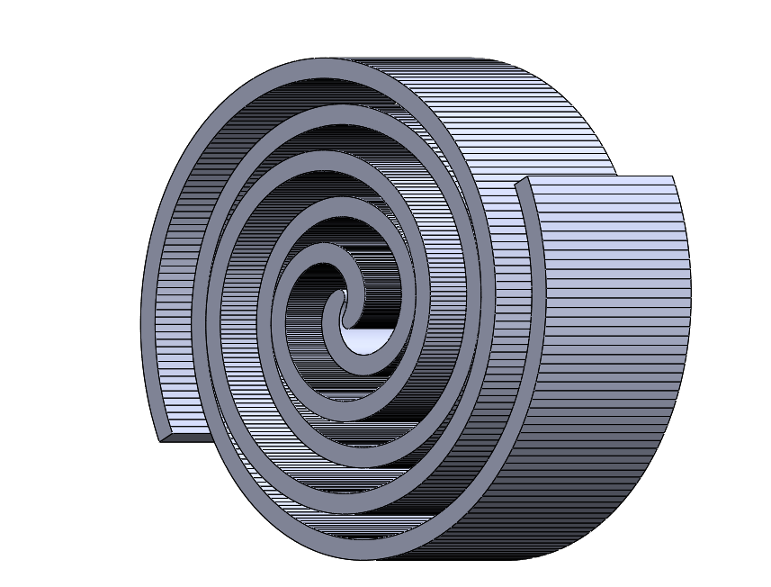

Link to my project: the scroll compressor
Same job
The compressor block in the cycle is a positive displacement machine, like a scroll.
How it works
The orbiting scroll moves inside the fixed scroll and squeezes trapped refrigerant.
In the loop
It raises the refrigerant pressure and enthalpy, as seen in the P–H diagram.
Scroll model
Fixed (grey) and orbiting (red) scroll
Full chain: battery heat → cold plate → evaporator → scroll compressor → condenser
Notes:
Connect the two pieces of work. In the simulation the compressor is a positive displacement block. In my project I designed the scroll compressor, with a fixed scroll and an orbiting scroll, which is the physical component doing that pressure and enthalpy rise.

Slide 10
Three things to remember
1
Cold-plate conduction cools better
≈ 293 K versus 315–320 K with convection alone, under the same 1 kW load.
2
The R-1234yf loop is validated
Evaporation, compression, condensation and throttling all appear on the P–H diagram.
3
The compressor is the heart
My scroll compressor design is the physical counterpart of the compressor block.
Notes:
Close with these three messages, then invite questions.

