Slide 1
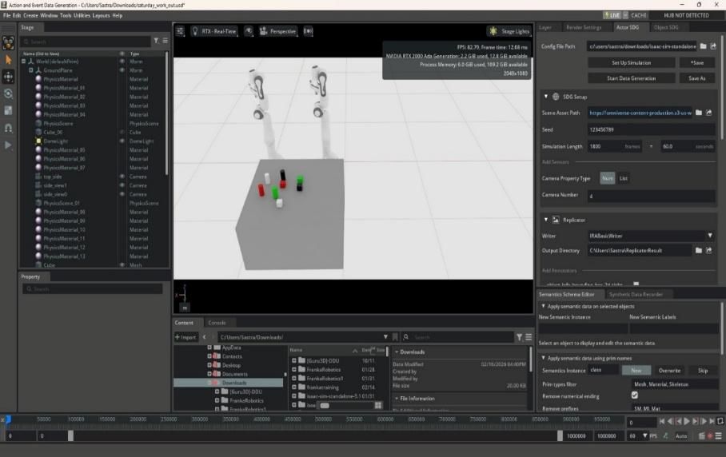
MCT300 / MEC300 MINI PROJECT | MAY 2026
AI-Vision Based Guided Pick and Place Dual Arm Manipulator
Perugu Venkata Aditya
Reg. No. 127161035
B.Tech. Mechanical Engineering (Digital Manufacturing)
Guide: Dr. Badri Narayanan R, Sr. Asst. Professor | School of Mechanical Engineering, SASTRA
Simulation workspace in NVIDIA Isaac Sim
Notes:
Good morning. I am Perugu Venkata Aditya, a B.Tech Mechanical Engineering (Digital Manufacturing) student at SASTRA. This is my mini-project: an AI-vision guided pick-and-place system for a dual-arm manipulator, built and tested entirely in NVIDIA Isaac Sim, guided by Dr. Badri Narayanan R. In one sentence: the robot looks at the table, recognises each object, finds where it is in 3D, and then picks and places it - with no manual programming of positions.

Slide 2






What I Will Cover
1 Introduction & Problem
2 Literature & Objectives
3 System & Tools
Why vision-guided dual-arm robots
What exists and the gap
Architecture and software stack
4 Methodology
5 Results
6 Wrap-up
The 8-step procedure
Detection, 3D, IK, pick-and-place
Challenges, learning, conclusion
Notes:
I will go in the same order that the robot works - from the problem, through seeing, locating and moving, to the results. Each section matches one stage of the pipeline, so you can stop me anywhere and ask about that stage.

Slide 3




Introduction: The Dual-Arm Manipulator
Two coordinated arms
The core idea
Common base, human-like handling
1
Detect objects with YOLOv8
AI vision
Real-time detection and decisions
2
3D position by depth + TF
Adaptable
Copes with changing positions and light
3
Joint angles by MATLAB IK
Industry 4.0 ready
Smart sorting and material handling
Notes:
A dual-arm manipulator is two robot arms on one base that work together, like human hands. This allows tasks like holding with one hand while working with the other. Adding AI vision lets it react to what it sees instead of replaying fixed positions. This fits Industry 4.0, where factories are smart, connected and flexible. My project covers the vision-to-motion chain that makes this possible.

Slide 4





Why a Dual-Arm Robot?
Coordinated operation
Precision & stability
Complex tasks
Both arms act at once, cutting task time
One arm steadies, the other works
Assembly, alignment, re-orientation
Higher productivity
Flexibility
Safer for humans
Parallel execution raises throughput
New objects and tasks, same hardware
Takes over hazardous, repetitive work
Notes:
These are the six reasons dual-arm is better than single-arm. Coordinated operation: both arms work at the same time. Precision and stability: one arm holds, one works. Complex tasks: assembly and re-orientation. Productivity: parallel work raises throughput. Flexibility: new tasks without new hardware. Safety: robots take dangerous or repetitive work, with force limits and collision avoidance. In this project the pick-and-place uses the two-arm set-up and the same pipeline can drive either arm.

Slide 5
Problem Statement
1
Fixed programs
2
Weak perception
Robots fail when object position or lighting changes
Traditional vision struggles with complex scenes
3
Vision and motion not integrated
4
Hardware is costly
Dual-arm coordination needs both together
Testing on real robots is risky and slow
Answer: build and validate a vision-guided pipeline in simulation first
Notes:
Four problems. One: industrial robots follow fixed programs, so if an object moves they fail. Two: classical vision struggles with real, complex scenes. Three: vision and motion control are rarely properly joined, especially for dual-arm. Four: building real hardware first is costly and risky. So the answer is to design and prove the whole pipeline in simulation first.

Slide 6

Objectives
GENERAL OBJECTIVE
Detect objects, estimate their 3D position and move to them using inverse kinematics in a simulated dual-arm system
Visual perception
Depth sensing
3D localisation
YOLOv8 boxes, labels, confidence
RGB-D data through ROS 2
Pixels to X, Y, Z
Coordinate mapping
Motion control
Evaluation
TF camera to robot base
Joint commands in Isaac Sim
MATLAB IK and accuracy limits
Notes:
The general objective is one sentence: detect objects, estimate their 3D position and move to them using inverse kinematics inside simulation. Then six specific objectives, one per stage: perception, depth, 3D localisation, coordinate mapping, motion generation, and evaluation. Every result slide later maps back to one of these.

Slide 7
Literature Survey and Research Gap
Work | What they did | Gap
YOLO (Redmon, 2016) | Real-time detection in one pass | No depth, no manipulation
Dual-arm pick-and-place (Harada, 2012) | Synchronised dual-arm trajectories | No AI perception
Hand-eye coordination (Levine, 2018) | End-to-end grasp learning | Huge real-world data needed
6D pose (Le, 2021) | Deep learning + 3D vision pose | Pose only, no robot control
Deep RL grasping (Chen, 2023) | Grasping learned by interaction | High compute, long training
Push and grasp (Wang, 2025) | Dual-arm clutter handling | Complex learning methods
Gap: no integrated YOLO + depth + TF + IK pipeline for a dual-arm robot
Notes:
I reviewed nine papers; this table shows the six most relevant. Redmon gave us YOLO but no manipulation. Harada planned dual-arm motion but without AI vision. Levine learned grasping end-to-end but needed huge real-world data. Le estimated 6D pose but did not control a robot. Chen used reinforcement learning, which is compute heavy. Wang and Kasaei handled clutter with complex learning. None combine detection, depth, frame transformation and inverse kinematics for a dual-arm robot, which is exactly the gap this project fills.

Slide 8
System Architecture
PERCEPTION
SPATIAL UNDERSTANDING
CONTROL
Isaac Sim RGB-D camera
Depth fusion to X, Y, Z
MATLAB inverse kinematics
Synthetic dataset
ROS 2 TF frames
Joint commands via ROS 2
YOLOv8 detection
Camera to robot base
Dual-arm pick and place
Pixels -> 3D position -> Robot frame -> Joint angles -> Motion
Notes:
The whole system is three blocks. Perception: Isaac Sim creates data, YOLOv8 is trained and detects objects. Spatial understanding: depth turns pixels into 3D, and TF expresses that position in the robot frame. Control: MATLAB inverse kinematics gives joint angles and the arms execute pick-and-place through ROS 2. Each block feeds the next, so an error early on, like a wrong frame, shows up as a wrong grasp at the end.

Slide 9


Tools and Technologies
NVIDIA Isaac Sim
Simulated robot, RGB-D camera, synthetic data
YOLOv8 / YOLOv8n
Detects 8 classes: cube and cylinder in 4 colours
ROS 2 Humble
Publisher-subscriber links between modules
Action Graph + TF
Streams data, publishes frame transforms
MATLAB Robotics Toolbox
Inverse kinematics for joint angles
Notes:
Five tools. Isaac Sim is the virtual workshop: physics, robot, camera and automatic data generation. YOLOv8 does detection. ROS 2 Humble is the messaging system, like the nervous system of the robot, and its Action Graph is where I wired the nodes inside Isaac Sim. TF keeps track of coordinate frames. MATLAB Robotics Toolbox solves inverse kinematics because MoveIt and other solvers did not work reliably in this set-up.

Slide 10
Methodology: Eight Steps
1
2
3
4
Synthetic data
Dataset prep
Training
Validation
Isaac Sim scenes: RGB, depth, boxes
YOLO format, train and val split
YOLOv8 trained, best.pt saved
Precision, recall, visual check
5
6
7
8
Depth fusion
Frame transform
Grasp + IK
Pick and place
Box centre + depth gives X, Y, Z
Camera to robot base via TF
MATLAB joint angles
Dual-arm motion executed
Notes:
This is the step-by-step procedure. Steps 1 to 4 build the eyes: data, labels, training and checking. Steps 5 and 6 build spatial understanding: depth and frame transformation. Steps 7 and 8 build the hands: grasp, inverse kinematics and pick-and-place. The following slides walk through each step with its result.

Slide 11


Step 1: Synthetic Data in Isaac Sim
Scene
Table, dual-arm robot, 8 object types
Variation
Position, orientation, lighting, viewpoint
Output
RGB images, depth maps, 2D boxes
Notes:
Training a detector normally needs thousands of hand-labelled photos. Instead I built the scene in Isaac Sim and let it generate RGB images, depth and bounding boxes automatically. I varied object position, orientation, lighting and viewpoint so the model sees many conditions. This saves time and gives perfect labels, but the trade-off is that the data is synthetic, so real-world performance must still be verified.

Slide 12
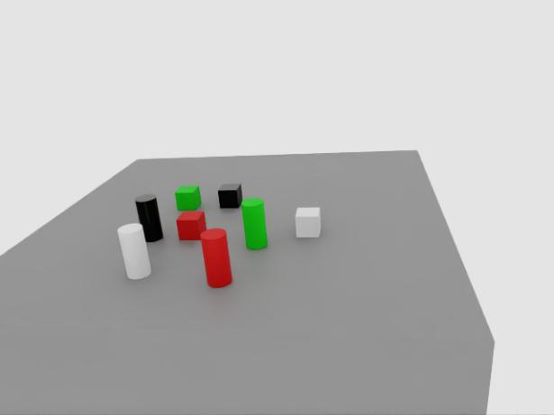
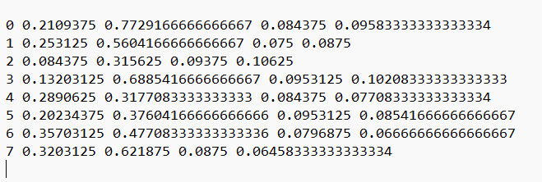
Step 2: Dataset Preparation (YOLO Format)
class_id
x_center
y_center
width
height
Label file (one line per object)
Matching RGB image
Values normalised 0 to 1, so labels are independent of image size
Notes:
Each image has a text file with one line per object: class id, then the box centre x and y, width and height. All four box numbers are normalised between 0 and 1, so they do not depend on image size. For example class 0 could be a red cube and class 1 a red cylinder. I split data into training and validation sets and checked class ids and box alignment so the model does not learn from wrong labels.

Slide 13
Steps 3 and 4: Training and Validation
Parameter | YOLOv8 | YOLOv8n (Nano)
Model size | Larger | Very compact
Accuracy | Higher, deeper features | Slightly lower
Speed | Moderate | Very fast
Hardware | High GPU and memory | Low-end devices
Latency | Higher | Very low
Best use | Accuracy-critical inspection | Robotics, fast response
Process
Train on labelled images over many epochs
Tune learning rate and batch size
Save best weights (best.pt)
Validate on unseen images
Check precision, recall, F1
Table: YOLOv8 vs YOLOv8n
Notes:
In training the model learns from the labelled images over several epochs; I tuned learning rate and batch size and saved the best weights. In validation the model is tested on images it has not seen, using precision, recall and F1. I compared the larger YOLOv8 with the nano variant YOLOv8n. Nano is much lighter and faster, which suits real-time robotics, while the larger model gives deeper feature extraction for complex scenes. An early run with a small dataset gave poor accuracy, which improved after I added more images.

Slide 14
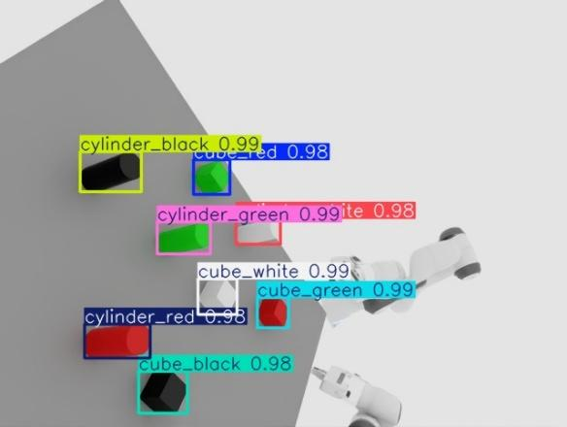
Result: Real-Time Object Detection
8
object classes (cube, cylinder x 4 colours)
0.98-0.99
confidence on detected objects
Real time
tested live inside Isaac Sim
Notes:
This is the trained model running live on the Isaac Sim camera. Every object has a coloured box, a class name such as cube_red or cylinder_green, and a confidence score. Confidence is about 0.98 to 0.99 for all objects visible here. The box is important beyond recognition: its centre pixel is what I pass on to the depth step to locate the object in 3D.

Slide 15
Step 5: Depth Fusion - From 2D to 3D
Pinhole camera model
Worked example
X = (u - cx) x Z / fx
X = -0.178 m
Y = (v - cy) x Z / fy
pixel u = 148
(u, v): box-centre pixel Z: depth f: focal length
Y = -0.141 m
Pipeline
pixel v = 247
Box centre (u, v)
+ Depth Z
= (X, Y, Z)
Z = 1.159 m
depth at that pixel
Notes:
A detection gives only a pixel location, which is not enough for a robot. The depth camera gives the distance Z at that pixel. Using the pinhole camera model, X equals the pixel offset from the image centre times Z divided by the focal length, and Y likewise. In my worked example the object at pixel 148, 247 with depth 1.159 m and focal length 600 pixels gives X about minus 0.178 m and Y about minus 0.141 m in the camera frame. Note that these are camera-frame values; the next step moves them to the robot frame.

Slide 16
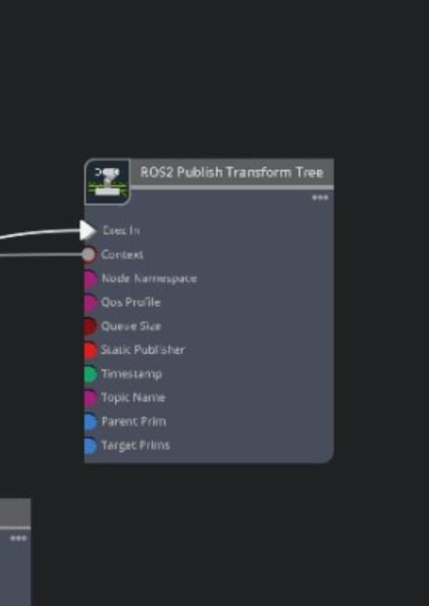

Step 6: Coordinate Transformation with TF
Why it is needed
Camera frame is not the robot frame
What TF stores
Rotation and translation between frames
Result
Object position correct in robot workspace
Issue fixed
Wrong frame alignment gave wrong coordinates
Notes:
The 3D point from the last step is measured from the camera, but the robot arm measures everything from its own base. The ROS 2 Publish Transform Tree node in the Action Graph holds the rotation and translation between camera and robot base, so the point can be converted. This was a real problem in my work: early positions were wrong because the frames were not aligned correctly. After fixing the frame configuration in TF the positions became consistent.

Slide 17
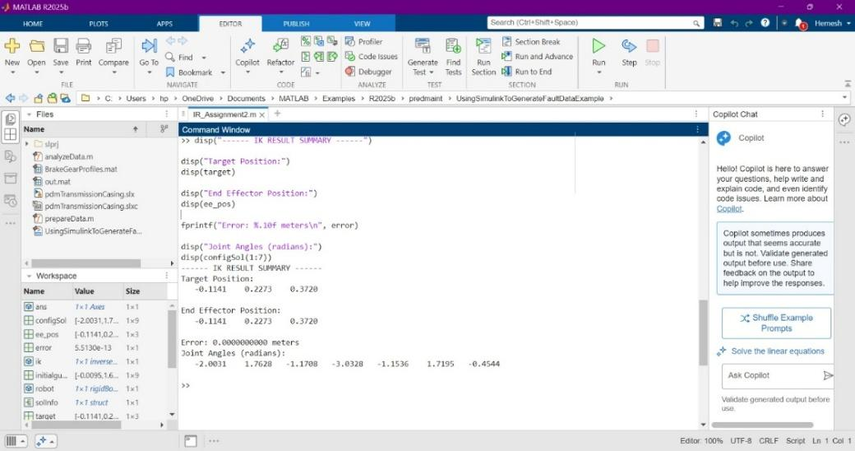
Step 7: Inverse Kinematics in MATLAB
Input
Target X, Y, Z in robot frame
Solver
Robotics Toolbox inverse kinematics
Output
Joint angles and position error
MATLAB output: target position, end-effector position, error and joint angles
Notes:
Forward kinematics goes from joint angles to hand position. Inverse kinematics is the reverse: given where the hand must be, find the joint angles. I pass the robot-frame X, Y, Z to a MATLAB Robotics Toolbox solver. It prints the target, the achieved end-effector position and the error, then the joint angles. I first tried MoveIt and other IK solvers but they did not work reliably in this set-up, so MATLAB was used. A limitation is that this step is run in MATLAB, not yet fully automated inside ROS 2.

Slide 18
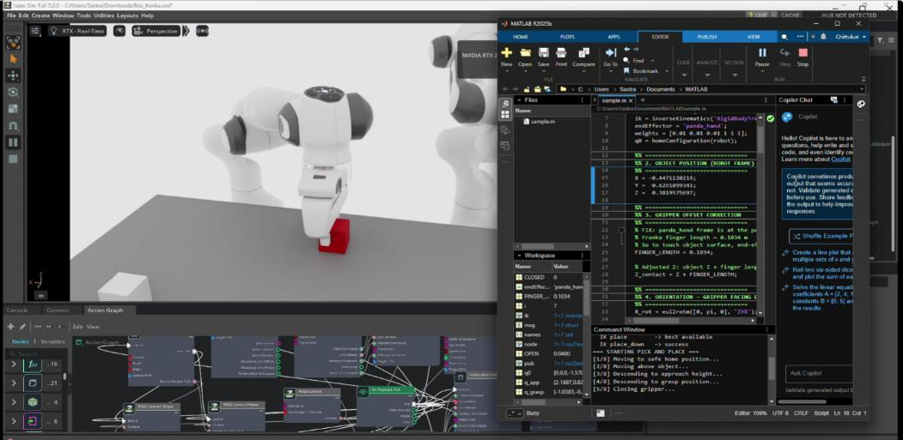
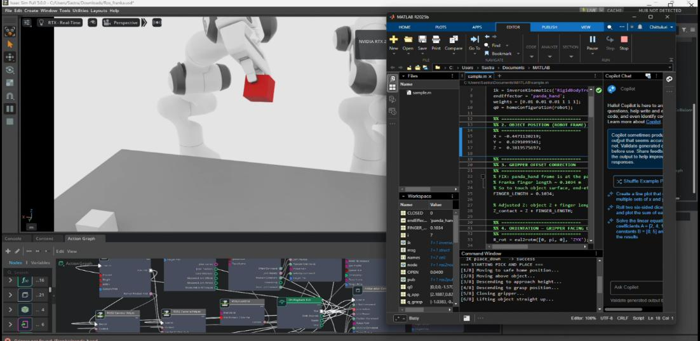
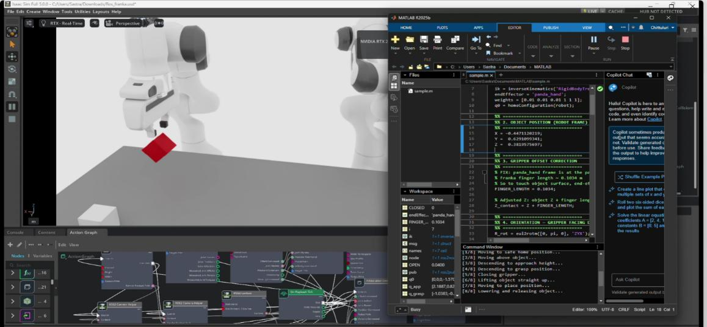
Step 8: Pick, Hold and Place
1 Pick
2 Hold
3 Place
Move to object, grasp
Lift and transport
Release at target
Detection -> depth -> TF -> inverse kinematics -> motion, all in one run
Notes:
With the joint angles computed, the arm moves above the object, descends, closes the gripper for a stable grasp, lifts, carries the object to the target location and releases it. These three frames show picking, holding and placing in Isaac Sim. This is the end of the chain, so it only works if the detection, depth, transform and inverse kinematics are all correct. It shows the full integration of perception, planning and control.

Slide 19
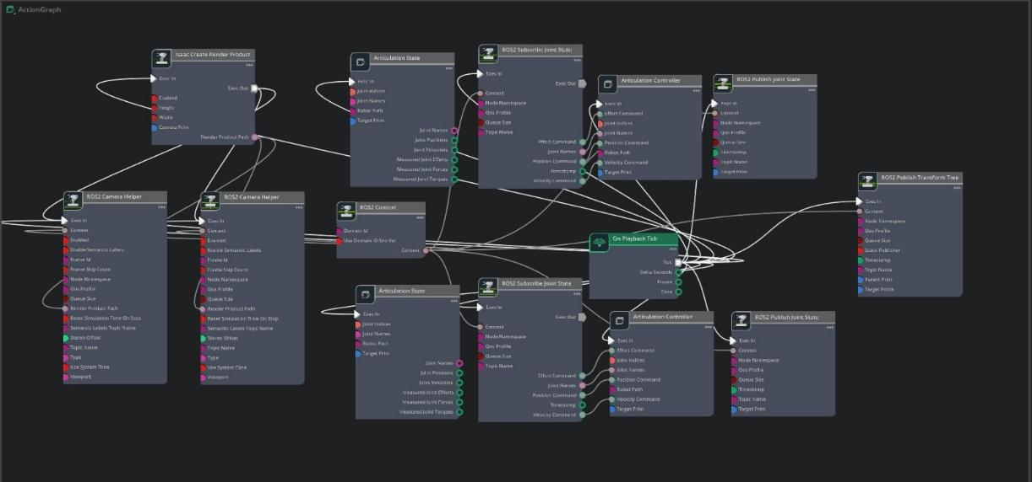
ROS 2 Action Graph
Camera and depth
Stream RGB and depth
Transform tree
Publishes frames
Control nodes
Joint commands, both arms
Notes:
The Action Graph is a node diagram inside Isaac Sim. Camera and depth nodes stream RGB and depth to ROS 2 topics. A transform tree node publishes the frames. Control nodes receive joint commands and drive both arms. I first tried the built-in Replicator script for depth but it produced repeated syntax errors, so I switched to the Action Graph for stable data. Debugging path mismatches between nodes was one of my main challenges.

Slide 20
Model Performance Evaluation
0.990
overall mAP@0.5 (YOLOv8n)
Precision
Detections that are correct
Recall
Real objects that are found
F1-score
Balance of precision and recall
Notes:
Three metrics. Precision: of everything the model detected, how much was right. Recall: of all real objects, how many it found. F1 is the balance of the two. YOLOv8n reached an overall mAP at 0.5 of 0.990, and all eight classes are between 0.987 and 0.991, so no class is weak. One honest caveat: these are very high because the data is clean and synthetic; in the real world, noise, shine and clutter will lower it, which is why real-world testing is my future work.

Slide 21
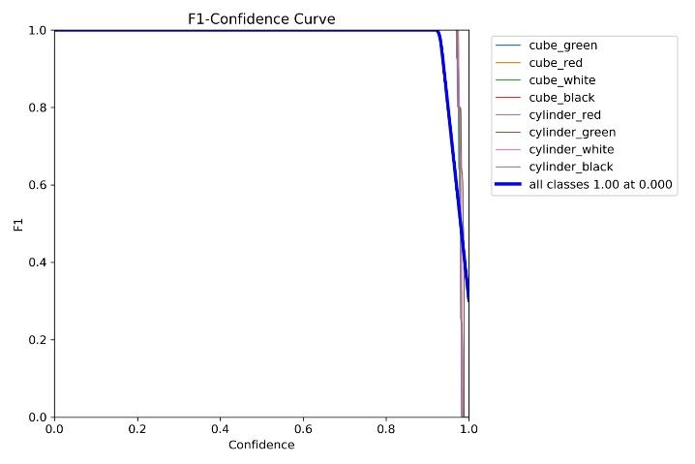
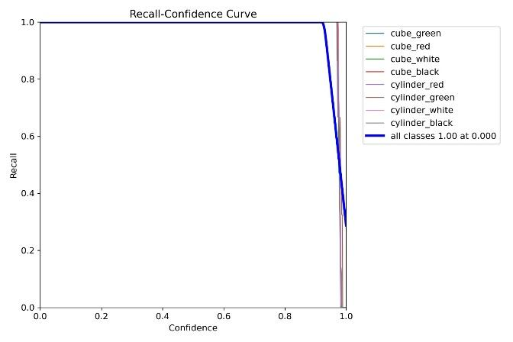
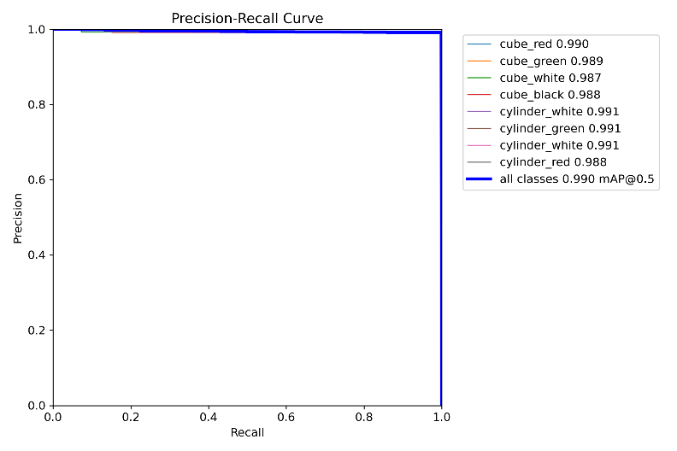
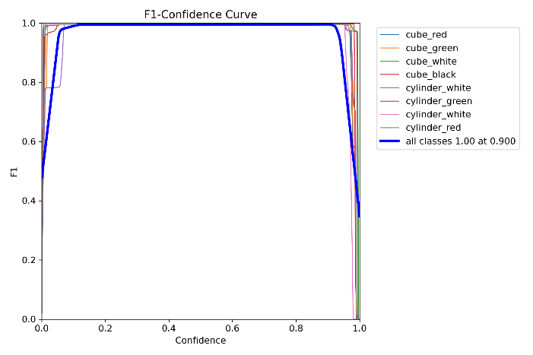
Evaluation Curves
YOLOv8: F1 vs Confidence
YOLOv8: Recall vs Confidence
YOLOv8n: Precision vs Recall
YOLOv8n: F1 vs Confidence
Notes:
Top row is YOLOv8. Its F1 and recall curves stay at 1.0 across most confidence thresholds and drop only at the very highest values, so almost nothing is missed. Bottom row is YOLOv8n. The precision-recall curve hugs the top-right corner, which is the ideal, and the F1 curve peaks at about 1.0 near confidence 0.9. In practice a confidence threshold around 0.5 to 0.9 gives reliable detections.

Slide 22
Challenges and How I Solved Them
Poor accuracy
Cause: Small initial dataset
More training images
Depth script errors
Cause: Replicator syntax issues
ROS 2 Action Graph
Wrong coordinates
Cause: Frames not aligned
Configured TF correctly
IK not converging
Cause: MoveIt / other solvers
MATLAB Robotics Toolbox
Notes:
Four real problems. One, poor accuracy with a small dataset, fixed by generating more images. Two, depth through the built-in Replicator script kept failing with syntax errors, so I moved to the Action Graph. Three, wrong coordinates because frames were misaligned, fixed in TF. Four, MoveIt and other solvers could not give reliable inverse kinematics, so I used MATLAB. Each fix taught me to check the interface between two stages, not just each stage alone.

Slide 23


My Contribution and Learning
Contribution
Learning
Limitations and ethics
Dual-arm robot in Isaac Sim with ROS 2
NVIDIA Isaac Sim
Path mismatches affected accuracy
MATLAB joint-angle calculations
ROS 2 Action Graph and TF
IK errors reduced coordination
Action Graph node connections
Inverse kinematics
Simulation only: validate safety first
Notes:
My role was mainly the robot side. I worked on the dual-arm robot in Isaac Sim with ROS 2 for object handling and motion control, and I implemented the MATLAB calculations that give joint angles. What I learned: Isaac Sim, ROS 2 Action Graph and TF, and inverse kinematics. Limitations: Action Graph path mismatches caused inaccurate positioning, MATLAB joint-angle errors reduced precision, and everything is simulation only, so safety and force limits must be validated before real use near people.

Slide 24
Conclusion and Future Scope
What was achieved
Future scope
YOLOv8 detection, mAP@0.5 about 0.99
Test on a physical dual-arm robot and real camera
Depth fusion: 2D pixel to 3D position
Collision-aware planning, synchronised arms
TF mapping to the robot frame
Run IK inside ROS 2 for a closed loop
MATLAB IK and dual-arm pick-and-place
Clutter and 6D pose estimation
Modular ROS 2 architecture, tested safely in simulation
Notes:
To conclude: I built and demonstrated a complete perception-to-action pipeline in simulation. YOLOv8 detects objects at about 0.99 mAP, depth fusion gives 3D positions, TF maps them to the robot frame and MATLAB inverse kinematics drives the pick-and-place. The architecture is modular and safe to test. Future work: test on a real robot with a real RGB-D camera, add collision-aware planning and dual-arm synchronisation, run IK inside ROS 2 for a closed loop, and handle clutter with 6D pose estimation.

Slide 25

Thank You
Ready to explain
Why YOLOv8 for this task?
Questions welcome
How do pixels become 3D?
Why do we need TF?
Perugu Venkata Aditya
Why MATLAB for IK?
B.Tech. Mechanical Engineering (Digital Manufacturing) | SASTRA Deemed to be University
How does this reach the real world?
Notes:
Thank you. These are the questions I am ready for. Why YOLOv8: single-pass, real-time and easy to link with ROS. How depth becomes 3D: the pinhole model. Why TF: camera and robot frames differ. Why MATLAB: MoveIt and other IK solvers did not work reliably here. What about the real world: the metrics are from synthetic data, so the sim-to-real gap is the next test. I am happy to take questions.

