Slide 1

MCT 300 – MINI PROJECT
Review - 3
AI-BASED VISION GUIDED PICK-AND-PLACE
DUAL-ARM MANIPULATOR
Presented by:
Perugu Venkata Aditya – 127161035
B.Tech. Mechanical Engineering (Digital Manufacturing)
Guide:
Dr. BADRI NARAYANAN R
Sr. Asst. Professor
School of Mechanical Engineering
Notes:
Good morning. I am Perugu Venkata Aditya from B.Tech Mechanical Engineering (Digital Manufacturing). My mini project is an AI vision guided pick-and-place system for a dual-arm manipulator. In simple words: the robot looks at objects with a camera, finds what they are and where they are, and then picks and places them. Everything was built and tested in the NVIDIA Isaac Sim simulator under the guidance of Dr. Badri Narayanan R.

Slide 2
Contents
1. Introduction
7. Results
2. Problem Statement
8. Interpretation and Discussion
3. Literature Survey
9. Attainment of Objectives
4. Solution / Objective
10. My Contribution and Learning
5. Methodology / Work Plan
11. Conclusion
6. Implementation of Methodology
2
Notes:
This is the order of my presentation. First the background: introduction, problem and literature. Then what we planned: objective and methodology. Then what I actually did and the results, followed by interpretation, discussion, my own contribution and the conclusion.

Slide 3
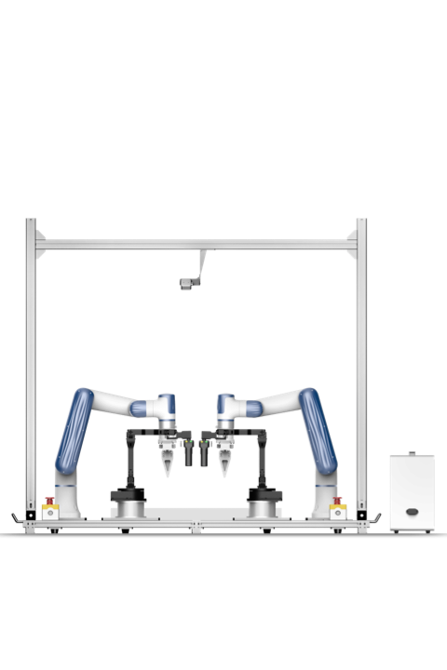
Introduction
A dual-arm robotic manipulator consists of two coordinated robotic arms mounted on a common base, designed to perform tasks requiring:
AI vision for real-time detection and decisions.
Dynamic adaptability to changing environments.
Industry 4.0 readiness for smart, connected automation.
Coordinated handling for precise manipulation and transfer.
Use in smart manufacturing and automated material handling.
3
Notes:
A dual-arm robot has two arms on one base that work together, like our two hands. Because of this it can hold an object with one arm and work on it with the other. I added AI vision so that the robot can see and decide, instead of repeating fixed positions. This is also what Industry 4.0 asks for: smart, connected and flexible automation, for example in sorting and material handling.

Slide 4
Problem Statement
Most industrial robots operate using fixed programs and predefined paths, which limits autonomy and the ability to adapt to changing environments.
They perform well only in controlled settings, but fail when object positions or lighting conditions change, highlighting the need for intelligent perception systems.
Traditional vision systems struggle to detect and classify objects accurately in complex, real-world scenes, reducing flexibility and adaptability.
Existing systems often lack integration between vision sensing and motion control, especially in dual-arm robots, where efficient coordination and synchronization is critical for accurate pick-and-place operations.
Before physically building the robot system, we can design and simulate tasks in a virtual environment to reduce risk, time, and cost.
4
Notes:
These are the four problems that motivated my work. Normal industrial robots follow fixed programs, so they fail when an object moves or the light changes. Older vision methods find it hard to recognise objects in real scenes. Vision and robot motion are often not properly joined, especially in dual-arm robots where both arms must be coordinated. And building a real robot first is costly, so we design and test in a simulator before the real hardware.

Slide 5
Literature Survey
S No. | Title | Authors | What They Did | Pros | Limitations / Research Gap
1 | You Only Look Once: Unified, Real-Time Object Detection (IEEE CVPR, 2016) | Joseph Redmon et al. | Introduced YOLO for real-time object detection widely used in robotics. | High accuracy; real-time detection; works in dynamic environments. | Not designed for manipulation; no dual-arm coordination.
2 | Pick and Place Planning for Dual-Arm Manipulators | Kensuke Harada, Torea Foissotte | Presented a method for planning pick-and-place motions using dual-arm manipulators, with offline region analysis and online trajectory selection. | Deals with coordinated motion planning for both arms. | Assumes known object geometry and does not integrate modern vision / imitation learning.
3 | A visual imitation learning algorithm for the selection of robot's grasping points | Shuai Zhang, Zhiguo Wang | Proposed a CNN-based imitation learning algorithm where robots learn optimal grasping points from human demonstrations. | Reduces reliance on manual geometric modelling; faster grasp planning. | Focused mainly on grasp points; does not address full dual-arm task sequencing or motion coordination.
5
Notes:
I studied nine papers. For each one I noted what they did, the advantage and the limitation. The first is YOLO, which gives fast detection but does not do any robot manipulation. The second plans dual-arm pick-and-place but assumes the object geometry is known and has no modern vision. The third learns grasp points from human demonstration but does not handle full dual-arm sequencing.

Slide 6
Literature Survey
S No. | Title | Authors | What They Did | Pros | Limitations / Research Gap
4 | Research on LFD Systems of Humanoid Dual-Arm Robot | Ze Cui, Lang Kou | Investigated learning from demonstration for a humanoid dual-arm robot, using GMM and keyframe segmentation to build action primitives. | Improves demonstration generalization for complex tasks. | Heavy reliance on motion capture and real human data; vision integration needs work.
5 | Learning Dual-Arm Push and Grasp Synergy in Dense Clutter | Yongliang Wang, Hamidreza Kasaei | Developed a hierarchical DRL framework for dual-arm push-grasp strategies in dense clutter. | Extends dual-arm coordination into cluttered environments. | Computationally intensive training; needs large simulation data; real-world transfer still challenging.
6 | A Multi-task CNN for Autonomous Robotic Grasping in Object Stacking Scenes | Hanbo Zhang, Xuguang Lan | Proposed a CNN that jointly performs object detection and grasp planning in stacked scenes. | Combines perception and grasp planning in one model. | Tested mostly in controlled settings; performance drops in unstructured real environments.
6
Notes:
Papers four to six. The humanoid learning-from-demonstration work needs a lot of motion-capture data. The push-and-grasp paper handles clutter using reinforcement learning but needs heavy training and real-world transfer is difficult. The multi-task CNN combines detection and grasp planning but is mostly tested in controlled settings.

Slide 7
Literature Survey
S No. | Title | Authors | What They Did | Pros | Limitations / Research Gap
7 | Vision-Based Robotic Object Grasping – A Deep Reinforcement Learning Approach | Yan-Ling Chen, Yan-Rou Cai | Combined vision (YOLO object detection) with deep reinforcement learning (Soft Actor-Critic) to grasp objects autonomously. | Integrates vision with learning; reduces manual programming. | RL is data and computation heavy; not focused on dual-arm coordination.
8 | 6D Pose Estimation with Combined Deep Learning and 3D Vision Techniques for Fast and Accurate Object Grasping | Tuan-Tang Le, Trung-Son Le | Combined 2D deep learning recognition with 6D pose estimation for accurate real-time 3D object pose in cluttered scenes. | High accuracy and improved grasping success in real pick-and-place. | Single-arm grasping; needs extensive pose datasets; no dual-arm coordination.
9 | Learning Hand-Eye Coordination for Robotic Grasping (IJRR, 2016) | Sergey Levine et al. | Used deep learning for robotic grasp prediction. | High grasp success; works in dynamic environments. | High computational cost; single-arm focus.
7
Notes:
Papers seven to nine. Chen combined YOLO with reinforcement learning but this needs a lot of data and compute. Le estimated 6D pose very accurately but only for a single arm. Levine learned hand-eye coordination with deep learning but needed huge data and a single arm. So none of them joins detection, depth, coordinate transformation and dual-arm control in one pipeline. That is the gap my project fills.

Slide 8
Solution / Objective
Implement an AI-based vision system (YOLOv8) to enable real-time object detection and classification, allowing the robot to perceive dynamic environments accurately.
Develop a dual-arm coordination framework to ensure synchronized and efficient motion during complex operations.
Combine vision sensing, decision-making, and motion control in a unified AI-driven system, enabling autonomous operation.
Minimize human intervention by automating task planning and execution, ensuring real-time responsiveness despite changes in object positions or lighting conditions.
Use NVIDIA Isaac Sim to simulate, train, and validate AI-based dual-arm robotic systems before real-world implementation.
8
Notes:
This slide is what I plan to do about the problems. Use YOLOv8 so that the robot can recognise objects in real time. Make both arms work in a coordinated way. Join vision, decision and motion into one system so that the robot works on its own with less human help. And use Isaac Sim to build, test and validate everything before touching real hardware.

Slide 9
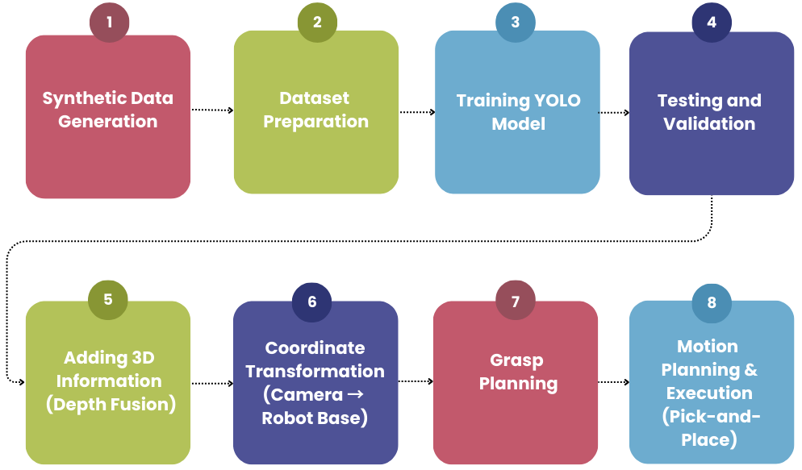
Methodology / Work Plan
9
Notes:
This flowchart is the whole project in eight steps. Steps one to four are about teaching the robot to see: generate data, prepare the dataset, train YOLO and test it. Step five adds depth to get the 3D position. Step six changes that position from the camera frame to the robot frame. Step seven is grasp planning and step eight is the actual pick-and-place. The output of each step is the input of the next.

Slide 10
Methodology / Work Plan
1. Synthetic Data Generation
Create virtual scenes and objects in NVIDIA Isaac Sim.
Generate RGB images, depth maps, and 2D bounding boxes.
Capture varied lighting and object positions.
2. Dataset Preparation
Convert annotations to YOLO format.
Organize images and labels into train/validation sets.
Verify label accuracy and class IDs.
3. Training YOLO Model
Train on the labelled synthetic dataset; tune over epochs.
Save trained weights (best.pt) for deployment.
4. Testing and Validation
Evaluate on validation dataset; inspect predicted boxes.
5. Adding 3D Information (Depth Fusion)
Combine depth data with 2D detections.
Compute real-world object positions (X, Y, Z).
6. Coordinate Transformation (Camera → Robot Base)
Convert object coordinates from camera frame to robot arm frame.
7. Grasp Planning
Determine optimal grasp points and orientations.
8. Motion Planning & Execution (Pick-and-Place)
Generate collision-free robot trajectories.
Execute pick-and-place tasks accurately.
10
Notes:
Here are the eight steps with a few points each. In synthetic data we create virtual scenes and get RGB, depth and bounding boxes automatically. In dataset preparation the boxes become YOLO format text files and we split train and validation. Training gives best.pt, the best weights. In testing we check precision, recall and look at the boxes. Then depth fusion gives X, Y, Z, TF changes camera frame to robot base, grasp planning picks the grasp points and finally we execute pick-and-place with collision-free paths.

Slide 11
Implementation of Methodology
Created a simulation environment in NVIDIA Isaac Sim with a virtual RGB-D camera.
Captured real-time RGB and depth data from the simulated environment.
Established ROS2 communication by subscribing to RGB and depth topics.
Verified continuous data flow between simulation and processing modules.
Implemented a custom YOLOv8 model for object detection.
Detected objects and extracted bounding boxes, labels, and confidence scores.
Utilized depth information to estimate 3D position of detected objects.
Computed spatial coordinates using the center of bounding boxes.
Applied ROS2 TF framework to transform coordinates from camera frame to robot base frame.
Sent control commands to the robotic arm to validate system response.
11
Notes:
This slide is what was actually implemented. The camera in Isaac Sim gives RGB and depth. ROS 2 carries the data to my processing code. The YOLOv8 model detects objects and gives box, label and confidence. The box centre plus the depth value gives the 3D position. ROS 2 TF converts it to the robot base frame, and the control commands are sent to the arm to check the robot responds.

Slide 12
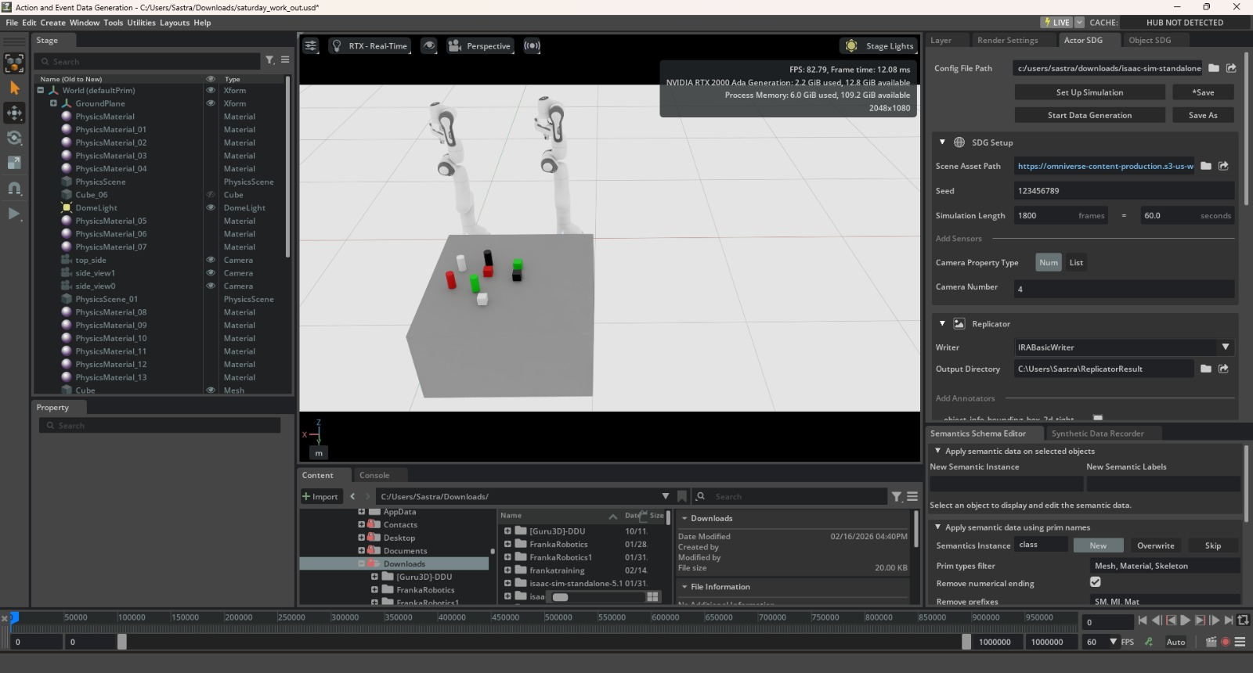
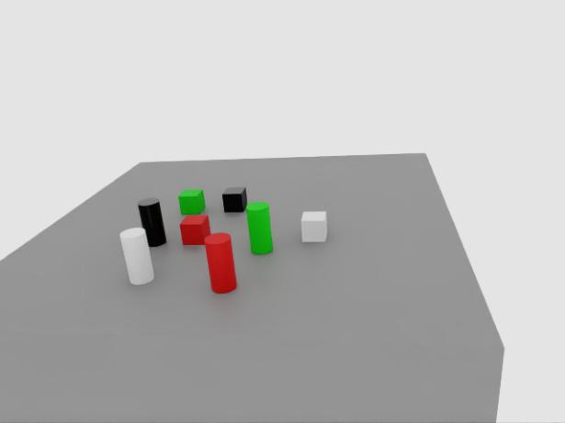
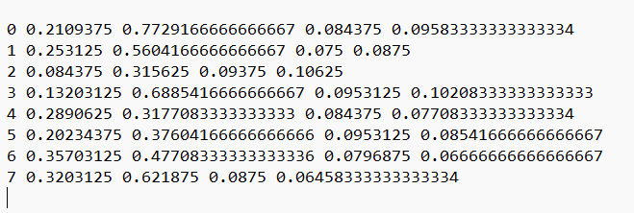
Result: Environment and Synthetic Data
Isaac Sim environment
RGB image
YOLO label: <class_id> <x_center> <y_center> <width> <height>
Values are normalized (0–1). Example: 0 → cube, 1 → cylinder.
2D labels (YOLO format)
12
Notes:
First I built the virtual workspace in Isaac Sim: a table, the dual-arm robot, and cubes and cylinders in four colours. I changed object positions, lighting and viewpoint so the dataset is varied. The simulator then gives RGB images with labels automatically. The label file has one line per object: class id, x centre, y centre, width and height, all between 0 and 1. The right image is one RGB image from the camera.

Slide 13
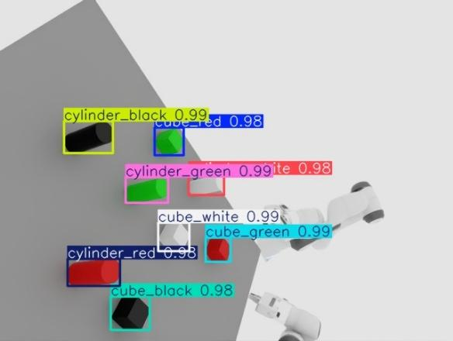
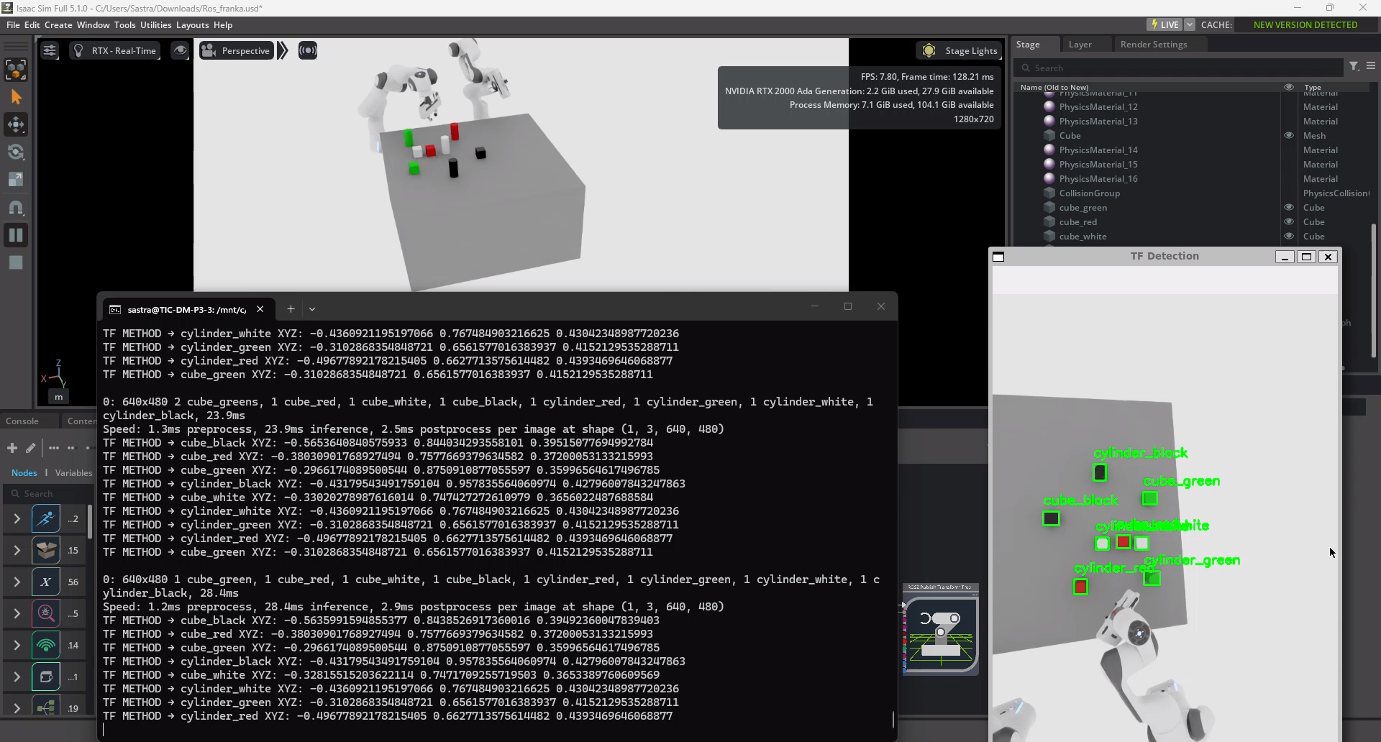
Result: Object Detection
Simulation environment was created and tested in real-time through trained YOLOv8 model in NVIDIA Isaac Sim and successfully detected objects.
Live detection in Isaac Sim
Detection output with class and confidence
13
Notes:
This is the trained YOLOv8 model running on the live camera of Isaac Sim. Each object has a coloured box with its class name, for example cube_red or cylinder_green, and a confidence score of about 0.98 to 0.99. The centre of every box is what we use in the next step to find the 3D position.

Slide 14
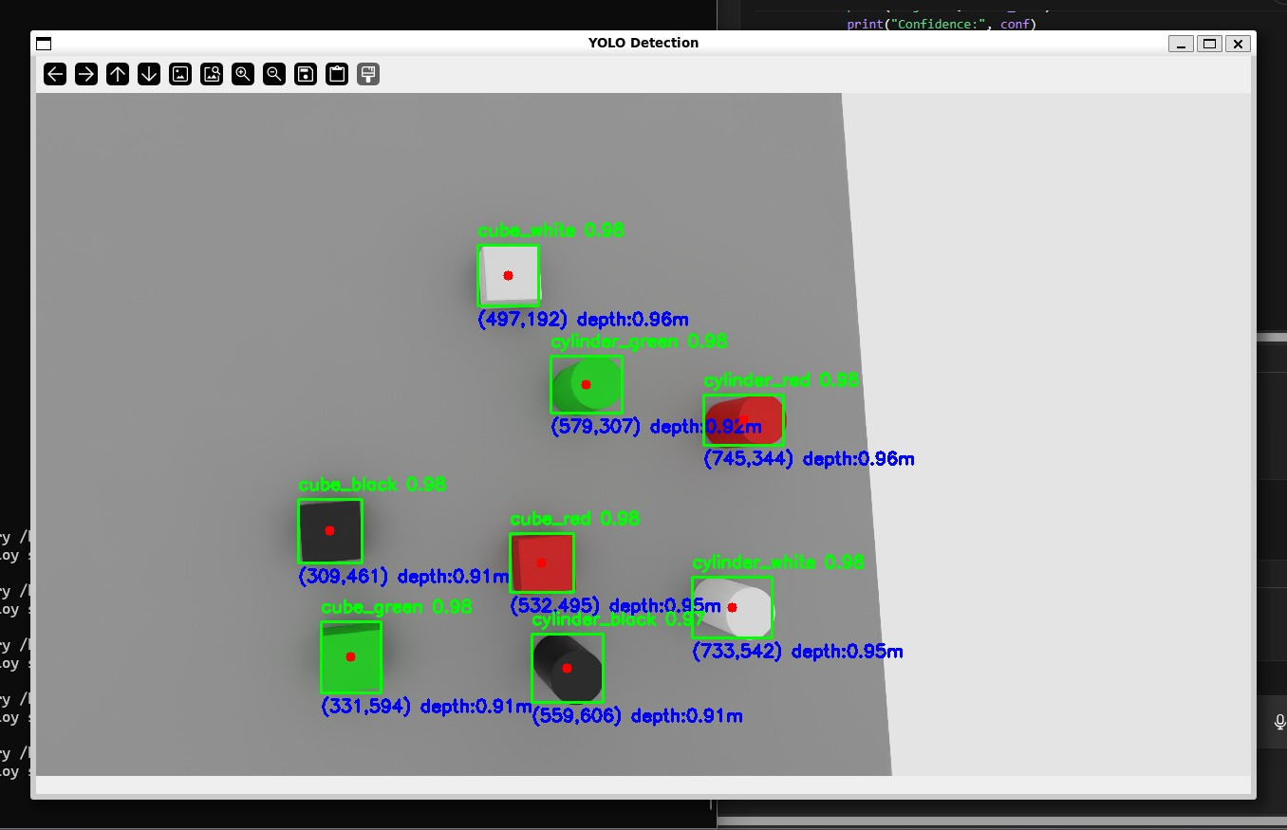
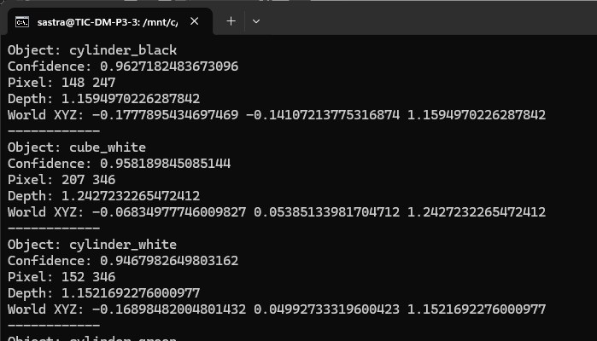
Result: Depth Integration (2D to 3D)
Depth information was generated from NVIDIA Isaac Sim using the ROS2 Action Graph and integrated with 2D YOLO detections to obtain the 3D position of objects.
YOLO detection with depth
Console output: pixel, depth, world XYZ
X = (u − cx)·Z / fx = (148 − 240) × 1.1595 / 600 = −0.1778 m
Y = (v − cy)·Z / fy = (247 − 320) × 1.1595 / 600 = −0.1411 m
14
Notes:
A 2D detection only gives a pixel. The depth camera gives the distance at that pixel. With the camera intrinsics, X equals pixel offset times depth divided by focal length, and the same for Y. For the black cylinder at pixel 148, 247 and depth 1.159 m, the console prints world X about minus 0.178 and Y about minus 0.141. This matches my hand calculation at the bottom.

Slide 15
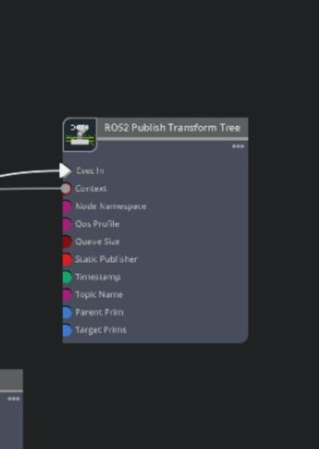
Result: Coordinate Transformation
Coordinate transformation from the camera frame to the robot base frame was achieved using a ROS2 TF node within the Action Graph.
The node applies rotation and translation between reference frames.
Initial wrong coordinates were caused by improper frame alignment and were corrected by configuring the frames in TF.
ROS2 Publish Transform Tree
15
Notes:
The position we got is measured from the camera. But the robot arm measures from its own base. So we need to convert it. In the Action Graph, the ROS 2 Publish Transform Tree node publishes the rotation and translation between the frames, and this converts the position into the robot frame. In the beginning my coordinates were wrong because the frames were not aligned properly, and I fixed it by configuring the frames correctly in TF.

Slide 16
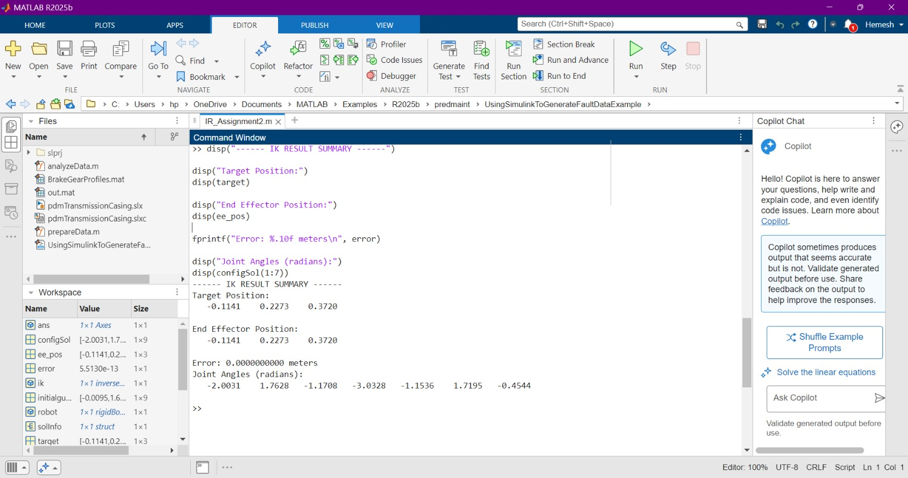
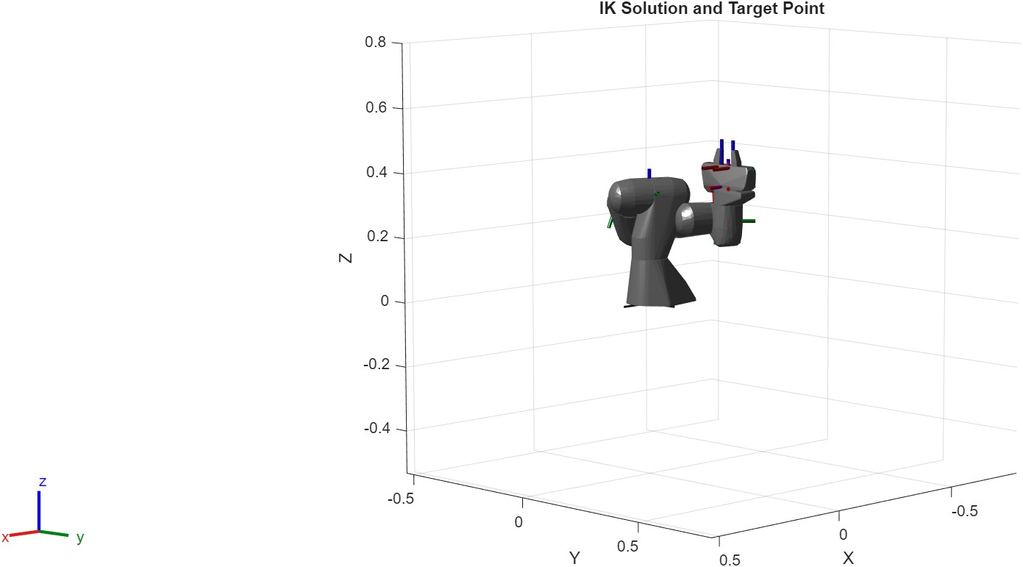
Result: Inverse Kinematics (MATLAB)
Inverse kinematics was computed using MATLAB to determine joint angles required for pick-and-place operations.
IK solution and target point
MATLAB result: joint angles
16
Notes:
Inverse kinematics means: I know where the gripper has to reach, so what should each joint angle be? I give the X, Y, Z target to the MATLAB Robotics Toolbox solver and it returns the joint angles. The left picture is the MATLAB output with target position, end-effector position, error and joint angles. The right picture is the solved robot pose reaching the target point. I used MATLAB because MoveIt and other IK solvers did not work reliably in my setup.

Slide 17
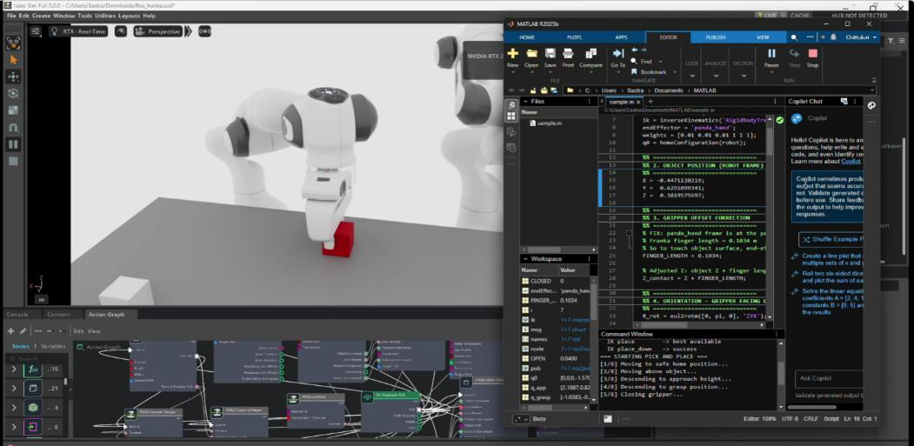
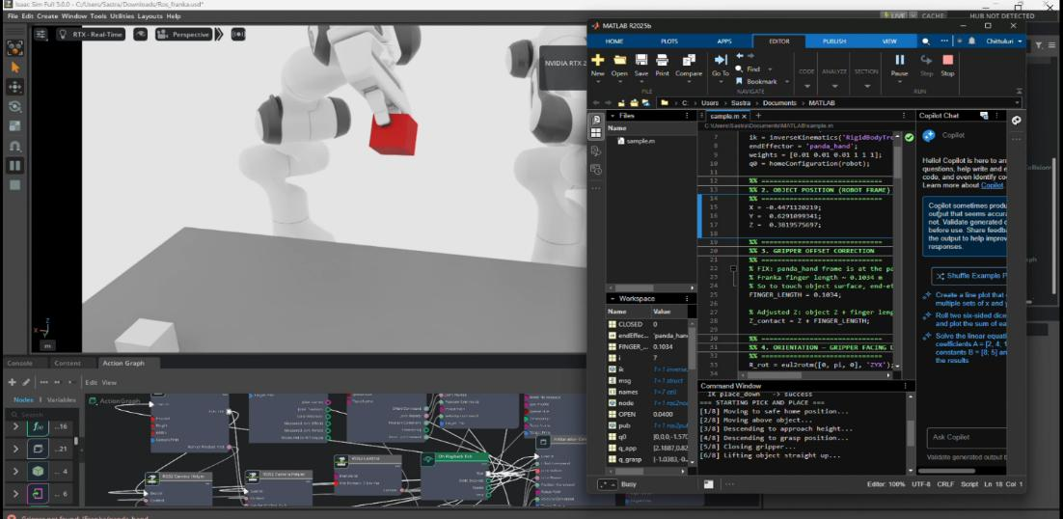
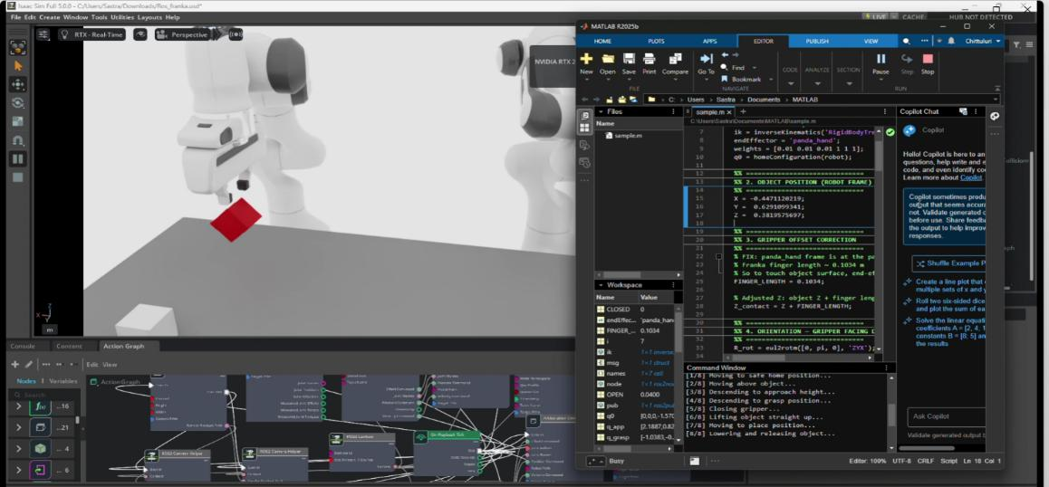
Result: Pick-and-Place Operation
Based on the calculated joint angles, the robotic manipulator moves toward the detected object, performs a stable grasp, lifts it, transports it to the target location and places it accurately.
Picking of object
Holding of object
Placing of object
Perception, planning and control are integrated for autonomous task execution.
17
Notes:
This is the final stage where everything comes together. Using the joint angles, the arm goes to the detected object, closes the gripper for a stable grasp and lifts it. Then it carries the object to the target position and places it. These three images show picking, holding and placing in Isaac Sim.

Slide 18
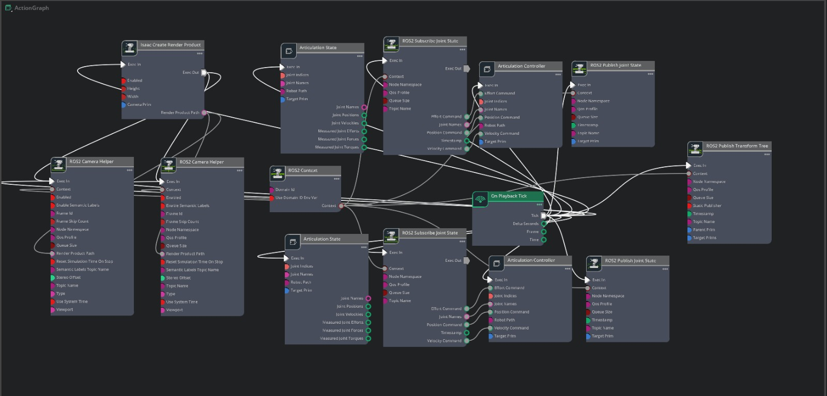
Result: ROS2 Action Graph
All nodes are interconnected to acquire RGB images, depth information and perform coordinate transformations.
Camera and depth nodes continuously stream data.
Control nodes send joint commands for both robotic arms, enabling coordinated motion and execution of pick-and-place.
18
Notes:
The Action Graph is a node diagram inside Isaac Sim, and it is the backbone of the communication. Camera and depth nodes keep streaming the data. The transform node gives the frames. And the control nodes send joint commands to both arms. I first tried to get depth with the built-in Replicator script but it kept giving syntax errors, so I used the Action Graph, which was stable. Path mismatches between nodes were my biggest debugging problem.

Slide 19
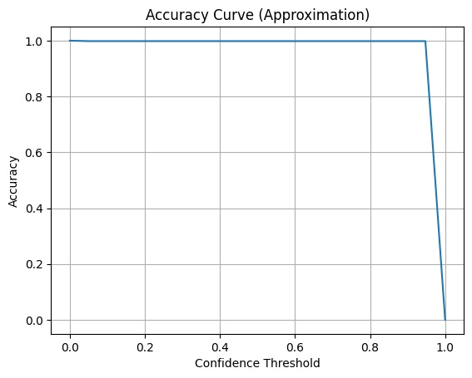
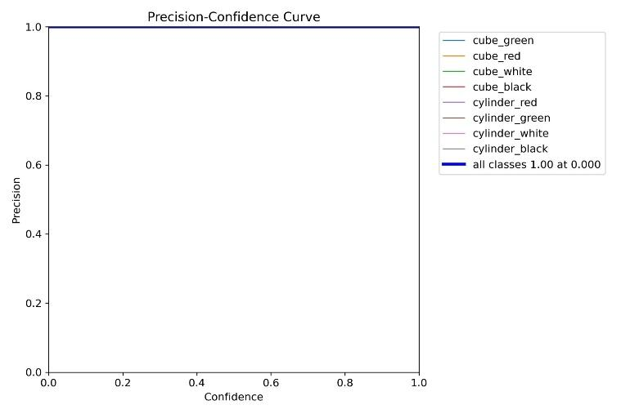
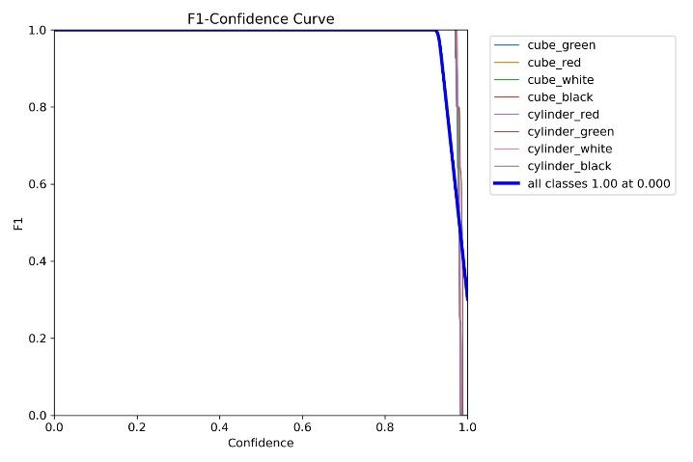
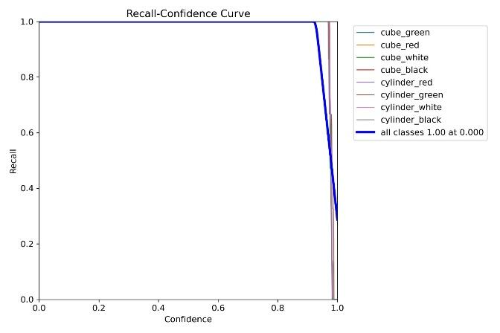
Result: Model Evaluation – YOLOv8
The performance was evaluated using precision, recall and F1-score. Model: YOLOv8
19
Notes:
To check the model I used precision, recall and F1-score. Precision tells how many detections are correct, recall tells how many real objects were found, and F1 is the balance of both. For YOLOv8 the curves stay at 1.0 for almost the whole confidence range and fall only at the highest values, which means that almost every object is detected correctly. One honest point: this is on clean synthetic data, so real-world results will be lower.

Slide 20
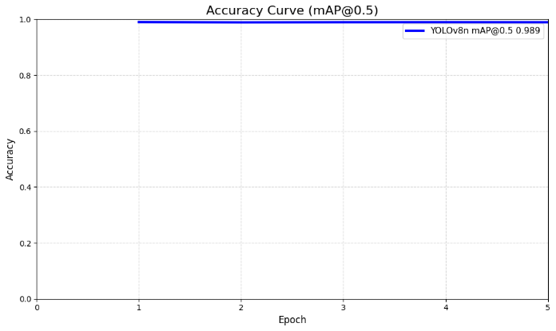
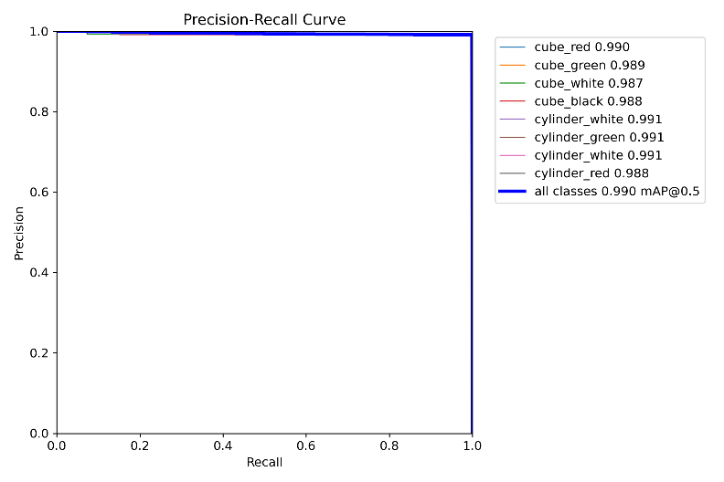
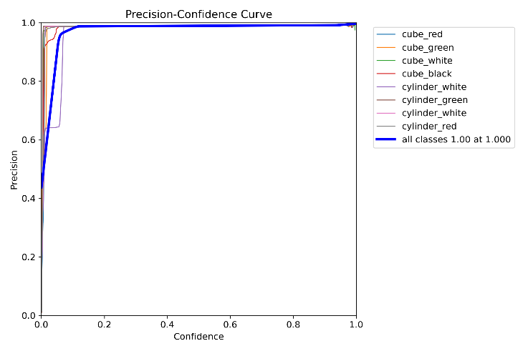
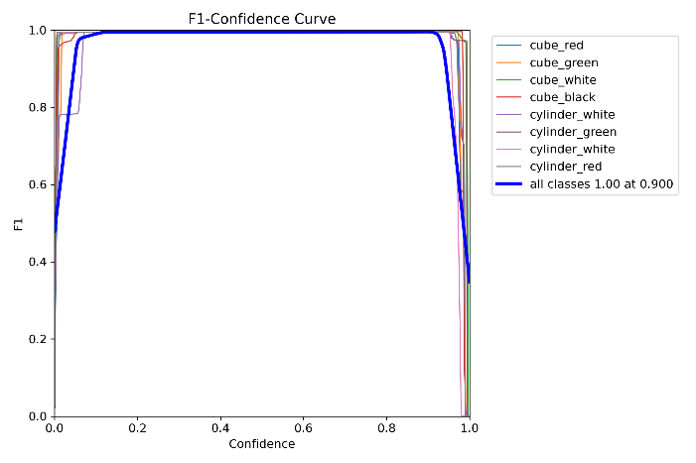
Result: Model Evaluation – YOLOv8n
Model: YOLOv8n (overall mAP@0.5 = 0.990)
20
Notes:
YOLOv8n is the nano model, smaller and faster. Its overall mAP at 0.5 is 0.990, and every class from cube_red to cylinder_red is between 0.987 and 0.991, so no class is weak. The precision-recall curve is close to the top-right corner, which is the ideal, and the F1 curve peaks at about 1.0 near confidence 0.9. So the nano model is almost as accurate as the bigger one but suits real-time robots better.

Slide 21
Interpretation
Real-time object detection was achieved using the trained YOLOv8 model in NVIDIA Isaac Sim, showing that the model can reliably identify objects in the simulation environment.
RGB and depth data obtained via the ROS2 Action Graph were combined to estimate object positions in 3D space, showing that fusion of visual and depth information enables spatial understanding beyond simple 2D detection.
The 3D coordinates in the camera frame were transformed into the robot base frame using ROS2 TF, showing that proper frame alignment is essential for bridging perception and robotic execution.
Inverse kinematics solved in MATLAB converts transformed 3D target positions into joint angles, so task-space coordinates are translated into joint-space commands.
The overall system integrating YOLOv8, ROS2, Isaac Sim, TF, and MATLAB demonstrates a complete perception-to-action framework.
21
Notes:
What do the results mean? Real-time detection works reliably in the simulator. Depth plus 2D detection gives true 3D position, which a 2D detection alone cannot. TF with rotation and translation maps positions correctly into the robot workspace, so frame alignment is the bridge between seeing and acting. MATLAB inverse kinematics turns task-space positions into joint-space commands. Together YOLOv8, ROS 2, Isaac Sim, TF and MATLAB form a complete perception-to-action framework.

Slide 22
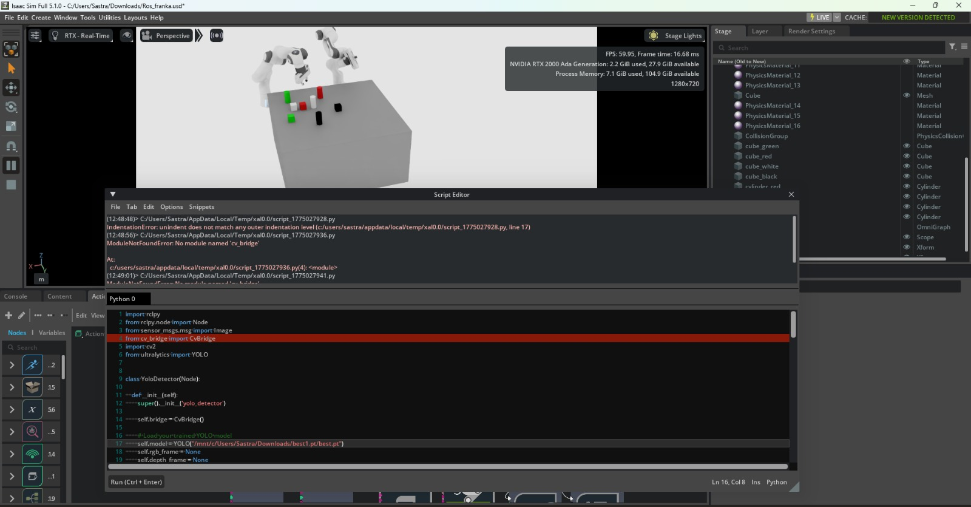
Discussion
Initial training of the YOLOv8 model with a smaller dataset resulted in poor detection accuracy, which improved after increasing the number of training images.
The initial attempt to generate depth information using the built-in Replicator script resulted in multiple syntax issues, leading to the adoption of the ROS2 Action Graph for stable and reliable data acquisition.
Incorrect object coordinates were observed during the initial transformation due to improper frame alignment, which was resolved by correctly configuring the coordinate frames using ROS2 TF.
Attempts to compute inverse kinematics using MoveIt and IK solvers were unsuccessful in this setup, leading to the use of MATLAB for reliable joint angle computation.
Replicator script errors
22
Notes:
These are the problems I faced and how they were solved. With a small dataset the accuracy was poor, and it improved when I increased the number of training images. The built-in Replicator script for depth gave syntax errors, so I used the Action Graph. Wrong object coordinates came from improper frame alignment and were solved with TF. MoveIt and other IK solvers were unsuccessful in my setup, so I used MATLAB. The screenshot at the bottom is from the Replicator script error.

Slide 23
Attainment of Objectives
The AI-based vision system using YOLOv8 was successfully implemented, enabling real-time object detection in the simulation environment.
RGB and depth data from NVIDIA Isaac Sim were used to estimate 3D object positions, allowing the robot to perceive spatial information effectively.
A perception-to-action pipeline was developed by integrating vision sensing, coordinate transformation, and motion control.
Inverse kinematics was implemented using MATLAB to enable the robot to perform pick-and-place related movements.
The system was validated in NVIDIA Isaac Sim, demonstrating successful simulation and testing before real-world deployment.
23
Notes:
Here I compare the result with the objectives I set at the beginning. Every objective was achieved in the simulation: YOLOv8 detection, 3D position from RGB and depth, the perception-to-action pipeline, MATLAB inverse kinematics and the final validation in Isaac Sim before any real-world use.

Slide 24
My Contribution and Learning
My Contribution
Inferences (What I Learned)
Worked on the dual-arm robot in NVIDIA Isaac Sim using ROS 2 for object handling and motion control.
Implemented MATLAB-based calculations to determine joint angles for motion.
Limitations: Action Graph path mismatches and MATLAB joint-angle errors reduced positioning accuracy and dual-arm coordination.
YOLOv8: how neural networks detect and classify objects in real time.
Depth: how 3D position is estimated from 2D image coordinates.
ROS2 TF: rotation and translation between reference frames.
MATLAB IK: computing joint angles from a target position.
Isaac Sim: testing and validating robotic systems before real-world use.
24
Notes:
This slide is about my own part. I worked on the dual-arm robot in Isaac Sim with ROS 2 for object handling and motion control, and I did the MATLAB calculations for the joint angles. Through this I learned how YOLO detects, how depth gives 3D position, how rotation and translation work between frames, how to get joint angles from a target, and why simulation is useful. The limitations I faced were Action Graph path mismatches and MATLAB joint-angle errors.

Slide 25
Conclusion
The system uses YOLO for real-time object detection along with depth estimation to convert 2D image data into 3D spatial coordinates.
Coordinate transformation is performed using ROS 2 and inverse kinematics in MATLAB to achieve precise positioning of the robotic manipulator.
The robot performs autonomous pick-and-place operations by integrating perception, decision-making, and control, reducing the need for manual intervention.
NVIDIA Isaac Sim is used for simulation-based testing and data generation, providing a safe environment that reduces development time and risk before real-world deployment.
The ROS 2 architecture enables modular and scalable communication, while the dual-arm configuration improves coordination, stability, and precision in object handling.
25
Notes:
To conclude: the system uses YOLO with depth to turn 2D images into 3D coordinates. ROS 2 and MATLAB inverse kinematics position the manipulator, and the robot does pick-and-place on its own with less manual intervention. Isaac Sim gave a safe place for data generation and testing. The ROS 2 architecture is modular and scalable, and the dual-arm set-up improves coordination, stability and precision. The next step would be testing on a real robot with a real camera.

