Slide 1
Types of compressors
Compressor types
Positive displacement
Dynamic
rotary
reciprocating
centrifugal
axial
scroll
vane
diaphragm
Double acting
screw
Single acting

Slide 2
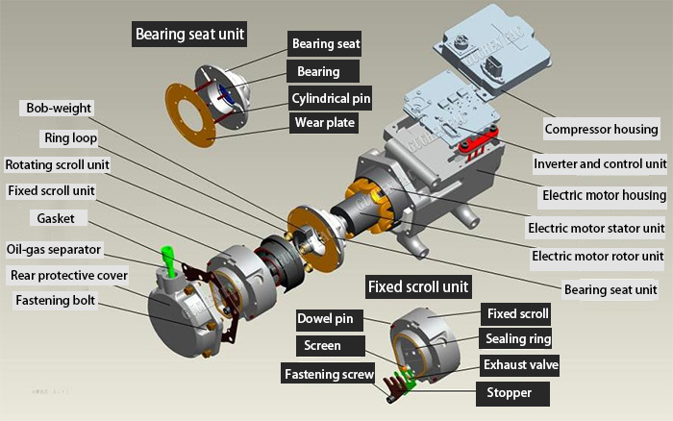
Scroll Compressor parts

Slide 3

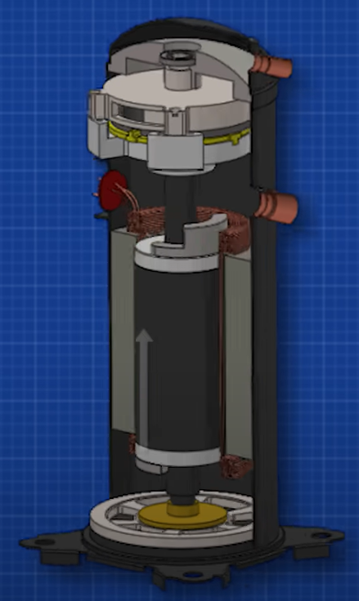
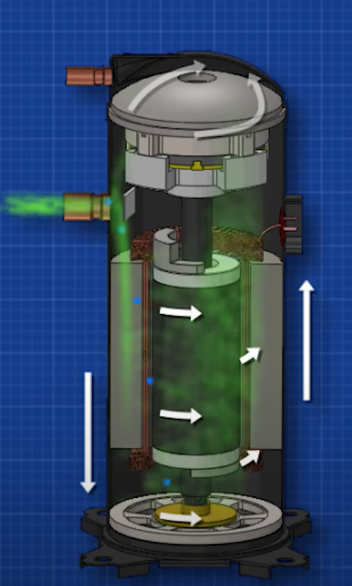
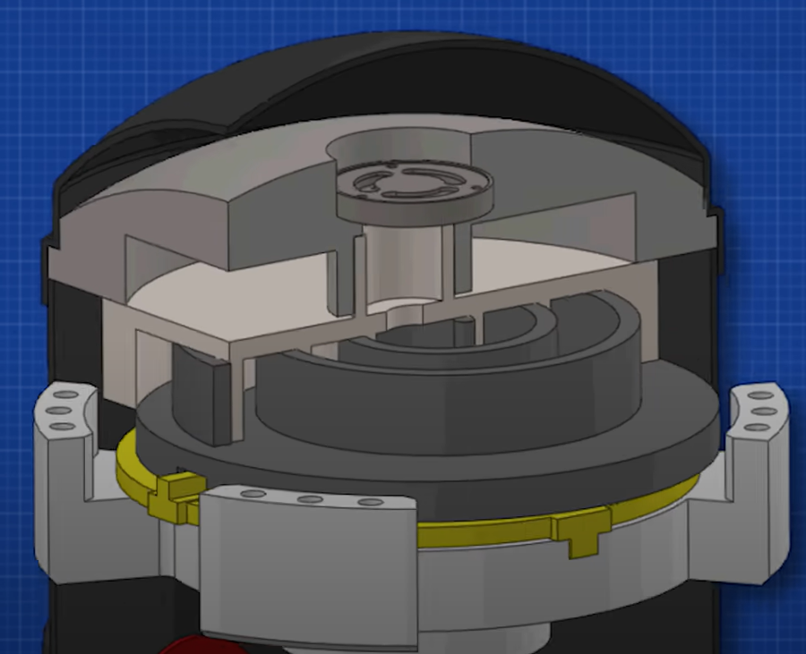
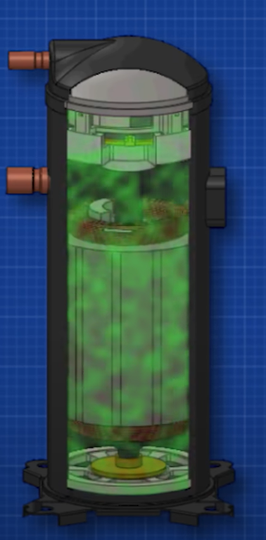
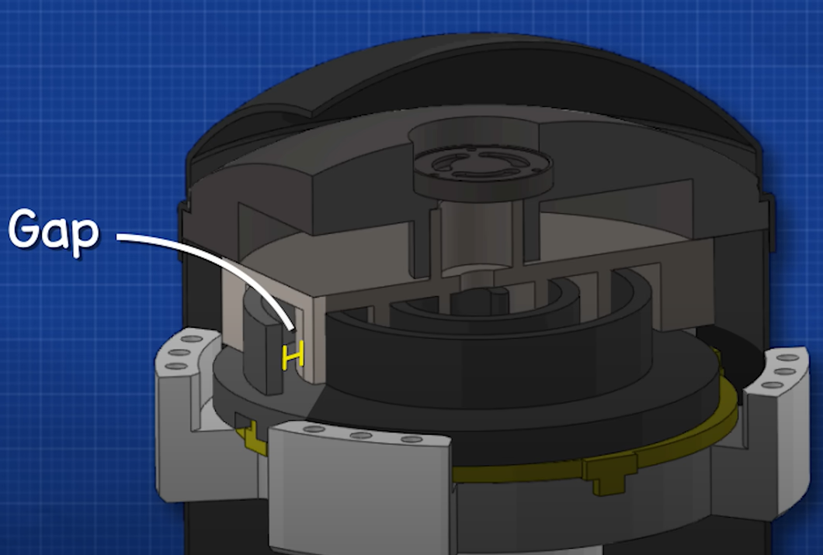
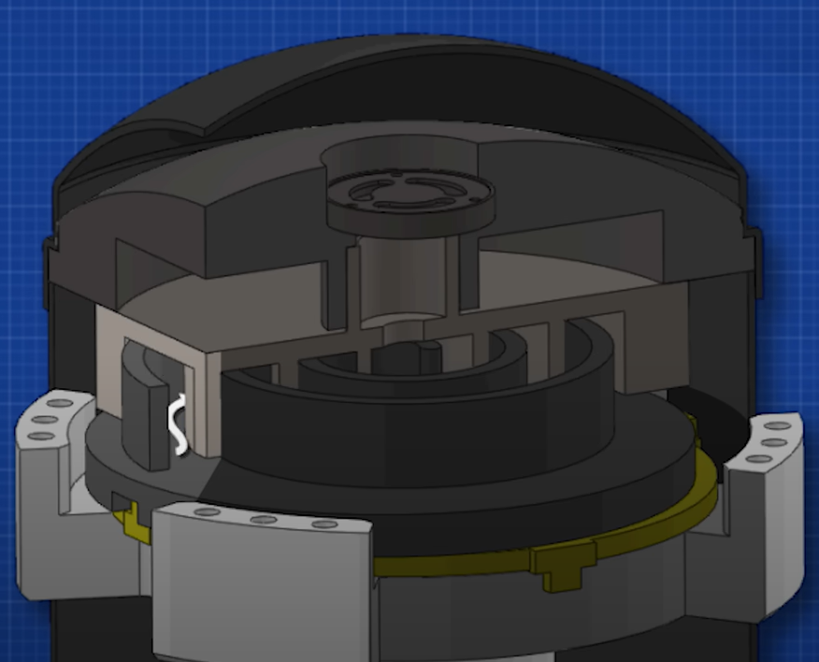
Working of scroll
Outlet
Refrigerant inlet
motor
Cross section view of the
Scroll compressor
Refrigerant inlet view
Fixed scroll
Moving scroll

Slide 4

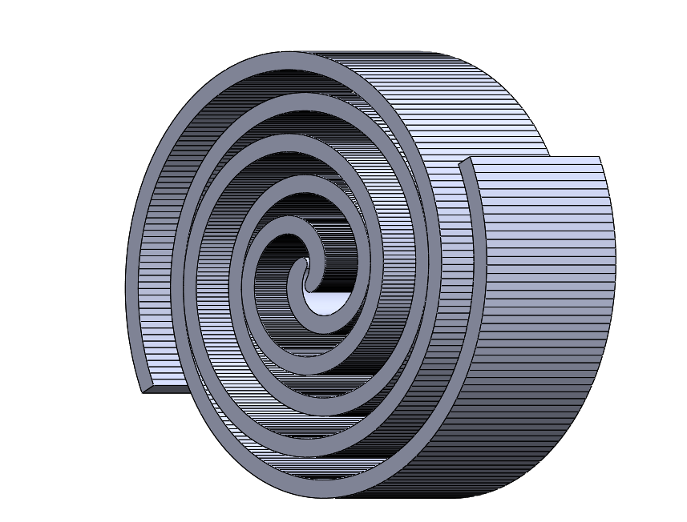
GEOMETRY DESIGN
Two-Arc Discharge
Fixed
Orbiting
Scroll Model
Fixed & Orbiting Scroll

Slide 5
Material used for the Scroll - Aluminium 4032 Alloy
Properties :
Young's modulus - 73000 N/mm^2
Yield Strength - 280 N/mm^2
Density - 2.69 g/cc
Poisson’s ratio - 0.33

Slide 6
Model - 2 Design Improvisations
Modifications
Stepped Shaft
Coupler
Motor Holder
Compressor Holder
Fasteners M4 Nuts and Bolts

Slide 7
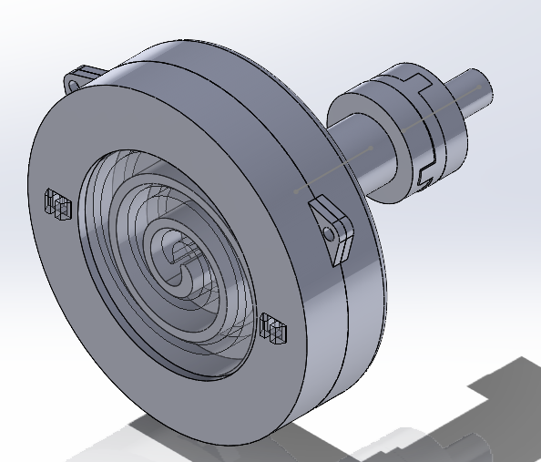
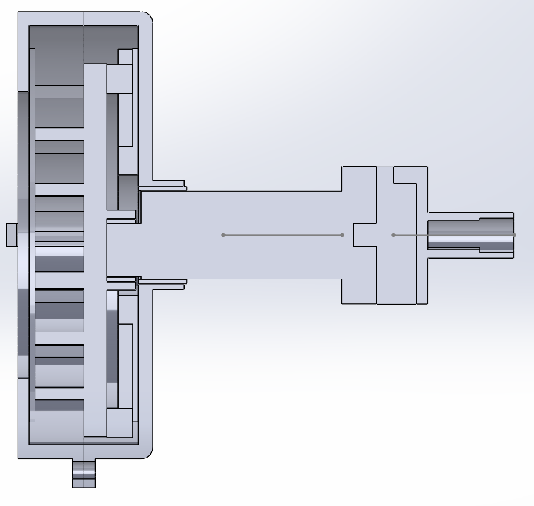
Initial design of the working scroll compressor
Isometric view
Section view

Slide 8
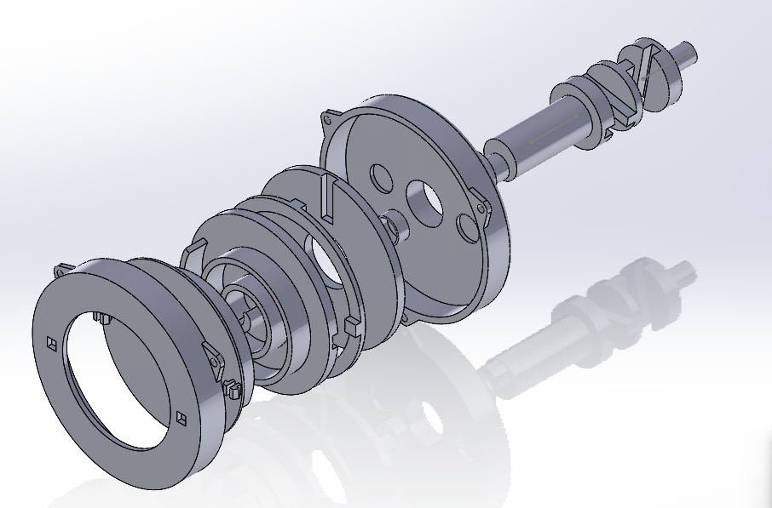
Initial design of the working scroll compressor
Exploded view

Slide 9
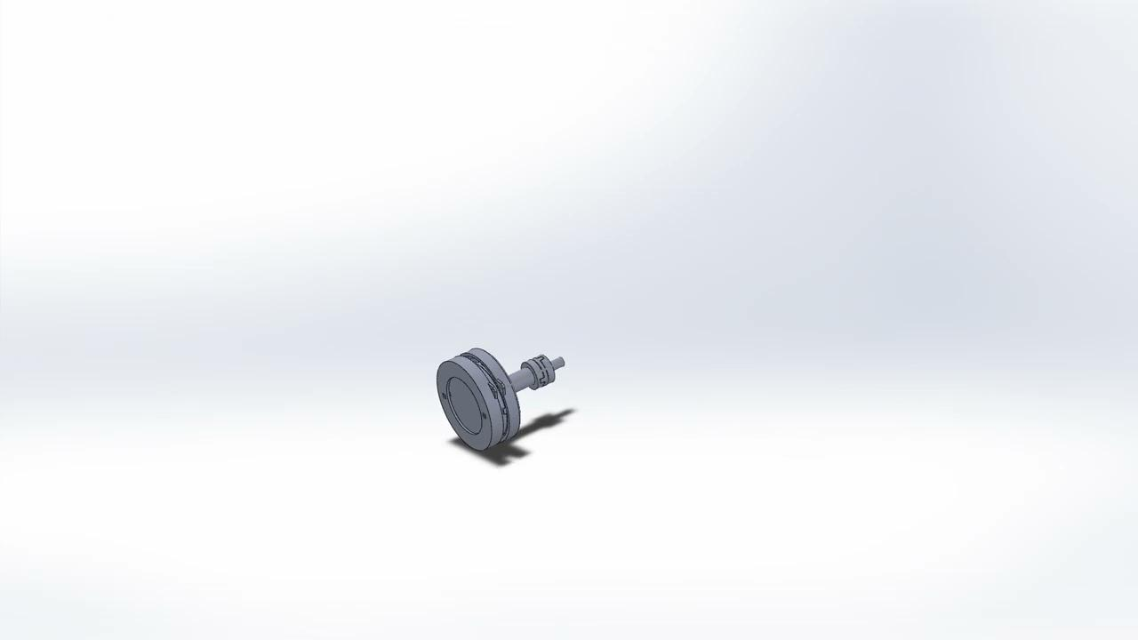

Slide 10
Initial design of the working scroll compressor
The initial model of the scroll compressor was held by a clamp which was bolted down to a board.
oldham's coupling was used at the end of the shaft which connects to the motor to tackle misalignment.
The design was not able to run long as the parts we misaligned heavily and the clamp was not able to hold the compressor making it difficult to run.

Slide 11
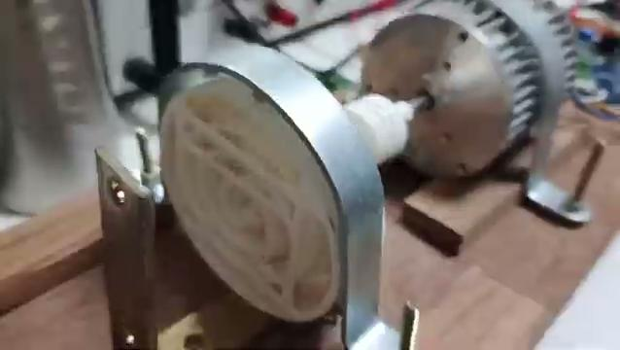

Slide 12
Initial design of the working scroll compressor
After running the first model we have observed that the oldhams coupling between the compressor shaft and the motor motor shaft was unstable.
This made it impossible to run at higher RPM so we have opted for the jaw coupling which was more stable compare to the previous one.

Slide 13
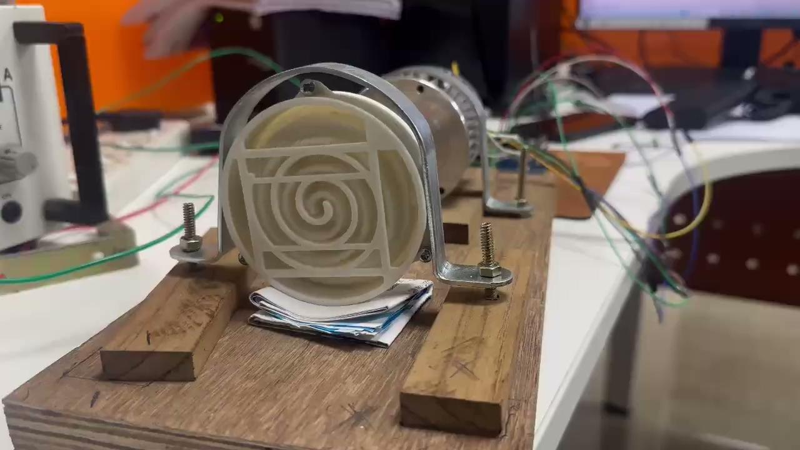

Slide 14
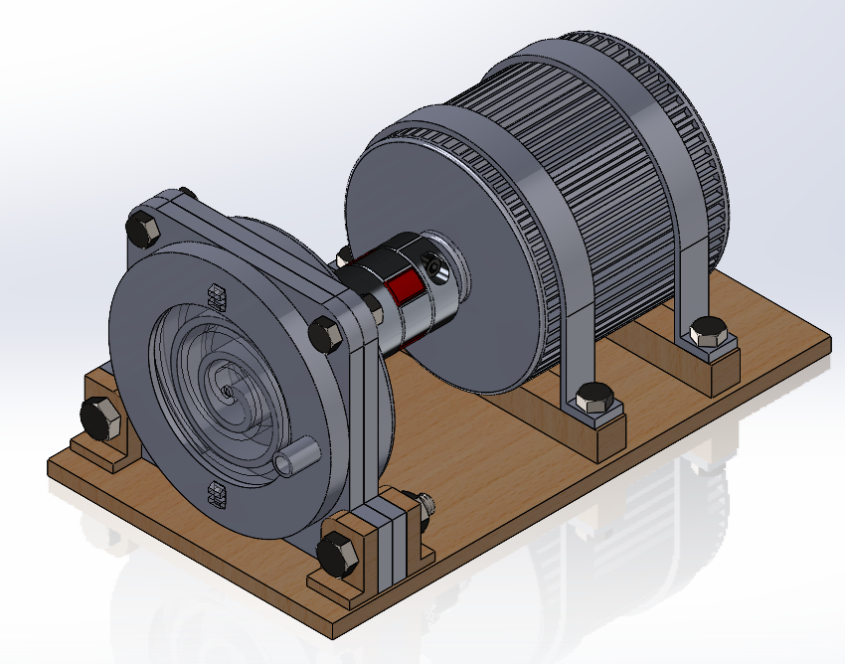
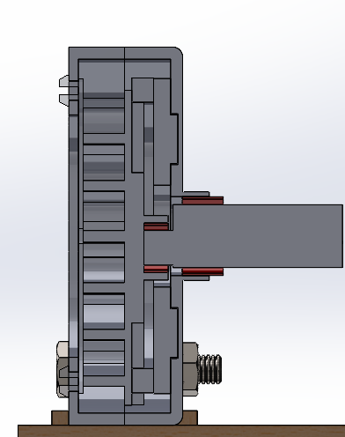
2nd Iteration of the Scroll Compressor Design

Slide 15
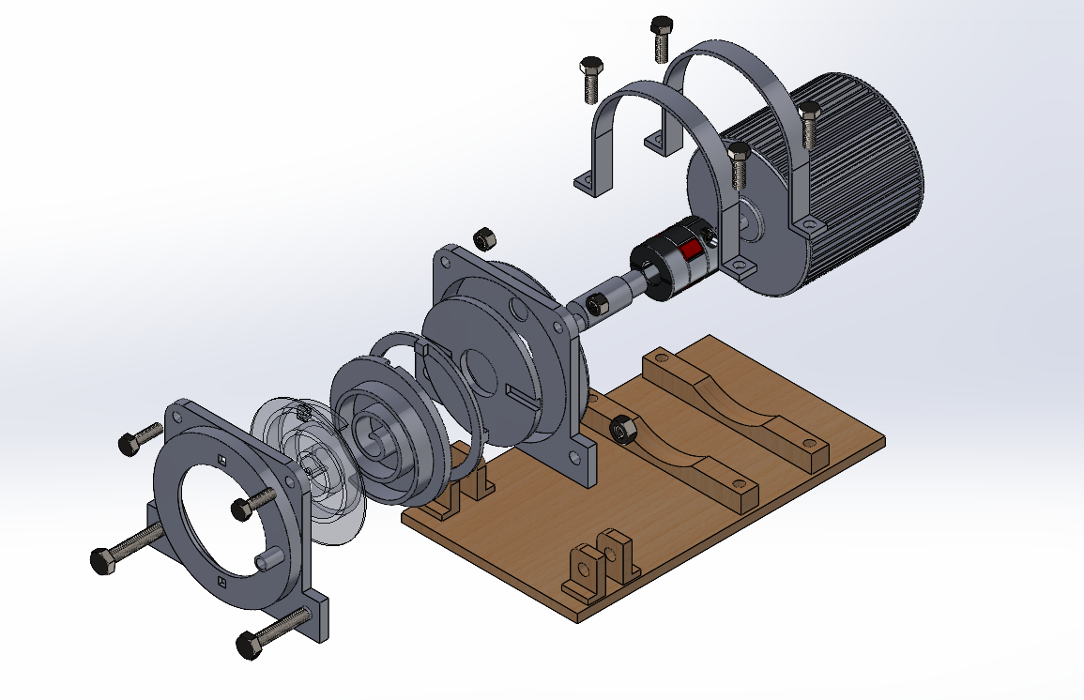
2nd Iteration of the Scroll Compressor Design

Slide 16


Slide 17
2nd Iteration of the Scroll Compressor Design
In the 2nd iteration of the working compressor the whole setup was changed to give a more stable platform for the scroll.
In this design we made changes such that the the scroll body is directly bolted to the plank rather than a clamp which was unstable.

Slide 18
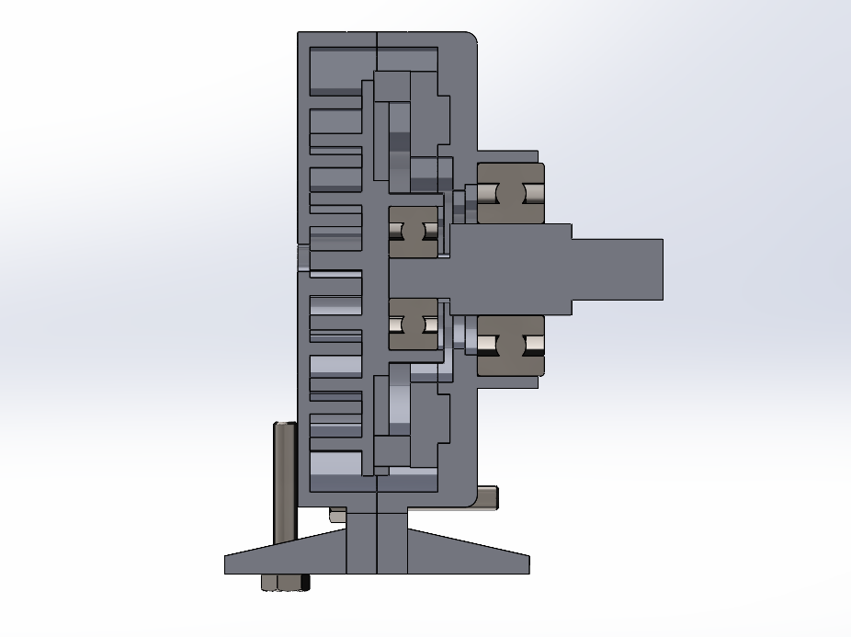
3rd Iteration of the Scroll Compressor Design

Slide 19
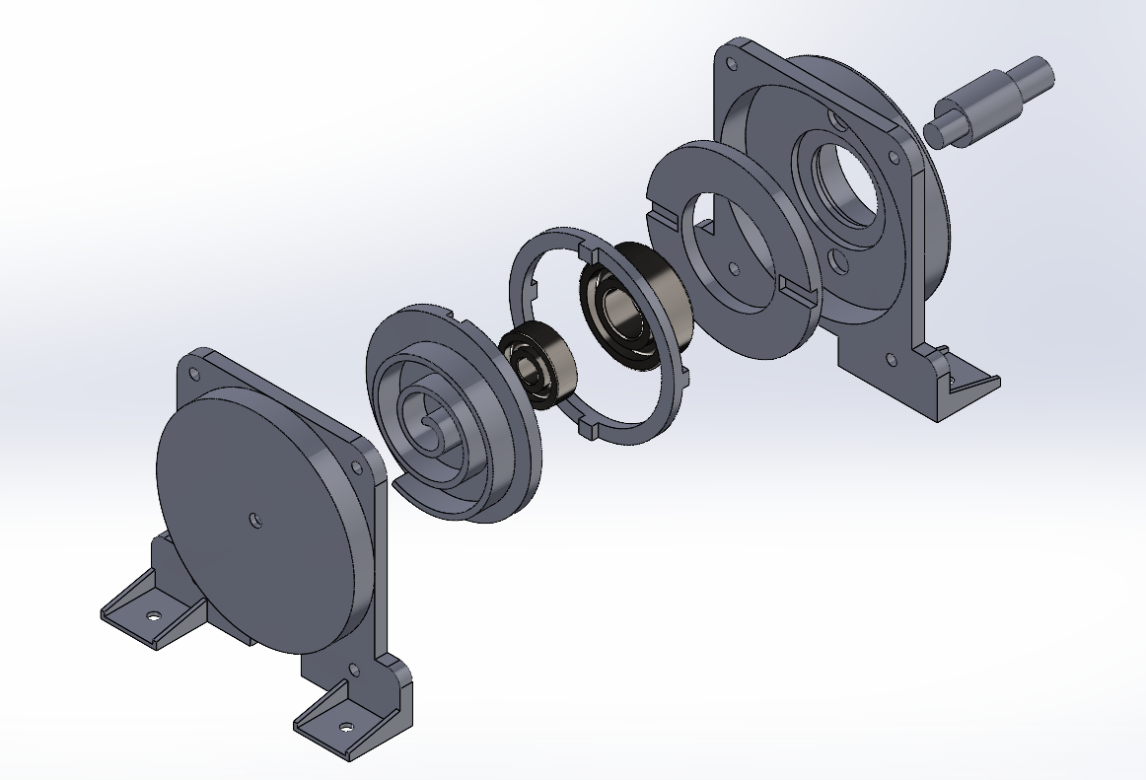
3rd Iteration of the Scroll Compressor Design

Slide 20
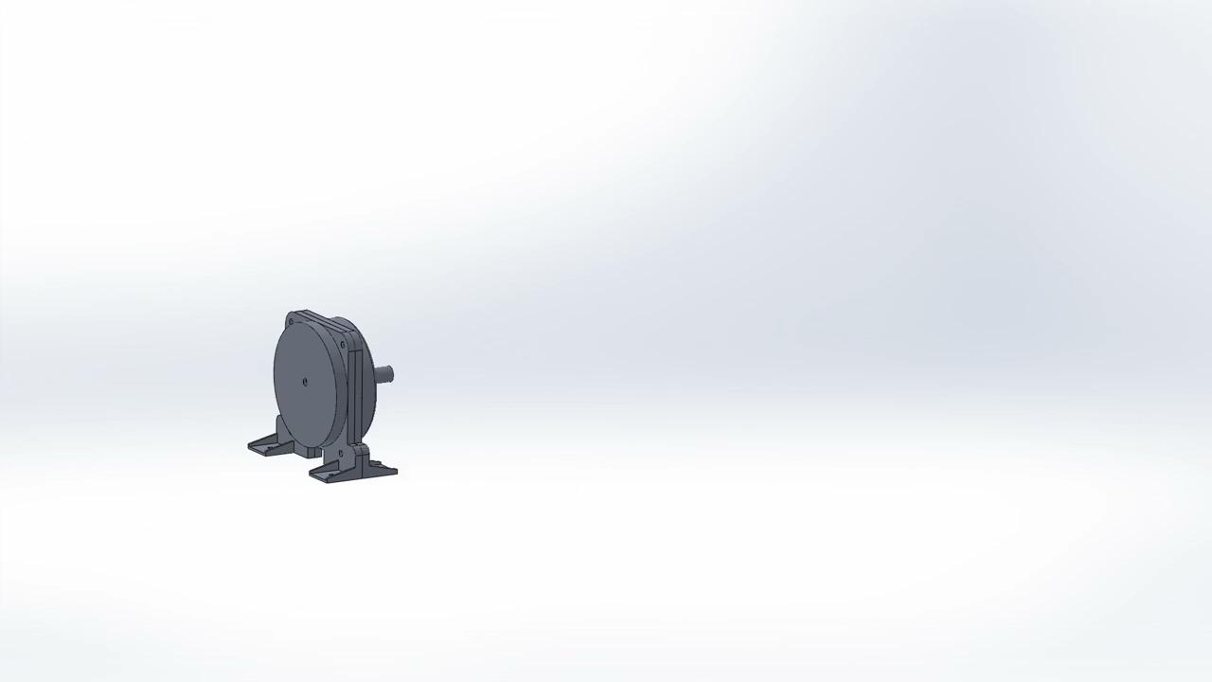

Slide 21
3rd Iteration of the Scroll Compressor Design
In the third iteration ball bearings were added in place of the sleeves.
The sleeve in the previous models were melting due to heat generated from the friction causing the components to melt with them.
Also the sleeve were not able to align properly due to the tolerance causing server shaft misalignment.
The bearing provided stability at the higher RPM which the sleeve lacked.

Slide 22
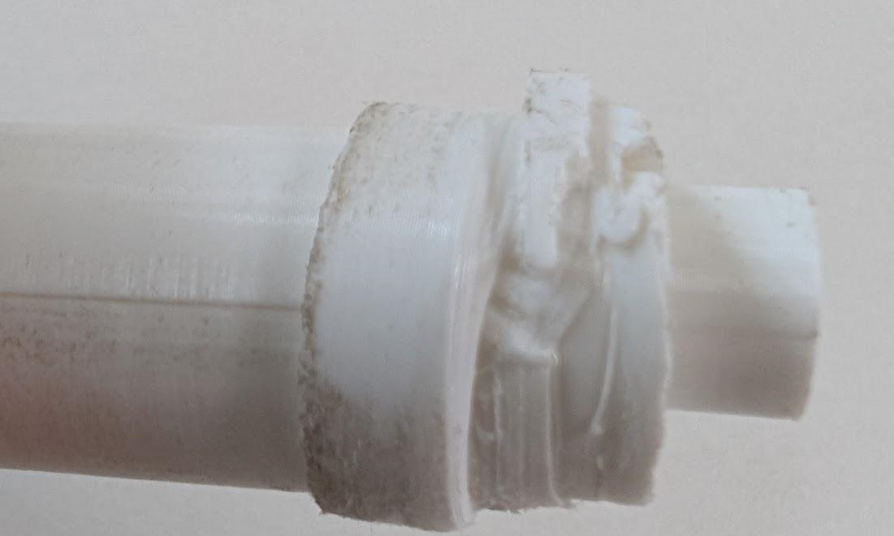
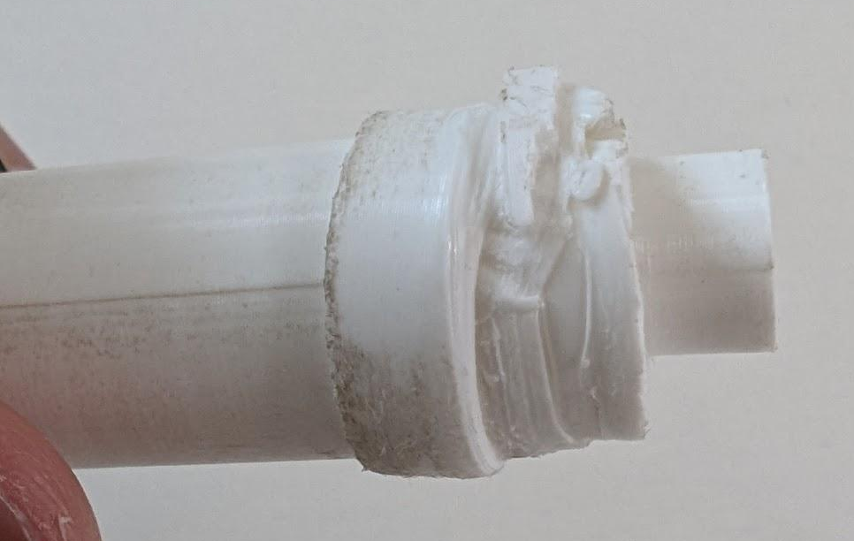
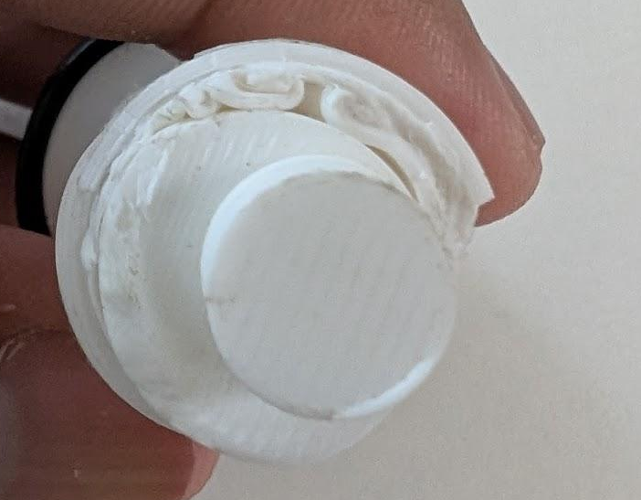

Slide 24
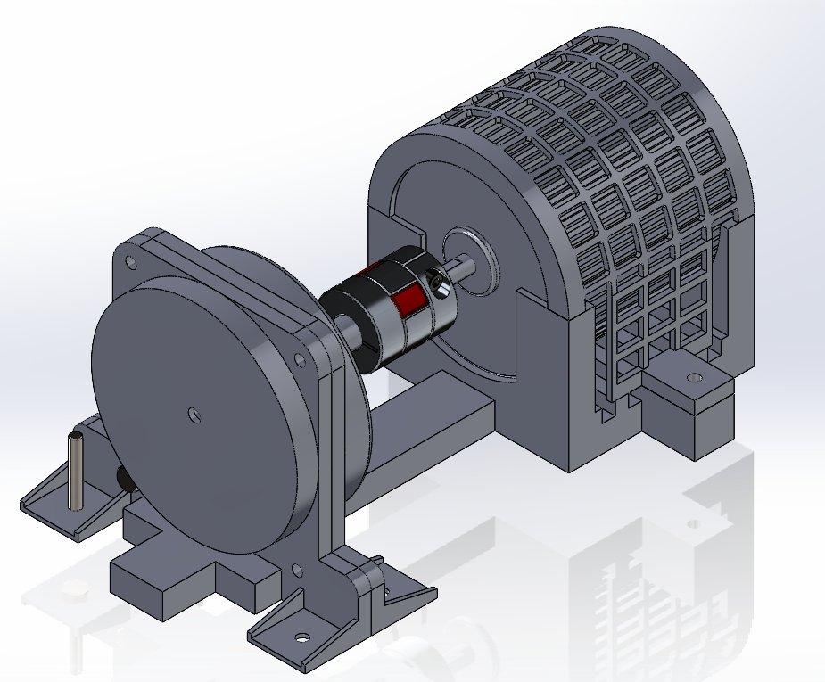
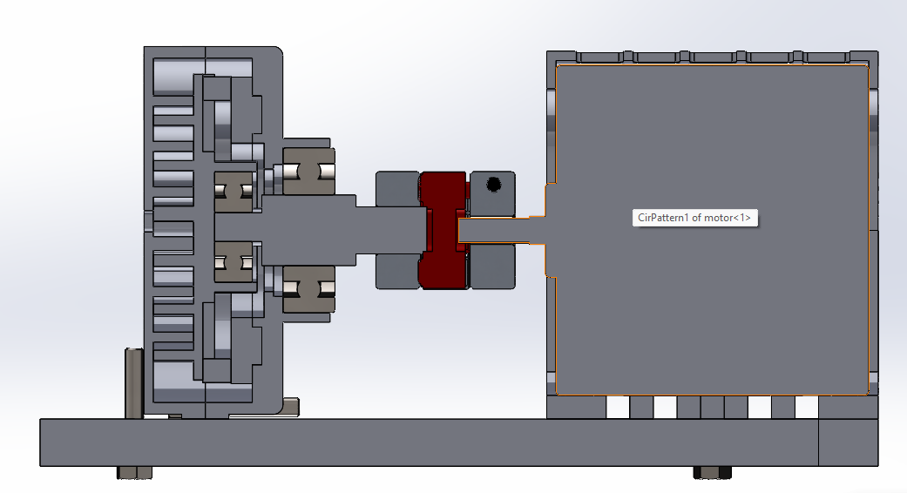
4th Iteration of the Scroll Compressor Design

Slide 25
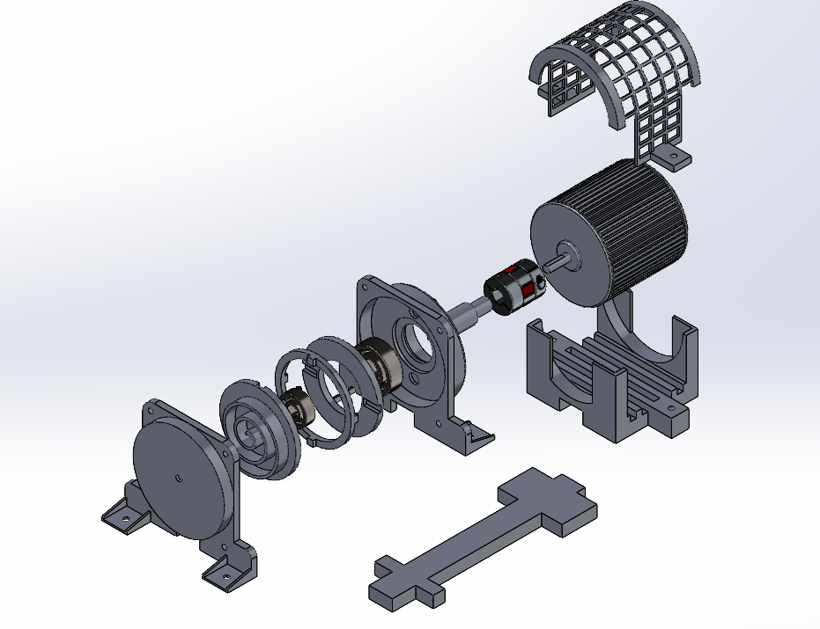
4th Iteration of the Scroll Compressor Design

Slide 26
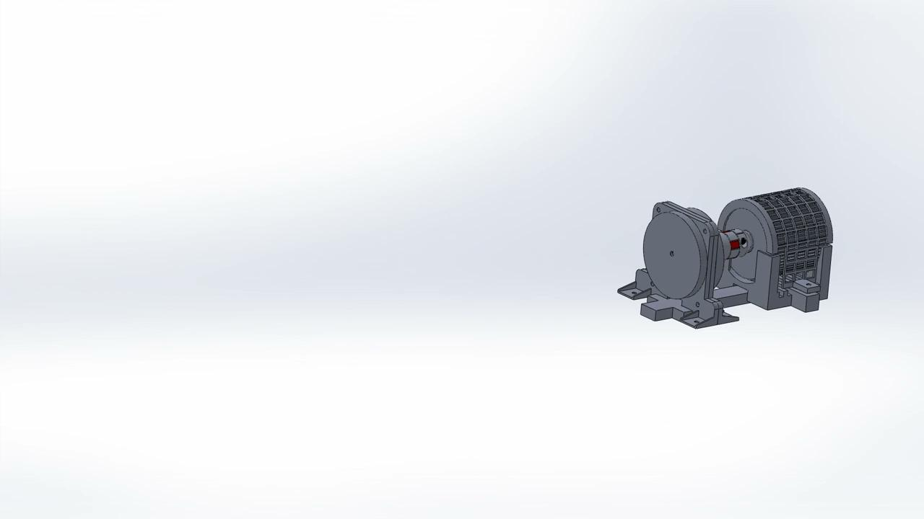

Slide 27
4th Iteration of the Scroll Compressor Design
In the 4th iteration a casing was designed for the motor to prevent misalignment as in the previous iterations it was being held with a clamp which caused error in placement.
Also a bar has been added at the bottom to prevent lateral misalignment which was a major issue in the previous cases.

Slide 28
Semi Hermetic scroll compressor model
We have made a semi hermetic model after the successfully running the previous model without any major issues.
In this model unlike the previous ones the motor is in the casing rather than outside.
In this we have included a discharge value and a discharge chamber for further modifications.

Slide 29
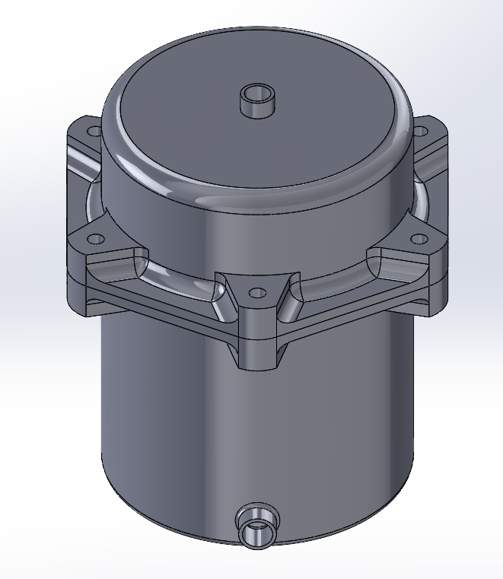
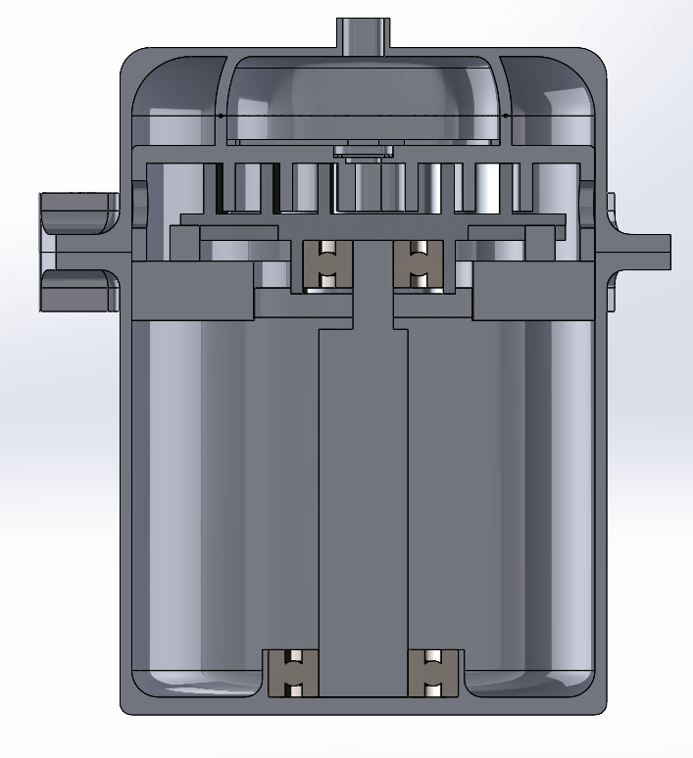
Semi Hermetic scroll compressor model

Slide 31
