Slide 1
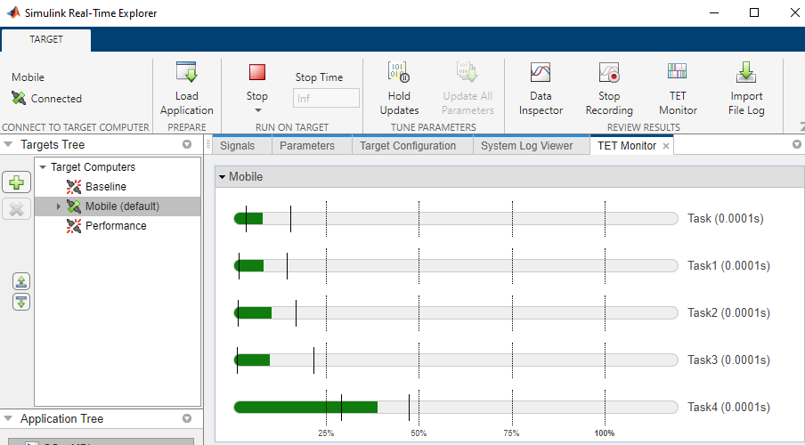
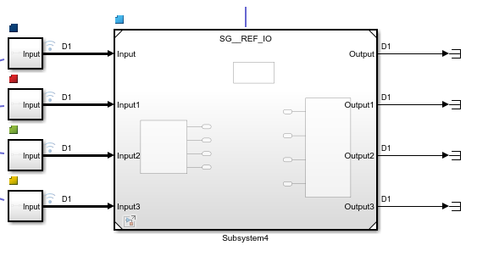
Concurrent execution with SpeedGoat
Multiple CPU usage

Slide 2
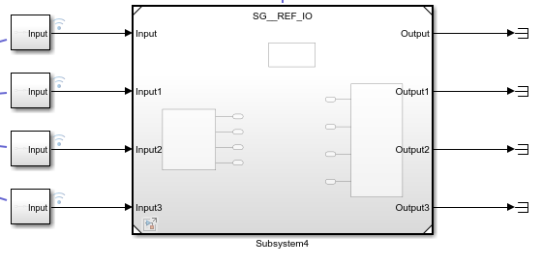

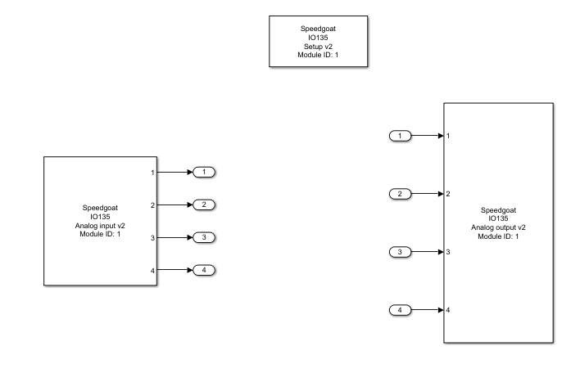
The model
We have different (local) subsystems that generate inputs to a referenced system. The latter is a standalone model with the input, output and setup modules from SpeedGoat.
Rmk: The SpeedGoat modules NEED to be in an external model that is referenced because it doesn’t work otherwise (according to Martin from SG…)
Referenced system

Slide 3
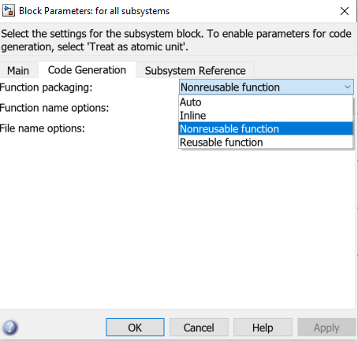
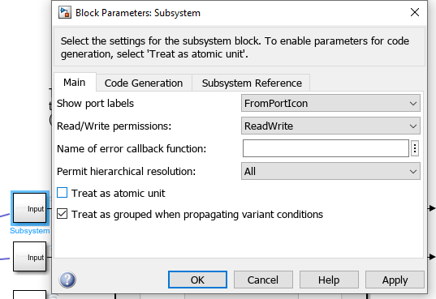
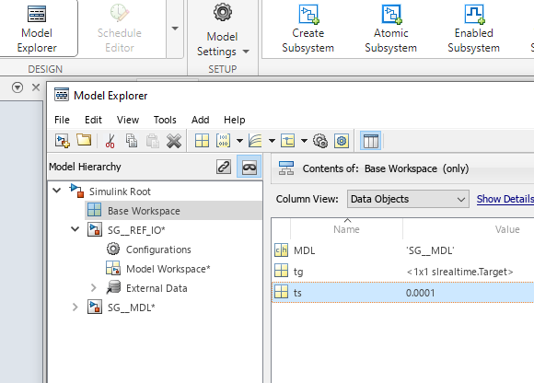
Setting up the model
Set the local subsystems to “treat as atomic unit”
In the “code generation” tab, set “function generation” to “Nonreusable function” - otherwise the code will not compile (workaround by Sebastian Schaefer from Mathworks).
Create a MATLAB sample time variable ts in the base workspace such that it can be read by both SG_MDL and SG_REF_IO models. (Rmk: Simulink variable will not work)

Slide 4
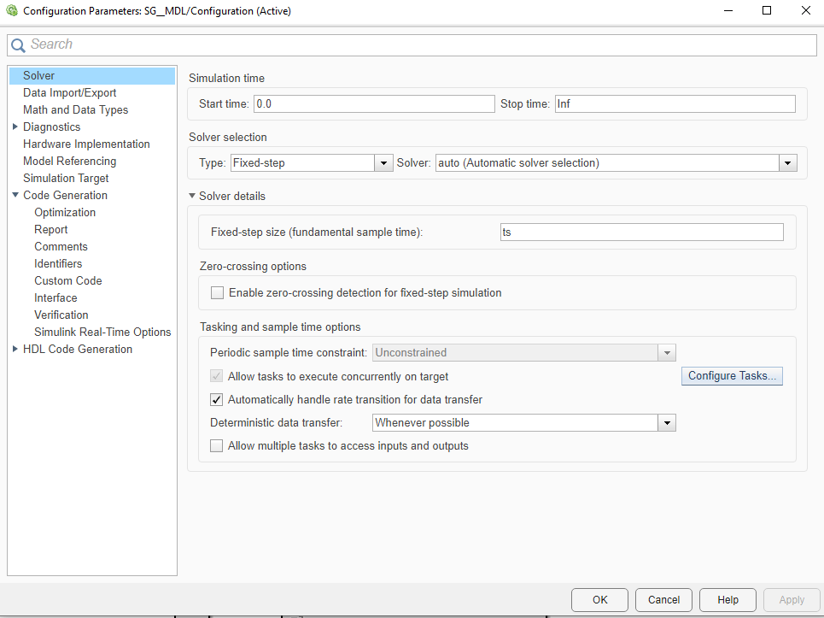
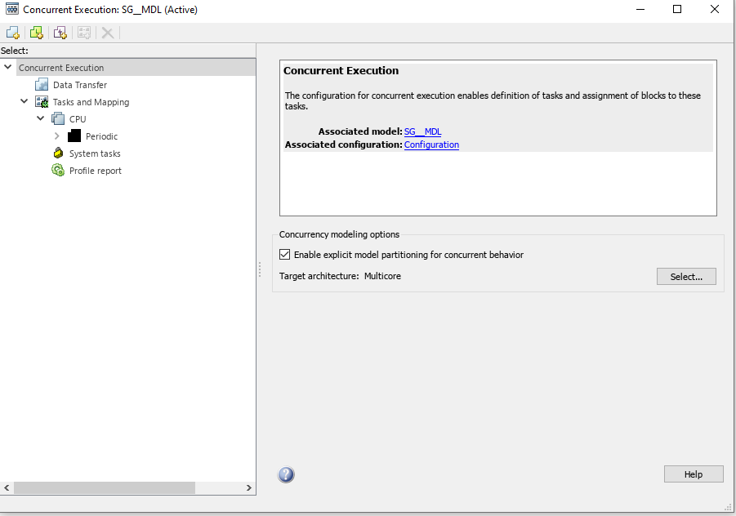
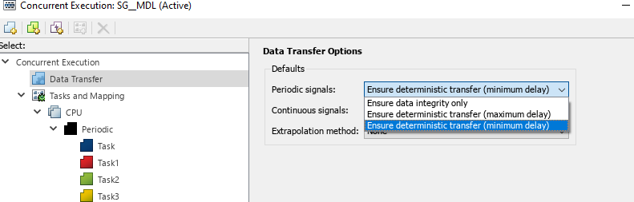
Setting up the model
1
In Simulink, open Configuration Parameters then set Fixed-step size with the sample time variable ts
Click Configure tasks (1) , enable explicit model partitioning (2) and add tasks (3)
Set periodic signals to ensure deterministic transfer (minimum delay) (4)
3
2
4

Slide 5
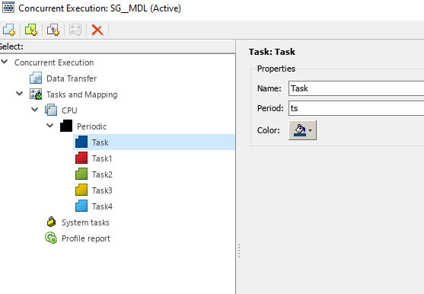
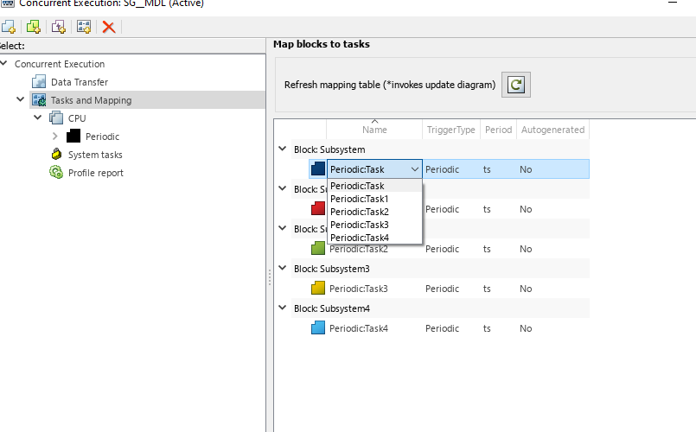
Setting up the model
Set the period as the sampling time for all tasks
Attribute each block to the tasks

Slide 6
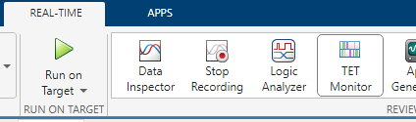
Monitor with Task Execution Time
Via “slrtExplorer” or by “tg.ModelStatus.TETInfo” in matlab command window

