Slide 1
UNIT 1 BASICS OF FULL STACK

Slide 2
Understanding the Basic Web Development Framework - User - Browser – Webserver – Backend Services – MVC Architecture - Understanding the different stacks –The role of Express – Angular – Node – Mongo DB – React

Slide 3
Full Stack Web Developer
• A full stack web developer is a person who can develop both client
and server software.
In addition to mastering HTML and CSS, he/she also knows how to:
• Program a browser (like using JavaScript, jQuery, Angular, or Vue)
• Program a server (like using PHP, ASP, Python, or Node)
• Program a database (like using SQL, SQLite, or MongoDB)

Slide 4
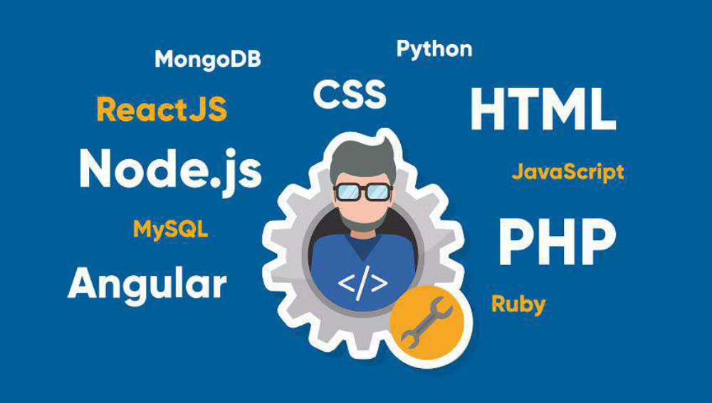
Skills required for a full stack developer

Slide 5
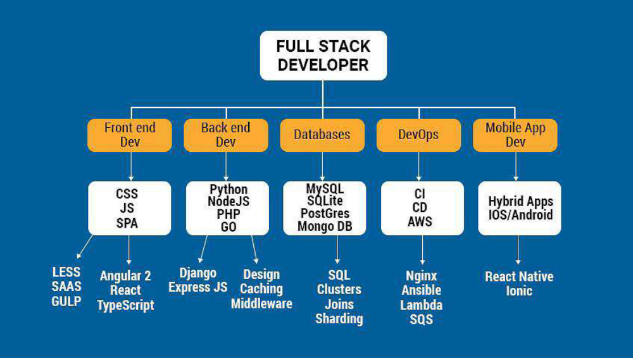

Slide 6
Popular stacks
MEAN stack includes the following:
• Front-end framework: JavaScript and AngularJS
• Database: MongoDB
•Web-framework: Node.js
• Back-end web framework: Express.js

Slide 7
The LAMP stack is made up of
• Operating System: Linux
• Web Server: Apache
• Front-end framework: JavaScript
• Database: MySQL
• Programming and Development: PHP

Slide 8
MERN stack, like MEAN stack, consists of JavaScript based technologies.
• These are the main components of MERN stack:
• Database: MongoDB
• Web Programming Framework: Express
• Building UI: Node.js and React

Slide 9
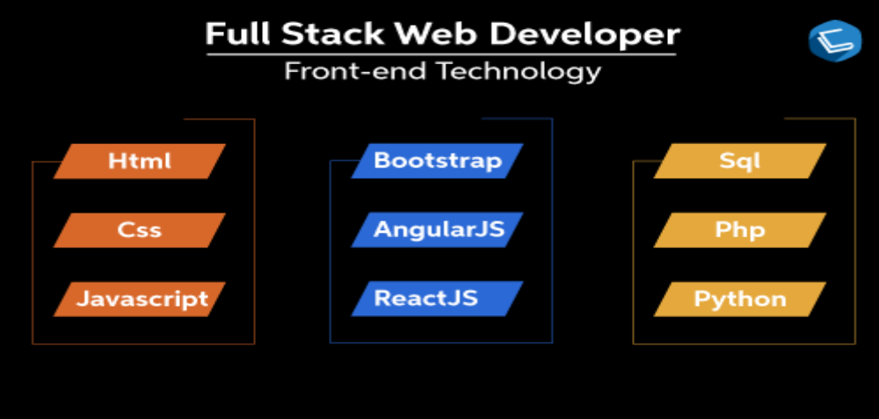
Full stack web development road map

Slide 10
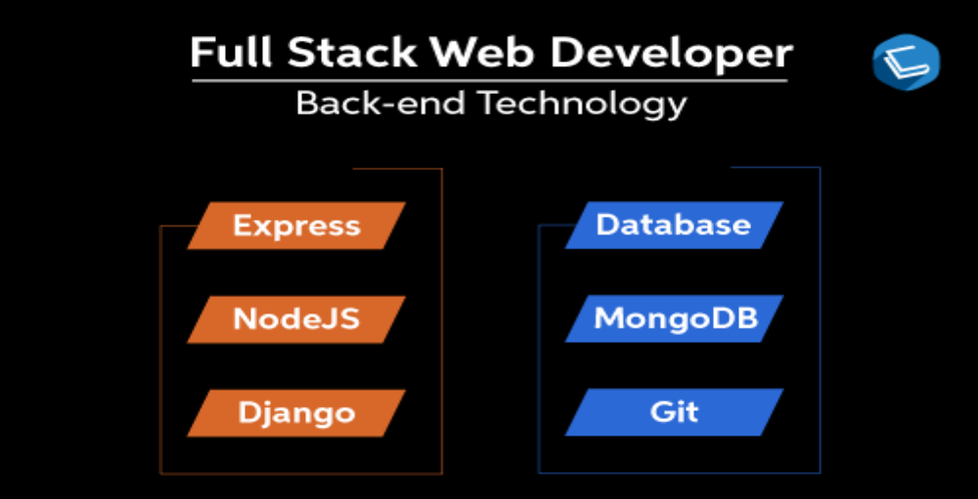

Slide 11
Understanding the Basic Web Development Framework
• A web development framework is a set of resources and tools for software developers
to build and manage web applications, web services and websites, as well as to
develop application programming interfaces (APIs).
• Web development frameworks are also referred to as web application frameworks or
simply web frameworks.

Slide 12
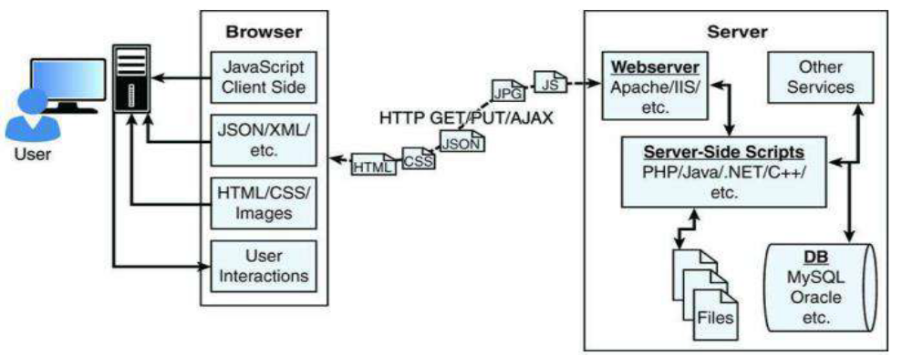
The main components of any given web framework are the user, browser, webserver, and backend services.

Slide 13
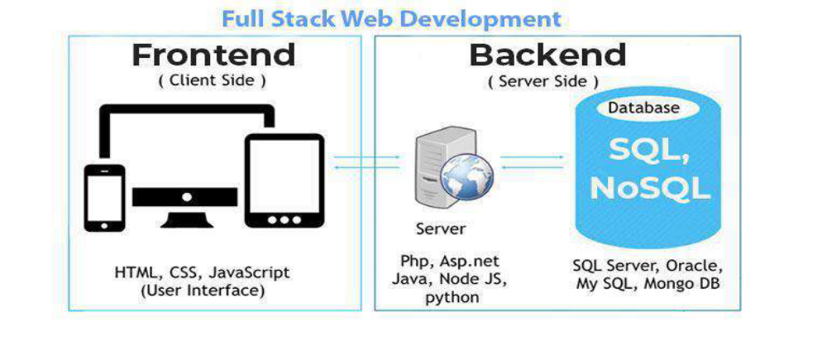

Slide 14

User
• fundamental part of all websites
• User expectations – developing a good website.
• Users accept “world-widewait,” but no longer.
• They expect websites to behave closer to computers
and mobile applications.
• role - to sit on the visual output and interaction input of
webpages.

Slide 15
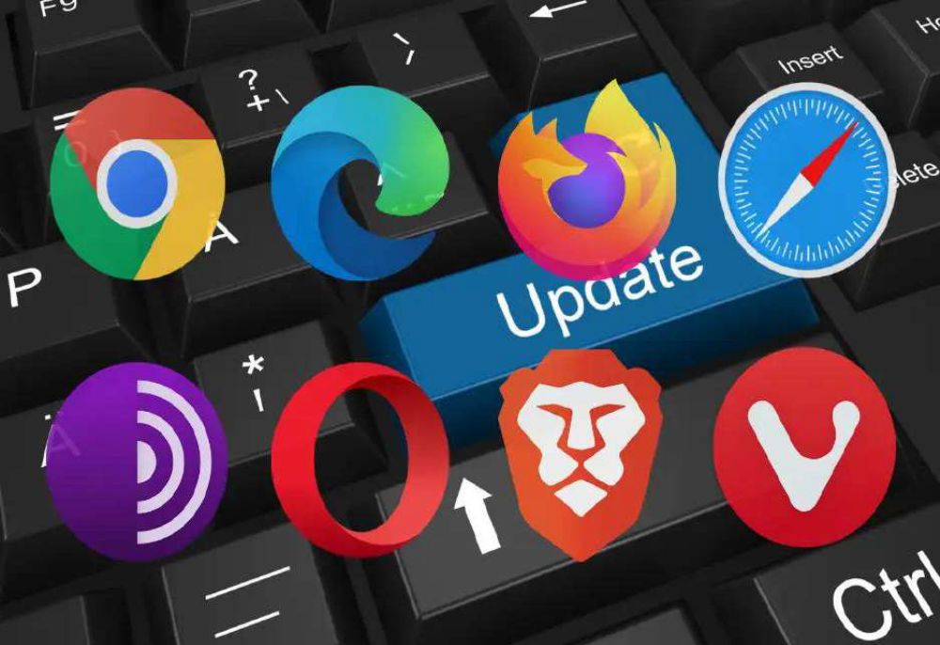
Browser
• The browser plays three roles in
the web framework.
• First, it provides communication
to and from the webserver.
• Second, it interprets the data
from the server and renders it
into the view that the user
actually sees.
• Finally, the browser handles user
interaction through the keyboard,
mouse, touchscreen, or other
input device and takes the
appropriate action.

Slide 16
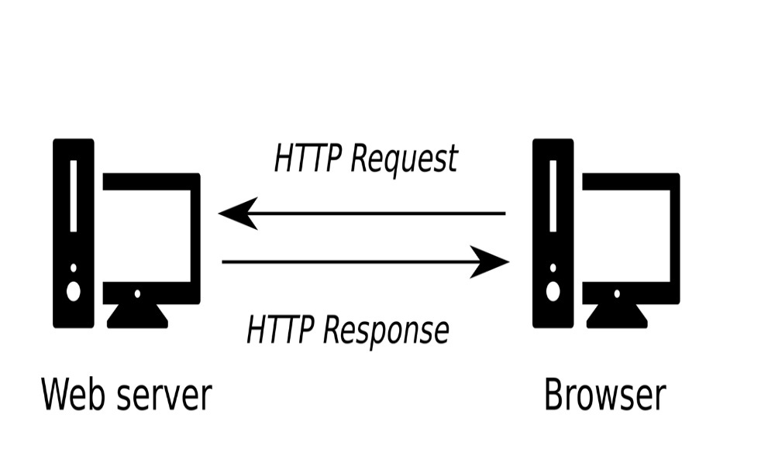
Browser to Webserver Communication
Browser-to-webserver communication consists of a
series of requests using the HTTP and HTTPS
protocols.
The browser makes three main types of requests to
the server:
GET: The GET request is typically used to retrieve
data from the server, such as .html files, images, or
JSON data.
POST: POST requests are used when sending data to
the server, such as adding an item to a shopping
cart or submitting a web form.
AJAX: Asynchronous JavaScript and XML (AJAX) is just a GET or POST request done directly by JavaScript running in the browser.

Slide 17
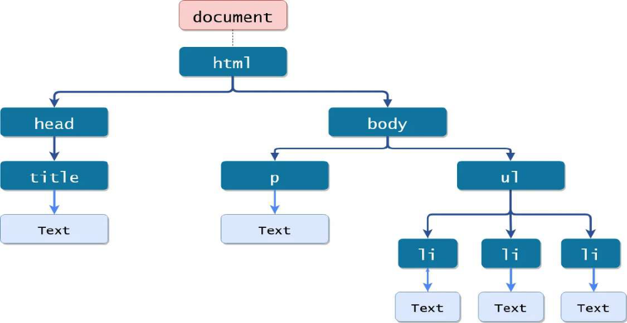
Rendering the Browser View
• The browser reads data from the initial URL and then renders the HTML document to build a
Document Object Model (DOM).
• The DOM is a tree structure object with the HTML document as the root. The structure of the
tree basically matches the structure of the HTML document.
• For example, the document will have html as a child, and html will have head and body as
children, and body may have div, p, or other elements as children, like this:
• document
• + html
• + head
• + body
• + div
• + p

Slide 18
The following are the most common types of data the browser uses.
• HTML files: These provide the fundamental structure of the DOM.
• CSS files: These define how each of the elements on the page is to be styled; for example, font, color,
borders, and spacing.
• Client-side scripts: These are typically JavaScript files. They can provide added functionality,
manipulate the DOM to change the look of the webpage, and provide any necessary logic required to
display the page.
• Media files: Image, video, and sound files are rendered as part of the webpage.
• Data: Any data, such as XML, JSON, or raw text, can be provided by the webserver as a response to
an AJAX request.
• HTTP headers: The HTTP protocol defines a set of headers that can be used by the browser and
client-side scripts to define the behavior of the webpage

Slide 19
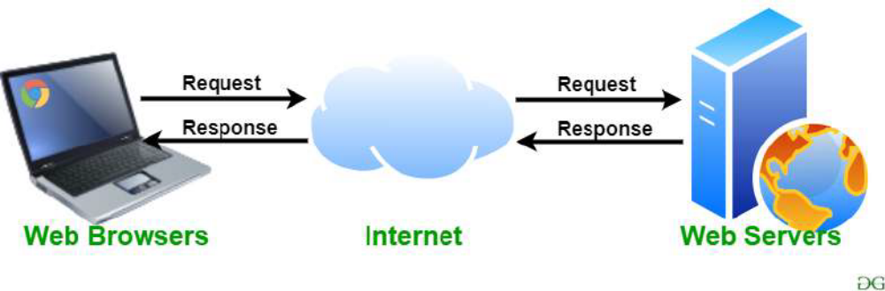
Webserver
• The webserver’s main focus is handling
requests from browsers.
• Most out-of-the-box webservers, such as
Apache and IIS, are made to serve static
files such as .html, .css, and media files.
• A server-side program can be executed by
the webserver to perform the task the
browser is requesting.
• These can be written in PHP, Python, C, C++,
C#, Java, … the list goes on and on.
• Webservers such as Apache and IIS provide
mechanisms to include server-side scripts.

Slide 20

Backend Services
• Run behind the webserver and provide
data used to build responses to the
browser.
• Common type of backend service is a
database that stores information.
• When a request comes in from the
browser that requires information from
the database or other backend service,
the server-side script connects to the
database, retrieves the information,
formats it, and then sends it back to the
browser.
• Conversely, when data comes in from a
web request that needs to be stored in
the database, the server-side script
connects to the database and updates
the data.

Slide 21
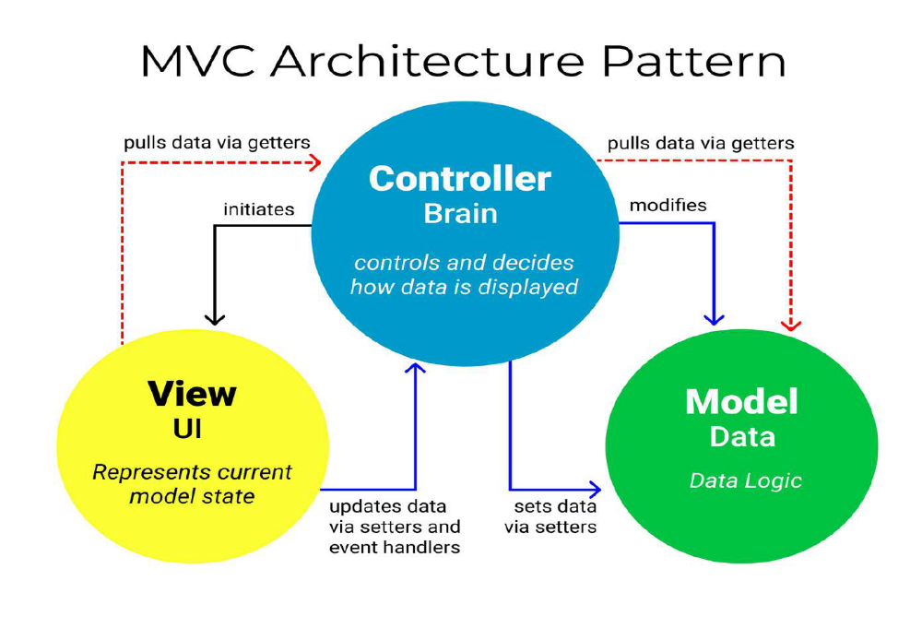

Slide 22
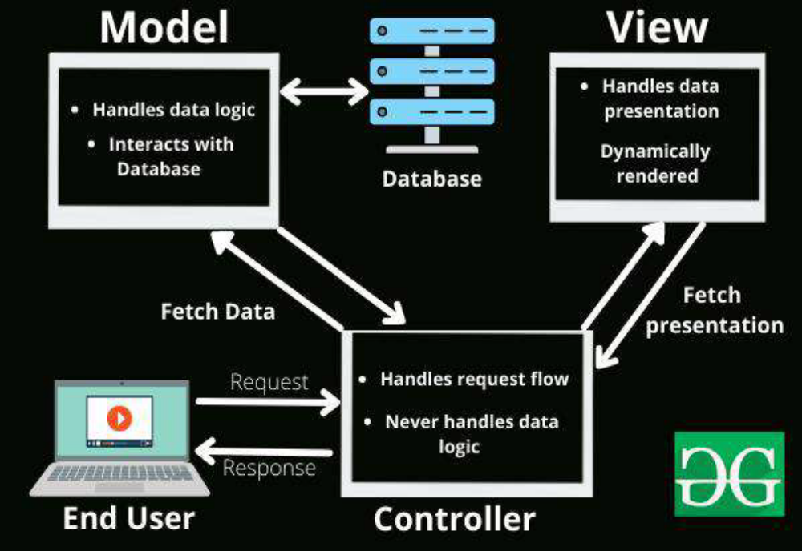

Slide 23
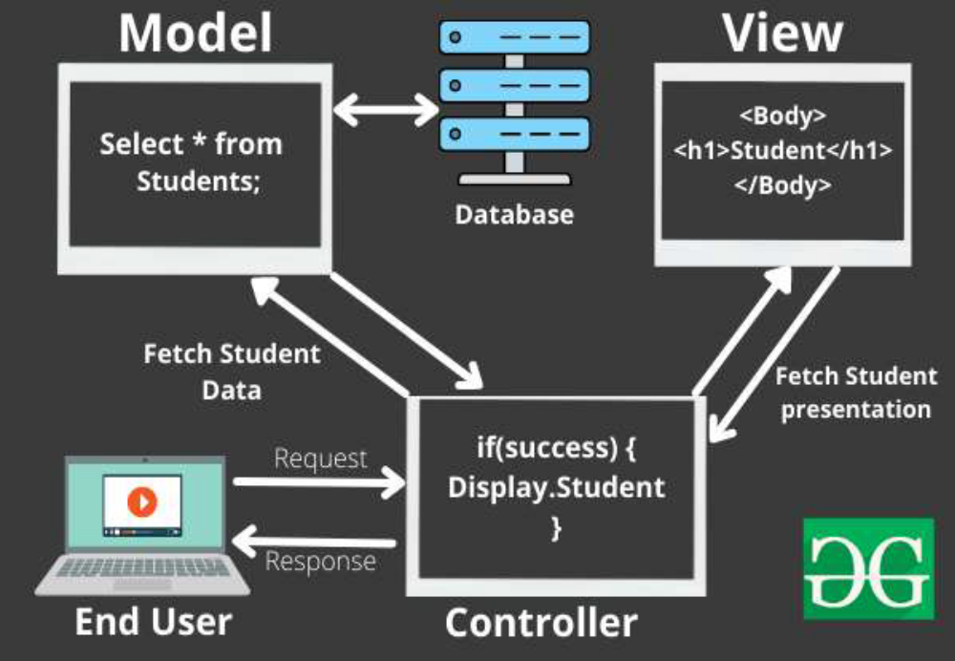

Slide 24
UNDERSTANDING THE DIFFERENT STACKS
• The most common version of the stack is the Node.js-to-Angular stack comprised of MongoDB, Express, Angular, and Node.js.
• In the Node.js-to-Angular stack,
• Node.js provides the fundamental platform for development.
• The backend services and server-side scripts are all written in Node.js.
• MongoDB provides the data store for the website
• The webserver is defined by Express
• The view in the browser is defined and controlled using the Angular framework.
• Angular is an MVC framework where the model is made up of JSON or JavaScript objects, the view is HTML/CSS, and the controller is made up of Angular JavaScript.

Slide 25
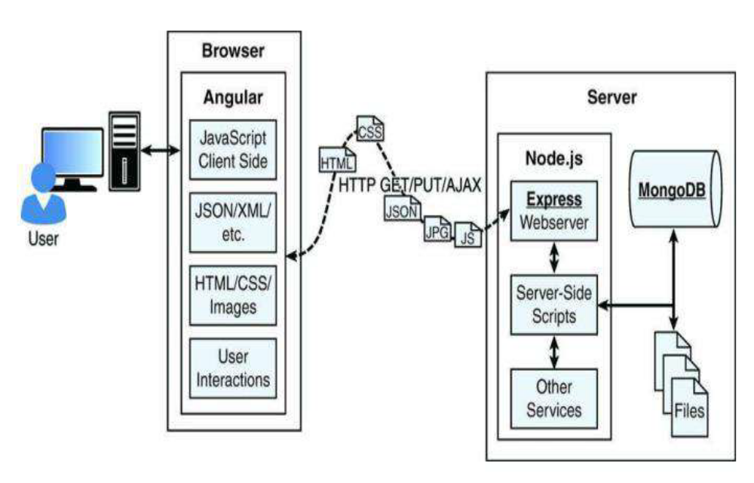

Slide 26
The role of Express
• The Express module acts as the webserver in the Node.js-to-Angular
stack.
• The Express module extends Node.js to provide several key
components for handling web requests.
• For example, the Express module provides the ability to easily set up
destination routes (URLs) for users to connect to.
• It also provides great functionality on working with the HTTP request
and response objects.
• It relies on other modules called middleware to provide the
functionality that most applications will need.

Slide 27
Features of Express
Route management: Express makes it easy to define routes (URL
endpoints) that tie directly to Node.js script functionality on the server.
Error handling: Express provides built-in error handling for documents
not found and other errors.
Easy integration: An Express server can easily be implemented behind
an existing reverse proxy system such as Nginx or Varnish. This allows it
to be easily integrated into your existing secured system.
Cookies: Express provides easy cookie management.
Session and cache management: Express also enables session
management and cache management.

Slide 28
• At the heart of Express is a router, which essentially takes a client
request, matches it against any routes that are present, and executes
the handler function that is associated with that route.
• The handler function is expected to generate the appropriate
response.
• A route specification consists of an HTTP method (GET, POST, etc.), a
path specification that matches the request URI, and the route
handler.
• Express application - created using the express() function.
• Middleware is installed for handling static files.
• A middleware function deals with any request matching the path
specification, regardless of the HTTP method.

Slide 29
Routing: When a request is received, the first thing that Express does is
match the request to one of the routes. The request method is
matched against the route’s method.
Route parameters are named segments in the path specification that
match a part of the URL.
Route Lookup: Multiple routes can be set up to match different URLs
and patterns. The router does not try to find the best match; instead, it
tries to match all routes in the order in which they are installed. The
first match is used.

Slide 30
Once a route is matched, the handler function is called, which was an
anonymous function supplied to the route setup function.
• The parameters passed to the handler are a request object and a
response object. The handler function does not return any value. But
it can inspect the request object and send out a response.
• Express is a web framework that has minimal functionality of its own.
An Express application is essentially a series of middleware function
calls.

Slide 31
Angular
• Angular is a client-side framework developed by Google.
• It provides all the functionality needed to handle user input in the
browser, manipulate data on the client side, and control how
elements are displayed in the browser view.
• It is written using TypeScript. The entire theory behind Angular is to
provide a framework that makes it easy to implement web
applications using the MVC framework.

Slide 32
Benefits of Angular
Data binding: Angular has a clean method to bind data to HTML elements
using its powerful scope mechanism.
Extensibility: The Angular architecture allows you to easily extend almost
every aspect of the language to provide your own custom implementations.
Clean: Angular forces you to write clean, logical code.
Reusable code: The combination of extensibility and clean code makes it
easy to write reusable code in Angular.
Support: Google is investing a lot into this project, which gives it an
advantage over other similar initiatives.
Compatibility: Angular is based on TypeScript, which makes it easier to
begin integrating Angular into your environment and to reuse pieces of your
existing code within the structure of the Angular framework.

Slide 33
Node.js
Node.js is a development framework based on Google’s V8 JavaScript
engine and it’s not a programming language.
Node.js is an open-source, cross-platform runtime environment for
executing JavaScript code outside a browser.
Therefore, Node.js code is written in JavaScript and then compiled into
machine code by V8 to be executed.
Node.js is just JavaScript, so you can easily take functionality from a
client-side script and place it in a server-side script.
Also, the webserver can run directly within the Node.js platform as a
Node.js module, so it makes it much easier than, Apache at wiring up
new services or server-side scripts.

Slide 34
The following are just a few reasons why Node.js is a great framework
to start from:
JavaScript end-to-end: One of the biggest advantages to Node.js is that
it allows you to write both server- and client-side scripts in JavaScript.
There have always been difficulties in deciding where to put scripting
logic. Too much on the client side makes the client cumbersome and
unwieldy, but too much on the server side slows down web
applications and puts a heavy burden on the webserver.
Event-driven scalability: Node.js applies a different logic to handling
web requests. Rather than having multiple threads waiting to process
web requests, they are processed on the same thread using a basic
event model. This allows Node.js webservers to scale in ways that
traditional webservers never can.

Slide 35
Extensibility: Node.js has a great following and an active development
community. New modules to extend Node.js functionality are being
developed all the time. Also it is simple to install and include new
modules in Node.js, making it easy to extend a Node.js project to
include new functionality in minutes.
Time: Time is valuable. Node.js is super easy to set up and develop in.
In only a few minutes, you can install Node.js and have a working
webserver.

Slide 36
MongoDB
• MongoDB is an agile and scalable NoSQL database.
The name Mongo comes from “humongous.”
• It is based on the NoSQL document store model.
• MongoDB provides great website backend storage for high traffic
websites that need to store data such as user comments, blogs, or
other items because it is fast, scalable and easy to implement.
• Node.js supports a variety of DB access drivers, so the data store
could just as easily be MySQL or some other database.

Slide 37
However, the following are some of the reasons that MongoDB really fits in
the Node.js stack well:
• Document orientation: MongoDB is document-oriented, the data is
stored in the database in a format that supports both server-side and clientside
scripts.
High performance: MongoDB is one of the highest-performing databases
available. Especially today when more and more people interact with
websites, it is important to have a backend that can support heavy traffic.
• High availability: MongoDB’s replication model makes it easy to maintain
scalability while keeping high performance.
• High scalability: MongoDB’s structure makes it easy to scale horizontally
by
sharing the data across multiple servers.
• No SQL injection: MongoDB is not susceptible to SQL injection, because
objects are stored as objects, not using SQL strings.

Slide 38
React
• React is an open-source JavaScript library maintained by Facebook that can be used
for creating views rendered in HTML.
• Unlike AngularJS, React is not a framework. It is a library.
• Not just Facebook itself, but there are many other companies that use React in production like Airbnb, Atlassian, Bitbucket, Disqus, Walmart, etc
• It is a component-based front-end library responsible only for the view layer of an MVC (Model View Controller) architecture.
• React is used to create modular user interfaces and it promotes the development of reusable UI components that display dynamic data.

Slide 39
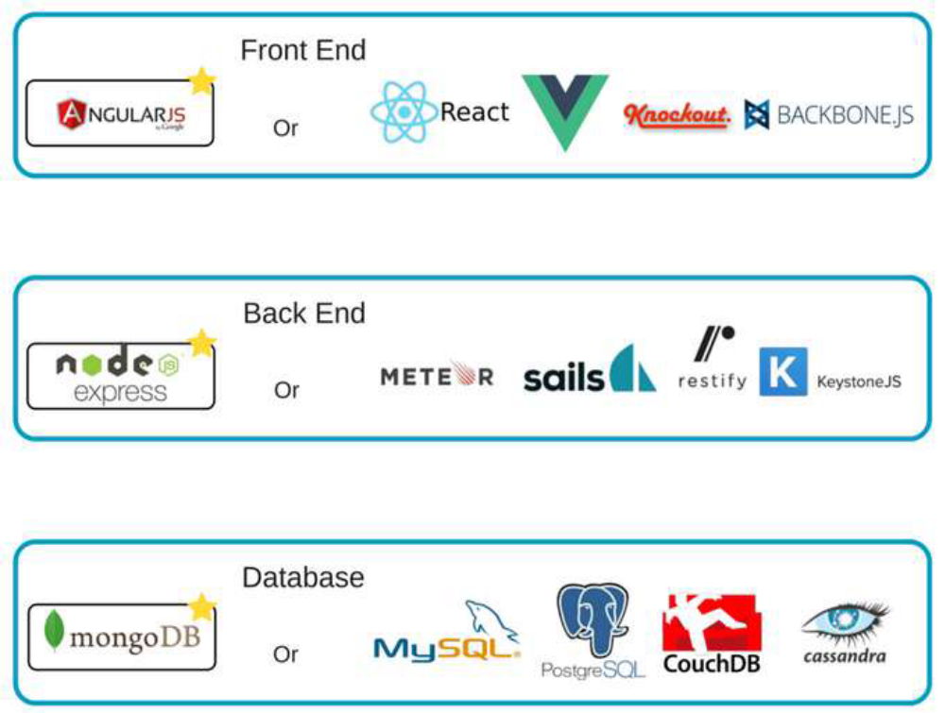

Slide 40
Benefits of using web development framework
• Speed up application development, reduce errors, write less code, reuse
code, simplify debugging and increase reliability.
• Used and stick faster to industry standards.
• Better security

Slide 41
Questions
1. Web Application Framework
2. GET request
3. POST request
4. AJAX
5. Example of MVC framework
6. Webserver
7. Node.js is written in???
8. MongoDB based on???
9. React

