Slide 1

Big data & Hadoop
www.eduami.org

Slide 2
Introduction
What is Data?
Facts and statistics collected together for reference or analysis
What is Information?
Information Analysis is the process of inspecting, transforming, and modelling information, by converting raw data into actionable knowledge
What is Big Data?
Big data is a term for data sets that are so large or complex that traditional data processing application software is inadequate to deal with them.

Slide 3






Scenarios
Weblogs, Social Media data, Twitter, Facebook
Supply Chain, Super Market UPC Code
Cell Towers
UID
We have big data from very long but we never kept them for analysis

Slide 4
What Enables Big Data?
Commodity Hardware
Reduction in storage costs
Open Source eco system
Web Economy
Notes:
We don’t need special hardware. It runs on cheaper disks, cheap servers
Open source Drive Community Standards
Web Economy provides – like Amanzon, Flipkart

Slide 5
What Does Big Data Enable?
Click Stream analysis, buying patterns
Sentiment Analysis
Fraud detection & Forensic analysis
Machine learning
Healthcare research
Prediction ( and prevention) of equipment failure

Slide 6
Big Data Defined
100s of TB to PB
Three Vs
Volume
TB to PB
Velocity
MB/Sec
Variety
Structured (Organized Data format)
Fixed Data Schema
Example: Database records
Unstructured (Unorganized Data)
Unknown Schema
Example: Audio, Video, Multi media files ..etc.
Semi Structured (Partial Organized Data)
Lacks forma structure of a data model
Example: JSON, XML, YAML ..etc
Uses Hadoop
Too big for OLTP
Uses distributed or Parallel processing
Notes:
(OLTP-online transaction processing-) If operation databases cannot handle the volume.

Slide 7
MapReduce
An algorithmic approach to deal with Big Data
Map Phase
Split the data and pre-process it
Shuffle Phase
Group values
Reduce Phase
Aggregate the results
Notes:
Hadoop is open source implementation of google map reduce
-Map phase will produce data in Key Value format
-In Shuffle phase the data is sorted by Key. So that all the data items related to key is contagious
-In Reduce phase it produce only one data for the key (i.e) Aggregate the results

Slide 8

What is Hadoop
It is an Apache project , combining a MapReduce engine with distributes file system (HDFS)
HDFS
It allows disks local to individual nodes in a Hadoop cluster to operate as a single pool of storage
Files are replicated across various node so that loss of one node will not cause loss of data
By default 2 additional copies of each file made, for total of 3 instances
Files cannot be update
Hadoop typically used in combination with complementary tools or technologies
Notes:
Open source implementation of Google Map Reduce and Google File System (GFS)
In some cases file can be appended but not updated
Map Reduce programs are natively written in Java

Slide 9
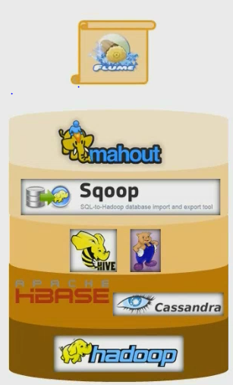
Hadoop Stack
Flume
Machine Learning or Data mining
RDBMS (Import/Export)
Query: HiveQL and Pig Latin
Database (Hbase or Cassandra)
Map Reduce , HDFS
Notes:
Hbase uses HDFS file system
Cassandra uses HDFS compatible Cassandra file system
Tables in these database are hdfs files
The Hive Queries or Pig statements converted to Java code , compiled and run as map reduce Jobs on Hadoop
Useful for data analysis people because they don’t need writed a Java code to do analysis
Sqoop (Sql to Hadoop)
Flume is for streaming log data (These are very useful for log analytics)

Slide 10
Hadoop Installation Mode
Standalone mode
Pseudo distribute mode
Fully Distributed Mode (Cluster)

Slide 11
MapReduce Demo

Slide 12


Vendors (Distributions)
Cloudera
Hortonworks
Hcatalog: Hive/Pig/MR Interop
MapR
Network File System replaces HDFS
IBM InfoSphere BigInsights
HDFS <-> DB2 Integration
Microsoft
Project Isotope
Notes:
They provide single installable and GUI to manage the components
Popular are Cloudera and Hortonworks
Doug Cutting creator of Hadoop is architect at cloudera
Hortonworks is the Hadoop team that spanned from Yahoo
Cloudera is most popular and widley used

Slide 13

Hadoop in the Cloud
Amazon EMR
Elastic MapReduce
Hadoop on Azure
Very Simple provisioning, Query in Browser, Query from Excel or Hive ODBC driver
Google Compute Engine
MapR platform as a Service

Slide 14

Q&A

