Slide 1
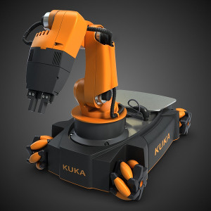
FOUNDATION COURSE (WS 2014)
Hackathon Project:
Robust position control of the arm using velocity interface.
Mentor:
Shehzad Ahmed
Team Members:
Padmaja Kulkarni
Ahamad Drak

Slide 2
Robot Motion Control Overview
Robot control interface
Motion Control Mechanisms:
  Position Control
  Velocity Control
  Torque/Force Control

Slide 3
Problem Formulation
In position control, the robot controller tries to move joints with the maximum allowable velocity.
Problems:
  Jerks in the starting and at stoppage
  Possibility of overshooting goal position
Velocity control mechanism allows smooth motion of joints.

Slide 4
Architecture
Functionalities Needed:
  1. Constraints satisfaction
  3. Velocity profiling

Slide 5
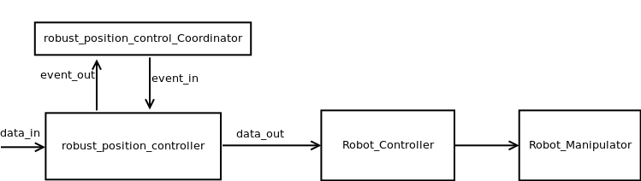
Architecture Diagram

Slide 6
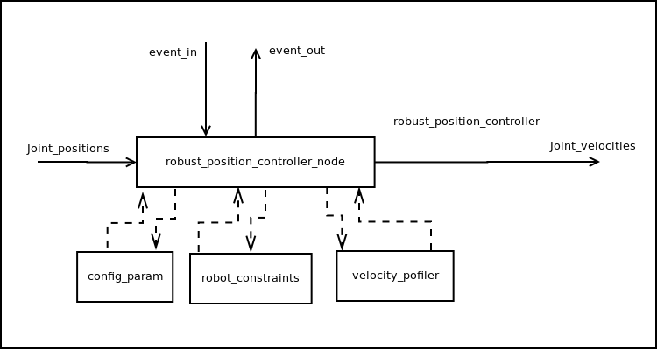
Component Diagram

Slide 7
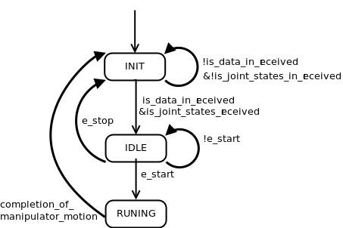
State Machine Diagram

Slide 8
Constraints
Joint limits
Maximum allowed velocity and acceleration
Threshold limit for set point

Slide 9
Velocity Profiler
Generation of velocity trajectory required for smooth motion
Different types of velocity profiler
  Rectangular
  Trapezoidal
  Parabolic

Slide 10
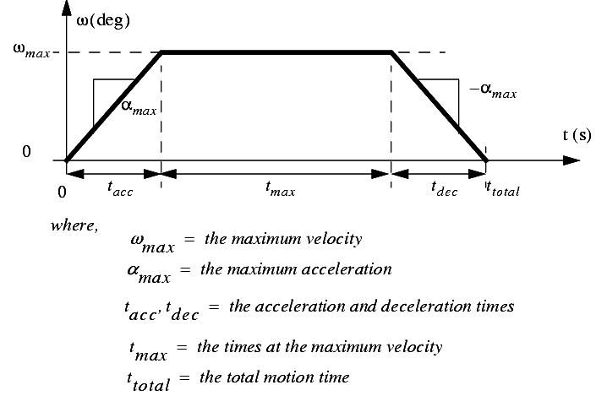
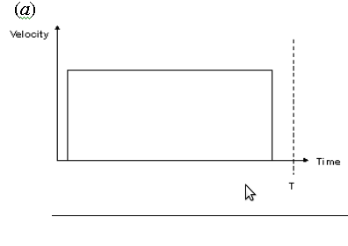
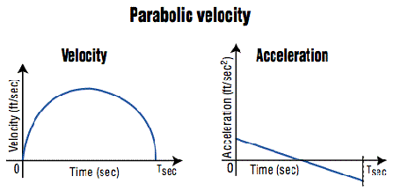
Velocity Profilers cont..

Slide 11
Tools Used
ROS
OROCOS KDL
GITHub
C++

Slide 12
Learnings
Utilization of ROS concepts
Robot control
Development of reusable and scalable components (Hackathon Theme)
Teamwork

Slide 13
FOUNDATION COURSE (WS 2014)
Thank You

