Slide 1
Smart Customer Purchase Analytics & Recommendation System
KEERTHI LAXMI VINAY- 2320030188
LAKSHMI PRASANNA- 2320030387
GOPISETTI VENKATA SREE PADMAJA - 2320030038

Slide 2
Introduction
Problem Statement :
Large amount of customer transaction data is generated
Raw data does not provide useful insights directly
Difficult to analyze customer behavior and buying patterns
Manual analysis is time-consuming and inefficient
Motivation :
Understanding customer behavior helps improve:
Marketing strategies
Customer retention
Business revenue
Data analytics provides clear insights from data Recommendation systems help in better product suggestions.

Slide 3
ABSTRACT
The Smart Customer Purchase Analytics & Recommendation System is a data analytics project that focuses on analyzing customer purchase behavior using big data analytics techniques. In today’s digital retail environment, organizations generate large volumes of transactional data that contain valuable information about customer preferences, buying patterns, and product performance. However, without proper analysis, this data cannot be effectively utilized for decision-making. This project uses historical customer purchase data to perform data cleaning, integration, and exploratory data analysis. Various analytical techniques are applied to study sales trends, customer segmentation, product-wise performance, and purchasing frequency. Data visualization tools are used to present insights through graphs and charts such as sales trends, category-wise revenue, and customer spending patterns. In addition, a basic rule-based recommendation approach is implemented to suggest products based on customer purchase history and frequently bought items. The system helps identify high-value customers, popular products, and potential cross-selling opportunities. This project demonstrates how big data analytics and visualization can support data-driven business decisions and serve as a foundation for intelligent recommendation systems in real-world retail applications.

Slide 4
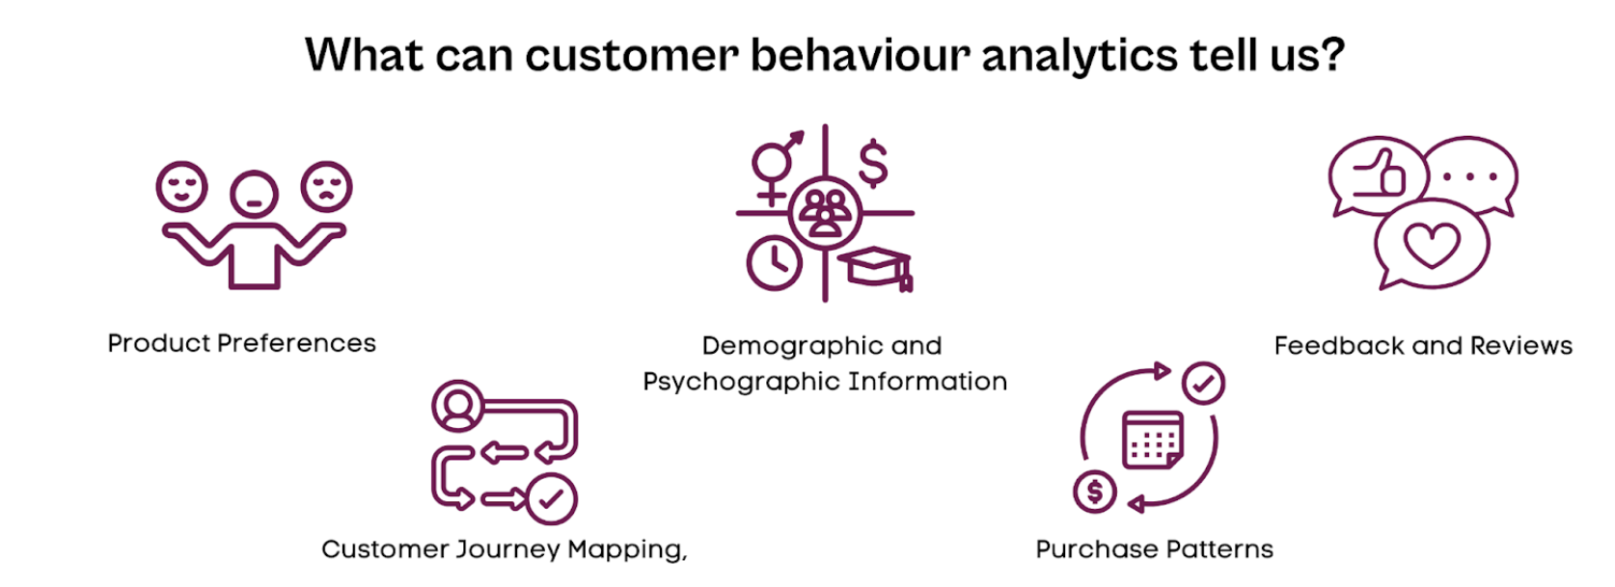

Slide 5
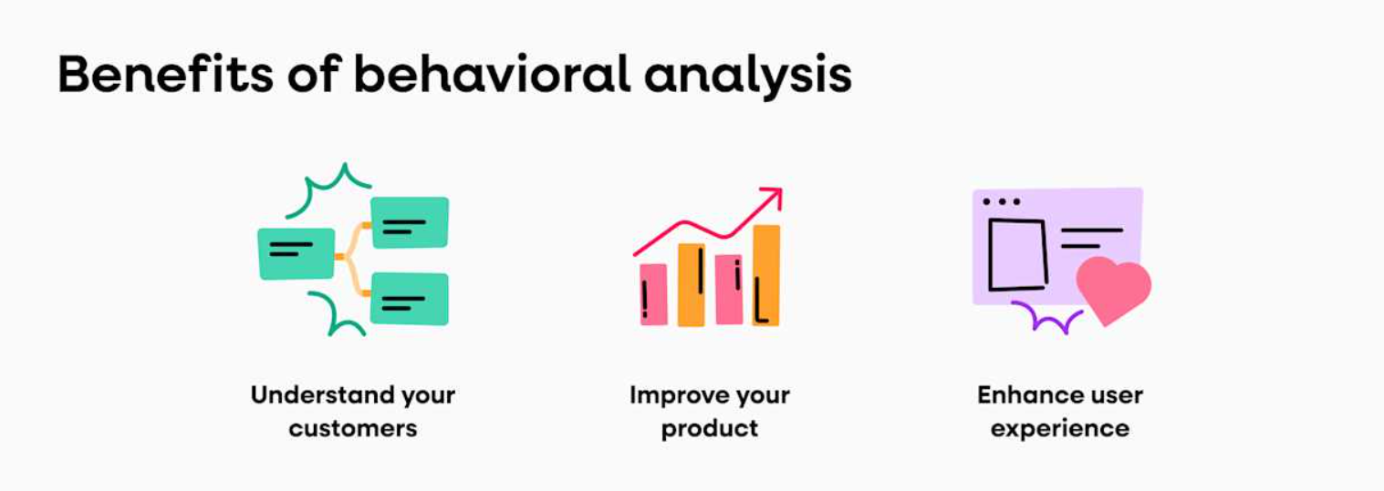

Slide 6
Objectives
Project Objectives :
Analyze customer purchase behavior using data analytics
Perform customer segmentation based on buying patterns
Identify sales trends and product performance
Visualize insights using charts and dashboards
Develop a basic recommendation system
Expected Outcomes :
Identification of high-value customers
Understanding customer buying patterns and frequency
Improved product recommendations
Better decision-making using data insights

Slide 7
Literature Survey
Existing Works :
Traditional CRM systems provide static reports
Many solutions use expensive analytics platforms
Limited use of advanced data analytics
Gaps Identified :
High infrastructure cost
Complex system setup
Limited accessibility for small businesses

Slide 8
Proposed Solution
Proposed Solution :
Data analytics system for customer purchase behavior
Converts raw transaction data into meaningful insights
Uses data cleaning, analysis, and visualization techniques
Helps in better decision-making and business understanding
Key Highlights :
Uses Python for data analysis and customer segmentation
Performs sales trend and product performance analysis
Uses charts and graphs for data visualization
Implements a rule-based recommendation system
Identifies high-value customers and buying patterns

Slide 9
Methedology
Data collection
Customer transaction data is collected from structured datasets representing real-world purchasing behavior.
Data analytics using Python
The collected data is analyzed in Google Colab using Python libraries to perform data cleaning, exploratory analysis.
Customer segementation
Customers are divided into groups based on their buying behavior, purchase frequency, and preferences to enable better analysis and targeted strategies.
Visualization & insights
Power BI is used to create interactive dashboards that visualize customer behavior patterns and support business decision-making.

Slide 10
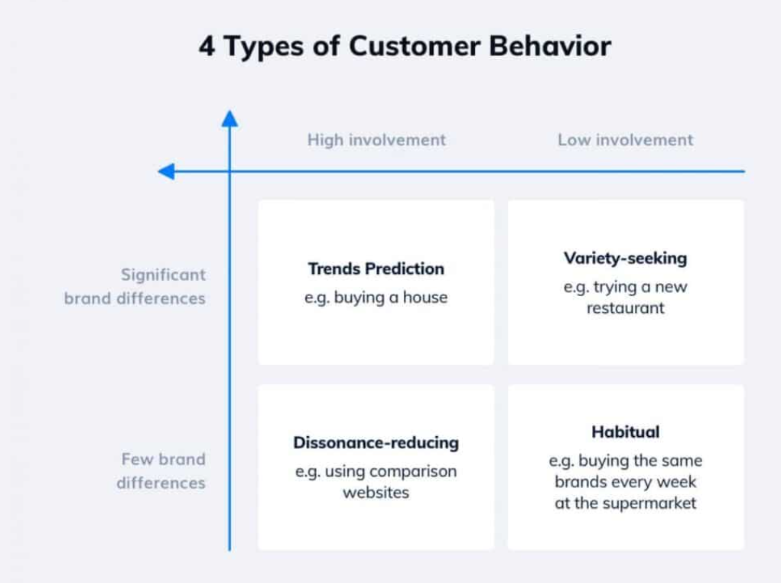

Slide 11
Expected Results & Deliverables
Provides meaningful insights into customer purchase behavior .
Supports data-driven decision-making using analytics .
Key Deliverables :
Cleaned and processed customer dataset .
Customer segmentation and analysis results.
Visualization dashboards (charts & graphs) .
Python notebook with complete workflow .
Final project report and documentation .

Slide 12
IMPLEMENTATION
Raw Transaction Data
Data Cleaning & Processing
EDA Analysis
Customer Segmentation
Business Dashboard

Slide 13
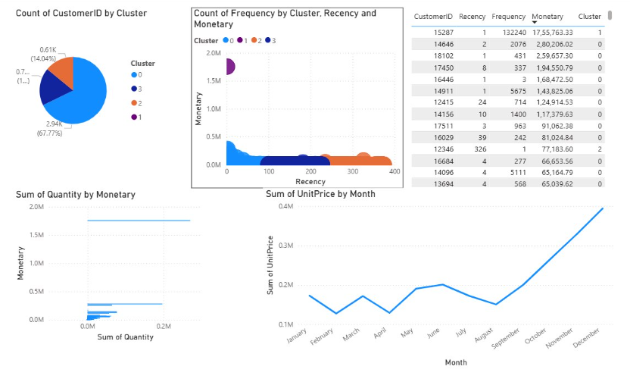

Slide 14
Thank you

