Slide 1
SHORT-TERM INTERNSHIP
ON
ARTIFICIAL INTELLIGENCE
K.PADMAJA
23555A0507
CSE-B

Slide 2
ABSTRACT
The Internship aimed to explore the forefront of artificial intelligence and technologies at the Artificial Intelligence Medical and Engineering Researchers Society (AIMER Society) focused on Generative AI, computer vision, chatbot development, and visual question answering. Initially concentrated on computer vision, covering techniques in image processing , image classification and object detection.
Additionally, examined various AI tools and techniques, including the use of advanced models and practical applications including GEMINI, ROBOFLOW, POWERBI, etc..

Slide 3
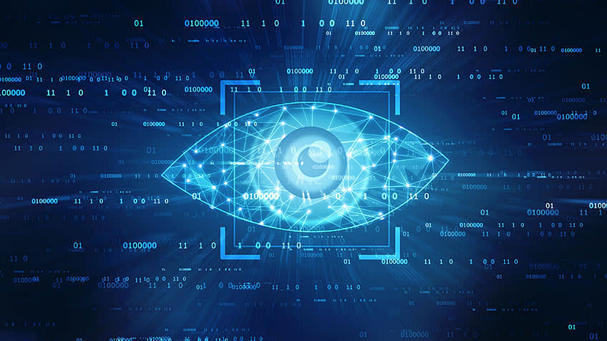
ARTIFICIAL INTELLIGENCE
Artificial Intelligence is a method of making a computer-controlled robot, or a software think intelligently more than the human mind.
Artificial intelligence (AI) refers to computer systems capable of performing complex tasks that historically only a human could do, such as reasoning, making decisions, or solving problems.

Slide 4
Applications of AI:
Artificial Intelligence has various applications in today's society. It is becoming essential for today's time because it can solve complex problems with an efficient way in multiple industries, such as Healthcare, entertainment, finance, education, etc. AI is making our daily life more comfortable and fast.

Slide 5
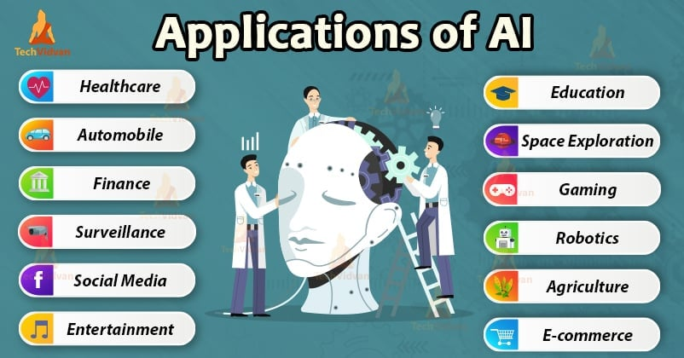
Following are some sectors which have the application of Artificial Intelligence:

Slide 6
VARIOUS TASKS PERFORMED DURING INTERNSHIP:
Chat Bot
Object Detection
Data Visualization using Power BI
Talking parrot/Robot

Slide 7
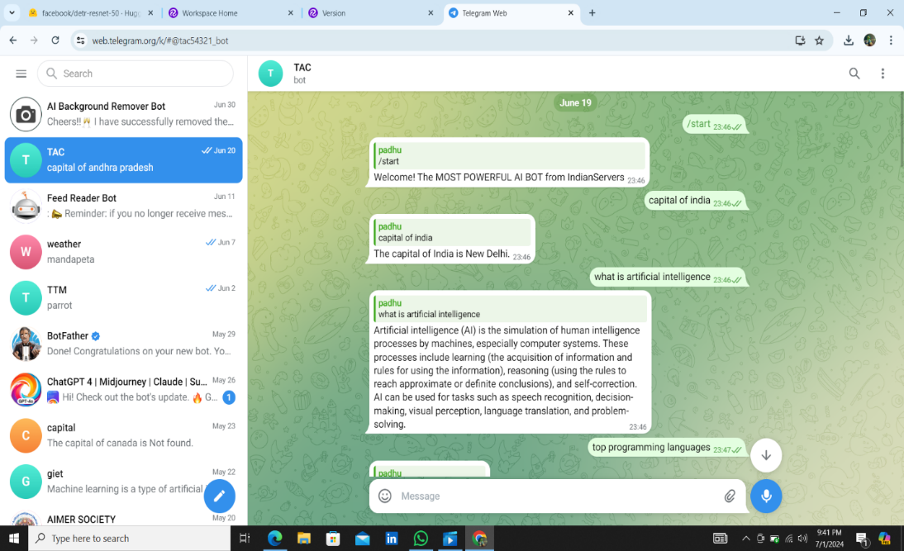
CHAT BOT:
A Telegram chatbot is a computer program that uses artificial intelligence (AI) to communicate with humans through messaging apps and it uses Deep learning algorithms.
Open Telegram and search for the Bot Father.
Start a chat with Bot Father and use the /new Bot command to create a new bot.
Follow the prompts to name your bot and choose a username.
Once created, you’ll receive a token. .
Execute your Python script to start the bot.
Open Telegram, search for your bot (using the username you set), and start a chat

Slide 8
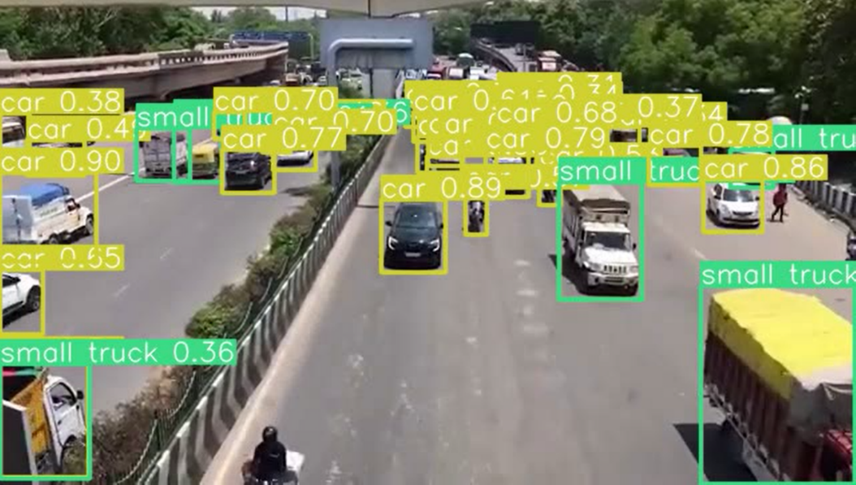
Object Detection:
Object detection is a computer vision task that involves identifying and locating objects in images or videos. It is an important part of many applications, such as self-driving cars, robotics, and video surveillance. One of the most popular neural networks for this task is YOLO.

Slide 9
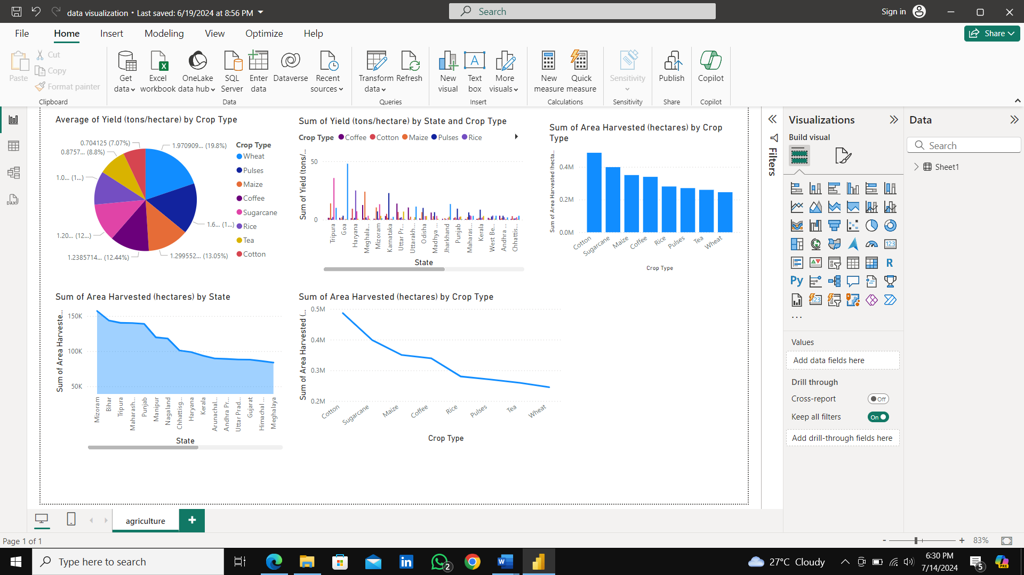
Data Visualization using Power BI:
Data visualization is the representation of data through use of common graphics, such as charts, plots, infographics and even animations. Power BI is a technology-driven business intelligence tool provided by Microsoft for analyzing and visualizing raw data to present actionable information.

Slide 10
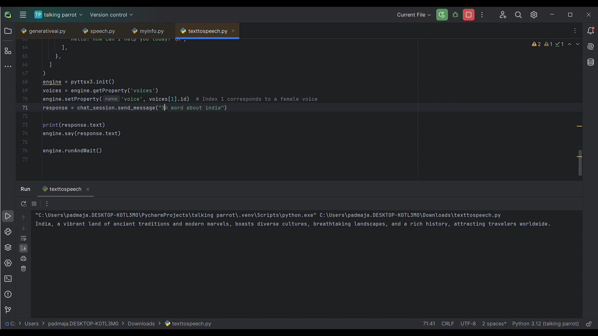
Talking parrot:
A talking parrot project involves creating an interactive system where a virtual or physical parrot can mimic speech or engage in conversations and it uses Neural Networking Algorithm (NNA). This can be achieved through:
Text-to-Speech (TTS) Technology: To make the parrot "talk" by generating human-like speech from text.
Speech Recognition: To enable the parrot to understand and respond to spoken input.
Natural Language Processing (NLP): To interpret and generate meaningful responses.

Slide 11
CONCLUSION:
The main theme of this AI concept is how we can utilize the AI services in Real life activities and complete the work in easy and early by interact with AI and smart devices.

Slide 12
THANK YOU!

