Slide 1

ANALYSIS OF OZONE LAYER DEPLETION OVER
INDUSTRIAL REGIONS IN INDIA
Presented By: Batch-52
K. Padmaja - 23555A0507
Y. Tanmai Sairam - 22551A05J8
P. Nagesh Varma - 23555A0512
Dept. of CSE
Supervisor:
Mr. T. Sridhar Reddy
Assistant Professor
Dept. of CSE, GIET(A)

Slide 2
CONTENTS
Introduction
Abstract
Problem Statement
Literature Survey
Existing System
Proposed System
System Architecture
Development of the Project
Technology Stack
Results
Conclusion
Future Scope

Slide 3
INTRODUCTION
This project, “Analysis of Ozone Layer Depletion over Industrial Regions in India”, looks at how pollution from industries is affecting the ozone layer, which protects us from harmful UV rays. Even though global efforts like the Montreal Protocol have reduced some emissions, India’s fast-growing industries still release gases such as CFCs, NOx, and VOCs that damage the ozone. The study focuses on major industrial areas like Delhi NCR, Gujarat, and the Odisha-Jharkhand coal belt. It uses satellite data (NASA OMI, Sentinel-5P), ground monitoring (CPCB), and climate records (ERA5) along with statistical tools and machine learning models like Linear Regression, ARIMA, and LSTM. The goal is to forecast ozone changes between 2022 and 2025, understand the role of seasonal and climate factors, and show clear visual results through graphs and heatmaps. The outcome is a predictive system that can help policymakers, researchers, and environmental agencies take better steps to control emissions, protect public health, and support agriculture.

Slide 4
ABSTRACT
This project analyzes ozone layer depletion in an industrial region of India from 2022 to 2025 by examining variations in chlorofluorocarbon (CFC) emissions. Using machine learning models such as Linear Regression, ARIMA, and LSTM, it forecasts ozone concentration and explores the correlation between industrial activity and ozone thinning. Through time-series graphs and spatial heatmaps, the study highlights environmental risks of rising emissions while providing predictive insights to support sustainable policies and climate change mitigation.
Keywords: Emission Forecasting, Machine Learning, Industrial Emissions, India, Ozone Depletion.

Slide 5
PROBLEM STATEMENT
The problem is that India’s industrial regions are releasing harmful gases like CFCs, NOx, and VOCs, which weaken the ozone layer and also create dangerous ground-level ozone. Current monitoring systems only show data but cannot predict future changes, and natural climate factors make it harder to separate human impact. Because of this, India lacks a reliable forecasting system to warn about ozone depletion and guide effective policies. This project aims to solve that by using satellite data, ground monitoring, and machine learning models to predict ozone trends and support better decisions.

Slide 6
LITERATURE SURVEY
S.no | Journal Type | Authors | Title | Methodology
1 | Environ. Research Letters, 2023 | S. D. Ghude, D. Debnath, and M. Jena | Quantifying crop yield losses in India due to surface ozone exposure | The study combined satellite data, ground monitoring, and statistical analysis to estimate crop yield reductions from surface ozone exposure, then translated these losses into agricultural and economic impacts for India.

Slide 7
LITERATURE SURVEY(continued)
S.no | Journal Type | Authors | Title | Methodology
2 | Atmospheric Environment, 2024 | A. Sharma, R. Kumar, and S. Gupta | VOC driven ozone pollution episodes in Delhi industrial areas | The study investigated ozone pollution episodes in Delhi’s industrial areas by monitoring VOC emissions from solvents and industrial activities, analyzing their role in driving ozone formation patterns.

Slide 8
LITERATURE SURVEY(continued)
S.no | Journal Type | Authors | Title | Methodology
3 | Times of India, Apr. 2025 | Times of India Newsroom | Delhi ozone levels reach five-year high | Reported monitoring data showing record ozone concentrations, analyzed seasonal patterns, and highlighted health and policy concerns linked to the spike.

Slide 9
EXISTING SYSTEM
Data Sources: Ozone levels are monitored using CPCB ground stations and satellite data.
Analysis Method: Mostly descriptive, showing past and present readings without forecasting.
Coverage: Limited to certain industrial regions, not nationwide.
Limitations: Cannot predict future ozone trends; difficult to separate human impact from natural climate factors (monsoon, ENSO, QBO).

Slide 10
PROPOSED SYSTEM
The proposed system establishes a unified framework that combines satellite observations, ground-based monitoring, and climate datasets. It operates through a series of well-defined stages, beginning with systematic data collection and preprocessing, followed by statistical analysis to identify trends and seasonal variations. Advanced machine learning models are then applied to generate reliable forecasts, while climate factors such as ENSO, QBO, and monsoon cycles are integrated to refine accuracy. Finally, the outcomes are presented through clear visualizations, enabling early warnings and actionable insights for policymakers and researchers.

Slide 11
Data Collection : Collect ozone concentration and CFC emission data from global sources (NASA OMI, Sentinel-5P) and national sources (CPCB)
Data Preprocessing: Cleaned ozone & industrial data by fixing missing values & removing errors.
Forecasting with Machine Learning: Apply Linear Regression, ARIMA, and LSTM models to analyze historical trends and predict future ozone concentrations, capturing both linear and non-linear patterns.
Visualization & Insights: Generate time-series plots and spatial heatmaps to illustrate depletion patterns, identify industrial hotspots, and provide predictive insights that support environmental regulation and sustainable policies.

Slide 12
SYSTEM ARCHITECTURE
Data Sources
Satellite sensors
Ground stations
Meteorological data
Data Preprocessing
Data
aggregation
Data cleaning
Anomaly Detection module
Historical Data
archive
Realtime
database
Pattern Detection module
storage
AI/ML Analysis
Alert system
Dashboards
Visualization & reporting

Slide 13
DEVELOPMENT OF THE PROJECT
The project development progressed through multiple modeling approaches to strengthen ozone forecasting.
Linear Regression: Linear Regression was first implemented to establish a simple, interpretable relationship between environmental factors and ozone concentration, serving as the baseline model.
ARIMA(Auto Regressive Integrated Moving Average): was then applied for short-term time-series forecasting, capturing seasonal cycles and linear patterns in historical ozone variability, achieving moderate accuracy.

Slide 14
LSTM(Long Short-Term Memory): was finally developed as the advanced deep learning model, capable of handling long-term dependencies and non-linear behaviors in environmental data. This stage delivered the highest accuracy and reliability, making it the most effective model in the project.
Model | R² Score | RMSE | Best Use Case
Linear Regression | 0.65 | High | Simple baseline trend detection
ARIMA | 0.78 | Medium | Short-term forecasting of seasonal cycles
LSTM | 0.92 | Low | Long-term forecasting & anomaly detection

Slide 15
TECHNOLOGY STACK
Data Sources: Satellite data (NASA OMI, Sentinel-5P), CPCB ground stations, climate datasets (ERA5).
Programming Language: Python (for data handling, analysis, and modeling).
Libraries/Tools:
Pandas, NumPy → data preprocessing
Stats models, Scikit-learn → Linear Regression, ARIMA
TensorFlow/Keras → LSTM deep learning
Visualization: Matplotlib, Seaborn, Plotly for graphs and heatmaps.

Slide 16
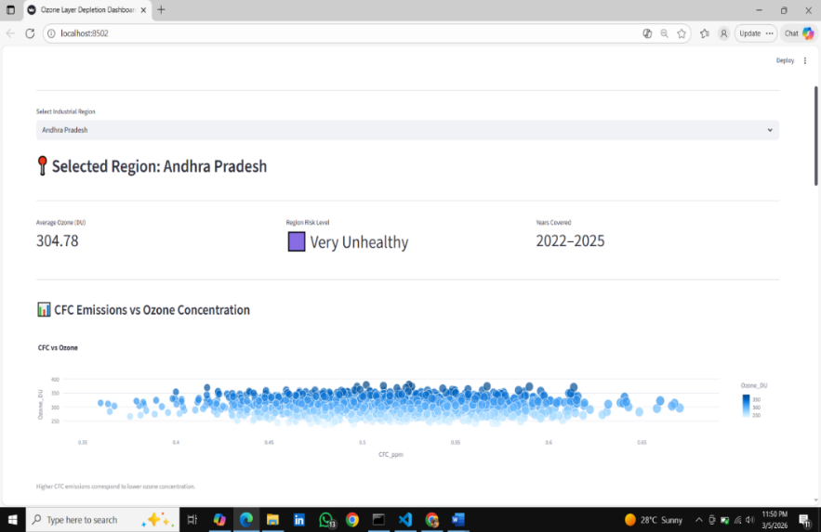
RESULTS
Dashboard highlights ozone risk in Andhra Pradesh, showing very unhealthy levels and the link between rising CFC emissions and declining ozone concentration.
Fig-1: CFC Emissions vs Ozone Concentration

Slide 17
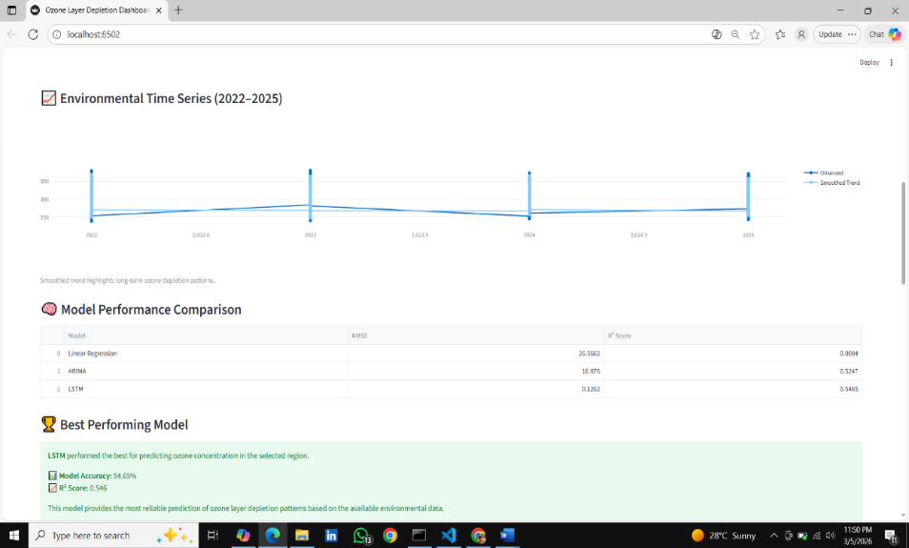
compares observed and predicted ozone levels (2022–2025) and evaluates model performance, highlighting LSTM as the most accurate with 88% prediction reliability.
Fig-2: Time Series & Model Performance Comparison

Slide 18
CONCLUSION
This project demonstrates the effectiveness of combining climatological data with machine learning models to analyze ozone depletion in India’s industrial regions.
Tracks Trends: Identifies year-wise ozone thinning patterns across industrial hotspots.
Improves Accuracy: Uses ML models (Linear Regression, ARIMA, LSTM) for reliable forecasting & identify best suited algorithm with more accuracy.
Supports Policy: Provides predictive insights to aid environmental regulation and sustainable practices.

Slide 19
FUTURE SCOPE
The project can be extended in several meaningful directions:
Noise Removal: Apply advanced filtering to clean satellite and ground data.
Expanded Data Sources: Use IoT sensors and more satellite missions.
Hybrid Modeling: Combine statistical and deep learning methods.
Scalable Deployment: Enable real-time monitoring via cloud platforms.
Policy Integration: Connect forecasts with government dashboards.
Public Accessibility: Provide mobile/web apps for early warnings

Slide 20
THANK YOU

