Slide 1
Overview about POSTMAN
Padma Kumari Jampana
Software Develper
Miracle Software Systems, Inc.

Slide 2
Introduction
Postman core concepts
Postman collections
Postman Environment
Collection Runner
What is a Cookie

Slide 3
Introduction
Started in 2012 and till now it is a well known API client which can be used for fulfilling all requirements of a developer and a tester during API development life cycle.
Most widely used app for API testing.
5 Million Developers and 100000 companies are using postman to access 130 million api's

Slide 4
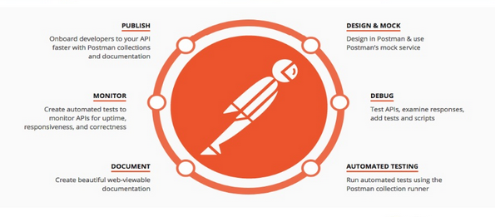
Postman can be used for:

Slide 5
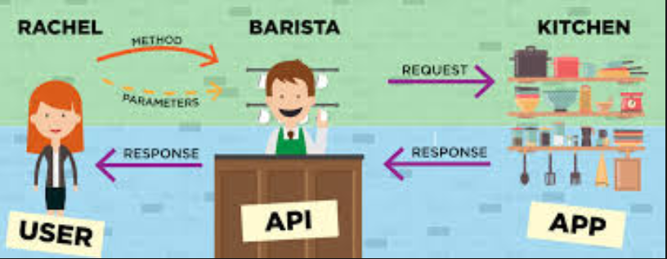
What is an API:
Application program interface is a set of definitions, protocols and tools for building software.

Slide 6
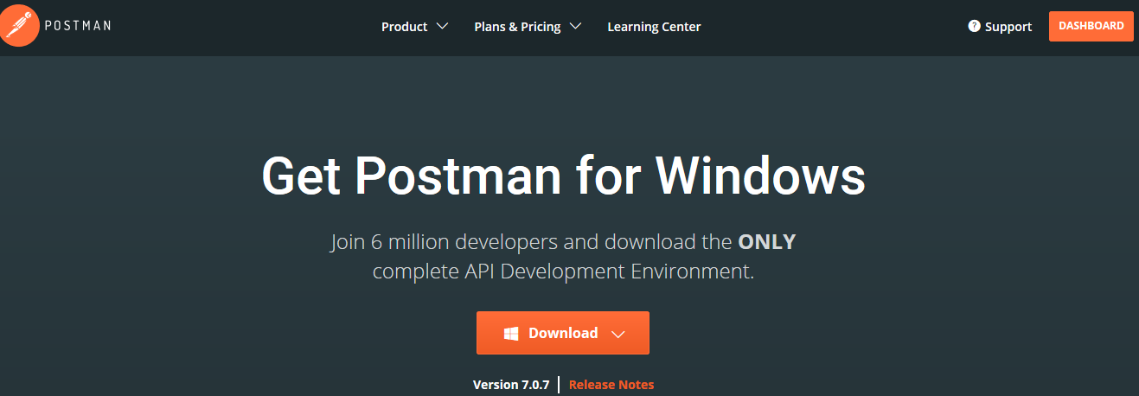
Installing Postman Tool
Click on this URL: https://www.getpostman.com/downloads/
Click on downloads icon

Slide 7
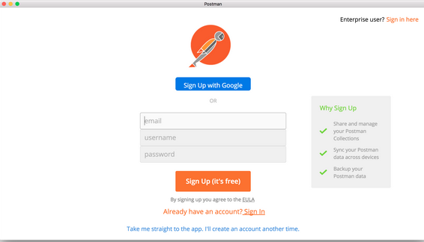
Installing Postman Tool
Launch the app, and see a prompt to log in or sign up.
Sign up with your email address or your Google account.

Slide 8
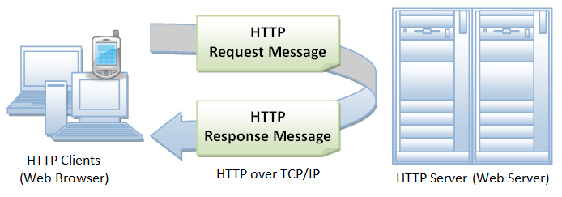
HTTP (HyperText Transfer Protocol)
HTTP (Hypertext Transfer Protocol) is perhaps the most popular application protocol used in the Internet (or The WEB)

Slide 9
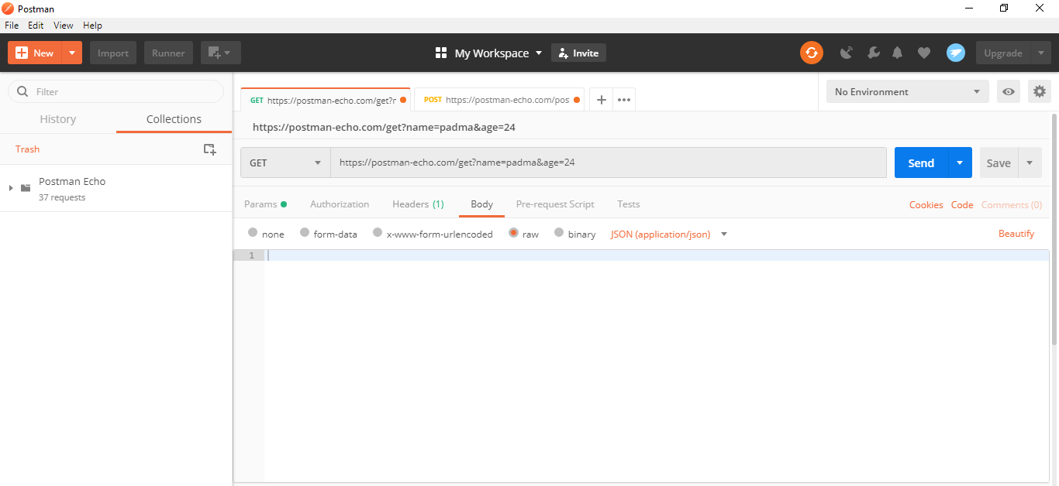
Get Request In Postman
A GET request is used to get the information from the server.

Slide 10
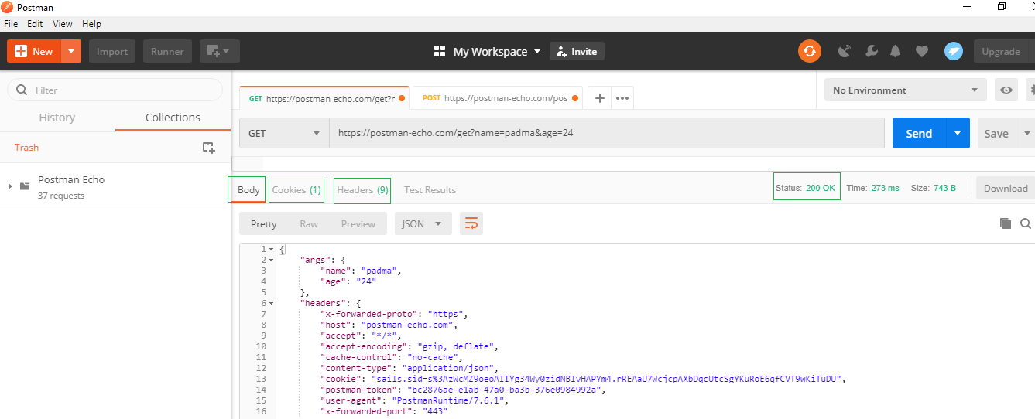
Understanding Response in Postman
Response user interface contains
Response Status and Information
Response Body
Response Cookies
Response Header

Slide 11
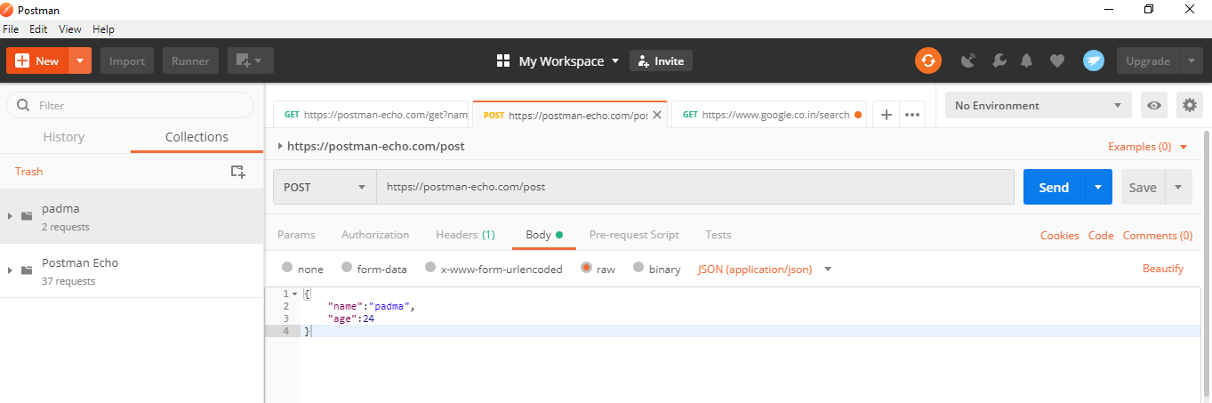
POST Request in Postman
A POST request is a method which is used when we need to send some additional information inside the body of the request to the server.

Slide 12
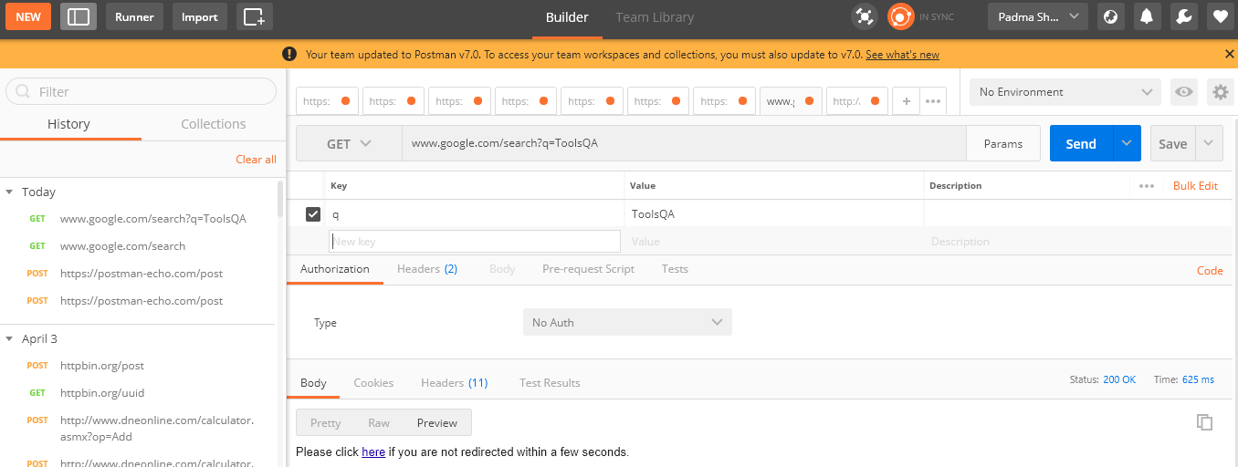
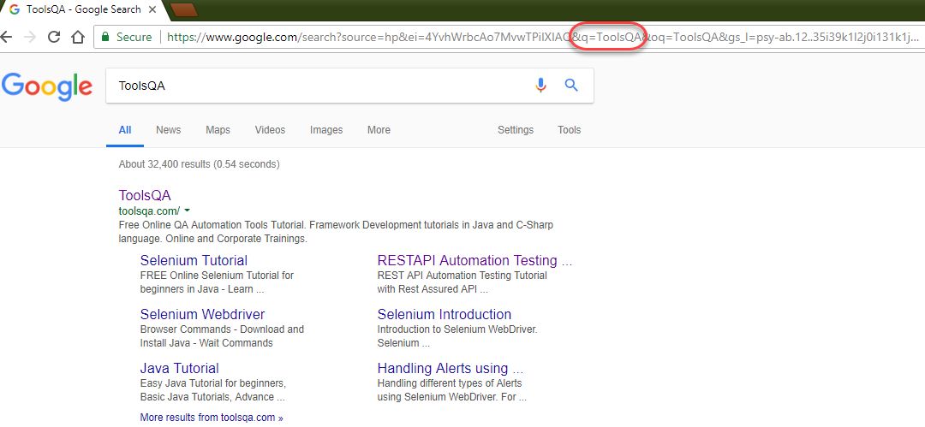
What are Parameters in Request:
https://www.bing.com/search?q=ToolsQA

Slide 13
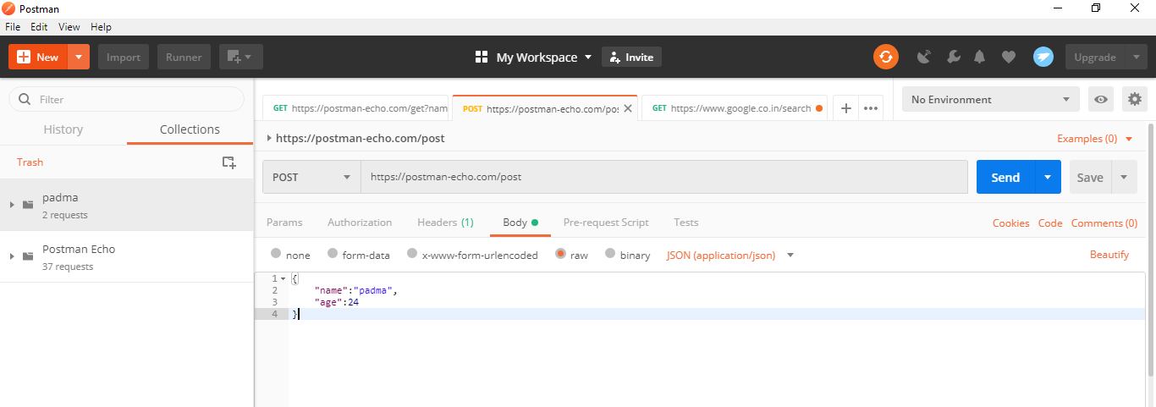
Collections in Postman
Collections are a group of requests grouped in to one folder.

Slide 14
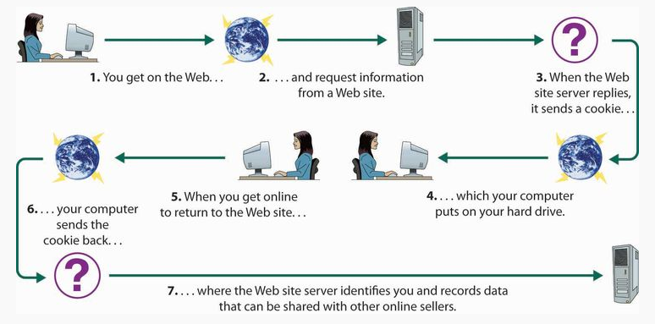
What is a Cookie
Cookie in simpler terms means just the textual information saved by some website.

Slide 15
Our teams are dedicated to innovating with IT and redefining solutions for customer excellence.

