Slide 1

Istio - Introduction to Service Management with Istio Service Mesh
Padmakar Kotule

Slide 2
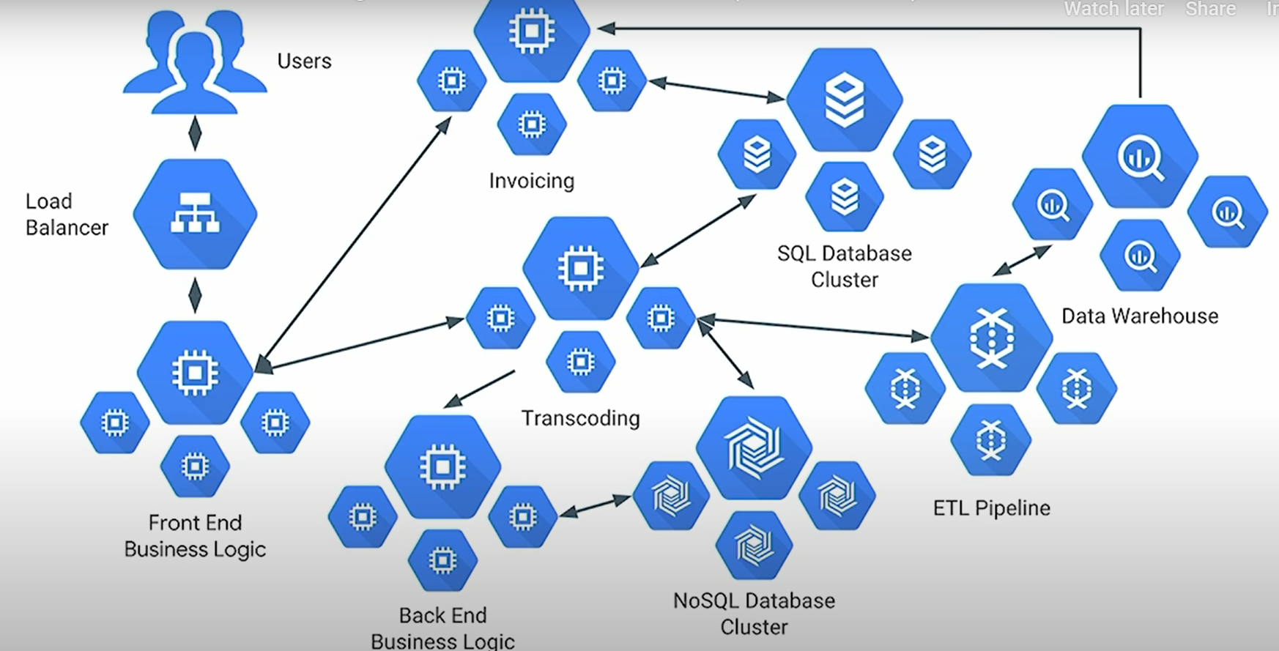
Monolithic to Micro services
Converting to micro services

Slide 3
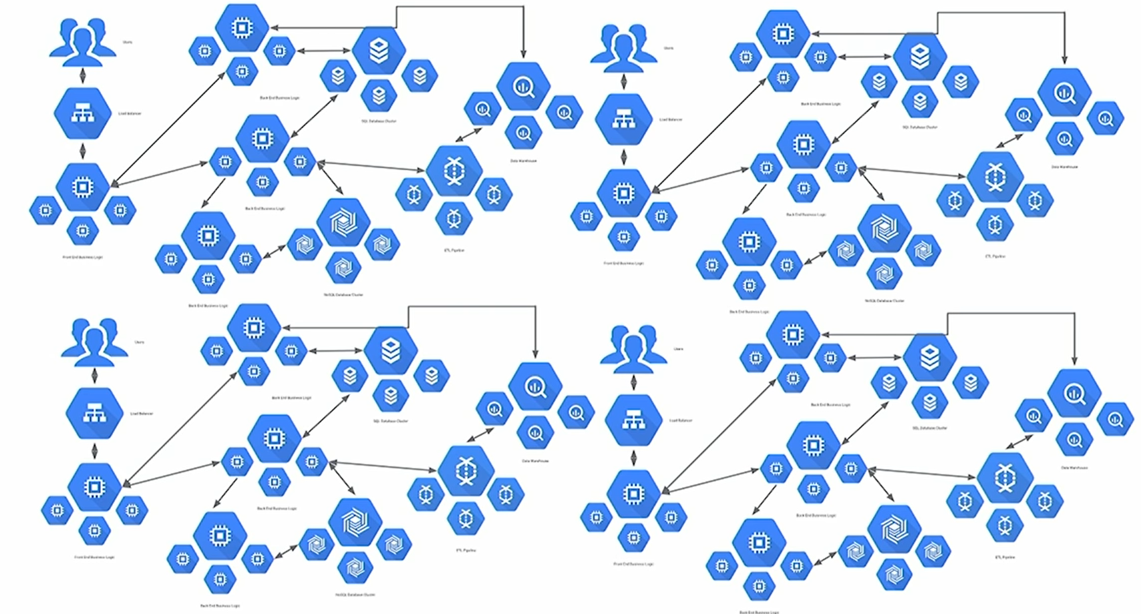
Micro services Complexity
Microservices Complexity

Slide 4
Transitioning
Converting from a monolith to a microservices architecture enables you to deploy your application more frequently, independently, and reliably.
handling service to service communication is challenging and
most of the time we depend upon third-party libraries or components to provide functionalities like,
load balancing
service discovery,
circuit breaker,
metrics,
telemetry, and more

Slide 5
Micro services - service to service communication challenges
Companies like Netflix came up with their own libraries like
Hystrix
for circuit breakers
Circuit breaking allows you to write applications that limit the impact of failures, latency spikes, and other undesirable effects of network peculiarities.
E.g. Tripping the circuit
In the DestinationRule settings, you specified maxConnections: 1 and http1MaxPendingRequests: 1. T
hese rules indicate that if you exceed more than one connection and request concurrently, you should see some failures when the istio-proxy opens the circuit for further requests and connections
Ref. - https://istio.io/docs/tasks/traffic-management/circuit-breaking/
Eureka
for service discovery
Ribbon
for load balancing which are popular and widely used by organizations.

Slide 6
What we do to manage it?
So what we do to manage it?
Hundred or thousand's of micro services, how to manage traffic between services, monitoring etc.
We develop tool effectively,
Welcome to Service mesh.

Slide 7
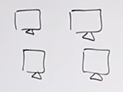
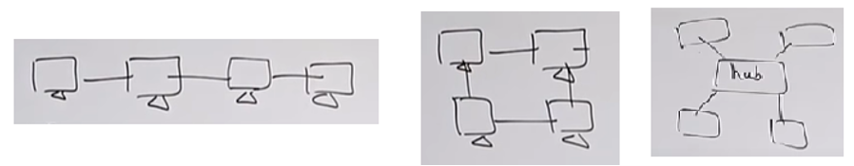
Off the topic – Service to service communication - Network
Communication between services/nodes will come as what’s the network topology
Generally network topology means how you are connecting nodes with each other.
E.g.
You can connect all computers in different ways, such as,

Slide 8
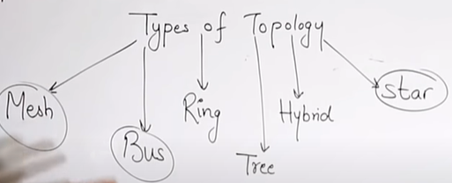
Off the topic - Networking
Network Topology
Physical topology
Actual layout of computer cables
How physical presence (How they are connected physically, e.g. in single line, or using central hub/switch etc).
Logical topology
The way actually devices communicate internally.
Logical topologies describe how signals act on the network.
How internally devices are communicating with each other.

Slide 9
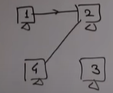
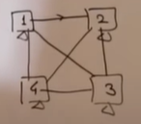
Off the topic - Networking
Network types of topology (Physical)
Start topology
Bus topology
Mesh topology
Ring topology
Tree topology
Hybrid topology
Mesh topology
Devices are connected directly with each other
Generally very secure as line is connected dedicated with each other
Mostly used in WAN (connecting routers)

Slide 10
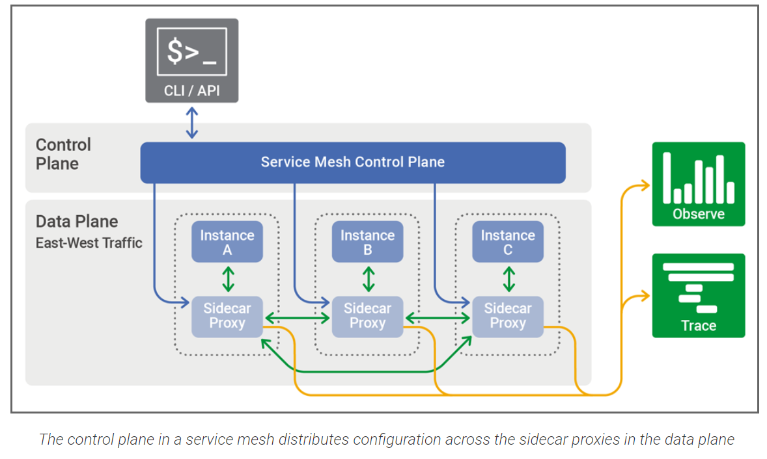
The Rise of Service Mesh Architecture
Service Mesh
Ref. https://www.nginx.com/blog/what-is-a-service-mesh/

Slide 11
The Rise of Service Mesh Architecture
What is service mesh?
A service mesh is a software-driven approach to routing and segmentation. The goal is to solve the networking and security challenges of operating Microservices and cloud infrastructure. Service mesh solutions bring additional benefits such as failure handling, retries, and network observability.
Ref. - https://www.hashicorp.com/resources/service-mesh-microservices-networking/
Some more definitions,
A service mesh can be defined as an infrastructure layer which handles the inter-service communication in a Microservices architecture. Service mesh reduces the complexity associated with a Microservices architecture and provides lot of the functionalities like:
Load balancing, Service discovery
Health checks, Authentication
Traffic management and routing, Circuit breaking and failover policy
Security, Metrics and telemetry, Fault injection etc..
Ref. - https://dzone.com/articles/the-rise-of-service-mesh-architecture

Slide 12
Why Is Service Mesh Necessary?
Handling service to service communication is challenging in Microservices and there are
third party libraries such as, Hystrix, Eureka, Ribbon etc.
However,
Challenges and complexity - these components need to be configured,
inside your application code and based on the language you are using, the implementation will vary a bit.
Libraries upgrade - Anytime these external components are upgraded,
you need to update your application, verify it, and deploy the changes.
Needless to say, this tight coupling increases the overall application complexity.
developer now needs to also understand how these components are configured so that he/she can troubleshoot in case of any issues.
Then how service Mesh help?
Service Mesh comes to the rescue here. It decouples this complexity from your application and puts it in a service proxy and lets it handle it for you. Service proxies can provide you with a bunch of functionalities like,
traffic management, circuit breaking,
service discovery, authentication,
monitoring, security, and much more
Ref. - https://dzone.com/articles/the-rise-of-service-mesh-architecture

Slide 13
Service Proxy, Envoy Proxy
Service Proxy
Example,
Say, in your Microservices architecture,
if you have five services talking with each other. Then,
instead of building the common necessary functionalities like
configuration, routing, telemetry, logging, circuit breaking, etc. inside every Microservices,
it makes more sense to abstract it into a separate component — called a 'service proxy.'
Envoy Proxy
Built on the learnings of solutions such as NGINX, HAProxy, hardware load balancers, and cloud load balancers, Envoy runs alongside every application and abstracts the network by providing common features in a platform-agnostic manner.
Ref. - https://www.envoyproxy.io/
Envoy from Lyft is the most popular open source proxy designed for cloud native applications.
Envoy runs along side every service and provides the necessary features.

Slide 14
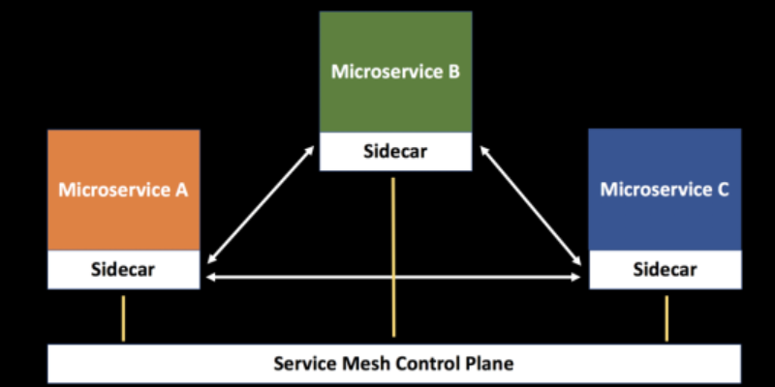
Sidecar Pattern - How Is Service Mesh Implemented?
To implement a service mesh, you can deploy a proxy alongside your services. This is also known as the sidecar pattern.
Ref. - https://dzone.com/articles/sidecar-design-pattern-in-your-microservices-ecosy-1
All the incoming and outgoing network traffic from an individual service flows through the sidecar proxy.
As a result, the sidecar manages the traffic flow between Microservices,
gathers telemetry data, and enforces policies.
In a sense, the service is not aware of the network and knows only about the attached sidecar proxy.

Slide 15
Sidecar Pattern - How Is Service Mesh Implemented?
Sidecar Pattern - How Is Service Mesh Implemented?
Inside a service mesh, we have the concept of a data plane and a control plane.
Date Plane
The data plane's responsibility is to handle the communication between the services inside the mesh and take care of the functionalities like,
service discovery,
load balancing,
traffic management,
health checks, etc.
Control Plane
The control plane's responsibility is,
to manage and configure the sidecar proxies
to enforce policies and
collect telemetry.

Slide 16

How does it work?
A service mesh doesn’t introduce new functionality to an app’s runtime environment
apps in any architecture have always needed rules to specify how requests get from point A to point B.
a service mesh is built into an app as an array of network proxies.
E.g.
As your request for this page went out, it was first received by your company’s web proxy…
After passing the proxy’s security measure, it was sent to the server that hosts this page…
Next, this page was returned to the proxy and again checked against its security measures…
And then it was finally sent from the proxy to you.
Ref. https://www.redhat.com/en/topics/microservices/what-is-a-service-mesh

Slide 17
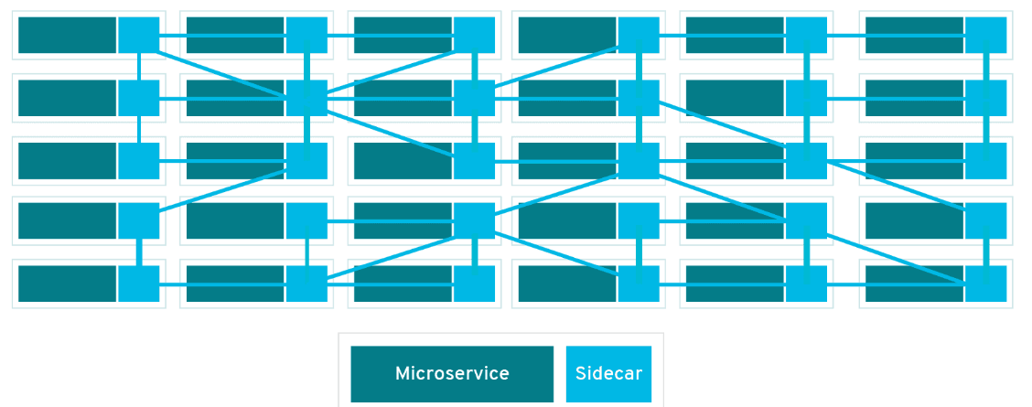
How does it work?
In a service mesh, requests are routed between microservices through proxies in their own infrastructure layer.
For this reason, individual proxies that make up a service mesh are sometimes called “sidecars,” since they run alongside each service, rather than within them.
Ref. - https://www.redhat.com/en/topics/microservices/what-is-a-service-mesh

Slide 18
Benefits of Using a Sidecar Pattern
Benefits of Using a Sidecar Pattern
Reduces the complexity in the Microservices code by abstracting the common infrastructure-related functionalities to a different layer.
Reduces code duplication in a Microservices architecture since you do not need to write configuration code inside each Microservices.
Provide loose coupling between application code and the underlying platform.

Slide 19
Service Mesh and Its Tooling Options
Most popular service mesh tools today are Linkerd, Istio and Consul Connect.
First, the biggest player in the service mesh space: Istio
Open-sourced in May 2017 by Google, IBM, and Lyft.
The second, it has been around a bit longer is: Linkerd, and
Third one is:
Consul Connect, the product Hashicorp (creators of Vault, Terraform, and Vagrant).
Ref. - https://logz.io/blog/istio-linkerd-envoy-comparison-service-meshes/

Slide 20
Service Mesh and Its Tooling Options (High level feature comparison)
Service Mesh - Tooling Options and high level feature comparison
Agent vs. Centralized service
Consul Connect uses an agent running on each node in a daemonset as the control plane, while Istio and Linkerd’s Conduit use centralized services.
Traffic Management
At present, Istio has more traffic management features than Linkerd, including circuit breakers, fault injection,
retries, timeouts, routing rules, virtual servers, load balancing, and others.
Security
All three products have good basic support for certificate rotation and external root certificate support, but Istio leads the pack when it comes to security features. With respect to mutual TLS (mTLS), Istio and Consult Connect offer support for both HTTP and TCP. Linkerd, however, does not support TCP mTLS. I
Observability - Monitoring (Matrix)
Mostly all tools integrated with Prometheus, Grafana. However Istio uses tool Kiali.
Tracing
Istio is compatible only with Jaeger’s, Zipkin’s, and Solarwinds’ tracing backends. Consul Connect supports Jaeger, Zipkin, OpenTracing, DataDog and Linkerd also supports Jaeger and Zipkin.
Ref. - https://logz.io/blog/istio-linkerd-envoy-comparison-service-meshes/

Slide 21
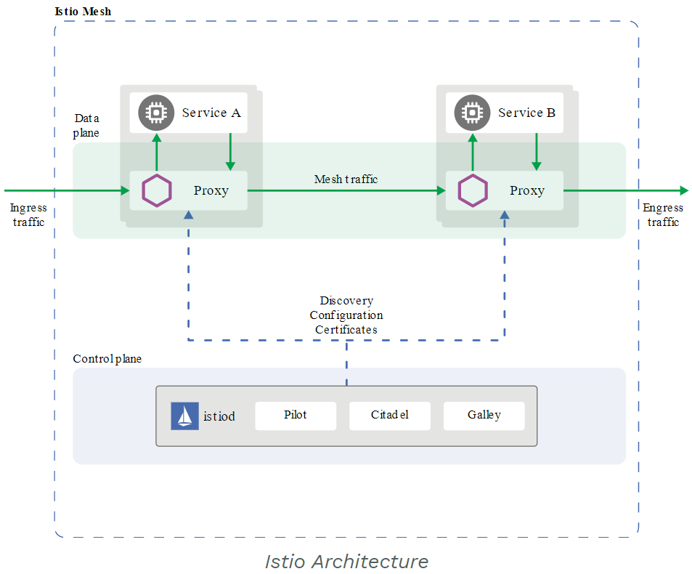
Istio – Service Mesh tool ( Architecture and components)
Different components os Istio Mesh
Ref. https://istio.io/docs/ops/deployment/architecture/

Slide 22
Istio - Service Mesh tool – (Architecture)
An Istio service mesh is logically split into a data plane and a control plane.
Data Plane
Set of intelligent proxies (Envoy) deployed as sidecars.
Collect and report telemetry on all mesh traffic.
Control Plane
Manages and configures the proxies to route traffic.
Components
Envoy
Pilot
Citadel
Galley
Ref. https://istio.io/docs/ops/deployment/architecture/

Slide 23
Istio - Components
Istio Components
Envoy
Istio uses an extended version of the Envoy proxy.
mediate all inbound and outbound traffic for all services in the service mesh
Envoy proxies are the only Istio components that interact with data plane traffic.
(Collect and report telemetry on all mesh traffic.)
It has built-in many features, for example:
Dynamic service discovery
Load balancing
TLS termination
HTTP/2 and gRPC proxies
Circuit breakers
Health checks
Staged rollouts with %-based traffic split
Fault injection
Rich metrics
Ref. https://istio.io/docs/ops/deployment/architecture/

Slide 24
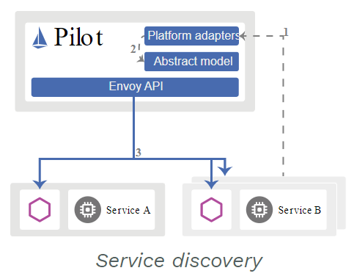
Istio - Components
Istio Components
Pilot
Pilot provides service discovery for the Envoy sidecars,
traffic management capabilities for intelligent routing
(e.g., canary rollouts, etc.), and resiliency (timeouts, retries, circuit breakers, etc.).
Ref. https://istio.io/docs/ops/deployment/architecture/

Slide 25
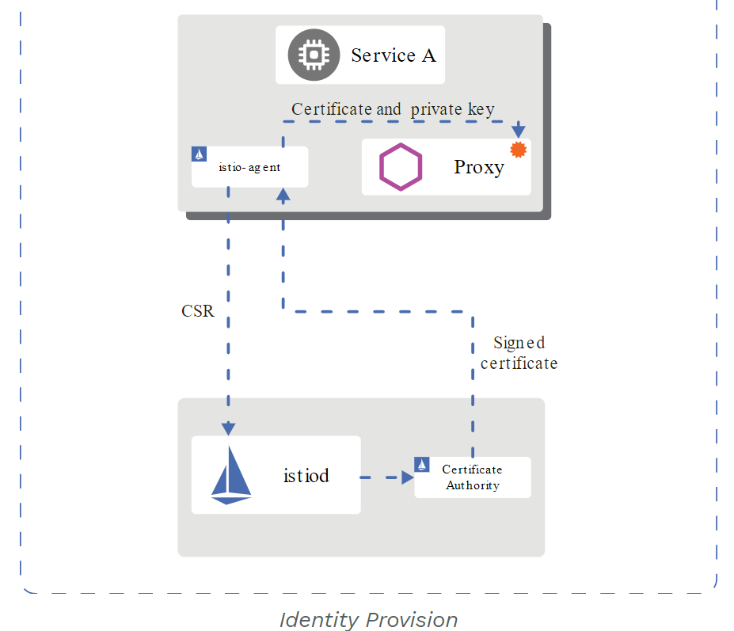
Istio - Components
Istio Components
Citadel
Citadel enables strong service-to-service and end-user authentication with built-in identity and credential management.
Mutual TLS authentication
Istio tunnels service-to-service communication through the client- and server-side PEPs, which are implemented as Envoy proxies.
Ref. - https://istio.io/docs/concepts/security/
Ref. https://istio.io/docs/ops/deployment/architecture/

Slide 26
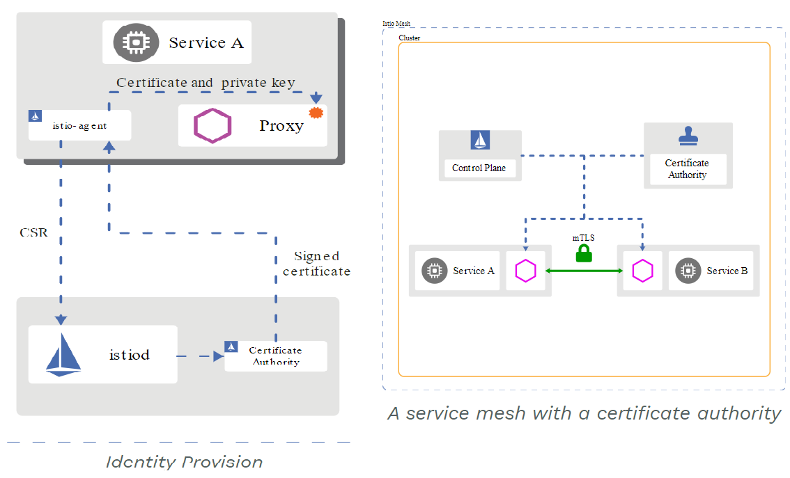
Istio - Components
Istio Components
Citadel
Ref. https://istio.io/docs/concepts/security/ , https://istio.io/docs/ops/deployment/deployment-models/

Slide 27
Istio - Components
Istio Components
Galley
Galley is Istio’s configuration validation, ingestion, processing and distribution component.
It is responsible for,
obtaining user configuration from the underlying platform (e.g. Kubernetes).
Ref. https://istio.io/docs/ops/deployment/architecture/

Slide 28
Istio - Deployment Models
Istio - Deployment Models
When configuring a production deployment of Istio, following questions, among others, represent independent dimensions of configuration.
single or multiple cluster
single or multiple network
single or multiple control plane
single or multiple mesh
Ref. https://istio.io/docs/ops/deployment/deployment-models/

Slide 29
Microservices deployment / Orchestration
Kubernetes
Deployment platform
DNS based service discovery
Simple L3/4 load balancing
Not so adequate for service-to-service communication

Slide 30
Microservices deal
Why Kubernetes not sufficient for servies?
Services have to deal with
Client Side Load Balancing
Fault tolerance – Timeouts and Retries
Observability
Monitoring & Tracing
Circuit Breaking

Slide 31
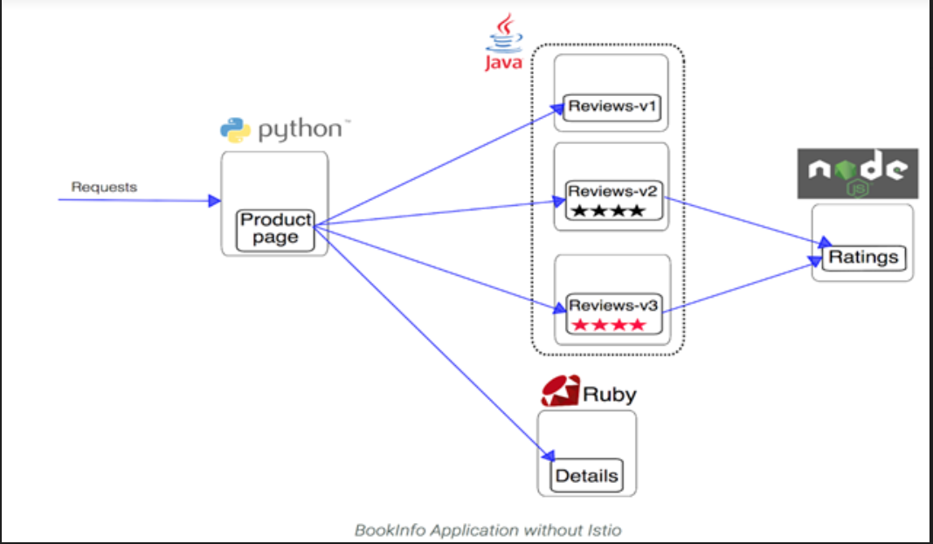
Demo App (Provided by Istio)
Demo App – Deployed on Kubernetes with Istio (Single Cluster)

Slide 32
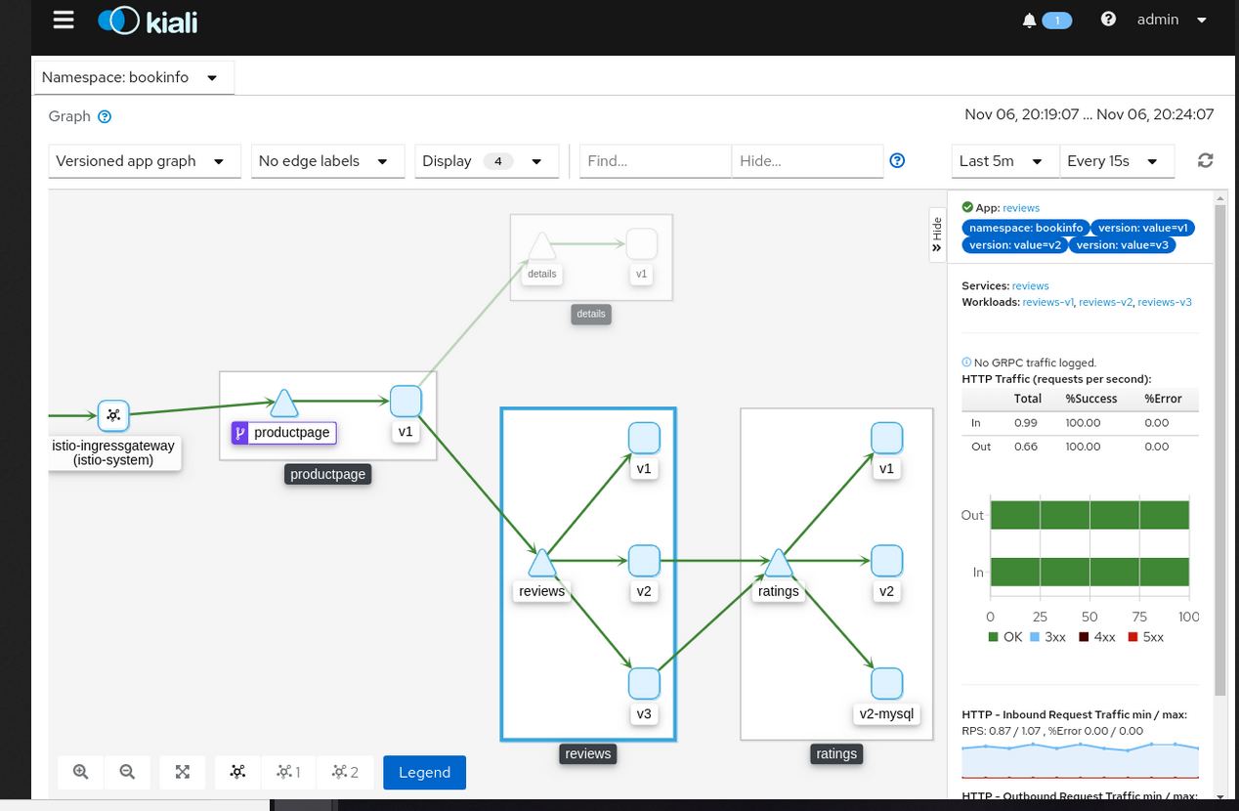
Istio – Tool Kiali (Visualizing Your Mesh)
Kiali

Slide 33
Istio - Demo
Demo

Slide 34
Questions / Comments / Suggestions?
Thank You!
Questions ? Comments / Suggestions ?

