Slide 1
HACKHERE HACKATHON PITCH DECK
QUANTUM
Quantitative Multi-Asset Financial Intelligence & Backtesting Platform
An institutional-grade ecosystem unifying Multi-Asset Financial Data Engineering, Vectorized Indicators, Cross-Asset Correlation, Realistic Zero Look-Ahead Backtesting, and AI Research Copilots.
💎 Gold (GC=F) • ₿ Bitcoin (BTC-USD) • ⚡ NVIDIA (NVDA) • 📈 S&P 500 (SPY) • 🤖 Featherless AI (Mistral-7B) & XGBoost

Slide 2
SYSTEM ARCHITECTURE & PIPELINE
End-to-End Quantitative & Execution Workflow
STEP 1
Data Ingestion
Collects live market data (yfinance) for Gold, BTC, NVDA, SPY with local caching & deterministic fallback for 100% demo resilience.
STEP 2
Factor Engine
Vectorized computation of SMA (20/50/200), EMA (12/26), daily returns, rolling volatility, Sharpe, and maximum drawdown.
STEP 3
Correlation & Regimes
Generates Pearson/Spearman matrix, dynamic rolling pair correlation, and Bull/Bear & High/Low Volatility regime classification.
STEP 4
Discrete Backtester
Simulates discrete trade executions with capital tracking, position sizing, fees (0-50 bps), and strict 1-bar delay (zero lookahead bias).
STEP 5
AI & Risk Audit
XGBoost directional forecasting, GMM regime clustering, 500-path Monte Carlo bootstrap, and Featherless AI Copilot synthesis.

Slide 3
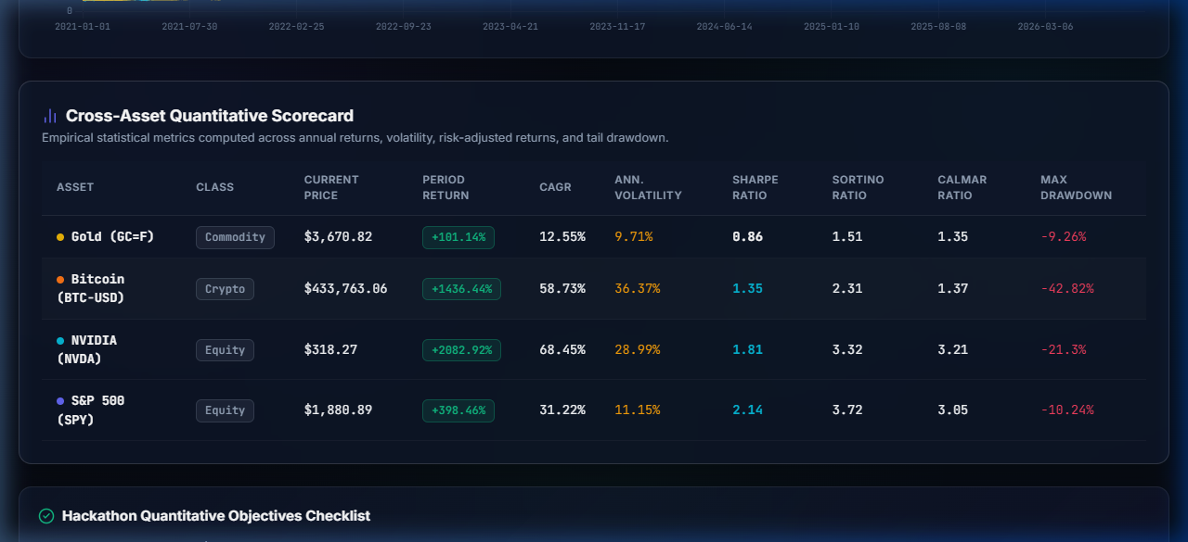
EVALUATION FOCUS 1
Multi-Asset Market Data Processing & Normalization
Core Capabilities & Normalization
• Universal Asset Classes: Commodities (Gold GC=F), Cryptocurrencies (Bitcoin BTC-USD), and Equities (NVIDIA NVDA & S&P 500 SPY).
• Normalized Trajectory (Base = 100): Indexes all assets to 100 on day 0, allowing direct visual comparison across radically different price ranges.
• Interactive Asset Cards: Instant display of Current Price, Period Return, Annualized Sharpe Ratio, and Maximum Drawdown.
• One-Click 'Analyze' Action: Clicking any asset card automatically cascades that asset across the entire platform.
• Dynamic Header Ticker: Top ticker updates in real time with price, Sharpe, and volatility.
📸 LIVE APP VISUAL: EXECUTIVE OVERVIEW & NORMALIZED CHART

Slide 4
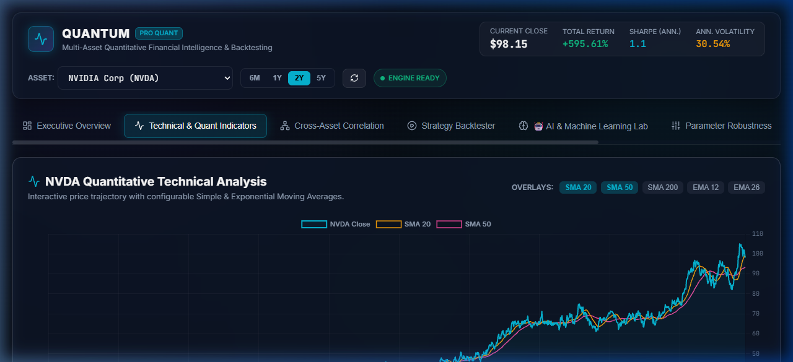
EVALUATION FOCUS 2
Quantitative Technical Indicator Engine
Mathematical Formulations
• Trend Overlays: Interactive toggles for Simple Moving Averages (SMA 20, 50, 200) and Exponential Moving Averages (EMA 12, 26).
• Sharpe Ratio: Excess annualized return over 4% risk-free hurdle divided by annualized volatility: (μ - rf) / σ * sqrt(252).
• Sortino & Calmar: Downside risk penalty and CAGR relative to maximum drawdown.
• 30-Day Rolling Analytics: Continuous rolling Sharpe ratio and rolling volatility.
• Continuous Underwater Drawdown: Peak-to-trough equity drop series tracking capital preservation.
📸 LIVE APP VISUAL: TECHNICAL INDICATORS & MOVING AVERAGES (NVDA)

Slide 5
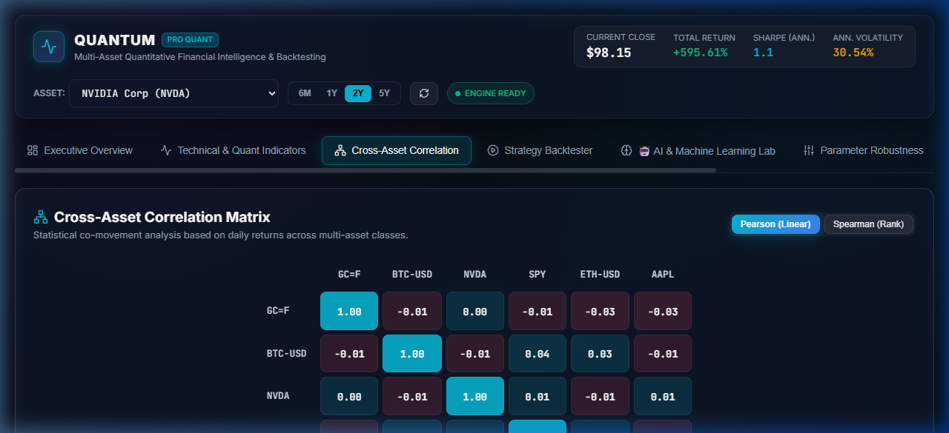
EVALUATION FOCUS 3
Cross-Asset Correlation Analysis & Decoupling
Heatmap & Rolling Correlation
• Cross-Asset Heatmap Matrix: Color-coded from deep rose (-1.0) to bright cyan (+1.0) across Gold, Bitcoin, NVIDIA, and SPY.
• Methodology Switcher: Instant one-click toggle between Pearson (Linear) and Spearman (Rank) correlation.
• Interactive Cell Linking: Clicking any matrix cell immediately loads that specific asset pair in the rolling correlation explorer below!
• Dynamic Rolling Correlation: Customizable rolling windows (15, 30, 60, 90 days) with zero-baseline reference to detect safe-haven decoupling.
• Automated Decoupling Insights: Highlights portfolio diversification benefits in real time.
📸 LIVE APP VISUAL: INTERACTIVE CORRELATION MATRIX & HEATMAP

Slide 6
REALISTIC EXECUTION ARCHITECTURE
Strategy Backtesting Simulation Workflow
STEP 1
Signal Generation
Signal computed strictly at bar close t across SMA Crossover, EMA Trend, Momentum ROC, Mean Reversion, or ML Alpha.
STEP 2
1-Bar Delay Execution
Trade executes on bar t+1. Strict 1-bar execution delay completely eliminates Look-Ahead Bias common in open-source backtesters.
STEP 3
Fee & Friction Deductions
Applies slippage and broker commissions (0 to 50 bps slider) to both entry and exit. Tracks cash, shares, and portfolio value.
STEP 4
Benchmark Attribution
Compares strategy equity head-to-head against Buy-and-Hold benchmark for Return, CAGR, Sharpe, Drawdown, Alpha, and Beta.

Slide 7
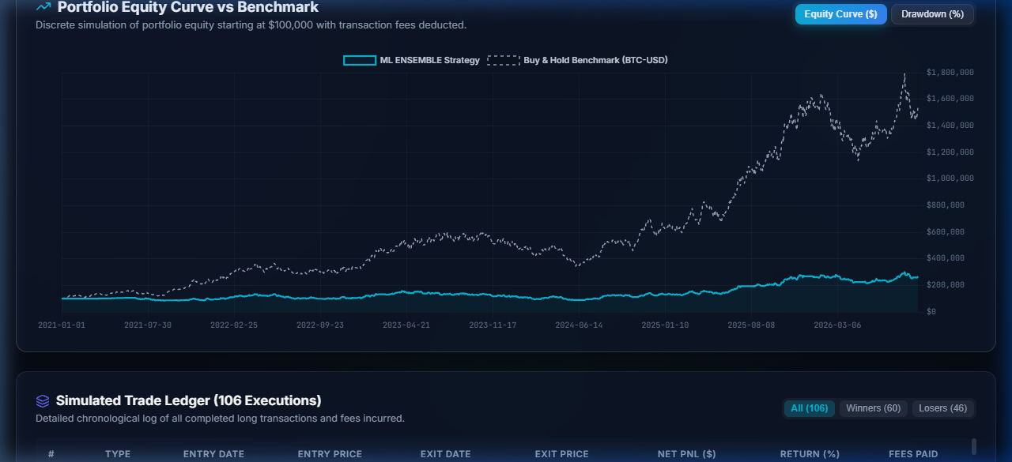
EVALUATION FOCUS 4
Strategy Backtest Dashboard & Trade Ledger
Interactive Dashboard & Ledger
• 5 Supported Strategies: SMA Crossover, EMA Trend, Momentum Breakout, Bollinger Mean Reversion, and AI/ML Predictive Alpha.
• Comparative Scorecard: Total Return %, CAGR %, Sharpe, Max Drawdown %, Alpha (α %), Market Beta (β), Win Rate %, and Profit Factor.
• Interactive Chart Views: One-click toggle between Portfolio Equity Curve ($) and Underwater Drawdown (%) vs. Benchmark.
• Simulated Trade Ledger: Full chronological ledger with Trade ID, Type (Long), Entry/Exit Dates, Prices, Net PnL ($), and Fees.
• Filterable Ledger: Instant filter by All, Winners, and Losers.
📸 LIVE APP VISUAL: BACKTEST EQUITY CURVE VS. BENCHMARK

Slide 8
FUTURE SCOPE: ML ARCHITECTURE
AI & Machine Learning Alpha Pipeline
STEP 1
Feature Engineering
Extracts MACD Diff, RSI 14, Distance to SMA 20/50, Bollinger %B, Volatility 15d, and Momentum ROC 5d/10d.
STEP 2
Walk-Forward Split
80/20 chronological train/test split. Prevents data leakage and simulates true out-of-sample forward trading.
STEP 3
Ensemble Classifier
Trains XGBoost Classifier + Random Forest. Computes directional probabilities: P(Bullish) vs P(Bearish).
STEP 4
Explainable AI (XAI)
Generates dynamic Feature Importance ranking showing which technical factors drive the AI's predictions.
STEP 5
Unsupervised Regimes
Gaussian Mixture Models (GMM) cluster market history into Expansion, High-Vol Shock, and Neutral states.

Slide 9
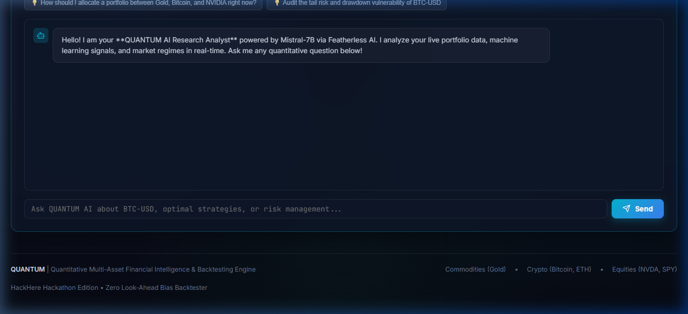
FUTURE SCOPE: AI IMPLEMENTATION
AI Lab & Featherless AI Research Copilot
Live AI Capabilities
• Supervised ML Directional Forecast: Real-time Next-Period Signal (BULLISH/BEARISH), Model Confidence %, and Test Accuracy.
• Explainable AI (XAI): Horizontal bar chart ranking feature importance (MACD Diff, RSI 14, Dist SMA 50).
• Unsupervised GMM Regime Clustering: Discovers latent market regimes without arbitrary heuristics.
• Featherless AI Quant Copilot: Live Mistral-7B research assistant powered by Featherless AI using the user's API key.
• Context-Aware Prompting: Copilot automatically receives real-time asset price, Sharpe ratio, volatility, and ML signals.
📸 LIVE APP VISUAL: AI DIRECTIONAL FORECAST & XAI FEATURE RANKING

Slide 10
SUMMARY & DEMONSTRATION
Advanced Risk Modeling & Conclusion
Risk Modeling (Monte Carlo & VaR)
• 500-Path Monte Carlo Bootstrap: Forward simulation across 126, 252, and 504 trading days with 5th to 95th percentile confidence cones.
• Value-at-Risk (VaR): Parametric (Normal) and Historical Empirical VaR at 95% and 99% confidence intervals.
• Expected Shortfall (CVaR): Quantifies average tail loss severity beyond VaR.
• Automated Research Audit Report: Synthesizes institutional rating grades (A to D) with one-click JSON export.
Conclusion & Live Demonstration
• 100% HackHere Compliance: Solves all telemetry, data engineering, backtesting, and future scope criteria.
• Zero Look-Ahead Bias: Mathematically sound discrete simulation.
• Zero Internet Dependency: Local disk caching and deterministic fallback ensures 100% presentation uptime.
• Live Dashboard: http://localhost:5173
• FastAPI Swagger Docs: http://localhost:8000/docs
• Launcher: start.ps1 / run.bat

