Slide 1
Hospital Bed Turnaround Viz Project

Slide 2
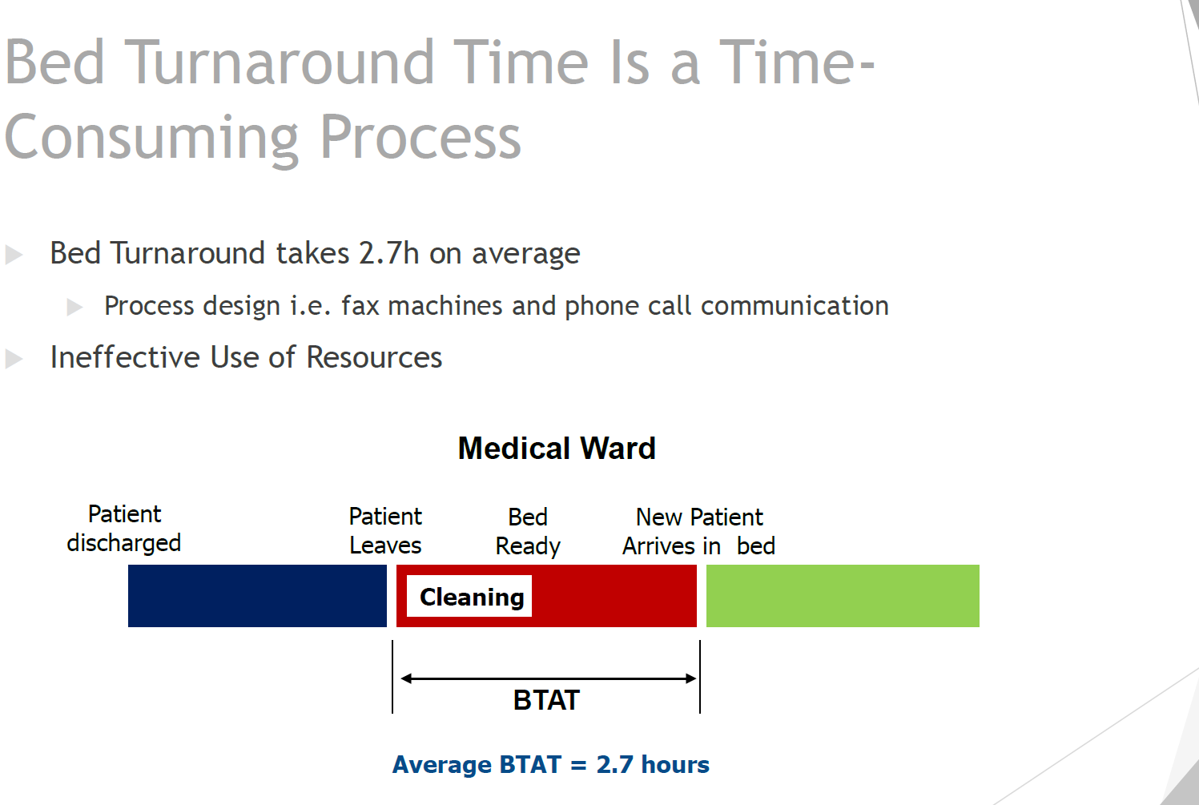

Slide 3
Bed Management Dashboardb
Coordinator View
Cleaner View
Porter View

Slide 4
Bed Management Dashboard
Coordinator View
Cleaner View
Porter View

Slide 5
Bed Management Dashboardbbb
Coordinator View
Cleaner View
Porter View

Slide 6
Bed Management Dashboardb
Coordinator View
Cleaner View
Porter View

