Slide 2
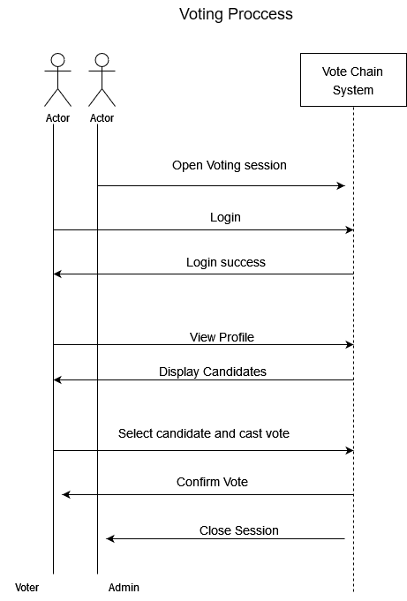

Slide 3
What is Web3
Web 3.0 enables a future where distributed users and machines can interact with data, value and other counterparties via a substrate of peer-to-peer networks without the need for third parties. The result: a composable human-centric & privacy preserving computing fabric for the next wave of the web. Web 3.0 is built largely on three new layers of technological innovation: edge computing, decentralized data networks and artificial intelligence.

Slide 4
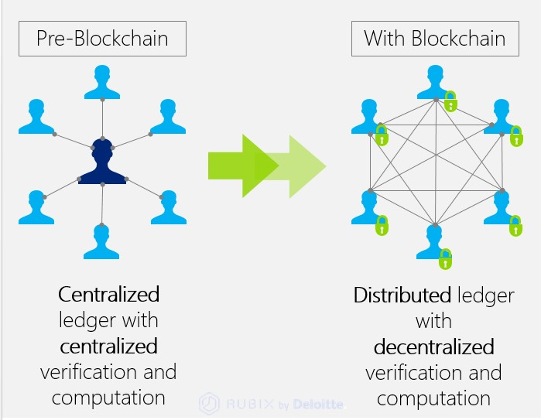

Slide 5
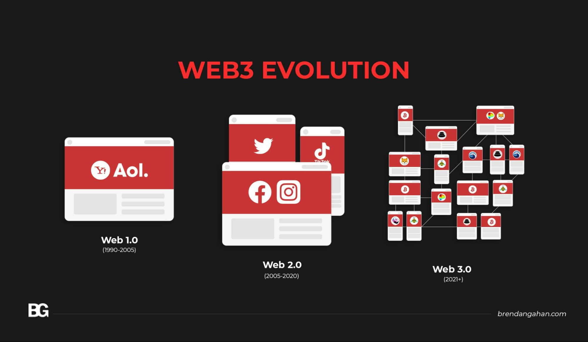

Slide 6
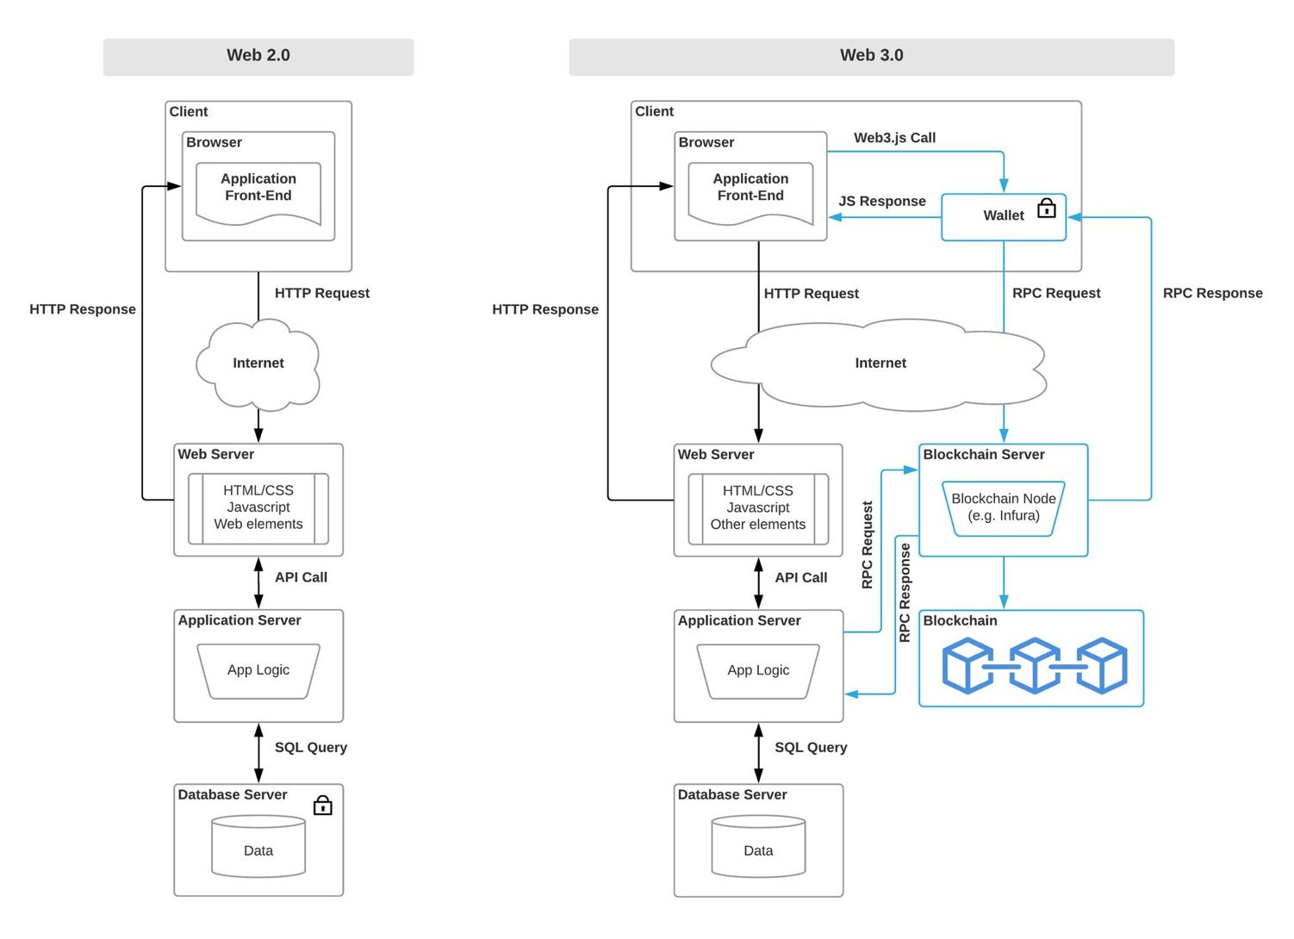

Slide 7
Advantages of Web 3.0
Advantages -
In terms of data security, end-users will benefit the most from data encryption.
Due to decentralized data storage, users will be able to access data in any situation. Users will receive multiple backups that will aid them if the server crashes.
Most blockchain systems are developed by non-profits, which provides an open-source blockchain platform that allows for collaborative design and development.
The data will be provided from any location and on any device.
Web 3.0 is useful for problem-solving and heavy knowledge-generation tasks.

Slide 8
What is a Blockchain?
A blockchain is essentially a distributed database of records or public ledger of all transactions or digital events that have been executed and shared among participating parties. Each transaction in the public ledger is verified by consensus of a majority of the participants in the system. And, once entered, information can never be erased. The blockchain contains a certain and verifiable record of every single transaction ever made. Bitcoin, the decentralized peer­ to­ peer digital currency, is the most popular example that uses blockchain technology. The digital currency bitcoin itself is highly controversial but the underlying blockchain technology has worked flawlessly and found wide range of applications in both financial and non­financial world.
The major advantages of this service is security and privacy that allows a user to give decentralized proof of the document that can’t be modified by a third party. The existence of the document is validated using blockchain that does not depend on a single centralized entity.

Slide 9
What Is Smart Contracts
Smart contracts are simply programs stored on a blockchain that run when predetermined conditions are met.
They typically are used to automate the execution of an agreement so that all participants can be immediately certain of the outcome, without any intermediary’s involvement or time loss.
They can also automate a workflow, triggering the next action when conditions are met.
Smart contracts are self-executing lines of code with the terms of an agreement between buyer and seller automatically verified and executed via a computer network.

Slide 10
What is RPC Node ?
A Remote Procedure Call or RPC node is a type of computer server that allows users to read data on the blockchain and send transactions to different networks.
Nodes or Web3 providers are needed to get the data from the blockchain; nodes run a copy of the blockchain. Nodes are an essential part of the web3 developer stack as without nodes, a web3 library cannot interact with smart contracts. They're like the gateway to the blockchain realm.

Slide 11
What is Meta Mask ?
MetaMask is a software cryptocurrency wallet used to interact with the Ethereum blockchain. It allows users to access their Ethereum wallet through a browser extension or mobile app, which can then be used to interact with decentralized applications.

Slide 12
Our Conclusion
We can leverage Block chain as a technology to bring trust and verifiability which Directly/indirectly answers most of the Web 2.0 problems.

