Slide 1
Guided Capstone
Big Mountain Resort Pricing

Slide 2
Problem Identification
Identify the optimal range for the ticket price which is aligned with pricing of other resorts.
Identify measures to reduce the costs on running the resort.

Slide 3
Recommendation and Key findings
The current weekend ticket price is $81. Our recommendation is to increase the price to $94
Increase the vertical drop by 150 feet lower down by adding a run and install additional chair lift here.
Close runs that are least used. It reduces support for ticket price and revenue.

Slide 4
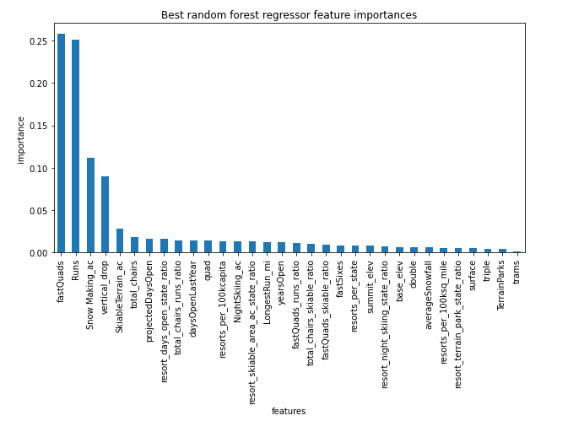
Modelling results and analysis
The predicted values is expected to be as close as $9 to real values in our test set.
The resort does not depend on which state it belong to
The main features that support the ticket prices are Vertical drop, snow making area, total number of chairs, fast squads, Runs and longest run.

Slide 5
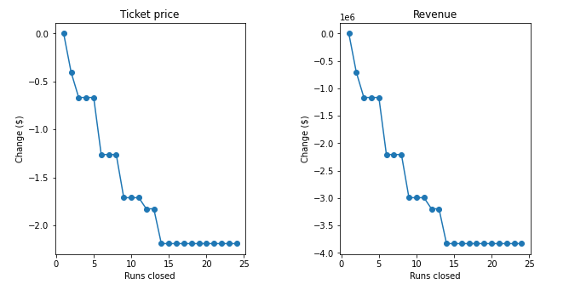
Prediction of ticket price and revenue if 350,000 visitors purchase 5 day ski ticket.
Suggest closing runs 5 or 8 or 11 that is least used.

Slide 6
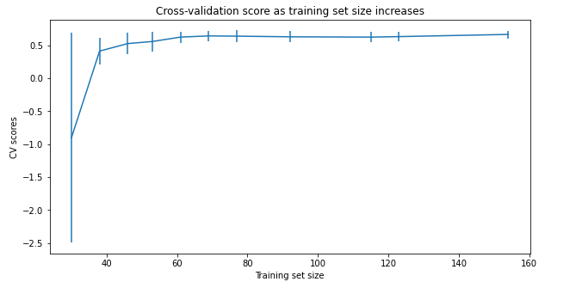
Training set of 40-50 is good enough for this model for future updates.

