Slide 1
Bank Customer card Churn Prediction and Analysis
Padma Parameshwaran

Slide 2

The Problem
Bank is concerned about more customers leaving their bank.
Customer leaving bank:
16.07 %
Finding who might churn will give the bank to attract them with additional incentives.
Can we Predict which customer is going to churn next?
What factors affect customer churn?

Slide 3
Data Information
Details : Bank customers who own the credit card.
Number of Records: 10127
Number of attributes:23
Sample Attributes : Client number, Attrition Flag, Customer Age, Gender, Dependent count, Education Level, Marital Status, Income Category,…
Acquired from: https://www.kaggle.com/sakshigoyal7/credit-card-customers

Slide 4
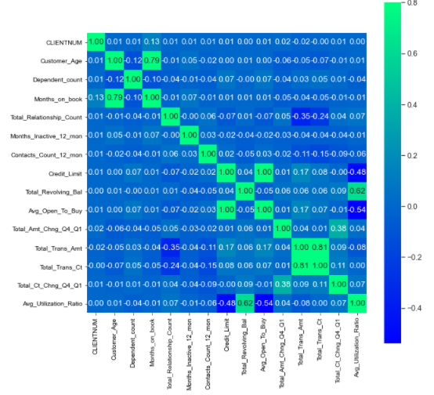
Correlation of attributes

Slide 5
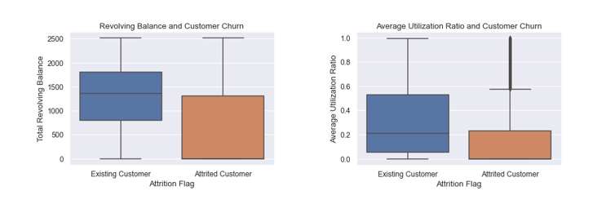
Key Findings
Revolving Balance and Average Utilization Ratio
Existing customers have at least $500 as their minimum balance and their utilization is also exceptionally low.

Slide 6
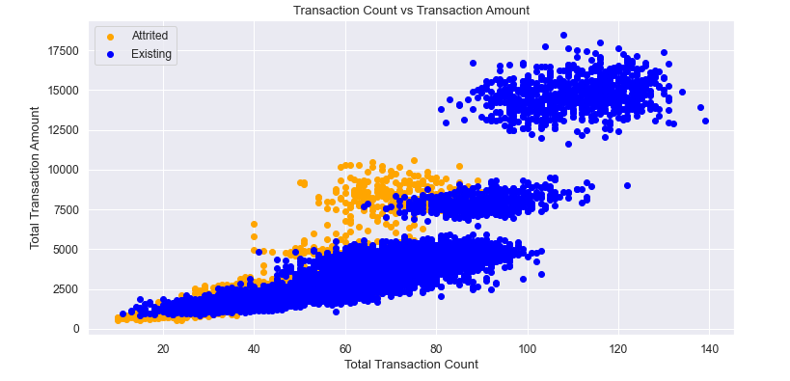
Customer s who left the bank had fewer transaction counts than existing customers.

Slide 7
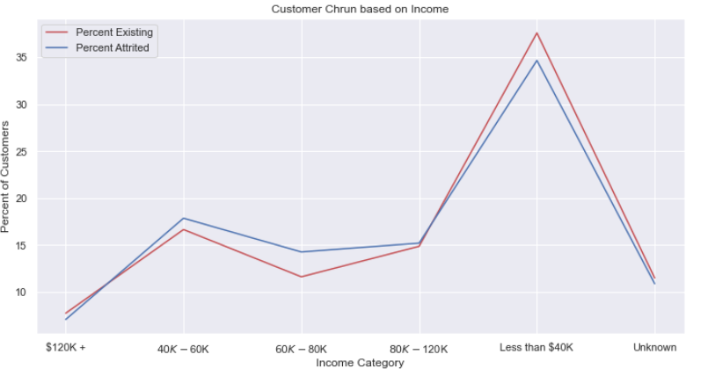
Customers whose income is in the range 40K-80K have higher percentage of staying with bank that other income

Slide 8
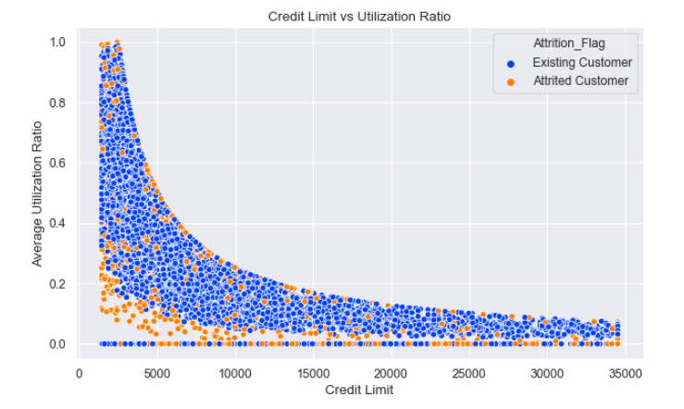
Most of the customers who are churned have lower credit limit and utilization ratio

Slide 9
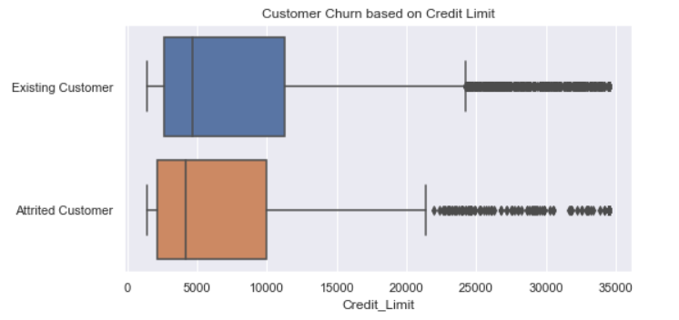
Effect of Credit Limit on churning
Null Hypothesis: Mean of credit limit of churned customers equal to mean of credit limit of existing customers
P-value = 0.016

Slide 10
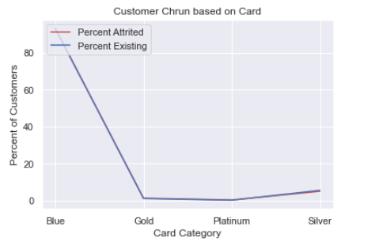
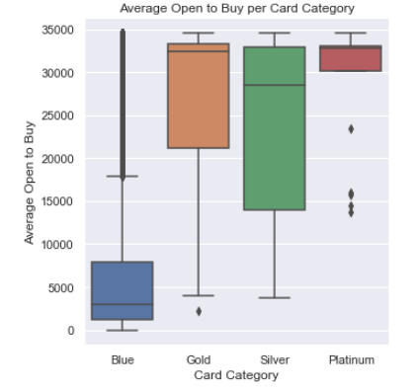
Card Category and Open to Buy
More activity on silver card holders though more customers are blue card holders

Slide 11
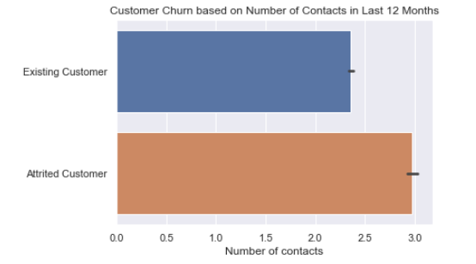
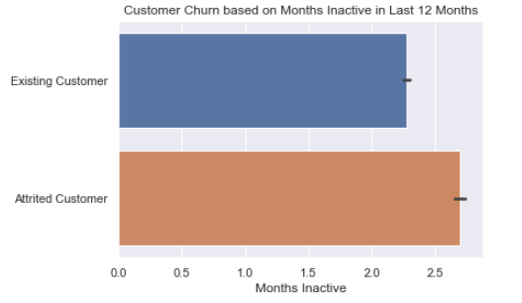
Inactivity and Contacts with the bank
If the number of contacts or Months Inactive exceed 2 the bank must be cautious and look for any churning signal

Slide 12
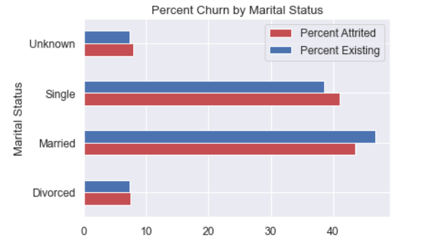
Large percentage of married customers are loyal to the bank.

Slide 13
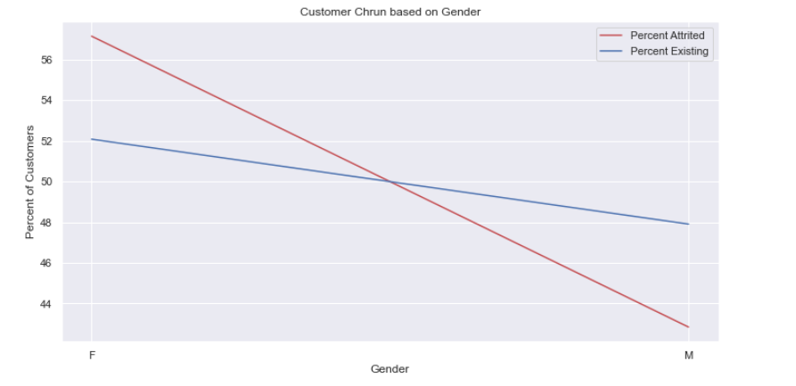

Gender
There is higher percentage of female customers who churn compared to male customers

Slide 14
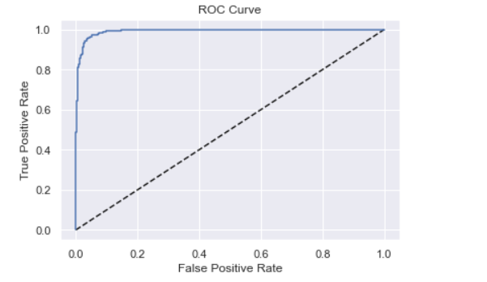
Modelling
Model | Accuracy | Precision | Recall | F1-score
Logistic Regression | 0.89 | 0.81 | 0.48 | 0.60
Random Forest | 0.96 | 0.92 | 0.86 | 0.88
SVM | 0.91 | 0.78 | 0.68 | 0.72
KNN | 0.86 | 0.70 | 0.26 | 0.37
Gradient Boosting | 0.97 | 0.93 | 0.89 | 0.91
Over Sampling with Gradient Boosting | 0.96 | 0.89 | 0.90 | 0.89
Best Model:
Gradient Boosting
The area under the ROC curve is 0.99246

Slide 15
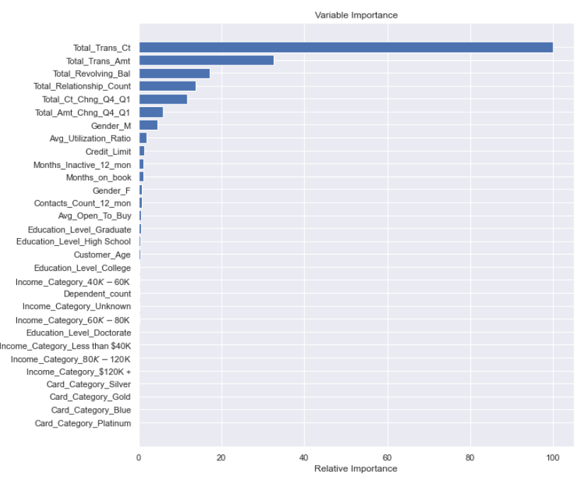
Feature Importance

Slide 16
Recommendations
These are the recommendations to attract new customers of these categories and to retain existing customers
Age of the customer between 45 and 55
Status Married
Income $40K - $80K
Gender Male

Slide 17
Future Improvements
Some outliers and columns can be removed to check if the performance improves further.
This can be combined with additional data of other products that the customers use in the same bank and cluster their behavior for further marketing.

