Slide 1
Docker Fundamentals
DevOps Workshop

Slide 2
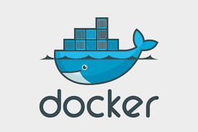
Workshop Objectives
Equip you with essential skills in modern software development using Docker.
Understand frontend and backend development principles, and how Docker simplifies development, deployment, and scaling for both.
Get a grasp of what Docker does and how it works, setting the stage for practical learning.

Slide 3
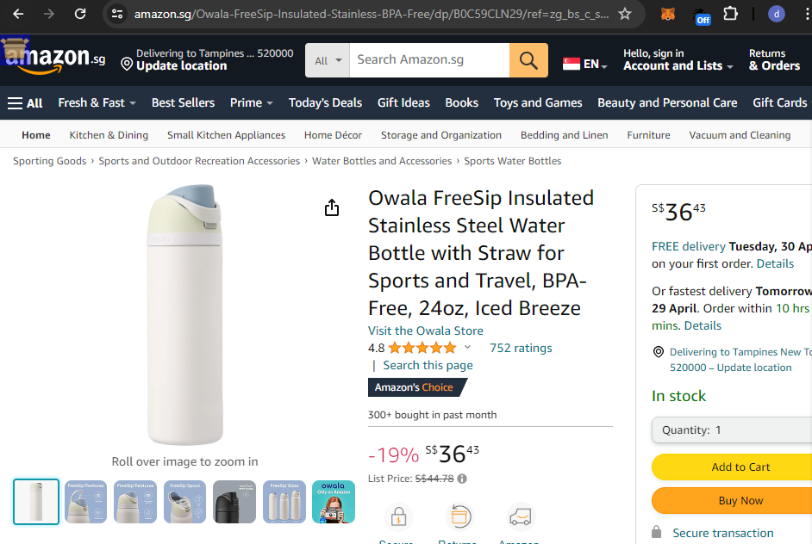
MODERN Software development
Software development has changed to fit today's needs, focusing on flexibility, collaboration and fast delivery.
Front-end Development:
Involves creating the user interface (UI) components of a website or app that users interact with directly.. www.amazon.com.sg
Popular UI Frameworks : React, Angular, and Vue.js
Backend Development:
Focuses on implementing the functionality of a website or application that operates behind the scenes
Tasks includes managing data, handling user authentication, and processing requests from the frontend.
Popular Programming Languages : Python, Java & etc. with frameworks like Django, FlaskAPI, Spring
Popular Databases : MySql, Oracle SQL, MongoDB

Slide 4
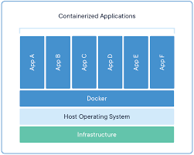
What is docker
Docker is a platform that enables developers to build, ship, and run applications quickly, securely and consistently in any environment
Docker helps eliminate the "it works on my machine" issue by ensuring consistent application performance across different environments.
Think of Docker as a tool that packages our applications into containers, which are lightweight, portable, and self-sufficient units capable of running anywhere.

Slide 5
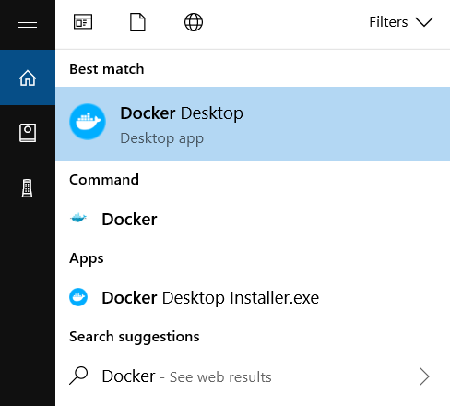
Downloading and Installing docker
Visit the official Docker website (https://www.docker.com/products/docker-desktop) and download Docker Desktop for your operating system (Windows or macOS) install it.
Verify Installation
open a terminal or command prompt and run the command docker --version
Launch Docker Desktop:
After installation, Docker Desktop should be available in your applications or system tray.
Launch Docker Desktop by double-clicking its icon.

Slide 6
Downloading Python in Windows Machine
Python, a popular programming language, can be downloaded and installed directly from the official Python website
https://www.python.org/downloads/
Considerations
Installing and managing different Python versions or package versions may require additional effort and can lead to dependency conflicts.
To avoid conflicts, developers often create virtual environments for each project to isolate dependencies and Python versions.
To run a Python file the command is
python <filename.py>
Ex. python hello.py

Slide 7
HOW TO run a py file demo

Slide 8
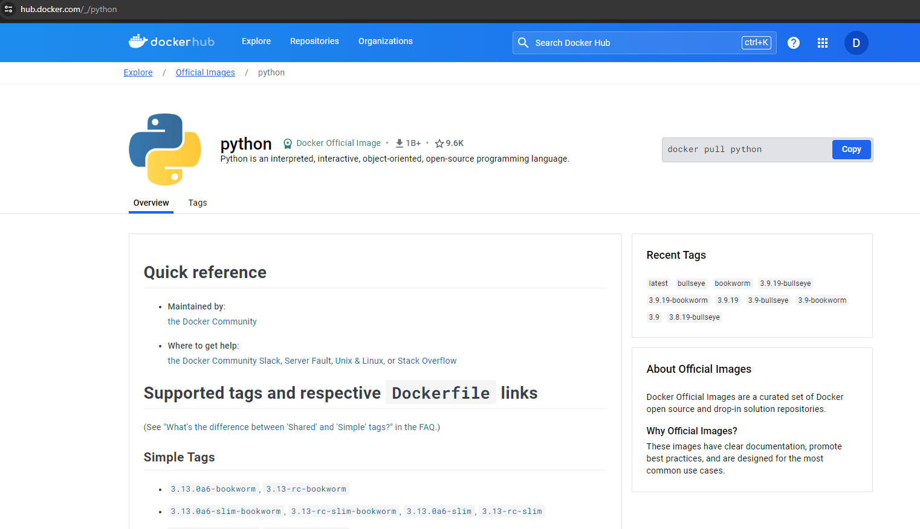
Docker hub /DOCKER IMAGE
Docker Hub is a cloud-based repository where Docker users can find, share, and collaborate on container images.
Docker simplifies the software installation process by providing pre-built images on Docker Hub (https://hub.docker.com/).
We can download python from Dockerhub by running the below command from cmd prompt or terminal
docker pull python

Slide 9
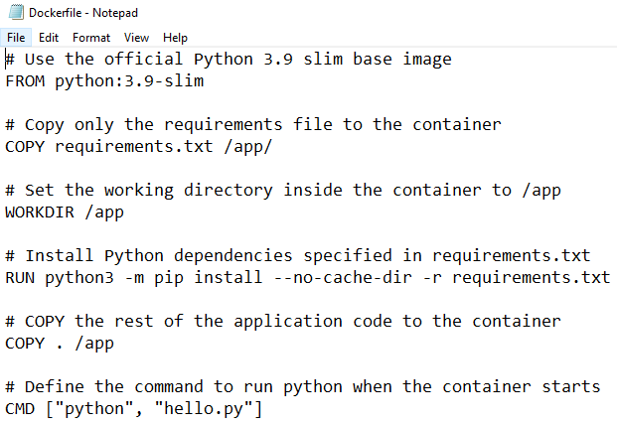
BUILDING DOCKER IMAGE For OUR Python APP
Dockerfile: A text files containing commands for building a Docker image.
Steps to create a Docker Image of Our Python Application:
Create a Dockerfile specifying the base Python image
Specify dependency libraries to install (usually done via a requirements.txt file)
Specify configurations that our application needs to run.
Run the Dockerfile from cmd prompt
Syntax: docker build -t <image_name> <path_to_Dockerfile>
Ex. docker build -t my_app .

Slide 10
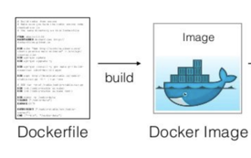
BUILDING DOCKER IMAGE For OUR Python APP
When you Run Dockerfile from cmd prompt using ‘docker build’ command, Docker starts the process of creating a docker image (containerizing your application)
Docker automatically fetches the specified Python base image from Docker Hub for our application.
Docker ensures that dependencies listed in the Dockerfile are installed within the container during the build process to avoid dependency conflict
Docker image:
contains everything your application needs to run smoothly—its code, dependencies, and configurations.
For ex. It's like a digital suitcase for your app. It holds all the important stuff your app needs to work, ( its code, tools it relies on, and how it's set up).

Slide 11
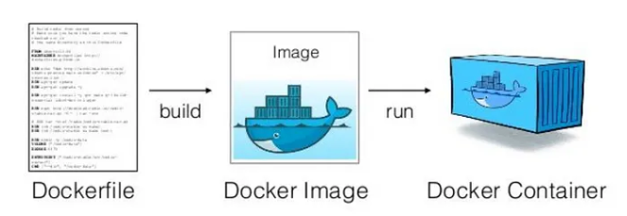
Docker Container
Docker containers are created from Docker images using the ‘docker run’ command.
Syntax: docker run <image_name>
Ex. docker run my_app
Imagine a shipping container:
it contains all the goods needed for transport,
isolated from the external environment
easily transported from one location to another without affecting its contents.
Similarly, Docker Containers are
a method to package software applications along with their dependencies and configurations into isolated environments,
enabling them to run consistently across different computing environments.
Ex. Think of them as virtual rooms for your apps. It's like giving each app its own little space to do its thing, without bothering the others.

Slide 12
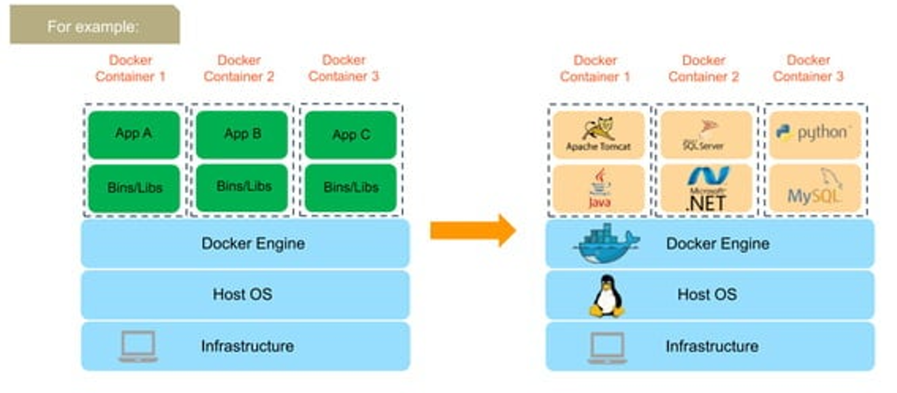
Docker Container

Slide 13
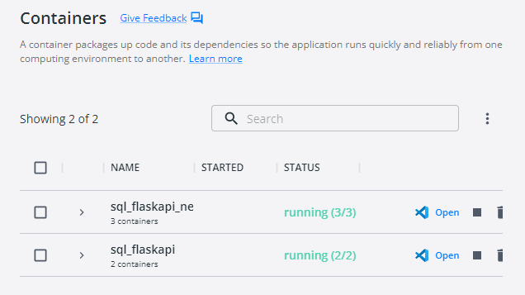
Docker Container management
Monitoring :
Containers can be monitored using the ‘docker ps’ command from cmd line.
Starting and Stopping:
Containers can be started, stopped, paused, and resumed using Docker commands (docker start, docker stop, docker pause, docker unpause).
Removal:
Containers can be removed using the ‘docker rm’ command.
Alternatively, all these can be done from docker desktop via UI

Slide 14
Docker Commands SEEN So FAR
To build docker image from dockerfile
docker build -t <image_name> <path_to_Dockerfile>
To create container from an image
docker run <image_name>
To check container status or container id:
docker ps
To start container : docker start <container_id>
To stop container: docker stop <container_id>
To delete a container : docker rm <container_id>

Slide 15
Basic Python App DEMO

Slide 16
Docker ARCHITECTURE
Docker Engine: Think of this as the heart of Docker.
It's the overall software responsible for building, running, and managing containers on your system.
When you interact with Docker through commands, you're essentially interacting with Docker Engine.
Docker Daemon: This is like the caretaker of Docker.
It runs in the background on your system and manages Docker objects, such as images, containers, networks, and volumes.
It's responsible for handling requests from the Docker Client and takes care of all the heavy lifting involved in managing containers.

Slide 17
Docker ARCHITECTURE
Docker Desktop includes both the Docker Daemon and the Docker Engine
Docker Client: This is your gateway to Docker
It's a command-line tool or API that you use to interact with the Docker Engine
requests passed to Docker Engine by Docker Client, such as 'docker run' or 'docker build', are handled by Docker Daemon
Docker demon which runs in the background and manages the actual execution and management of containers

Slide 18
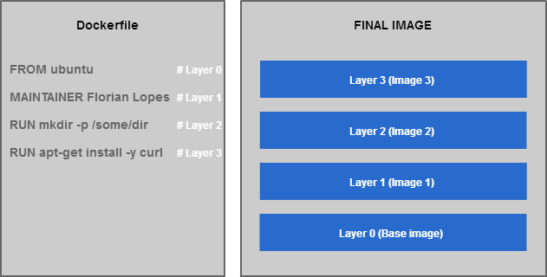
HOW DOCKER IMAGE IS BUILT FROM DOCKERFILE

Slide 19
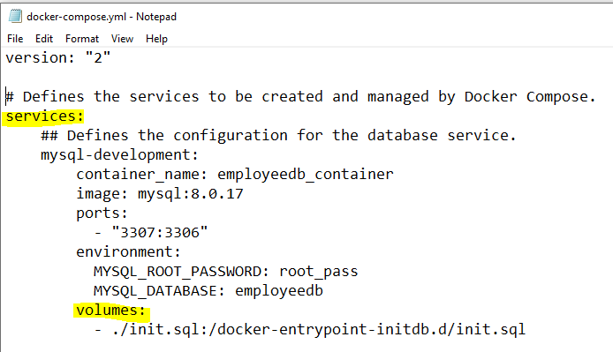
Docker COMPOSE
Docker Compose is a tool to deploy multiple containers at the same time with a single command.
It uses a YAML file (docker-compose.yml) to configure the application's services, networks, and volumes.
Advantages
Defines the entire application environment in a single file, making it easy to share and reproduce.
Automates the process of starting, stopping, and scaling multiple containers with a single command.

Slide 20
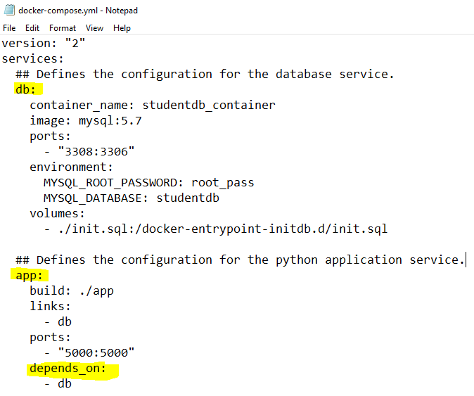
Why Docker COMPOSE
Coordinates the creation and management of multiple containers, ensuring they communicate with each other as defined in the configuration.
Automatically resolves dependencies between services, ensuring they start in the correct order.
Ex. Check depends-on keyword
Commands of docker compose
To start : docker-compose up –d
To stops : docker-compose down

Slide 21
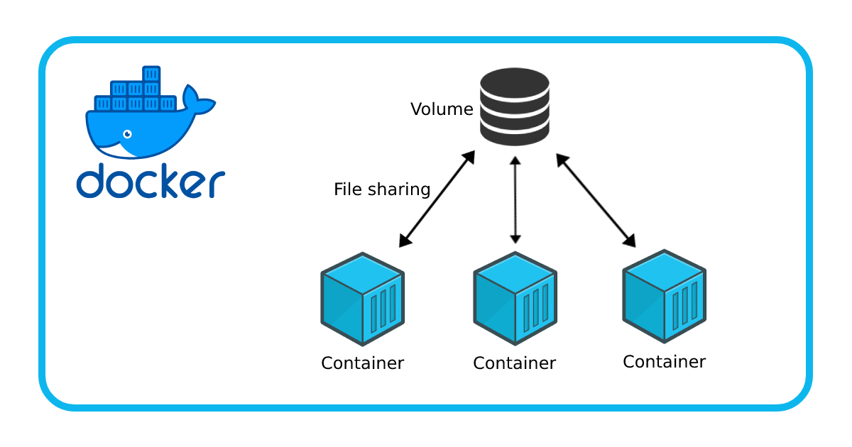
Docker Volume
To persist data generated by containers or share data between containers and the host machine.
Ex. Named Volumes, Bind Mounts
Advantages of using Docker Volume
data persists even if the container is stopped or removed.
easy backup and restore of data, allowing for disaster recovery and data migration.

Slide 22
Docker Commands SEEN So FAR
To build docker image from dockerfile
docker build -t <image_name> <path_to_Dockerfile>
To create container from an image
docker run <image_name>
To check container status or container id:
docker ps
To start container : docker start <container_id>
To stop container: docker stop <container_id>
To delete a container : docker rm <container_id>
To start docker compose : docker compose up –d
To stop docker compose : docker compose down

Slide 23
MYSQL SETUP demo

Slide 24
MYSQL_Flask API demo

Slide 25
Best Practices
Single Responsibility Principle: Each container should have a single responsibility.
This means one process per container. Ex. separate your front end, backend webservice, and database into different containers.
Use Official Images:
Use official Docker images from trusted sources like Docker Hub, whenever possible.
Keep Containers Stateless:
Store data and configuration outside the container, preferably in (volumes or external databases)
Optimize Image Size for faster deployment:
After specifying the base image, include requirements.txt and install it as the first step in your Dockerfile. Docker utilizes cache, ensuring efficient caching and faster build times.
Minimize the size of Docker images by removing unnecessary dependencies, which reduces deployment time and resource usage.
Security:
Follow security best practices such as using trusted base images, regularly updating images and dependencies
Documentation:
Maintain clear and up-to-date documentation for your Docker images and containers.

Slide 26
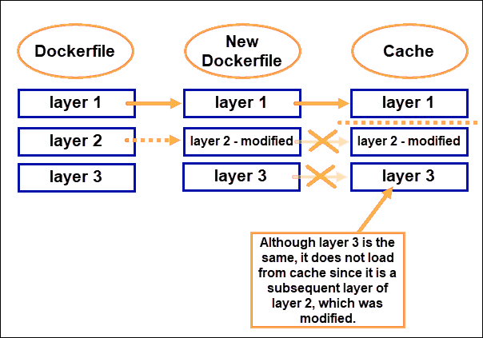
Best Practices

Slide 27
Overview of Docker NEtworks
Docker networking allows containers to communicate with each other, similar to how computers on a network communicate.
Docker network is a virtual network created by Docker to enable communication between Docker containers.
If two containers are running on the same host machine (our computer where Docker is installed and running) within a Docker network, they can communicate with each other without the need for ports to be exposed to the host machine.
Command for managing Docker networks.
Ex: docker network create my-network

Slide 28
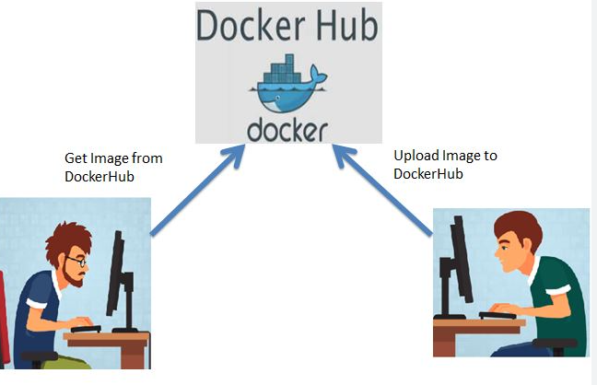
Pushing CUSTOM IMAGE to DockerHUb
Upload your locally built docker image to a central repository for sharing and collaboration among team members.
Steps to push docker image to docker hub
Create a Docker Hub Account and login to docker hub from cmd
Syntax: docker login
Tagging locally built Image: Before pushing, Use the ‘docker tag’ command to assign a tag to image, indicating the username, image name and version.
Syntax: docker tag <image_name> <username>/<image_name>:<version>
Ex. docker tag py_app tan/pyapp:v1
Upload your tagged image to Docker Hub with push command.
Syntax: `docker push <username>/< image_name>:<tag>
Ex: `docker push tan/pyapp:v1

Slide 29
Important Docker Commands
docker pull: Command for pulling an image or repository from a registry like Docker Hub.
Ex : docker pull python:3.9-slim
docker images: Command for listing available images on the local system.
Ex: docker images
docker ps: Command for listing running containers.
Ex: docker ps

Slide 30
Important Docker Commands
docker build: Command for building a Docker image from a Dockerfile.
Ex: docker build -t my-python-app .
docker run: Command for creating and running a container from an image.
Ex: docker run my-python-app
docker-compose: Command for managing multi-container Docker applications using a Docker Compose yml file.
Example: docker-compose up -d

Slide 31
Thank You

