Slide 1
Playlist recommendation system
Content Based Filtering Method

Slide 2
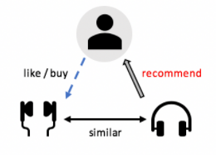
Content based filtering
Content-based methods gives recommendations based on the similarity of two Playlist or attributes.

Slide 3
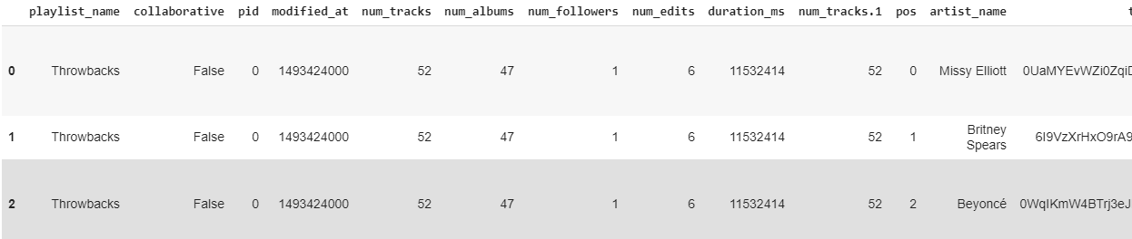
Dataset used
The Million Playlist Dataset (MPD) contains playlists created by users on the Spotify platform.

Slide 4
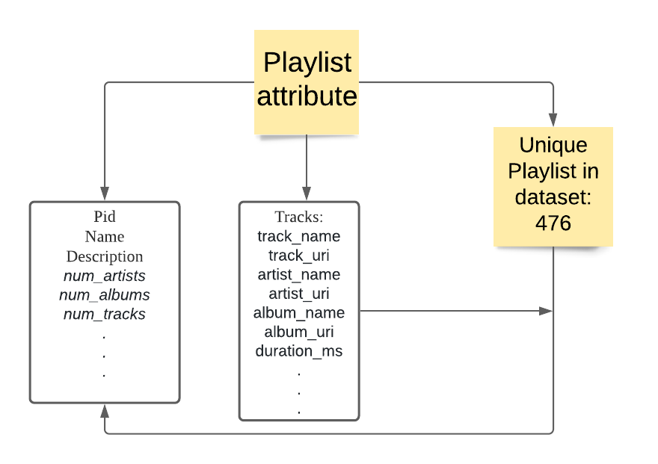
Data Key attribute

Slide 5
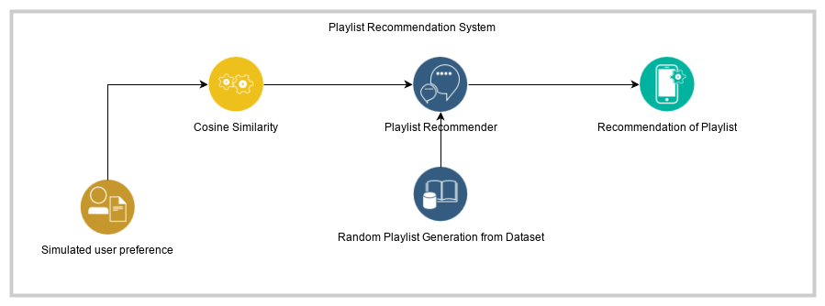
Process Flow

Slide 6
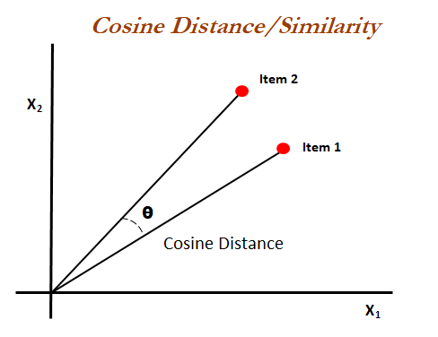
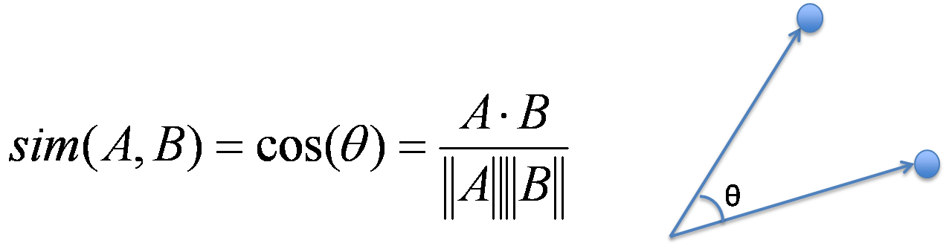
Cosine similarity

Slide 7
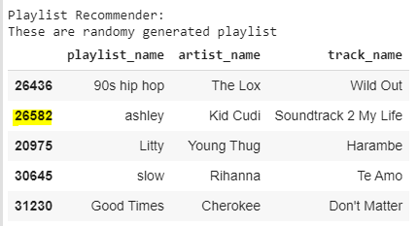
Random generation of playlist

Slide 8
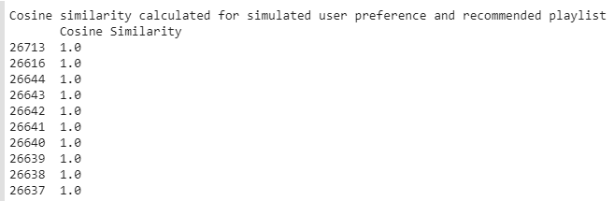
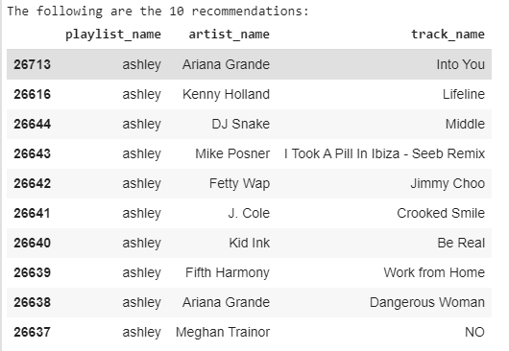
Recommendation of 10 playlist using cosine similarity using user preference

