Slide 1
Split Neural Networks for Time Series Federated Learning
Student: PADMAPRIYA MATHIVANAN
Supervisor: LUX

Slide 2
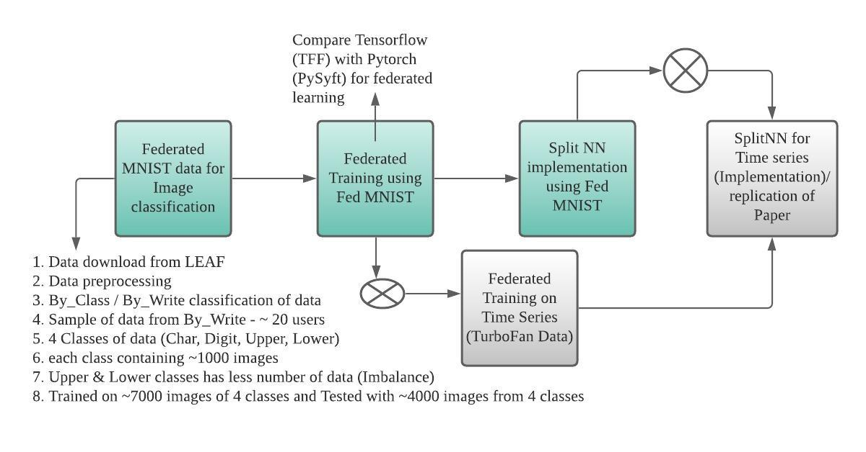
Week 1 Updates - Key steps:

Slide 3
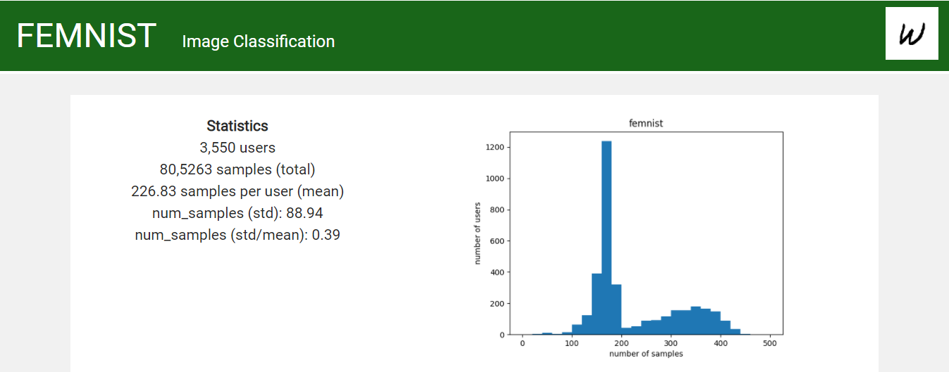

Federated MNIST
Image dataset : Partitioning the data in Extended MNIST based on the writer of the digit/character. LEAF - open-source benchmark for federated settings
Details: 62 different classes (10 digits, 26 lowercase, 26 uppercase), images are 28 by 28 pixels (with option to make them all 128 by 128 pixels), 3500 users

Slide 4
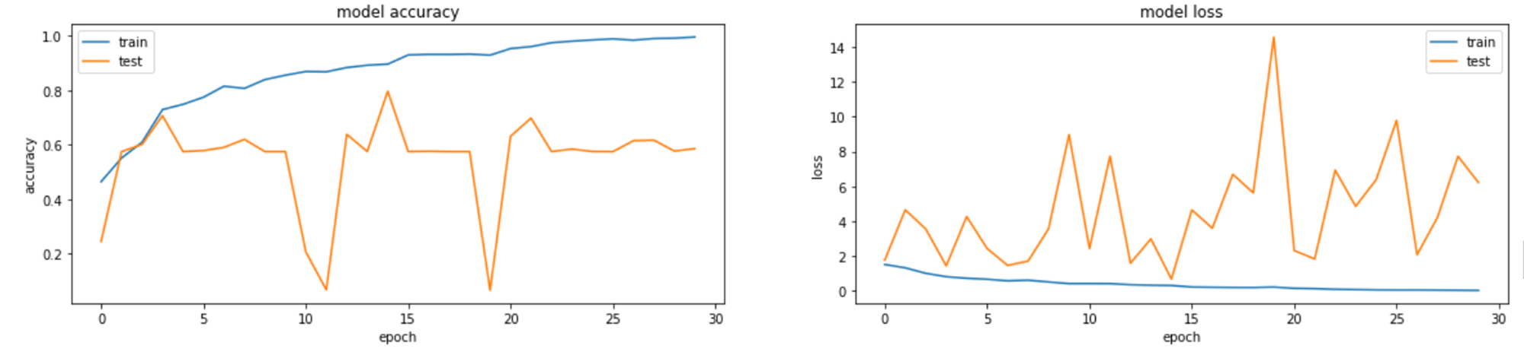
Comparison
Datasets | Model Name | Accuracy | Test Accuracy
MNIST | CNN | 99.84% | 98.17%
EMNIST (DIGITS) |  | 97.74% | 98.89%
EMNIST (LETTERS) |  | 95.39% | 87.57%
EMNIST (Balanced) |  | 90.46% | 79.61%
Federated MNIST (FEMNIST) |  | 99.54% | 58.54%

Slide 5
Reasons & Next steps
Model complexity
The sample training data is small to accurately generalize across classes
Data preprocessing is a challenge – Large datasets
Imbalance data with each classes
Parameters Tuning:
Recommended batch size by LEAF
Dropout Layers
Optimizer
Data preprocessing recommended by LEAF on FEMNIST – Federated Learning

Slide 6
Parameter Tuning

Slide 7
TFF Vs Pysyft Findings
PySyft | TFF
PySyft is intended to ensure private, secure deep learning across servers and agents using encrypted computation | Tensorflow Federated allows users to simulate a number of included federated learning algorithms
PySyft support for deploying on IOT Pysyft for IOT | TFF only supports simple local simulations
PySyft is more mature and has a bigger community for now | TFF is bound to grow quickly

Slide 8
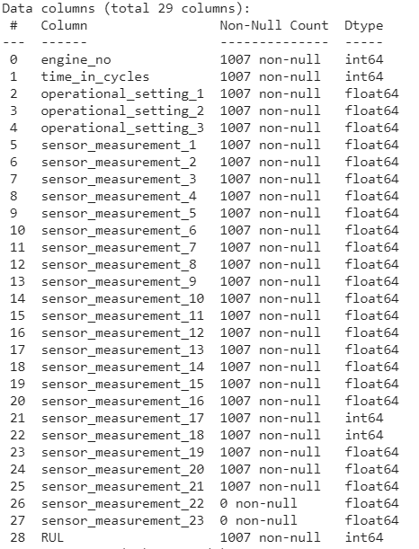
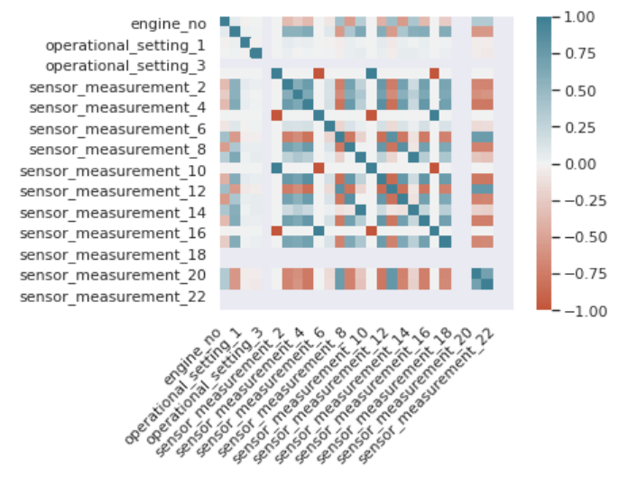
Data Analysis – Turbofan Turbofan Engine Degradation Simulation Data Set from NASA.
Working:
Data Analysis (Feature Engineering)
Understanding the pattern / distribution of data
Splitting data for initial training
Understanding Remaining useful life with time cycles of Engines

