Slide 1
Split Neural Networks for Time Series Federated Learning
Student: PADMAPRIYA MATHIVANAN
Supervisor: LUX

Slide 2
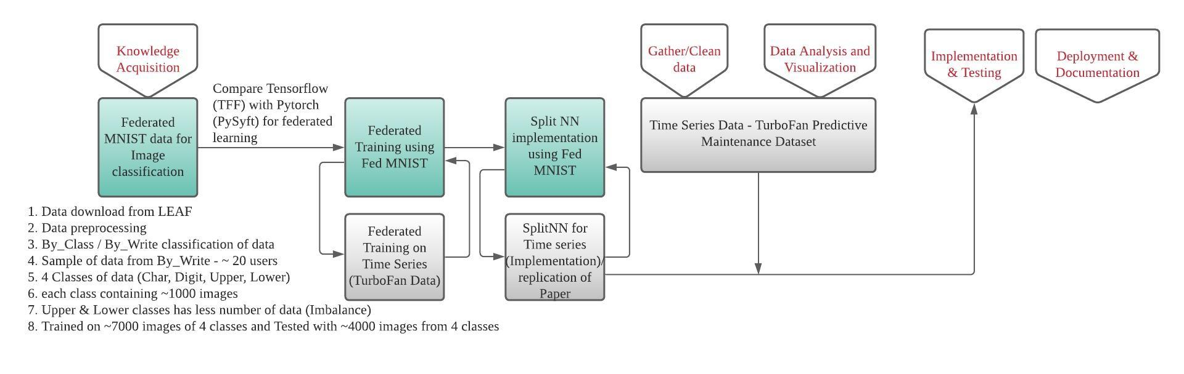
Week 1 Updates - Key steps:

Slide 3
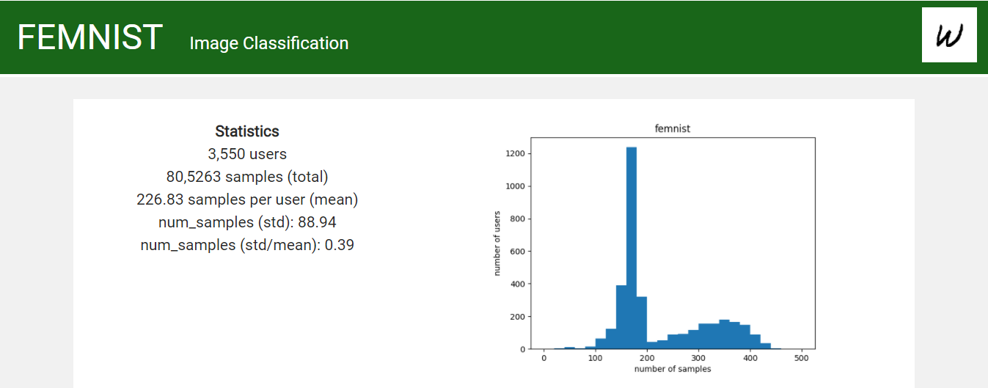

Federated MNIST
Image dataset : Partitioning the data in Extended MNIST based on the writer of the digit/character. LEAF - open-source benchmark for federated settings
Details: 62 different classes (10 digits, 26 lowercase, 26 uppercase), images are 28 by 28 pixels (with option to make them all 128 by 128 pixels), 3500 users
Reference:
A Research Library and Benchmark for Federated Machine Learning. FedML: A Research Library and Benchmark for Federated Machine Learning. FedML: A Research Library and Benchmark for Federated Machine Learning

Slide 4
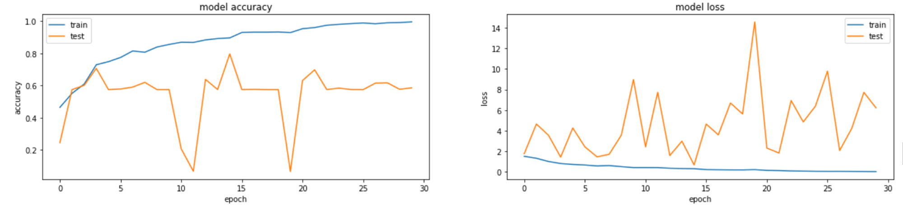
Comparison
Datasets | Model Name | Accuracy | Test Accuracy
MNIST | CNN | 99.84% | 98.17%
EMNIST (DIGITS) |  | 97.74% | 98.89%
EMNIST (LETTERS) |  | 95.39% | 87.57%
EMNIST (Balanced) |  | 90.46% | 79.61%
Federated MNIST (FEMNIST) |  | 99.54% | 58.54%

Slide 5
Reasons & Next steps
Model complexity
The sample training data is small to accurately generalize across classes
Data preprocessing is a challenge – Large datasets
Imbalance data with each classes
Parameters Tuning:
Recommended batch size by LEAF
Dropout Layers
Optimizer
Data preprocessing recommended by LEAF on FEMNIST – Federated Learning

Slide 6
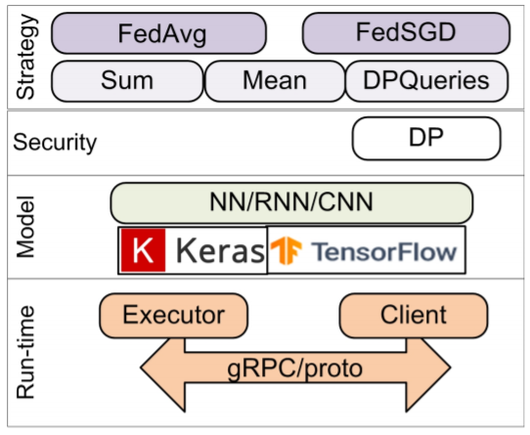
TensorFlow Federated Framework
Installation/Simulation
last version (0.17.0) of TFF uses the TensorFlow (TF) of version 2.3 for learning, estimation, and use of NNs.
TFF implements base classes for the FedAvg and federated stochastic gradient descent (FedSGD) algorithms
Can use several functions for aggregating the client model updates on the server (Sum, Mean, Differentially private)
To create novel federated algorithms, TFF supports a core API.
The current version of TFF implements only simulation mode. It is possible to use TFF via Google Colaboratory in a manner similar to TF. To use TFF locally, it is necessary to install the TFF package using Python’s pip package manager.
Drawback:
version of TFF 0.17.0 lacks in:
The federated mode of operation is not implemented
Vertical and hybrid data splitting is not supported
The decentralized architecture of building the system is not supported
Only a differential privacy mechanism is used
Community:
allows simulation of FL and selection of the optimal NN structure suitable for a user’s tasks.
The framework is supported by a quite big community with more than 60 contributors as of the end of October 2020.

Slide 7
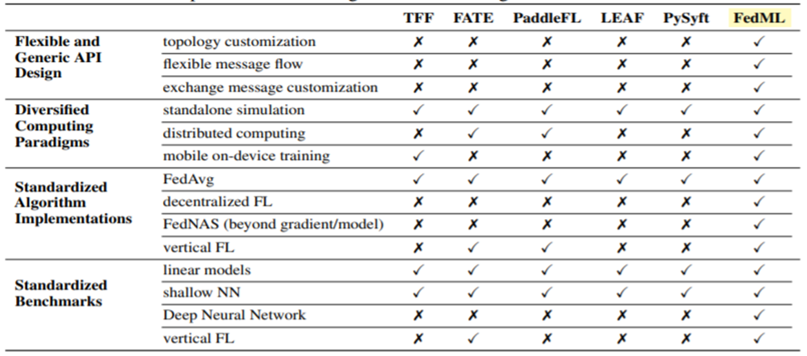
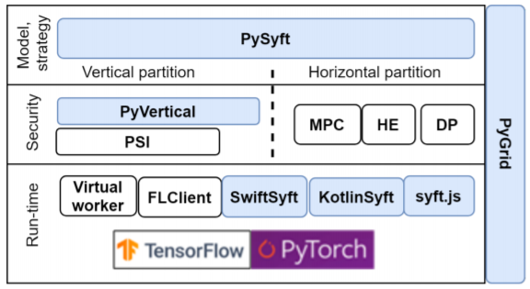
PySyft Framework
PySyft is a open-source Python project for secure and private deep learning with an MIT License.
PySyft simply decouples the private data from model training using the principles of FL secured with different privacy enhancing mechanisms
As a standalone library, PySyft functions only in simulation mode; to support federated mode, it has to be integrated with other projects of the OpenMined ecosystem, including PyGrid.
This framework has the largest community of contributors—over 250 developers—so it could be expected to have rapid development.
Reference: https://www.researchgate.net/figure/Comparison-with-existing-federated-learning-libraries-and-benchmarks-TFF-FATE-PaddleFL_tbl1_343253545
https://github.com/OpenMined/PySyft
https://www.mdpi.com/1424-8220/21/1/167/pdf

Slide 8
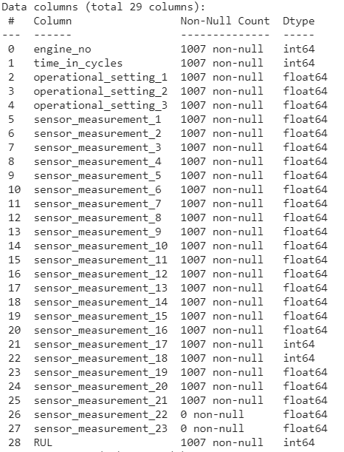
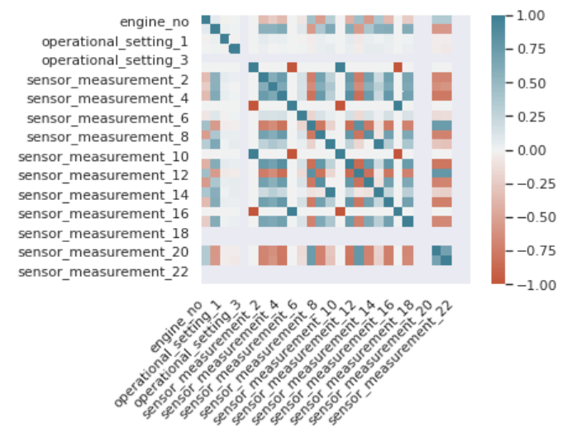
Data Analysis – Turbofan Turbofan Engine Degradation Simulation Data Set from NASA.
Working:
Data Analysis (Feature Engineering)
Understanding the pattern / distribution of data
Splitting data for initial training
Understanding Remaining useful life with time cycles of Engines

Slide 9
Thank You !
Open to discussion

