Slide 1
Split Neural Networks for Time Series Federated Learning
Week II Updates

Slide 2
What has been done
Experiments on datasets
1. MNIST
EMNIST
CIFAR 10 for Image classification using centralized data
Reference papers:
MNIST dataset State of the art model 2020: Effective Handwritten Digit Recognition using Deep Convolution Neural Network http://www.warse.org/IJATCSE/static/pdf/file/ijatcse66922020.pdf
EMNIST https://ieeexplore.ieee.org/document/8540626 Convolutional Neural Network (CNN) implemented with EMNIST introduced in https://arxiv.org/abs/1702.05373v1.
CIFAR10 (PDF) CNN Models with CIFAR10 dataset validated (PDF) Convolutional Neural Network for CIFAR-10 Dataset Image Classification (researchgate.net)

Slide 3
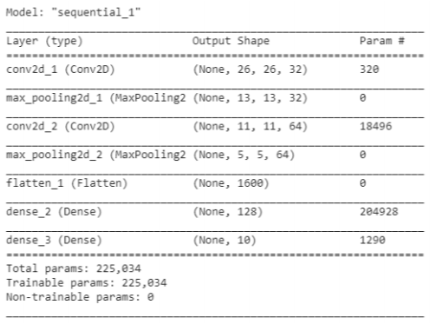
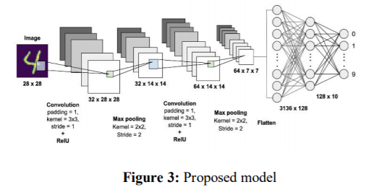
Experimented:
Understanding the simple image classification task using MNIST, EMNIST, CIFAR10 using centralized data.
Datasets 1 : MNIST - it consists of 70,000 handwritten images from 250 different sources out of which 60,000 are used for training, and the rest are used for training validation.
Model:
Dataset 2: EMNIST - Balanced: 131,600 characters. 47 balanced classes. Replicated CNN architecture in paper

Slide 4
Replications of Results (MNIST & EMNIST)
Was able to replicate the closer results using same models
From | Dataset used | Model Used | Training Accuracy achieved | Test Accuracy Achieved | Loss
Paper | MNIST | CNN | 96.95% | 98.51% | 0.1
Replication |  |  | 97.42% | 96.02% | 0.19
Paper | EMNIST - Balanced | CNN | - | 92%(15 epochs)
Replication |  |  | - | 90%(15 epochs)

Slide 5
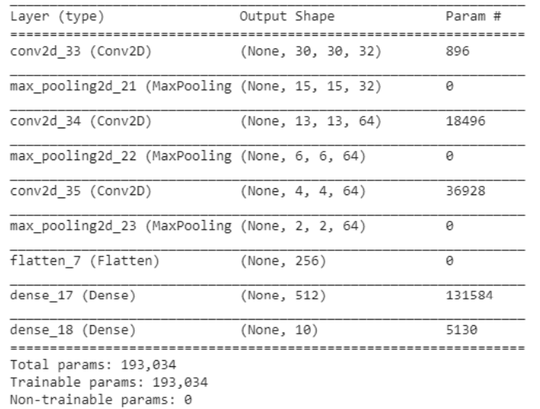
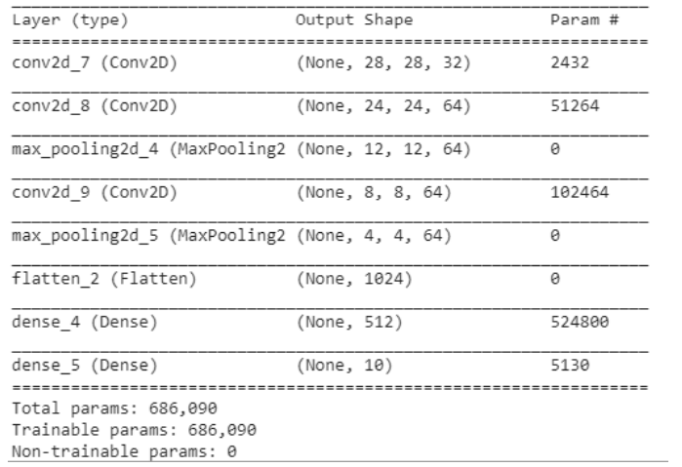
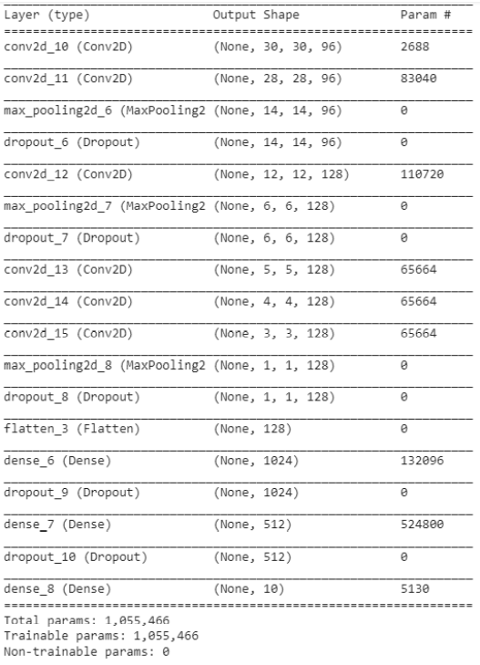
Dataset 3: Cifar 10 - dataset consists of 60000 32x32 colour images in 10 classes, with 6000 images per class. There are 50000 training images and 10000 test images
Net I
Net II
Net III

Slide 6
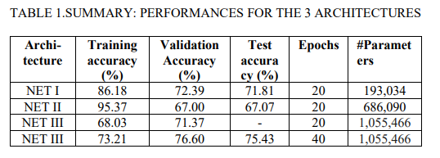
Replications of Results CIFAR10
From Paper
Replication of the paper work:
Architecture | Training Acc | Validation Acc | Test Acc | Epochs | # Parameters
Net I | 86.55% | 72.39% | 71.21% | 20 | 193,034
Net II | 97.86% | 69.29% | 68.90 | 20 | 686,090
Net III |  |  |  | 20 | 1,055,466
Net III | 71.64% | 74.24% | 73.78% | 40 | 1,055,466

Slide 7
Next Steps
Federated training simulations using Tensorflow and MNIST / CIFAR10 – In progress
Replication of federated training (real world scenario) on medical imaging & understanding of Federated and SplitNN work using Image data.

