Slide 1
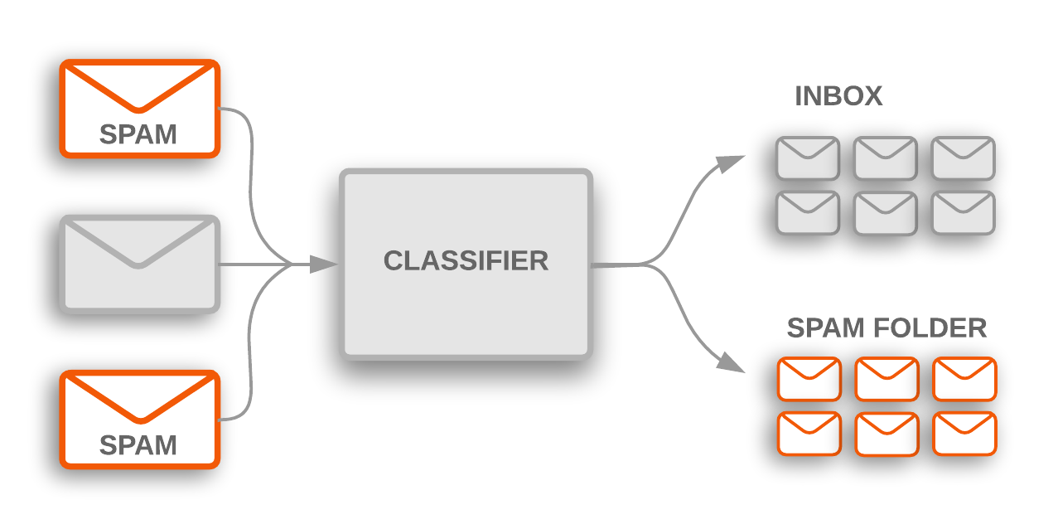
SMS SPAM DETECTION DATASET
INSAID ML – INTERMEDIATE PROJECT - Exploratory Data Analysis with Machine Learning Models

Slide 2
Information on the sms spam detection dataset
Info : Info function of the dataset gives us the following insights:
There are a total of 5572 samples/ rows and 5 features/columns in the dataset.
Columns are : ‘v1', ‘v2', ‘Unamed: 2', ‘Unamed: 3', ‘Unamed: 4'
All the columns are of object datatype.
There are missing values in the Unamed: 2, Unamed: 3, Unamed: 4 columns.

Slide 3
Information on the sms spam detection dataset
Describe: On describe of the data we infer that:
v1 and v2 has no missing values unlike the other 3 columns.
v1 column is the "target" which has 2 unique values (“ham” and “spam”). The value "ham" seems to be the top most value with a frequency of 4825.
v2 column has 5169 unique values and "Sorry, I'll call later bt not his girlfrnd" has been repeated for 30 times in the dataset.
Unamed: 2, Unamed: 3 and Unamed: 4 has very less values out of which most of them are unique values respectively.

Slide 4
Pre-processing: Cleaning decisions
The following are the decisions taken from the observations in the data.
Unamed: 2, Unamed: 3 and Unamed: 4 has a lot of null values hence it should be dropped.
v1 and v2 names should be replaced with 'spam' and 'messages'
v1 has 2 values "ham" and "spam", which can be replaced with 0 and 1
v2 has text values which needs to be processed and converted to a numerical notation before modeling the dataset.
We should introduce a new feature “msg_length” which holds the length of the actual messages in the dataset.

Slide 5
Pre-processing: Text column details
The values in the messages columns seems to have:
Words with a-z and A-Z (both lower and upper case)
Use of email addresses, web addresses
Use of punctuations (!"#$%&'()*+,-./:;<=>?@[]^_`{|}~)
Use of numbers (0-9)and float values.
Use of whitespaces before and after a word
Use of currency symbols, non ascii characters
Use of stopwords (A group of words which are highly frequently used without any additional information, such as articles, determiners and prepositions are called stop-words)
We have to cleanup all the above observations from the messages so that we can convert each word as a separate feature.

Slide 6
Pre-processing: Text cleaning decisions
The messages text column is processed with the following:
Email addresses are replaced with the word “email”
Web addresses are replaced with the word “link”
Punctuations (!"#$%&'()*+,-./:;<=>?@[]^_`{|}~) are removed.
Replace numbers (0-9) as “number”
Remove leading, trailing whitespaces and replace whitespaces between words with single space.
Replace money symbols with “currency”
Remove non-ascii characters
Convert the text to lower case
Remove all the stop words (using nltk - stopwords)
Stem the words which reduces the all the similar words to its word stem like (painted, painting and paint all replaced with paint) (using nltk – porter stemmer)
Now we shall create a new “processed_length” column which holds the length of the text in the processed message.

Slide 7

SPAM MESSAGES CLASSIFICATION DATASET
Exploratory Data Analysis

Slide 8
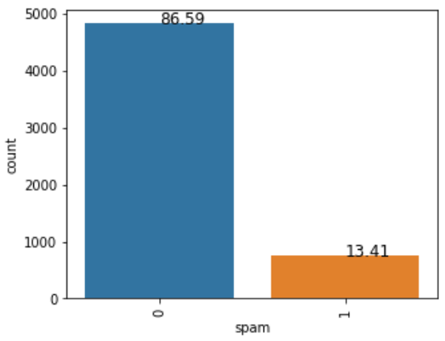
What is the spam and ham distribution in the dataset?
Observations:
13.41% of the messages in the dataset are spam and 86.59% of the messages are ham.

Slide 9
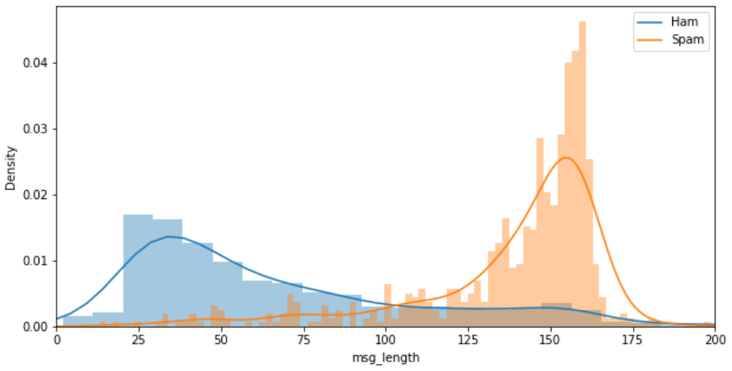
What is the variations in the actual messages length based on ham or spam?
Observations:
Spam messages tend to have more length messages.

Slide 10
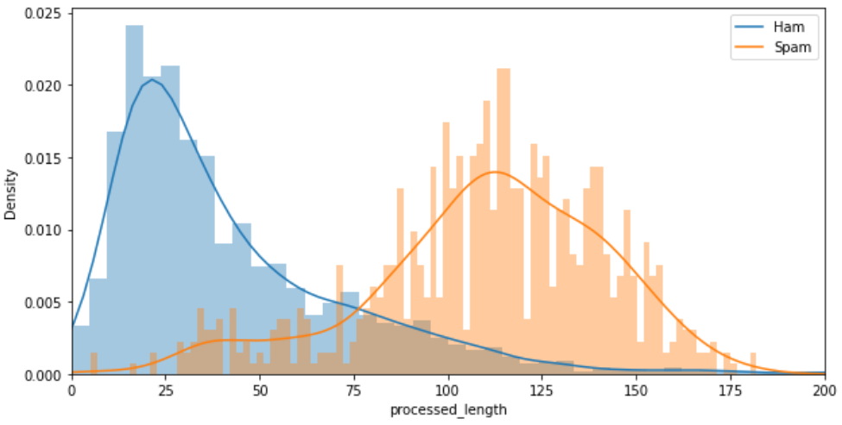
What is the variations in the processed messages length based on ham or spam?
Observations:
The message length distributions are overlapping for spam and ham which leaves difficulty in judging a spam or ham, hence we can use the actual message length for prediction which has discrete values that differentiates the data.

Slide 11
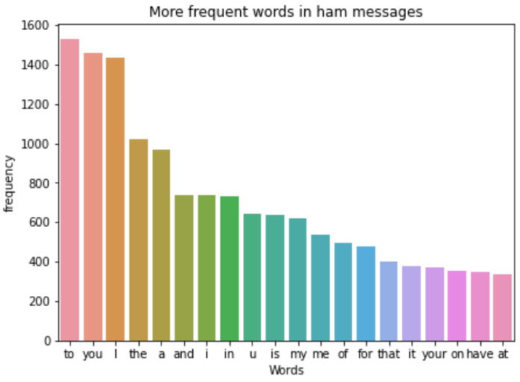
What are the most common words used in ham messages?
Observations:
We see that most of the common words are stopwords and articles which does not add much value to the information.

Slide 12
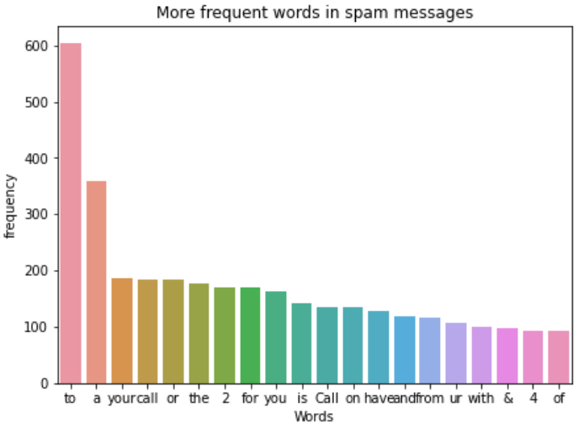
What are the most common words used in spam messages?
Observations:
We see that most of the common words are stopwords and articles which does not add much value to the information.

Slide 13
SPAM MESSAGES CLASSIFICATION DATASET
Feature Engineering and Scaling

Slide 14
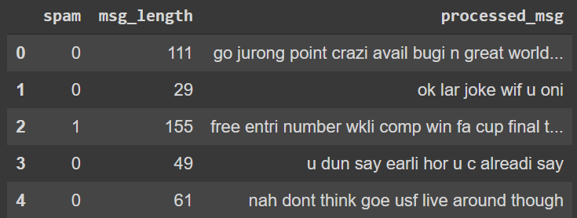
Processed Spam Dataset details:
The processed dataset now has the following details:
Spam: values 0 (ham)/1(spam).
Processed messages: values are processed text data.
Actual message Length: values Integer value from 2 to 910.

Slide 15
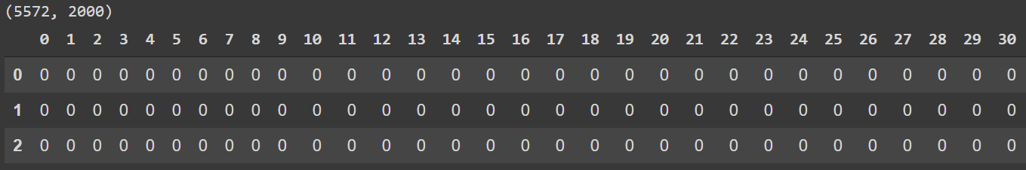
Feature Engineering: Text to Features
We can use Bag of words approach to extract features from the test data, wherein the entire sentence will be broken into individual words and the occurrence of each word is represented as a feature which can be used for classification. If a word exist in the text it will be valued as 1 else 0.
Here, I have extracted the top 2000 words from the processed messages to be the features. Hence, the text will be converted to a dataset with shape of (5572, 2000).

Slide 16
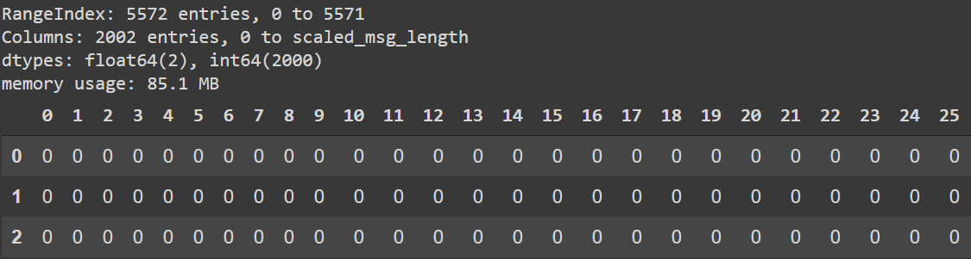
Scaling:
The actual message length should be scaled since its values are ranging from 2 - 910 while the other feature values are 0 and 1.
We can use the MinMax scaler for reshaping the data between 0 – 1.
The X input for models will be a dataset of 2000 words features and scaled actual message length. The y input for models will be the “spam” feature.

Slide 17
SPAM MESSAGES CLASSIFICATION DATASET
Model Predictions for Classification dataset

Slide 18
Models Details:
The Target variable "spam" is a binary class variable, hence its a classification dataset where we need to find if a message is a spam or ham. Hence the following algorithms are selected:
Logistic Regression
Decision Forest Classifier
Random Trees Classifier
K - Nearest Neighbor
Gaussian Naive Bayes
The different metrics which we have for validating the classifier models are:
Confusion Matrix
Accuracy
Recall
Precision
F1 Score

Slide 19
Prediction Strategy:
The dataset will be divided into train and test data’s in the ratio of 80:20.
In this dataset we are trying to classify a message as ham(0) or spam(1), hence the definition of various metrics would be as follows:
Accuracy : (TP + TN)/ (TP + TN + FP + FN) How many hams and spams where correctly classified??
Recall/Sensitivity: TP/ (TP + FN) How many spams where correctly predicted out of the total spams?
Precision: TP/(TP + FP) How many spams where correctly predicted out of total predictions?
F1 Score: 2.Precision * Recall/ (Precision + Recall) Weighted average of True positives and True negatives.
FN: We predicted as not spam but it was actually a spam.
FP: We predicted as spam but it was actually not a spam.

Slide 20
Prediction Strategy:
Here, we should avoid predicting a message as spam, which was actually not a spam, because it might be an important message to the user, which might lead to loss of information.
Hence FP should be less, which means precision should be very high for this dataset.
So, in the modeling, we need to make sure that the accuracy and precision values are high.

Slide 21
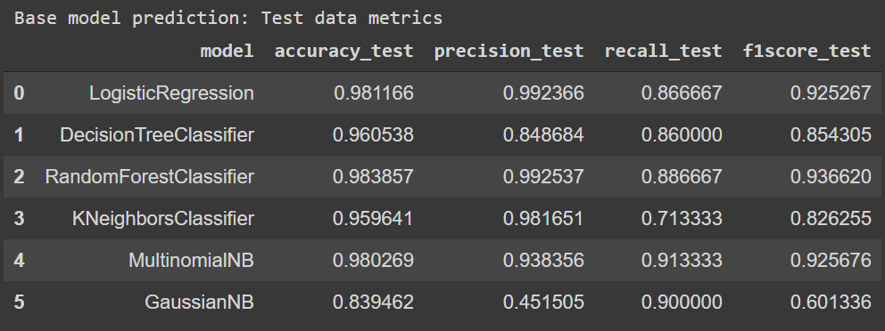
Base Model Prediction Metrics: Test data
After running the base models as listed in slide 18, the following metrics were recorded for test data:

Slide 22
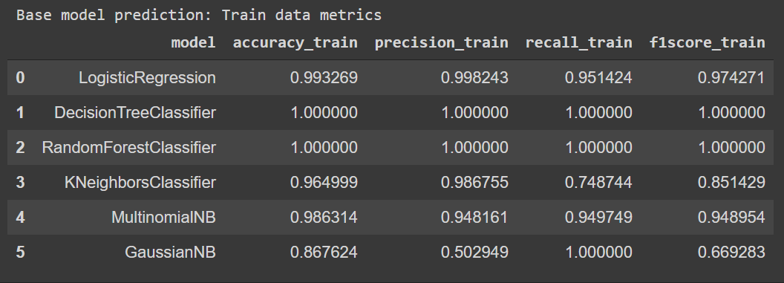
Base Model Prediction Metrics: Train data
After running the base models as listed in slide 18, the following metrics were recorded for train data:

Slide 23
Base Model Prediction Metrics: Observation
Random Forest Classifier is our best base model with:
Highest accuracy of 98.3% for test data and 100% for train data, which means approx 98% of our predictions are correct.
Precision of 99.2% test data and 100% for train data which means, approx 99% of the spam messages where predicted correctly out of the total predictions.
Around approx. (12%) of the spam data where missed and wrongly predicted as not spam.
We shall compare rest of all the variants with the best base model – Random Forest Classifier.

Slide 24
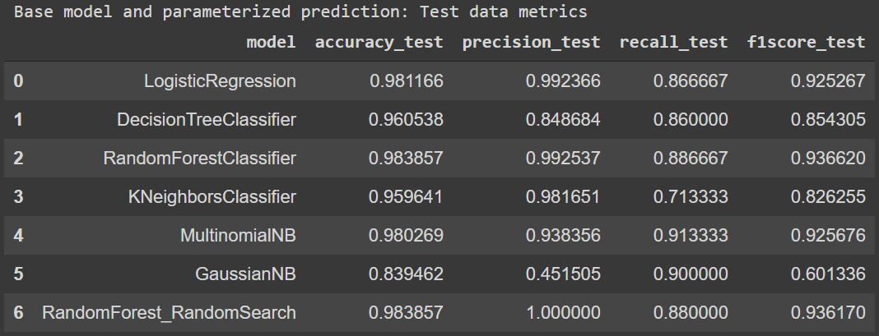
Random Forest – Random Search CV Model Prediction Metrics: Test data
After running the parameterized random forest random search model the following metrics were recorded for test data:

Slide 25
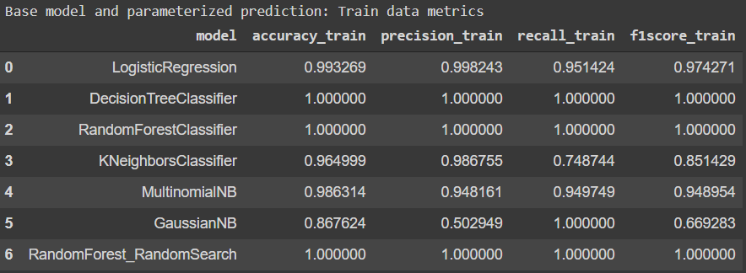
Random Forest – Random Search CV Model Prediction Metrics: Train data
After running the parameterized random forest random search model the following metrics were recorded for train data:

Slide 26
Random Forest – Random Search CV Model Prediction Metrics: Observation
Random Forest Classifier with Random Search gives a better result:
Parameters defined were :
Best params of the randomized searchcv model is : {'n_estimators': 100, 'min_samples_split': 10, 'min_samples_leaf': 1, 'max_features': 'sqrt', 'max_depth': 70, 'criterion': 'gini', 'bootstrap': False}
Highest accuracy of 98.3% for test data and 99.68% for train data, which means approx 98% of our predictions are correct.
Precision of 100% for test data and train data which means, approx 100% of the spam messages where predicted correctly out of the total predictions.
Around approx. (12%) of the spam data where missed and wrongly predicted as not spam.

Slide 27
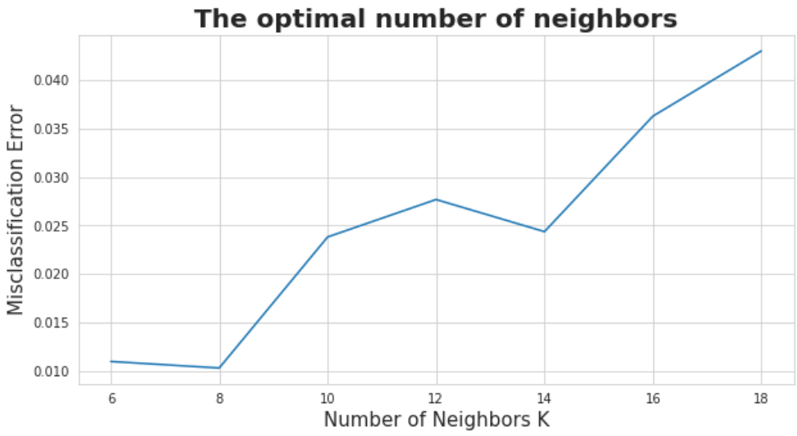
K Nearest Neighbour – Best K parameter evaluation
Using the cross validation score and by giving k value range of (6-20), the optimum K parameter value was found to be 8.

Slide 28
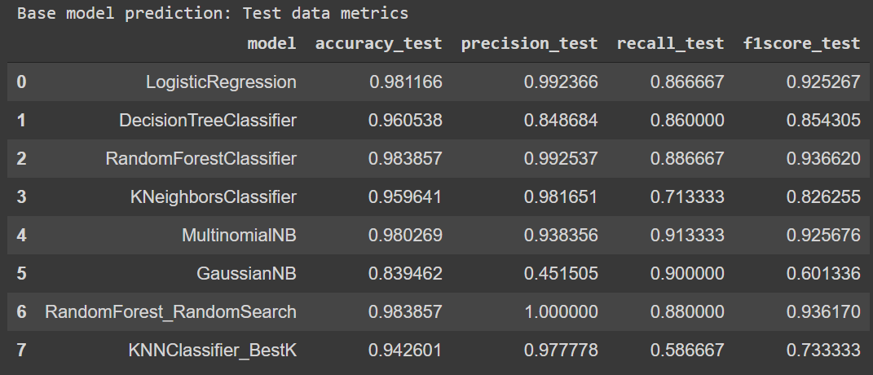
K Nearest Neighbor – Best K Model Prediction Metrics: Test data
After running the K Nearest neighbour with best K parameter the following metrics were recorded for test data:

Slide 29
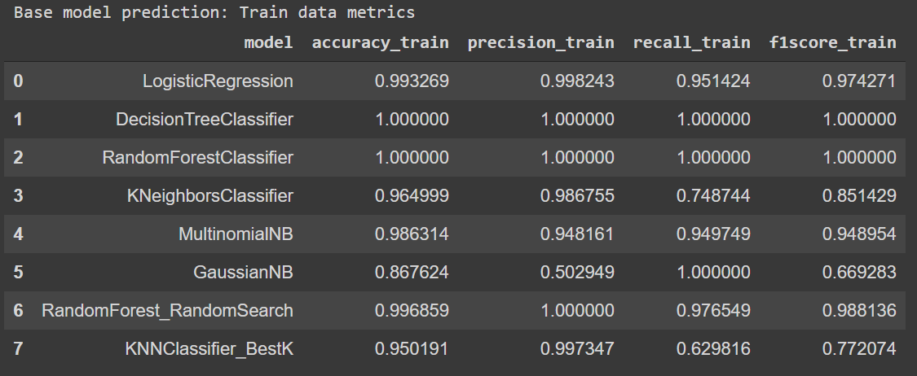
K Nearest Neighbor – Best K Model Prediction Metrics: Train data
After running the K Nearest neighbor with best K parameter the following metrics were recorded for train data:

Slide 30
K Nearest Neighbor – Best K Model Prediction Metrics: Observation
K Nearest Neighbor with optimal K, gives a depreciated result when compared to the base model.
Parameters defined were : algorithm='auto', leaf_size=30, metric='minkowski', metric_params=None, n_jobs=None, n_neighbors=8, p=2, weights='uniform'
Accuracy of 94.26% for test data and 95.01% for train data, which means approx 94% of our predictions are correct.
Precision of 97.7% for test data and 99.73% for train data which means, approx 98% of the spam messages where predicted correctly out of the total predictions.
Around approx. (38%) of the spam data where missed and wrongly predicted as not spam.

Slide 31
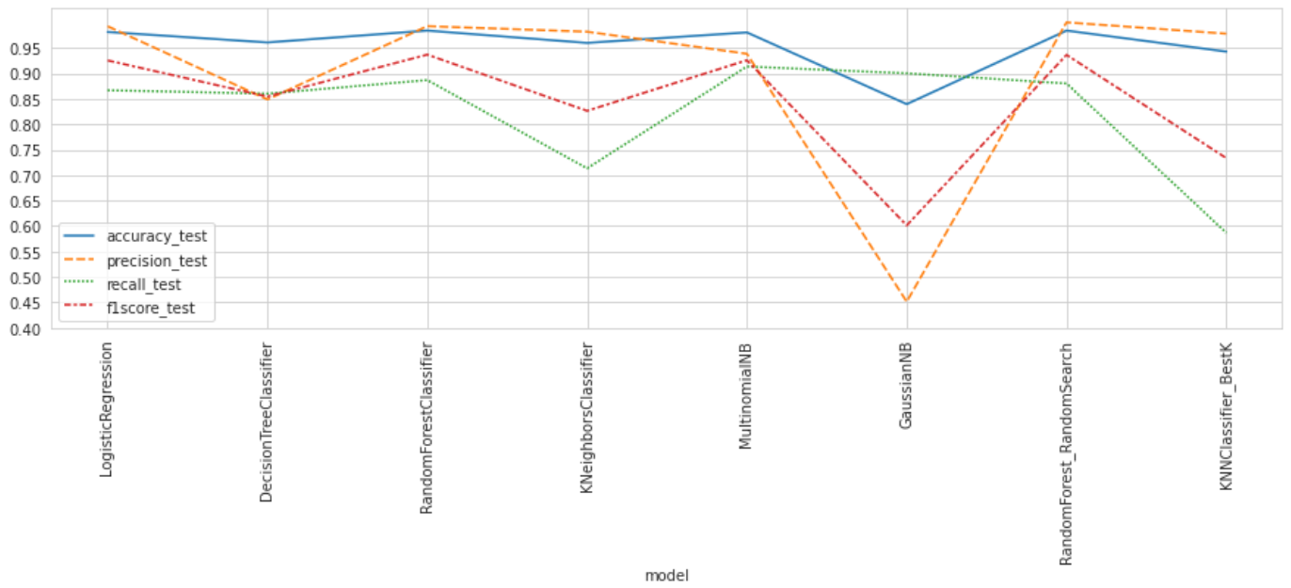
Conclusion
Here by I conclude that the Random Forest Classifier with randomized search is the best model for spam detection dataset.

