Slide 1
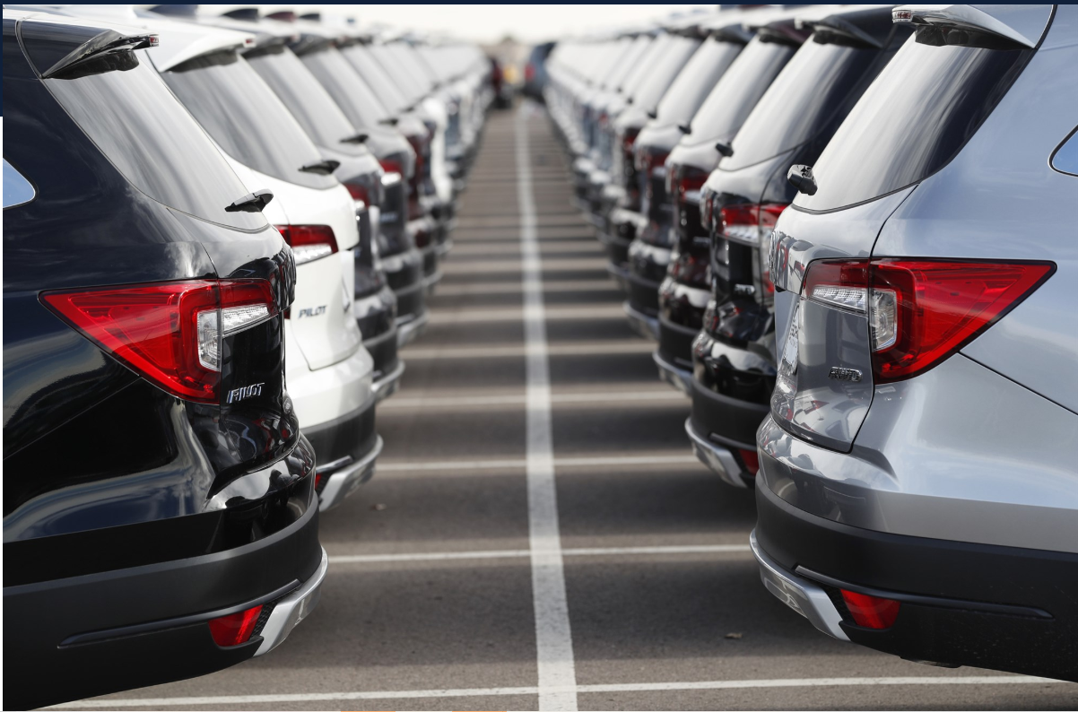
Ukraine Car Sale Ads
Exploratory Data Analysis

Slide 2
Information on the car sales data
Info : Info function of the dataset gives us the following insights:
There are a total of 9576 samples (rows) and 10 columns in the dataframe.
Columns are : 'car', 'price', 'body', 'mileage', 'engV', 'engType', 'registration', 'year', 'model', 'drive‘.
There are 4 columns with a numeric datatype and 6 columns with an object datatype.
There are missing values in the engV and drive column.

Slide 3
Information on the car sales data
Describe: On describe of the data we infer that:
Engine volume has 434 missing values and drive has 511 missing values.
The distribution of price is positive (right) skewed because the mean of price (15633.317) lies to the right of the median(50%) value (9200.00), on a distribution plot.
The max value of price (547800.00), mileage (999) and engine volume (99.99) are far away from their respective means, so there is a wide spread of data with some outliers.
Price and mileage has minimum 0 value which is not possible. Ideally we can replace them with NaN.

Slide 4
Pre-processing: Observations
Dataset info:
Number of variables: 10
Number of observations: 9576
Missing cells: 945 (1.0%)
Duplicate rows: 113(1.2%)
Summary of data types in this dataset:
Numeric: 4, Categorical : 5 , Bool: 1
Insights:
car has a high cardinality (87 distinct values). Volkswagen cars have highest count (936) and has frequency of 9.8%.
price has 267 zeros which should be treated as missing values. price has skewness of 7.131 and kurtosis of 93.743
Body type has a 6 distinct values. Sedan type of cars tops the list with 3646 records.
mileage has 348 zeros which should be treated as missing values.
engV has 434 missing values. It has skewness of 15.182 and kurtosis of 239.791
engtype has has a 4 distinct values. Petrol type of cars tops the list with 4379 records. It has "Other" values as well, we can treat them as NaN.
Registration is a boolean column and 'yes' data leads with 9015 values which means we have more of ukraine registered cars for sale.
model has high cardinality(888 distinct values)
Drive has 511 missing values.

Slide 5
Pre-processing: Cleaning decisions
Standardize all column headers to lower case (to prevent typos, ease of use)
Remove the duplicate rows
267 zeros of price values should be replaced with NaN.
348 zeros of mileage values should be replaced with NaN.
"Other" values of engtype should be replaced to NaN.
These missing values of price, mileage, engv should be replaced with their respective median values based on car and model.
These missing values of endtype, and drive should be replaced with their respective mode values based on car and model.

Slide 6
Post-processing: Observations
Dataset info:
Number of variables: 11
Number of observations: 9463
Summary of data types in this dataset:
Numeric: 5
Categorical : 5
Bool: 1
car has a high cardinality (87 distinct values).
model has high cardinality(888 distinct values)
These high cardinalities are fine, because we have different car brands and models available in the market.

Slide 7
Feature Based Analysis

Slide 8
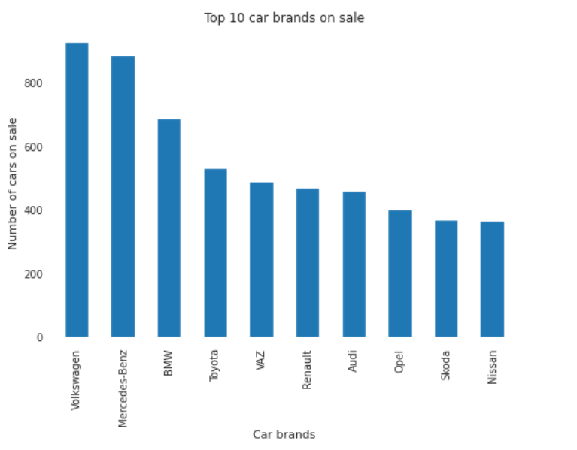
What are the top 10 car brands on sale?
These are the top 10 car brands out of 87 brands which were advertised for sale over years based on the given dataset, in which Volkswagen has the highest count of cars on sale.

Slide 9
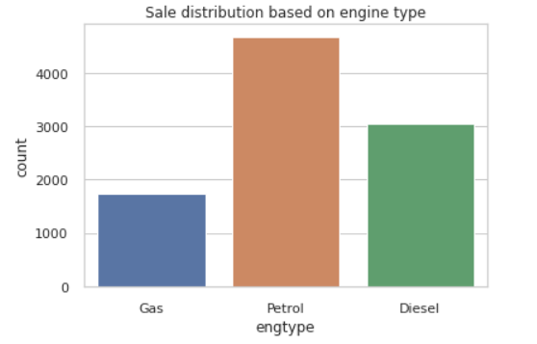
What is the sale distribution based on engine type?
This explains that cars with petrol engine types are high on sale. It constitutes 49.51% of total cars on sale.

Slide 10
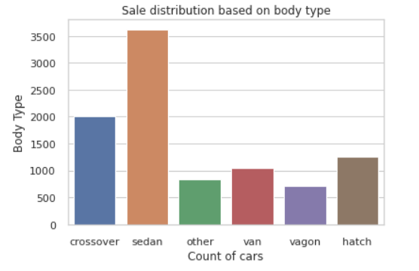
What is the sale distribution based on body type?
This explains that sedan type followed by crossover are the popular body types of cars on sale.

Slide 11
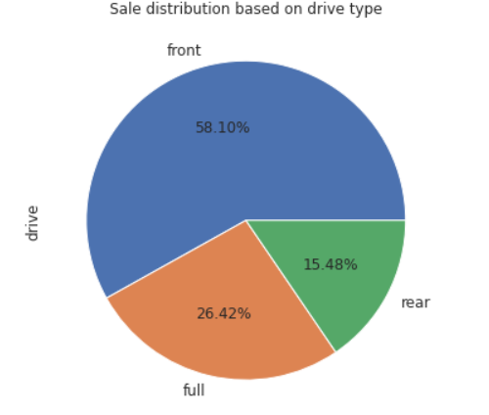
What is the sale distribution based on drive type?
This explains that front drive type cars are mostly on sale.

Slide 12
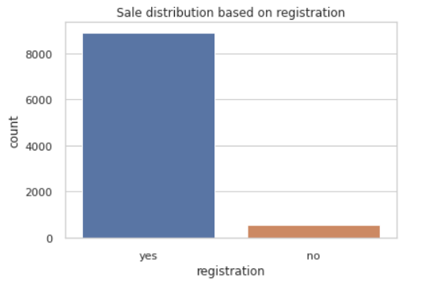
What is the car sale based on registration?
This explains that cars both registered in ukraine and from a different country were available on sale based on the dataset, in which 6% of cars were registered from a different country.

Slide 13
Price Based Analysis

Slide 14
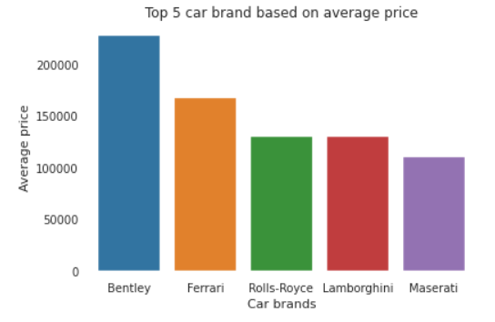
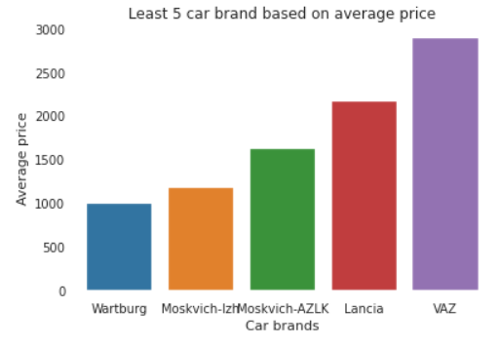
What are car brands on sale based on avg price?
Bently followed by Ferrari car brands have highest average price on sale.
Wartburg followed by Moskvich-izh car brands have the least average price on sale.

Slide 15
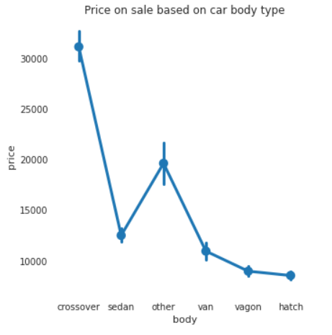
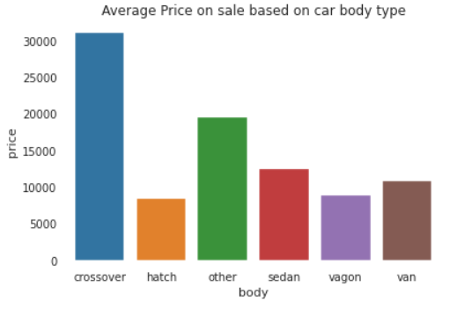
How price varies based on body type?
This explains that crossover followed by other and sedan body type of cars have high price on sale.

Slide 16
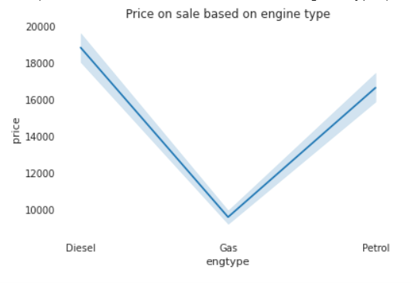
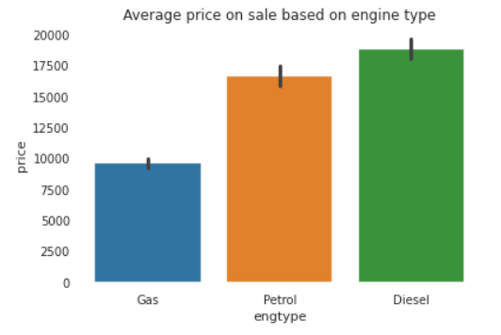
How price varies based on engine type?
This explains that diesel engine type of cars followed by petrol have high prices on sale. However based on number of cars, petrol engine type of cars were high on sale (refer slide 8).

Slide 17
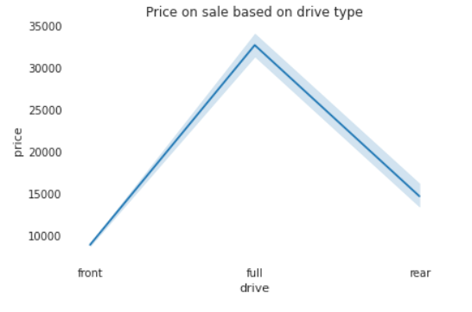
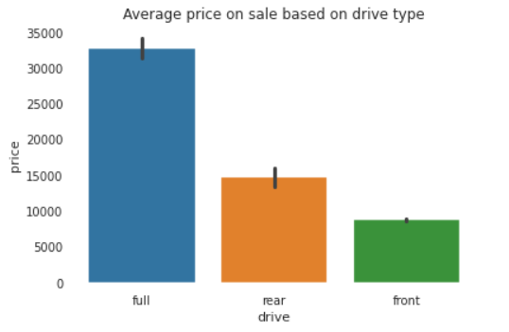
How price varies based on drive type?
This explains that full drive type cars followed by rear have high prices on sale. However, based on the number of cars, the front drive cars are the ones high on sale (refer slide 11)

Slide 18
Mileage Based Analysis

Slide 19
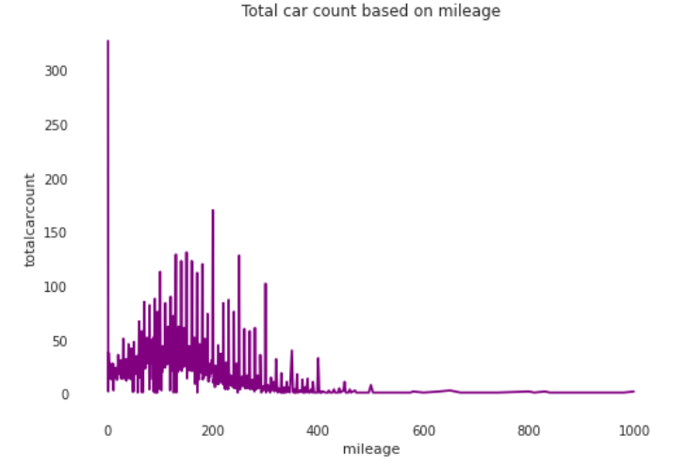
What is sale distribution based on mileage?
This shows that prominently more cars were on sale which had lesser mileage.

Slide 20
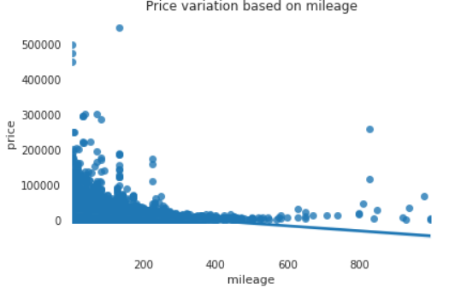
How price varies based on mileage?
This shows that variation in mileage affects the price of the car and they are inversely/ negatively co-related. Lesser mileage cars were quoted with fair price on sale.

Slide 21
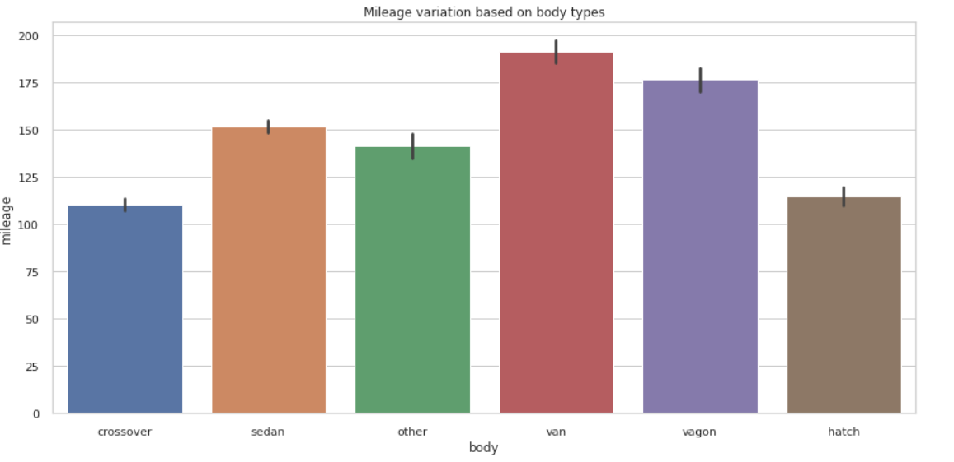
How mileage varies based on body type?
This explains that higher mileage is driven by cars with van body type followed by vagon and sedan. As the mileage increases, the maintenance of the used cars also increases hence this will have an impact on the buyer’s decision.

Slide 22
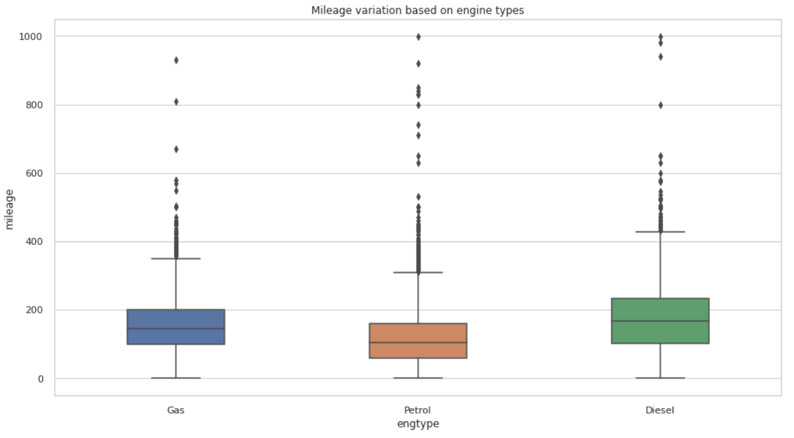
How mileage varies based on engine type?
This explains that cars with diesel engine types have been driven highly.

Slide 23
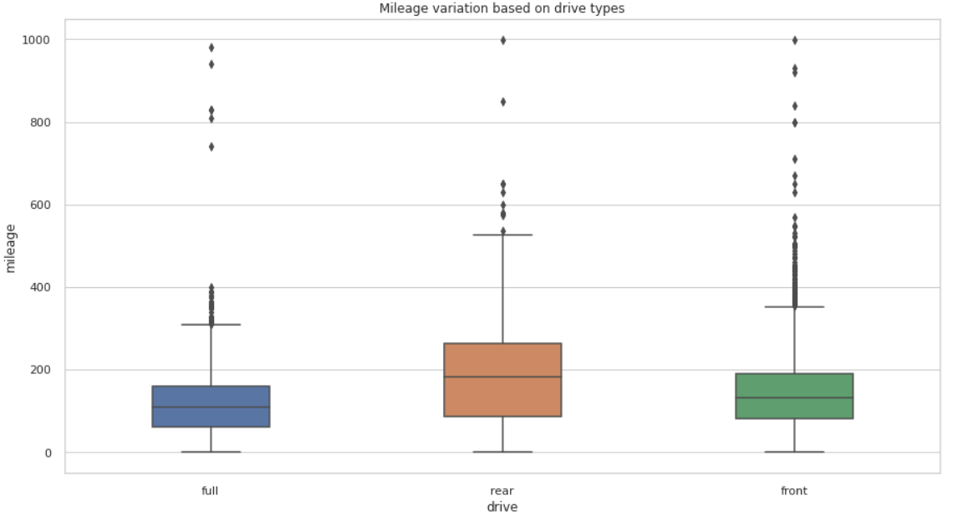
How mileage varies based on drive type?
This shows that cars with rear drive types were highly used.

Slide 24
Year Based Analysis

Slide 25
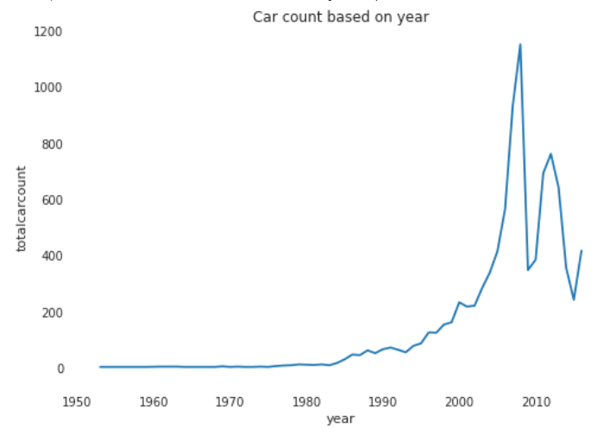
What is the car sale based on year of production?
This shows that high number of car sale were between 2005 -2012 with
2008 having the maximum count of 1150 cars on sale.

Slide 26
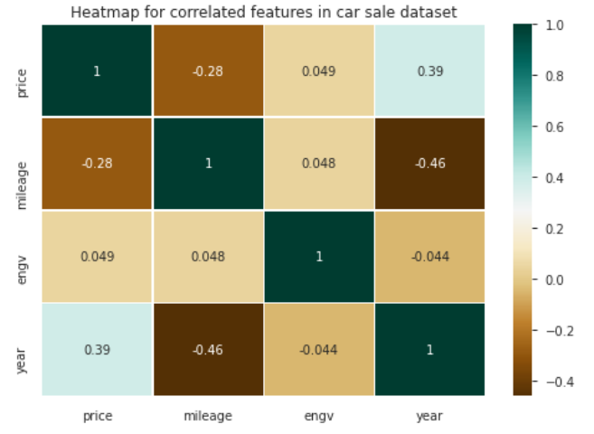
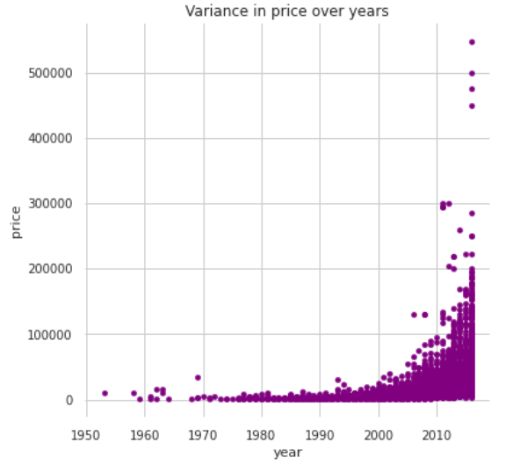
How is price variation over years?
This shows that price and year are positively correlated. Latest cars on sale fetches more price.

Slide 27
Multivariant Based Analysis

Slide 28
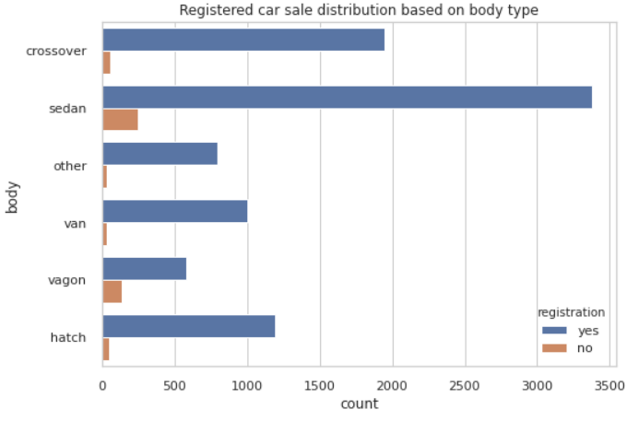
What is the registered car sale distribution based on body type?
This explains that we have high sale of sedan type which are registered in ukraine.

Slide 29
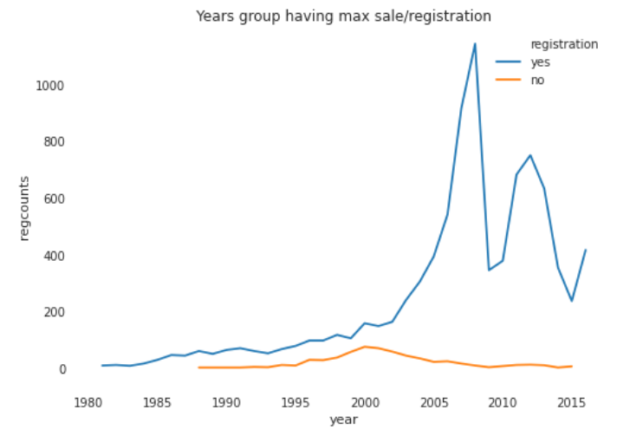
What is the trend of ukraine registered cars?
This shows that least number of sales were between 1953 – 1983. Ukraine registered cars were more on sale over years. Highest number of inland registered car sales were between 2005 – 2010 and maximum approx in 2008.

Slide 30
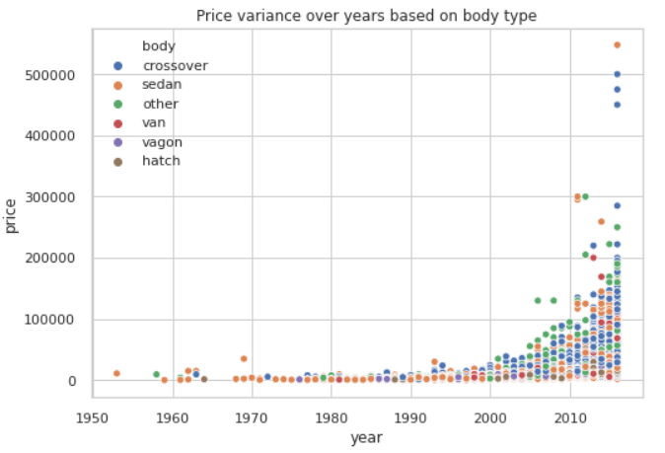
What is the price variance over years based on body type?
This explains that latest crossover body type cars were quoted with more price.

Slide 31
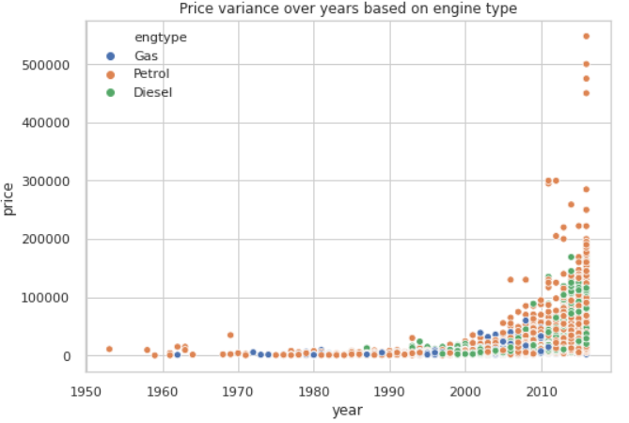
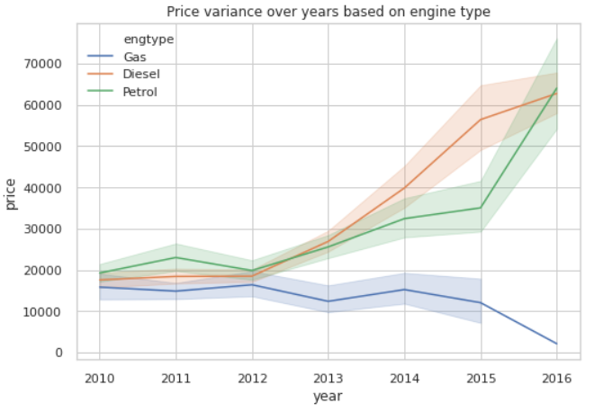
What is the price variance over years based on engine type?
This explains that more number of petrol engine type cars were on sale with a higher price over years.

Slide 32
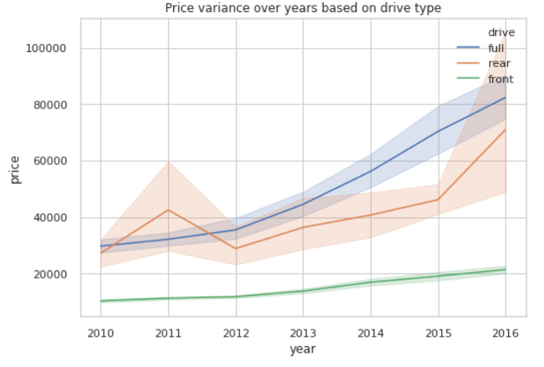
What is the price variance over years based on drive type?
This explains that more number of full drive type cars were on sale with a higher price over years.

Slide 33
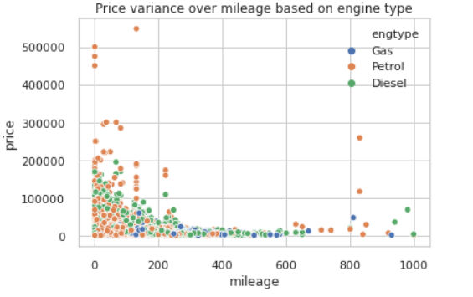
What is the price variance over mileage based on engine type?
This shows that prominently petrol engine type cars with lesser mileage have a decent price range.

Slide 34
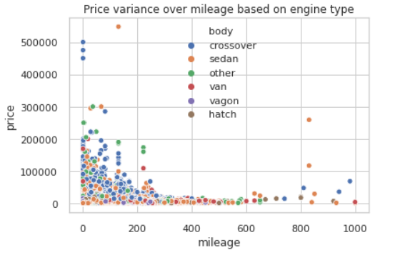
What is the price variance over mileage based on body type?
This shows that prominently crossover body type cars with lesser mileage have a decent price range which is followed by sedan body type cars.

Slide 35
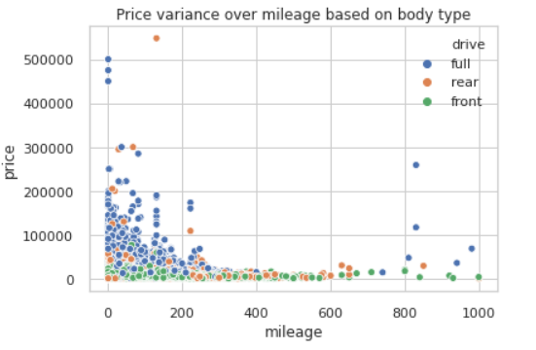
What is the price variance over mileage based on drive type?
This shows that prominently full drive type cars with lesser mileage have a decent price range which is followed by front and rear.

Slide 36
Conclusion

Slide 37
Conclusions
Using pandas profiling, we performed column standardization, removing duplicates and handled all the missing values in the dataset.
On feature wise analysis we infer that:
Volkswagen , Mercedes-Benz and BMW are the top car brands on sale past 50 years.
Sedan body type, petrol engine and front drive type cars were high on sale.
On price based analysis we infer that:
Bently and Ferrari were the most high priced cars on sale.
Crossover body type, Diesel engine type and Full drive type cars have high price range respectively.
On mileage based analysis we infer that:
Lesser the mileage, more is the price
Crossover body type, Petrol engine type and Full drive type cars have lesser mileage range respectively.
On year based analysis we infer that:
Maximum cars where on sale between 2005-2012 and 2008 having the highest count.
Price and year are positively correlated which means price increases over years.

Slide 38
Conclusions
Multi - variant analysis:
Crossover body type, Petrol engine type and full drive type cars have increase in price over years.
Petrol engines with lesser mileage were quoted with a fair price range on sale.
Actionable insights
We can infer that high price value can be quoted/predicted for cars with a combination of following:
Latest model cars with less than 5 years of registration.
High brand value cars.
Cars with less mileage.
Crossover and sedan body type cars.
Petrol engine type cars.
Full drive type cars.

