Slide 1

GHOULS, GHOSTS AND GOBLINS PREDICTION DATASET
ML – ADVANCED PROJECT(EDA AND ML PREDICTION)

Slide 2
Information on the Halloween dataset
There are 371 character observations.
There are 7 features (1 int, 4 float and 2 object type features)
ID : Appears to be the identification number of the monster in question
Bone Length : Average length of the bones in the creature.
Rotting Flesh : Percentage of flesh on the creature that is rotting
Hair Length : Average length of the hair on the creature.
Has Soul : The percentage of a soul present in the creature
Color : The color of the creature
Type : The category of the creature (i.e. ghoul, goblin or ghost)
There are no missing values
There are 3 unique types of Halloweens "GHOUL", "GOBLIN" and "GHOST"
There are 6 unique colors "CLEAR", "GREEN", "BLACK", "WHITE", "BLUE", "BLOOD"

Slide 3
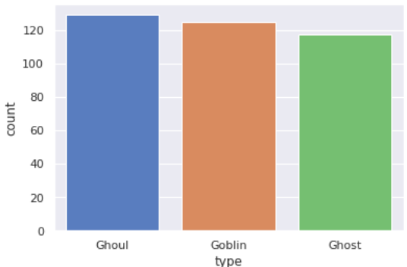
Exploratory Data Analysis
EDA – 1. Value count on Halloween types
Observations:
In the given dataset -
34.8% are Ghouls,
33.7% are Goblins and
31.5% are Ghosts

Slide 4
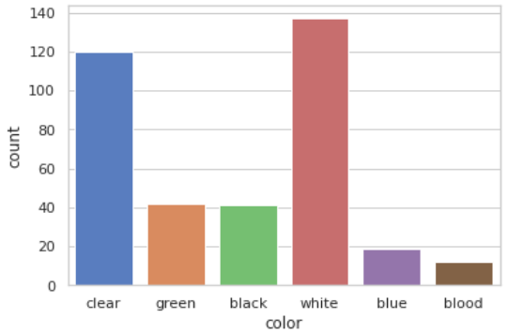
Exploratory Data Analysis
EDA – 2. Halloween color variations in the dataset
Halloweens are pre-dominantly in white and clear nature of colors.

Slide 5
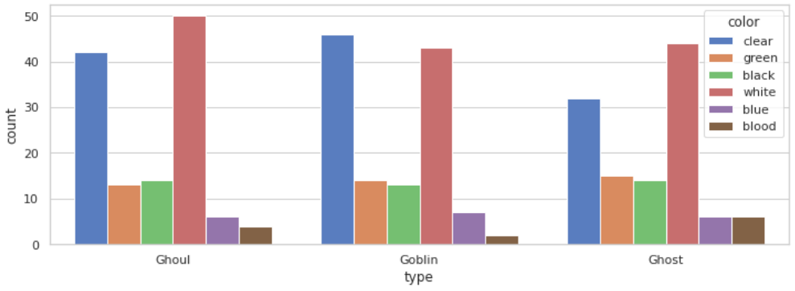
Exploratory Data Analysis
EDA – 3. Halloween color variations based on there type in the dataset.
All the Halloween types are mostly found in White or Clear in nature of color. We see that their colors are evenly distributed. So finding a Halloween based on color is tricky.

Slide 6
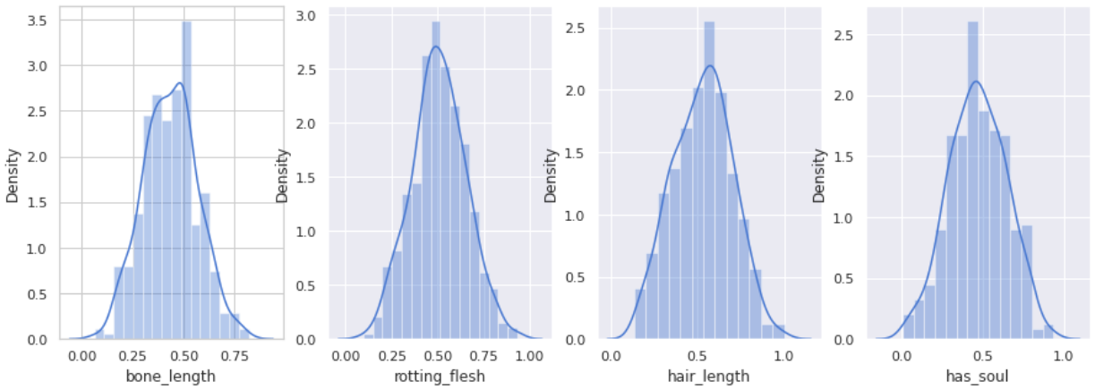
Exploratory Data Analysis
EDA – 4. Distribution of values for each characteristic feature?
We see that, almost all the features are normally distributed, hence we don’t need any feature transformations.

Slide 7
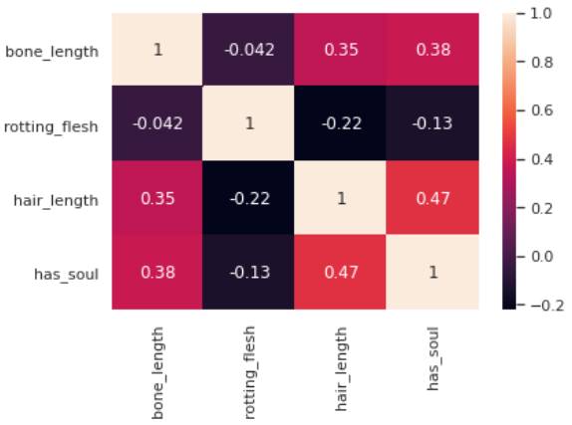
Exploratory Data Analysis
EDA – 5. What is the correlation of all features?
Observations:
Mostly a Halloween having a soul is expected to have considerable length of hair and bone with very less rotting flesh.
2. Halloweens which does not have a soul is expected to have more rotting flesh and less bone and hair length.

Slide 8
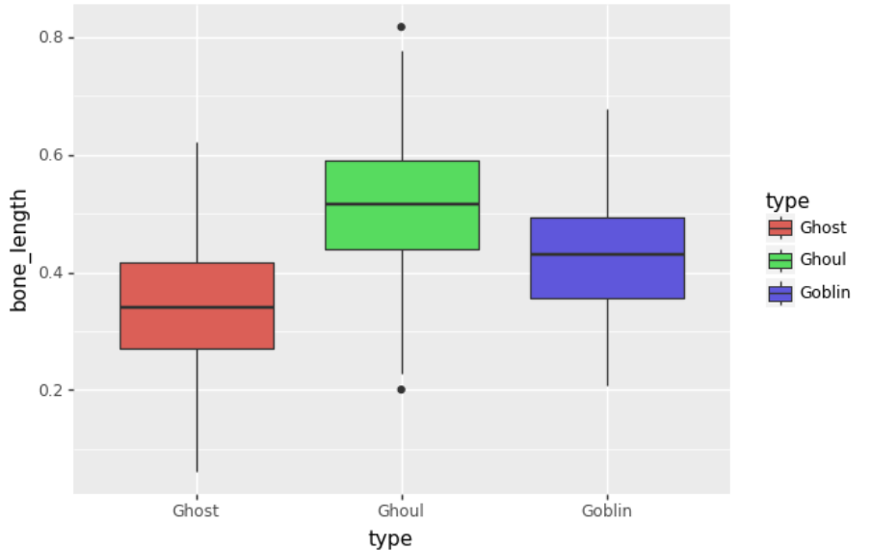
Exploratory Data Analysis
EDA – 5. Bone length variation with Halloween type?
Observations:
1. All Ghouls have higher bone
length compared to ghosts.
2. Approximately 50 percentile of Goblins have less bone
length compared to that of Ghouls.
3. And 50 percentile of Goblins have bone length similar to that of Ghouls, this area of prediction will be tricky.

Slide 9
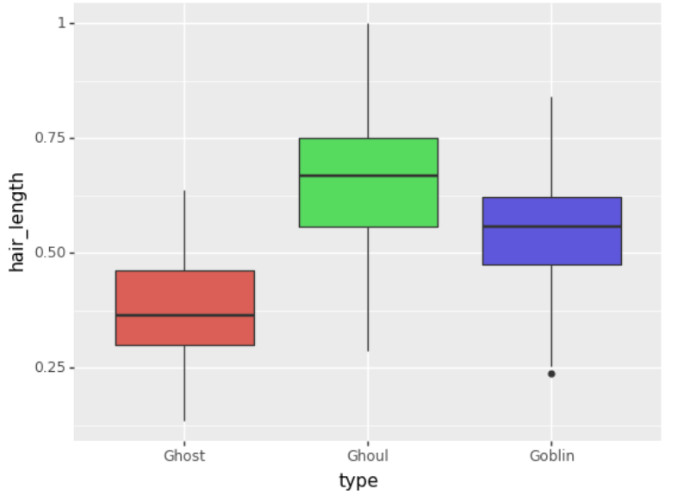
Exploratory Data Analysis
EDA – 6. Hair length variation with Halloween type?
Observations:
1. All the Ghouls have more hair
length when compared to Ghosts.
2. Approximately 50 percentile of
Goblins have less hair compared to
that of Ghouls.
3. And 50percentile of Goblins have hair length similar to Ghouls. So
differentiating this 50 percentile between them is going to be tricky.

Slide 10
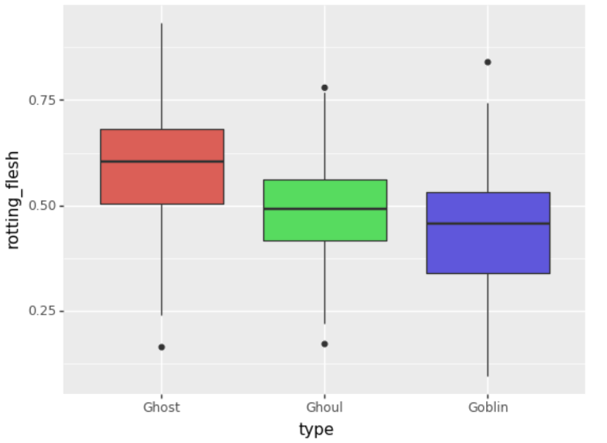
Exploratory Data Analysis
EDA – 7. Rotting Flesh variation with Halloween type?
Observations:
1. Ghosts have more rotting flesh
when compared to Goblins
2. Approximately 50percentile of Ghouls have less rotting flesh than all Ghosts.
3. Most of the Goblins have less
rotting flesh when compared all.

Slide 11
Feature Engineering
Actions:
1. Id column can be dropped since it doesn’t add any value to the Halloween type.
2. Color feature has 6 unique values (clear, green, black, white, blue, blood).
Encoding is to done on the color feature.
3. The target variable “Type” is a multiclass feature which should also be encoded. I have encoded as Ghoul – 1, Goblin – 2 and Ghost - 3

Slide 12
Model Predictions
In this classification dataset where in we need to find if the Halloween is a
GHOUL/GHOST/GOBLIN. The algorithms which I will be applying for this dataset are listed below:
1. Logistic Regression (Baseline, Grid Search CV)
2. Decision Tree Classifier (Baseline, Grid Search CV)
3. Random Forest Classifier (Baseline, Randomized Search CV)
4. K - Nearest Neighbour (Baseline, Best K)
5. Gaussian Naive Bayes
6. Support Vector Classifier (Baseline, Grid Search CV)
7. Linear Discriminant Analysis
8. Bagging Classifier
9. Gradient Boosting Classifier (Baseline, Grid Search CV)
10. Ada Boost Classifier
11. Voting Classifier

Slide 13
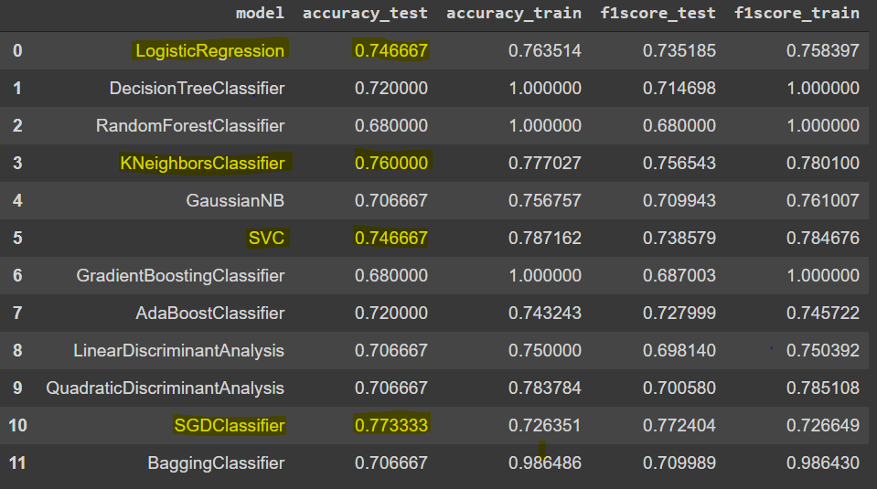
Model Predictions – Baseline Model Prediction
Base Model Prediction Metrics:

Slide 14
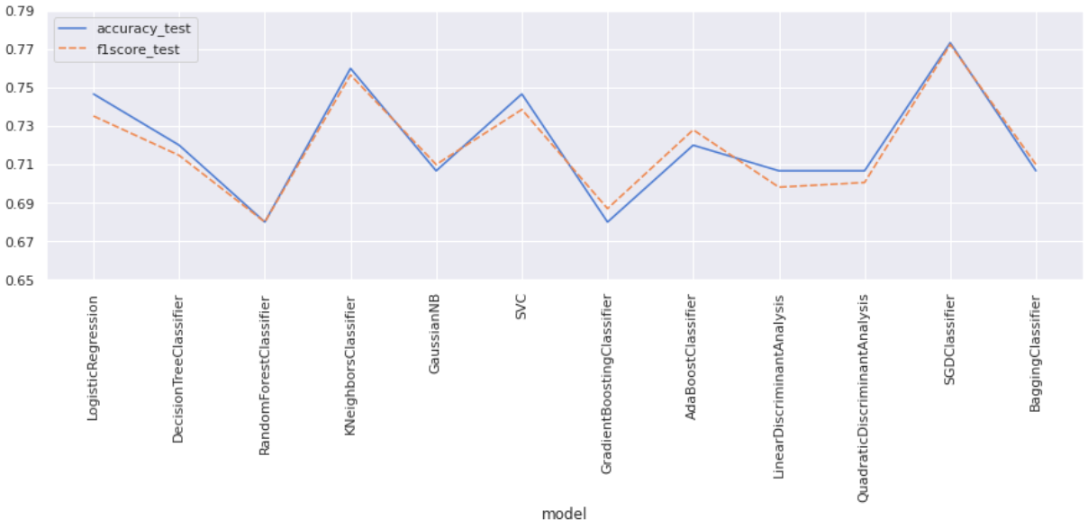
Model Predictions – Baseline Model Prediction
Base Model Prediction Metrics:

Slide 15
Model Predictions – Best Estimators
SL NO | MODEL | METHOD USED | BEST PARAMETERS
1 | RANDOM FOREST | RANDOMIZED SEARCH CV | n_estimators = 50 Min_samples_split=5 Min_samples_leaf = 5 Max_features= sqrt Max_depth = 30 Criterion= Entropy Bootstrap = True
2 | K NEAREST NEIGHBOUR | ELBOW CURVE | N_neighbours = 5
3 | STOCHASTIC GRADIENT CLASSIFIER | GRID SEARCH CV | alpha=0.0001 loss='log' Max_iter=37
4 | GRADIENT BOOSTING CLASSIFIER | RANDOMIZED SEARCH CV | n_estimators = 100, max_depth = 2 learning_rate = 0.05

Slide 16
Model Predictions – Best Estimators
SL NO | MODEL | METHOD USED | BEST PARAMETERS
5 | LOGISTIC REGRESSION | GRID SEARCH CV | C = 10, penalty = 'l2'
6 | SUPPORT VECTOR CLASSIFIER | GRID SEARCH CV | C = 10 degree = 3 kernel = 'linear‘ probability = True
7 | VOTING CLASSIFER | HARD VOTING OF MODELS WITH BEST PARAMETERS: 1. RANDOM FOREST 2. K NEAREST NEIGHBOUR 3. STOCHASTIC GRADIENT DESCENT 4. LOGISTIC REGRESSION 5. SUPPORT VECTOR CLASSIFIER

Slide 17
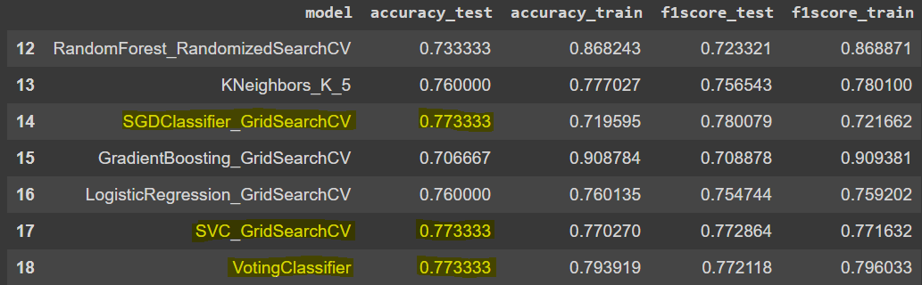
Model Predictions – Best Estimator
Best Estimator Model Prediction Metrics:

Slide 18
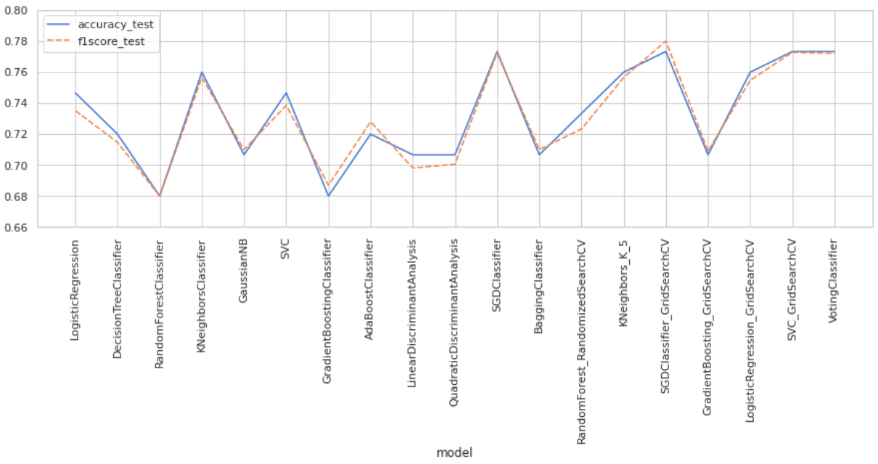
Model Predictions – Best Estimators
Best Estimator Model Prediction Metrics:

Slide 19
Model Predictions – Best Estimator
Best Estimator Model Prediction Metrics:
SL NO | MODEL | TEST ACCURACY | PREDICTION TIME
1 | STOCHASTIC GRADIENT CLASSIFER – BEST ESTIMATOR | 77.33% | 18.3ms
2 | SUPPORT VECTOR CLASSIFIER – BEST ESTIMATOR | 77.33% | 26.3ms
3 | VOTING CLASSIFIER | 77.33% | 174ms
CONCLUSION: STOCHASTIC GRADIENT CLASSIFIER with best estimator parameters can be used for predictions of Halloween dataset.

