Slide 1
ENSEMBLING PyCON 2019
By
Padmapriya Mohankumar

Slide 2
ENSEMBLES
Combine Predictions of several base estimators built with a given learning algorithm in order to improve generalizability / robustness over a single estimator
Two families of ensemble methods are usually distinguished:
Averaging methods:
The driving principle is to build several estimators independently and then to average / vote their predictions.
On average, the combined estimator is usually better than any of the single base estimator because its variance is reduced.
E.g. Bagging methods, Forests of randomized trees,
Boosting methods:
Base estimators are built sequentially and one tries to reduce the bias of the combined estimator.
The motivation is to combine several weak models to produce a powerful ensemble.
E.g. AdaBoost, Gradient Tree Boosting, ...

Slide 3
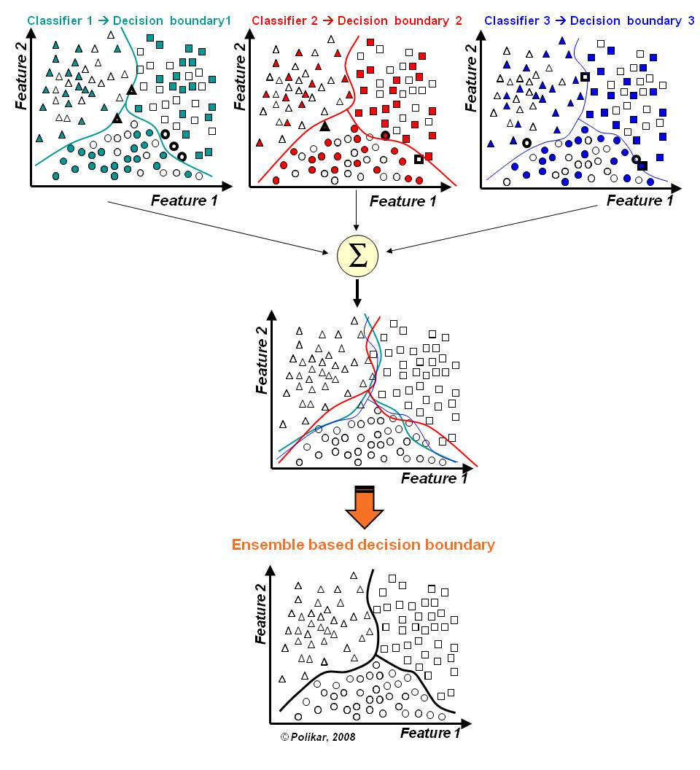
OVERVIEW OF ENSEMBLING
In the final stage of voting, we essentially have a combined surface resulting from individual surfaces
Source: https://github.com/MenuPolis/MLT/wiki/Bagging

Slide 4
ENSEMBLING TECHNIQUES - Bagging (Bootstrap Aggregation) :
Designed to improve the stability and accuracy of classification and regression models
It reduces variance errors and helps to avoid overfitting
Can be used with any type of machine learning model, mostly used with Decision Tree
Uses sampling with replacement to generate multiple samples of a given size. Sample may contain repeat data points
For large sample size, sample data is expected to have roughly 63.2% ( 1 – 1/e) unique data points and the rest being duplicates
For classification bagging is used with voting to decide the class of an input while for regression average or median values are calculate

Slide 5
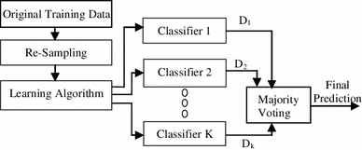
ENSEMBLING TECHNIQUES - Bagging (Bootstrap Aggregation) :
Re-sampling done for every classifier using a random function. For large n, 63.2% unique samples likely to be selected
Voting could be simple or weighted
Algorithm to generate classifiers. Could be Decision Tree, Naïve Bayes etc
K classifiers created in parallel and independently on respective training data
Source: https://link.springer.com/article/10.1007/s13721-013-0034-x

Slide 6
ENSEMBLING TECHNIQUES – Boosting
Similar to bagging, but the learners are grown sequentially; except for the first,
Each subsequent learner is grown from previously grown learners
If the learner is a Decision Tree, each of the trees can be small
just a few terminal nodes (determined by the parameter d supplied )
During voting higher weight is given to the votes of learners which perform better in respective training data unlike Bagging where all get equal weight
Boosting slows down learning (because it is sequential) but the model generally performs well

Slide 7
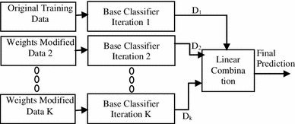
ENSEMBLING TECHNIQUES – Boosting - AdaBoosting
Training data from base data with focus on instances which were incorrectly classified by earlier model (if any)
Voting could be simple or weighted
K similar classifiers created in sequence with respective training data with focus on addressing the misclassified data, not the usual cost functions
It is called Adaptive Boosting as the weights are re-assigned to each instance, with higher weights to incorrectly classified instance

Slide 8
ENSEMBLING TECHNIQUES – Boosting - AdaBoosting
Two prominent boosting algorithms are AdaBoost, short for Adaptive Boosting and Gradient Descent Boosting
In AdaBoost, the successive learners are created with a focus on the ill fitted data of the previous learner
Each successive learner focuses more and more on the harder to fit data i.e. their residuals in the previous tree

Slide 9
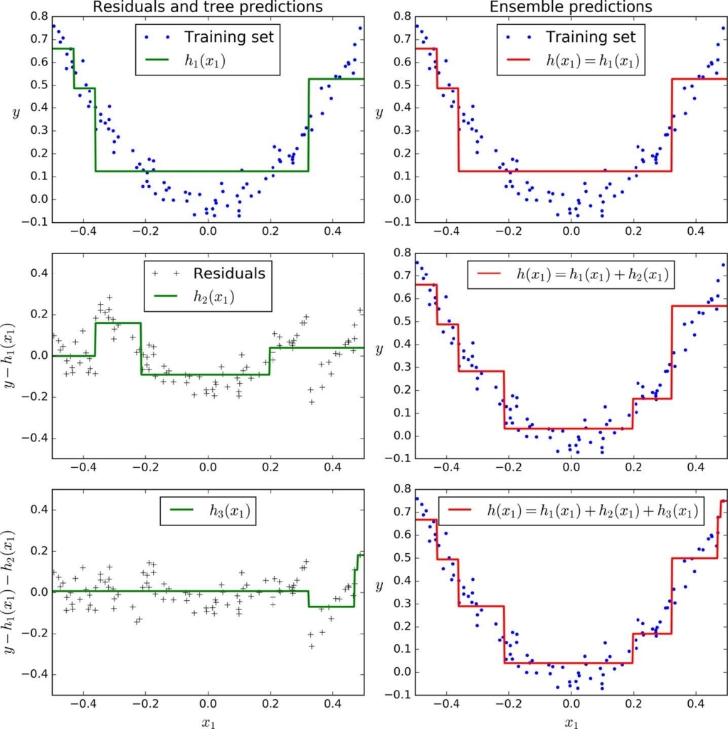
ENSEMBLING TECHNIQUES – Averaging Method – Gradient Descent Boosting
First learner results in residuals (dots that fall above and below the surface. The result (red) is same as first classifier
Next classifier focuses on the residuals of the first classifier to reclassify them as correctly as possible
The combined effect of this surface and previous classifier surface is shown in red
The third learner focusses on the residuals of the previous classifier
The combine result of the new surface with the previous surface is shown in red

Slide 10
ENSEMBLING TECHNIQUES – Random Forest
Each tree in the ensemble is built from a sample drawn with replacement (bootstrap) from the training set
In addition, when splitting a node during the construction of a tree, the split that is chosen is no longer the best split among all the features
Instead, the split is picked is the best split among a random subset of the features
As a result of this randomness, the bias of the forest usually slightly increases (with respect to the bias of a single non-random tree)
Due to averaging, its variance decreases, usually more than compensating the increase in bias, hence yielding overall a better result

Slide 11

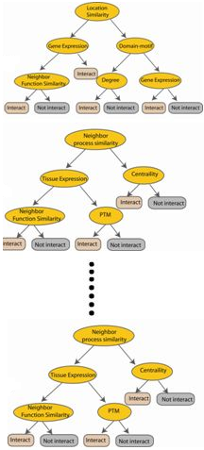



ENSEMBLING TECHNIQUES – RandomForest
Used with Decision Trees. Create different trees by providing different sub-features from the feature set to the tree creating algorithm. The optimization function is Entropy or Gini index
Randomly selected sub feature set
Independent trees created in parallel
N instances
Original number of features

Slide 12
ENSEMBLING TECHNIQUES -Stacking
Similar to bagging, but apply several different models to original data
The weights for each model is determined based on how well they perform on the given input data
Similar classifiers usually make similar errors (bagging)
forming an ensemble with similar classifiers may not improve the classification rate
Presence of a poorly performing classifier may cause performance deterioration in the overall performance
Similarly, even on presence of a classifier that performs much better than all of the other available base classifiers, may cause degradation in the overall performance
Another important factor is the amount of correlation among the incorrect classifications made by each classifier
If the consistent classifiers tend to misclassify the same instances, then combining their results will have no benefit
In contrast, a greater amount of independence among the classifiers can result in errors by individual classifiers being overlooked when the results of the ensemble are combined.

Slide 13
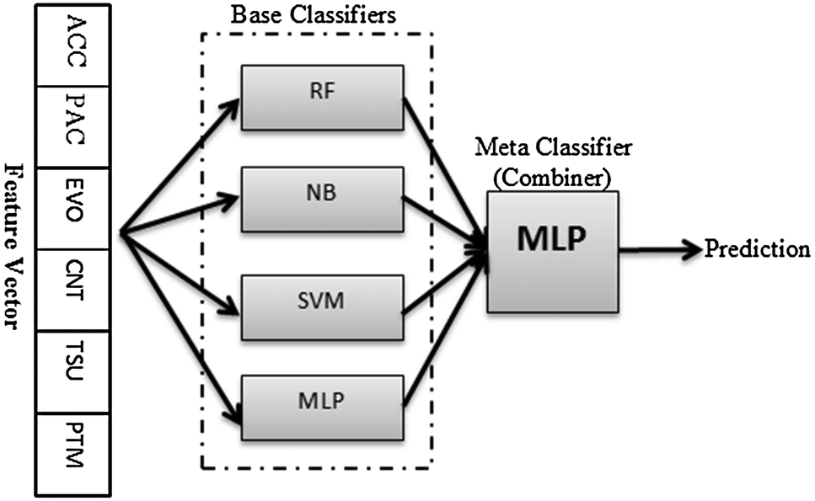
ENSEMBLING TECHNIQUES -Stacking
In stacking multiple layers of machine learning models are placed one over another where each of the models passes their predictions to the model in the layer above it
The top layer model takes decisions based on the outputs of the models in layers below it.

Slide 14
ENSEMBLING TECHNIQUES –Pros and Cons
Advantages
Proven method for improving the accuracy of the model and works in most of the cases.
Significant usecase in all machine learning hackathons.
Model becomes robust and stable
To capture linear and simple as well non-linear complex relationships in the data.
Disadvantages
Reduces the model interpretability
Very difficult to draw any crucial business insights at the end.
The selection of base models for creating an ensemble is an art
Really hard to master

Slide 15
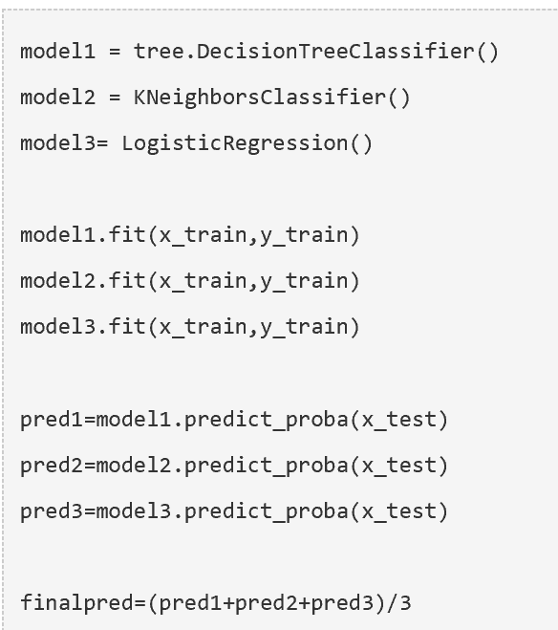
ENSEMBLING TECHNIQUES – Sample code in Python

Slide 16
Thank You

