Slide 1
THE BATTLE OF NEIGHBORHOODS

Slide 2
Discovering neighborhood
Tourism depends upon tourists.And tourists depends upon information about a particular place.
This project helps both tourists and businessmen.
It can help in predicting the tourism business for a particular city based on its cities.
Two cities are taken here -
New York
Toronto

Slide 3
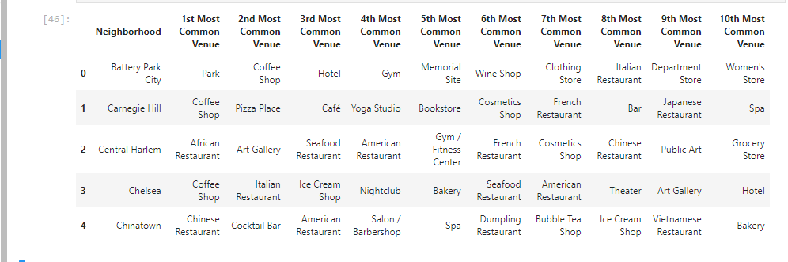
This shows the most visited places of certain neighborhoods in NY

Slide 4
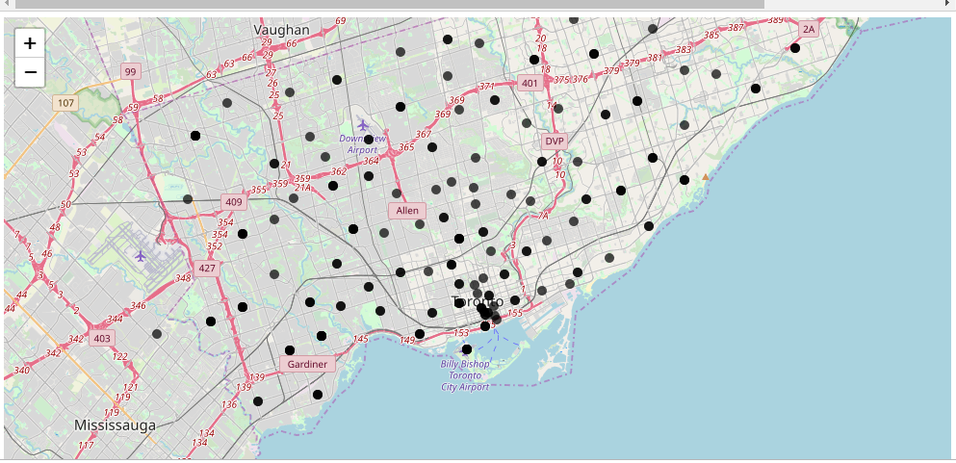
This is the Clustered model of Toronto

Slide 5
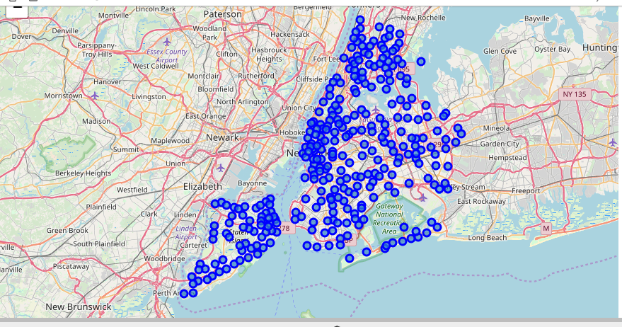
This is the clustered model of NY

Slide 6
Conclusion
Based on different clusters we can evaluate the density of venues around a particular neighborhood of a city and thus decide where to visit.

