Slide 2
CONTENT
Introduction
Literature Review
Objectives
Work Flow Diagram
Proposed System
Hardware and Software Requirements
Applications
Snapshots
Conclusion
References

Slide 3
INTRODUCTION
Digital images have become an integral part of our daily life because they can convey rich information. Due to the wide use of image acquisition tools, which are now very popular in mobile phones, the volume of images shared online is growing exponentially.
However, there are many professional software packages, such as Photoshop and Coral-draw that can be used to manipulate images and alter their contents without leaving visible artifacts for human eyes.
Two common approaches for image manipulation/forgery are:
Copy-move and splicing. In copy-move forgery, some parts of an image are copied to other regions in the same image. By contrast, image splicing combines two or more different images into one image.

Slide 4
RELATED WORK
Shi and Chen [3] proposed a method using statistical features from a 2D array including wavelet and Markov features. Images were divided into multiple blocks then a multiple block discrete cosine transform (MBDCT) was applied.
Zhang et al. [4] used DCT coefficients and LBP histogram as a feature vector to detect image splicing. To reduce the complexity and features dimensionality, Principle Component Analysis (PCA) was used.
The same authors in [5] proposed another model which shows the statistical difference between authentic and spliced images. This approach used MBDCT and statistical image quality metrics which includes mean square errors, normalized cross correlation and moment-based features.
Wang et al.

Slide 5
[6] used edge information of image chrominance component using a finite-state Markov chain. They extracted a low-dimensional vector which was fed into a Support Vector Machine (SVM) to detect image authenticity.
This work has been extended in [7]. Markov features have been extracted by using transition probability matrices in DCT and Discrete Wavelet Transform (DWT) domains. The recursive feature elimination (RFE) SVM was used.
Zhao et al. [8] explored the chroma channels and four gray level run-length run-number (RLRN) vectors in various directions were extracted as features.

Slide 6
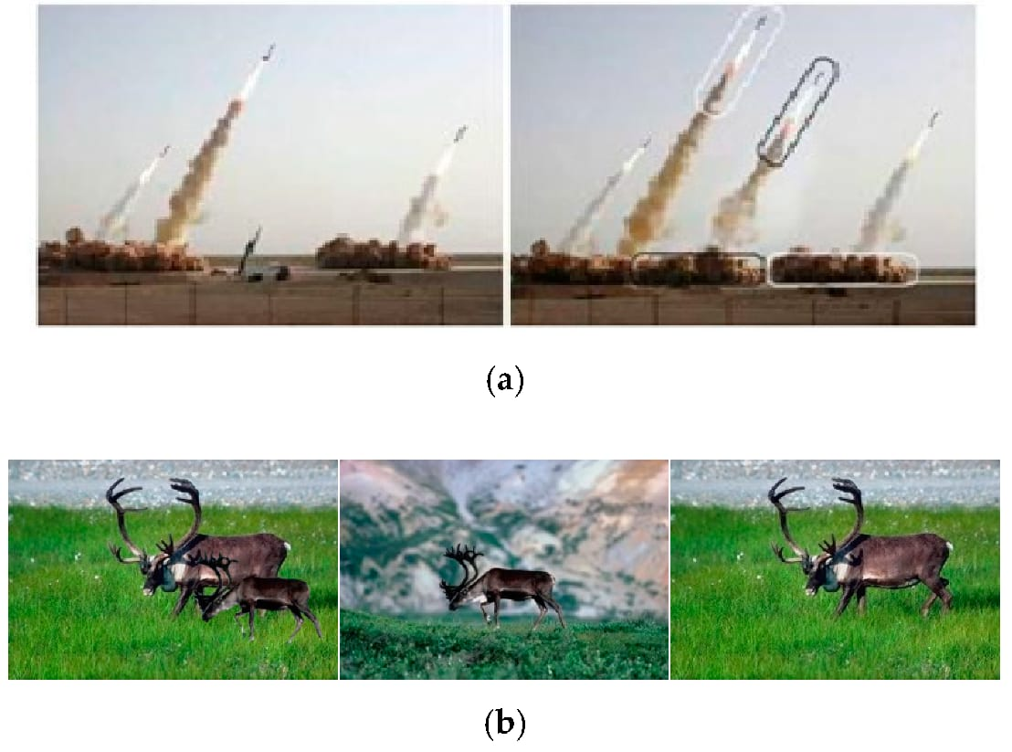
OBJECTIVES
Image splicing is best defined as a combination of two or more parts of different photographs to create a new image , which is known as a spliced image.
Image splicing deceives the human visual system to mislead the peoples hence we used deep learning concept to correctly detect and classify spliced images or original images.

Slide 7
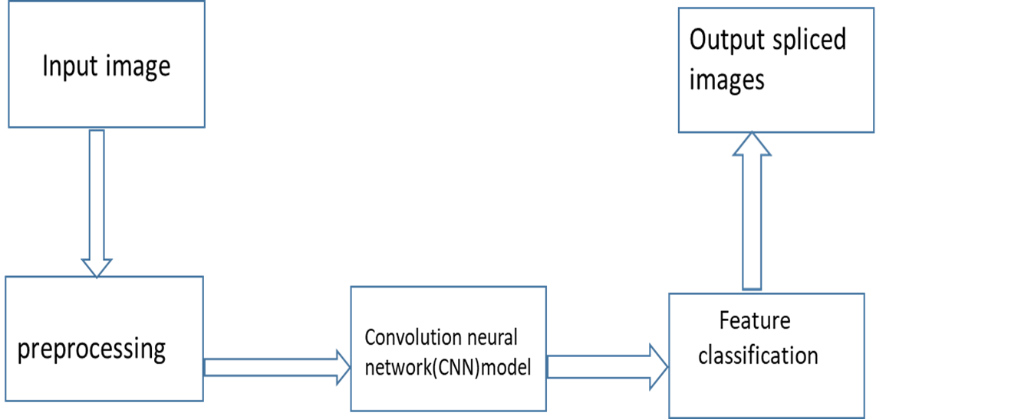
WORK FLOW DIAGRAM
Figure 2. The common workflow of image splicing detection

Slide 8
PROPOSED SYSTEM
To reduce the time required for extracting the image significant futures in order to train large set of data we have deep learning modules to extract only most important features to detect images slicing system efficiently.
PROJECT MODULES
Data collection.
Data-preprocessing and augmentation.
Data cross-validation.
Building deep learning module. (Convolution Neural Network)
Training and testing data.
Result findings and analysis.

Slide 9
Columbia Uncompressed Image Splicing Detection
The required standard dataset has been downloaded from https://www.ee.columbia.edu/ln/dvmm/downloads/authsplcuncmp/#:~:text=The%20image%20sizes%20range%20from,%2C%20books%20...etc

Slide 10
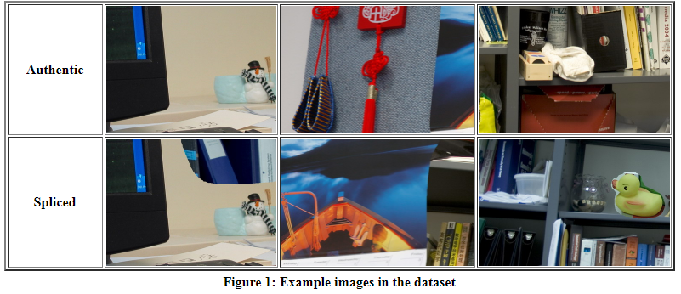

Slide 11
HARDWARE AND SOFTWARE REQUIREMENTS
HARDWARE REQUIRED
Processor : Intel Corei3 processor
RAM: 4GB
Hard disk :1TB HDD
SOFTWARE REQUIRED
Operating system: window 64bit
Tools used: Googlecolab
Programming language python

Slide 12
APPLICATIONS
It can be used to detect forgery skin marks, tattoos and biometrics.
It can be used to detect a variety of crimes, including counterfeiting (not genuine) of currency notes, cheques , as well as manipulation of important government documents, wills, financial deeds or educational certificates
It can be used for detecting modified regions in document images.
It can be used to detect bad image manipulate ion in medical field for claiming medical insurance.
It can used to detect infamous news reporting involving the use of fake images and videos.
Used for security applications with focus on image forgery detection and authentication.

Slide 13
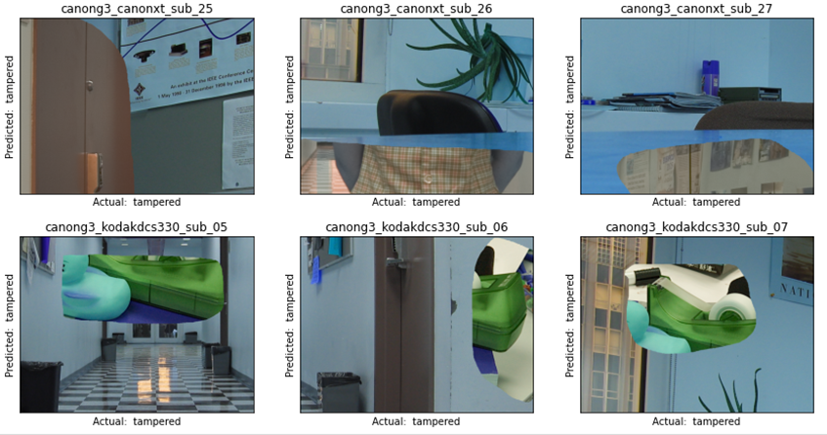
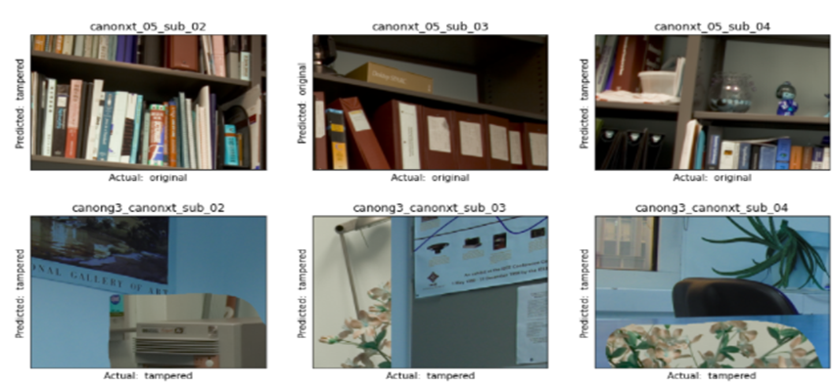
SNAPSHOTS

Slide 14
Conclusion
Image forensics is an active research area due to the large number of shared images online. These images can be easily manipulated with advanced image editing tools and the changes cannot be captured easily by bare human eyes. In this paper, a novel deep learning Convolution Neural Network model is proposed to extract appropriate features of an image in order to train the model efficiently and detect image splicing forgeries. The proposed technique is tested against Columbia Uncompressed Image Splicing Detection publicly available dataset to test the validity of the proposed technique. Based on the result obtains the proposed technique is able to detect/classify the given testing image undergo any splicing forgery or not.

Slide 15
REFERENCE
[1] G. K. Birajdar and V. H. Mankar, “Digital image forgery detection using passive techniques: A survey,” Digital Investigation, vol. 10, no. 3, pp. 226–245, 2013.
[2] “Fake pictures.” http://www.bbc.com/future/story/20121213-fakepictures- make-real- memories/. [Online; accessed January-2018].
[3] Y. Q. Shi, C. Chen, and W. Chen, “A natural image model approach to splicing detection,” in Proceedings of the 9th Workshop on Multimedia & Security, pp. 51–62, ACM, 2007.
[4] Y. Zhang, C. Zhao, Y. Pi, and S. Li, “Revealing image splicing forgery using local binary patterns of dct coefficients,” in Communications, Signal Processing, and Systems, pp. 181–189, Springer, 2012.
[5] Z. Zhang, J. Kang, and Y. Ren, “An effective algorithm of image splicing detection,” in IEEE International Conference on Computer Science and Software Engineering, vol. 1, pp. 1035–1039, 2008.

Slide 16
[6] W. Wang, J. Dong, and T. Tan, “Image tampering detection based on stationary distribution of markov chain,” in 17th IEEE InternationalConference on Image Processing (ICIP), pp. 2101–2104, 2010.
[7] Z. He, W. Lu, W. Sun, and J. Huang, “Digital image splicing detection based on markov features in dct and dwt domain,” Pattern Recognition, vol. 45, no. 12, pp. 4292–4299, 2012.
[8] X. Zhao, J. Li, S. Li, and S. Wang, “Detecting digital image splicing in chroma spaces,” in International Workshop on Digital Watermarking, pp. 12–22, Springer, 2010.

Slide 17
Thank you!!

