Slide 1
Project 1 – Group 5
Does Elon Musk's Crypto related Tweets have an affect on the price of Bitcoin?

Slide 2
Contents
Introduction - Marc (1 min)
Information Architecture - Padma (1 min)
Twitter Analysis - Padma (3 min)
Bitcoin Analysis - Suraj (2 min)
Dashboard - Suraj ( 1 min )
Results - Marc (2 min)

Slide 3
Introduction
Elon Musk is once again in the news, this time announcing his purchase of the social media platform, Twitter. The platform has been the billionaire's main vehicle for commenting on topics such as cryptocurrency. Elon Musk and his Twitter followers which currently stand at 90 million are mainly pro crypto supporters.
The objective of our project is to analyze his Twitter commentary around Cryptocurrency for the year 2021 and see if his comments have had an impact on the Bitcoin price during the period.

Slide 4
Key Questions
Does his crypto commentary impact on bitcoin price?
What type of commentary has more impact, positive or negative?
What type of commentary get more like and retweets?

Slide 5



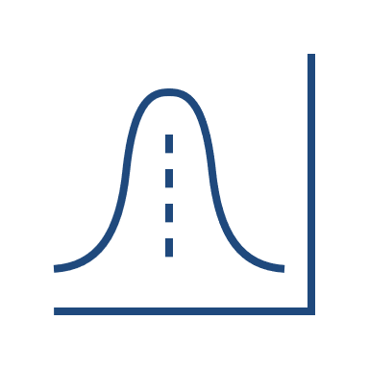




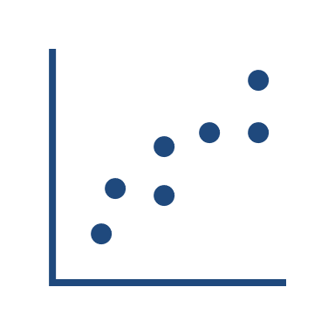



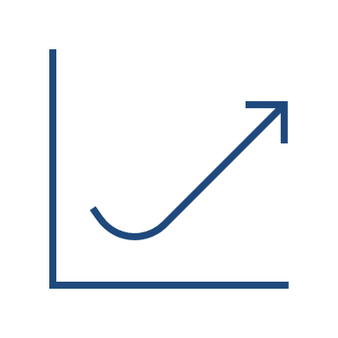


Information Architecture
bitcoin_data.ipynb
Results
Bitcoin Closing Price
Data cleanse and exploration
Analysis
Correlate
Twitter.ipynb
Plotting.ipynb
EM Crypto Twitter Data
Data cleanse and exploration
Sentiment Analysis
Analysis

Slide 6
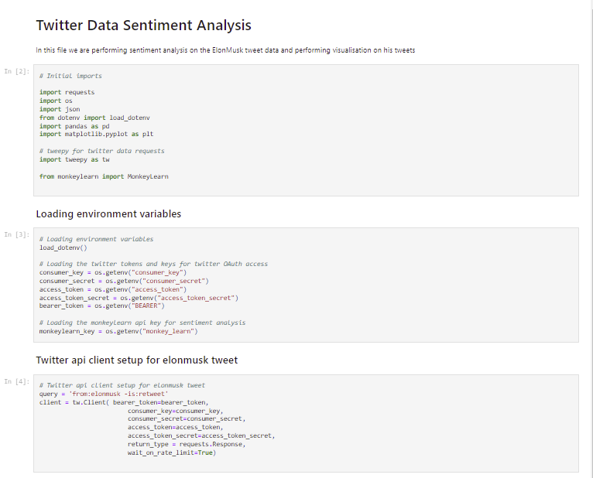
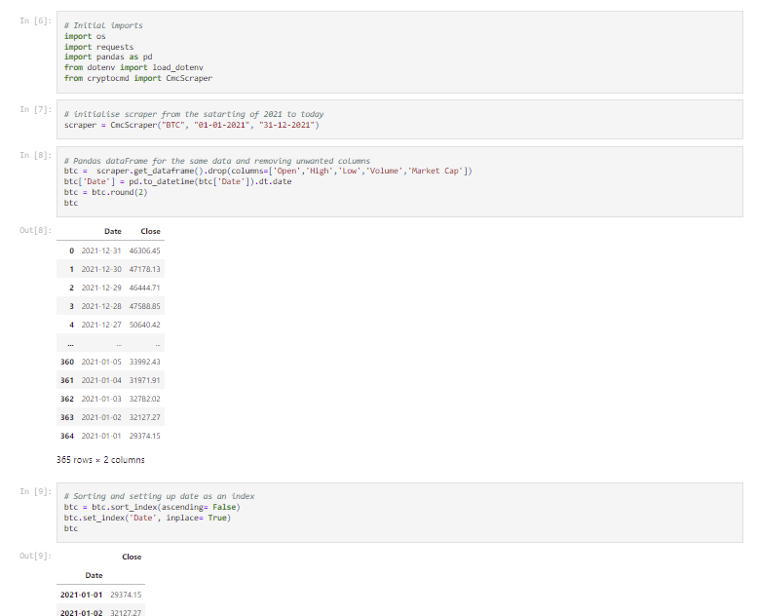
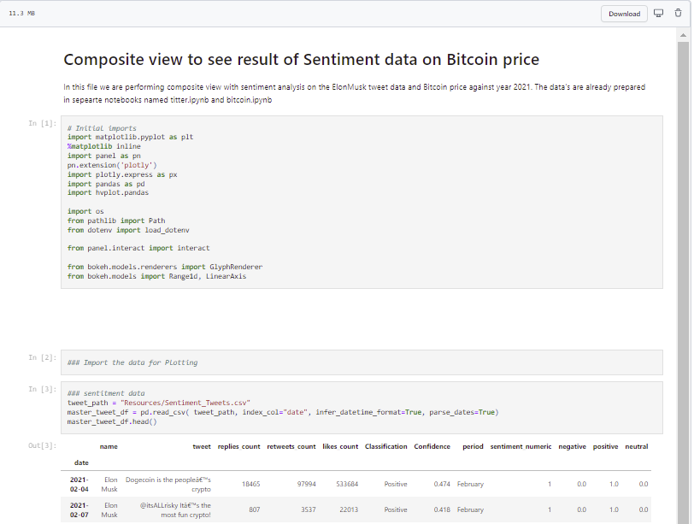
Jupyter Notebooks
Twitter.ipynb
Bitcoin_data.ipynb
Plotting.ipynb

Slide 7
Twitter Analysis

Slide 8
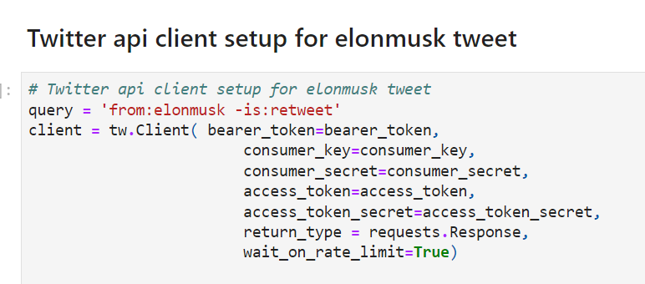
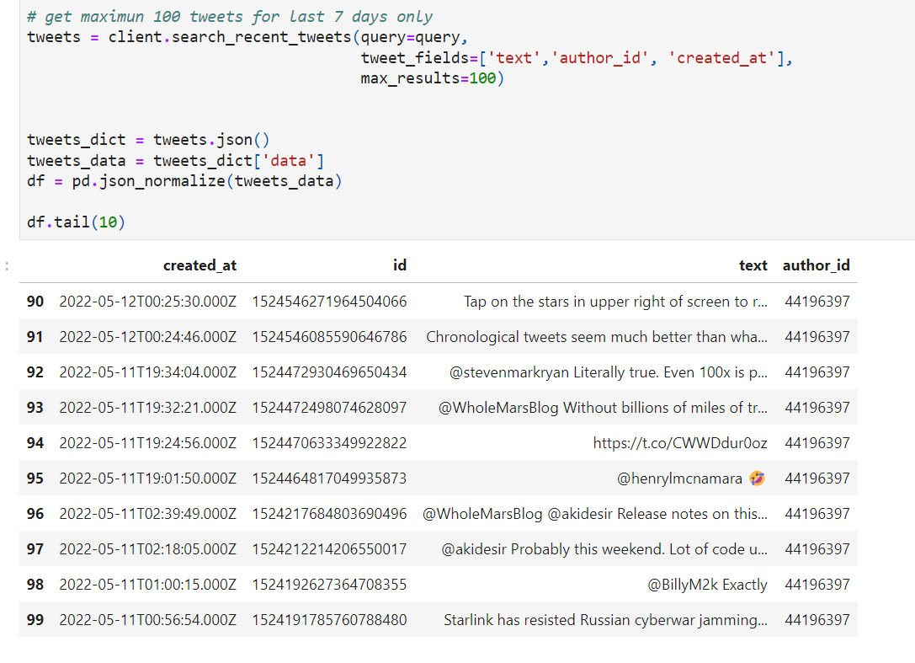
Twitter Data Sourcing

Slide 9
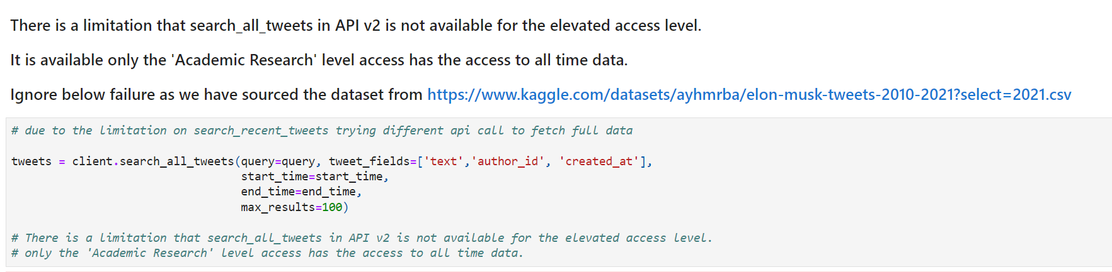
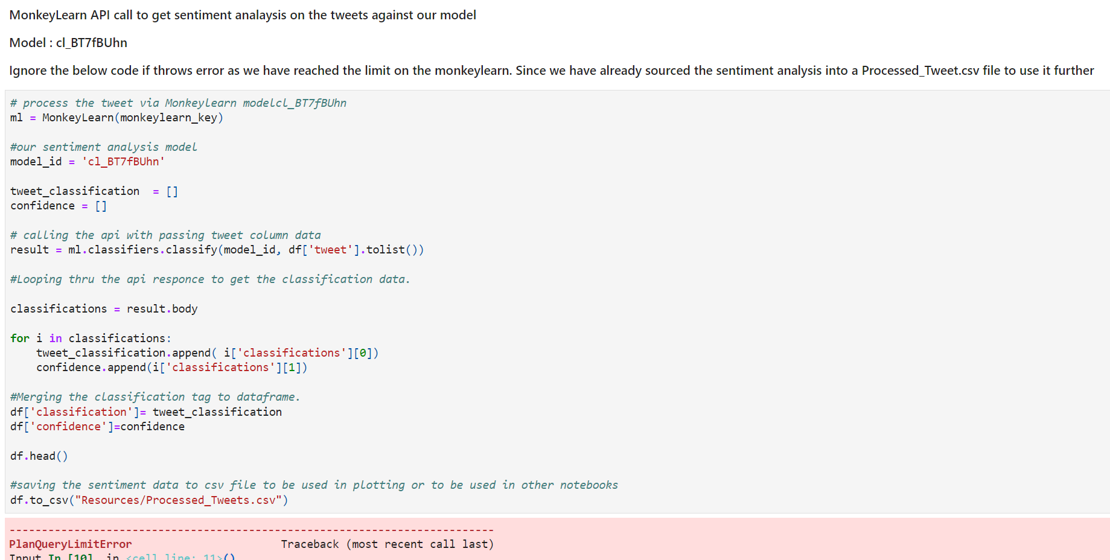
Roadblocks
1. All Tweet API v2 limitation on historical data
2. MonkeyLearn sentiment limitation on only 1000 queries

Slide 10
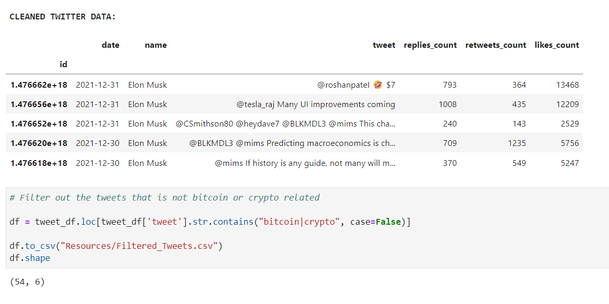
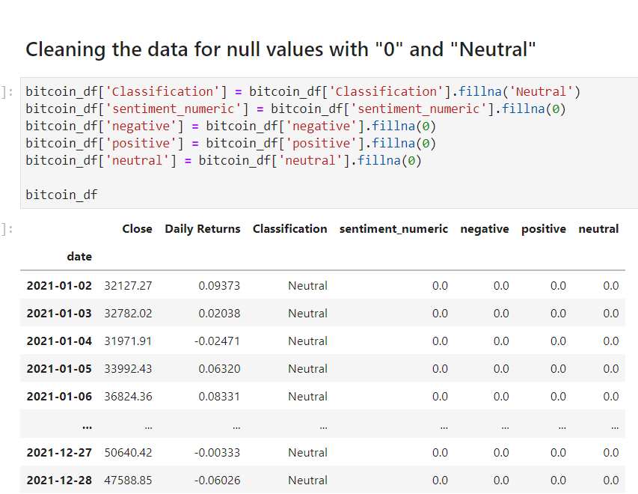
Data Cleansing & Exploration
Filter for EM crypto Tweets ( 3115 tweets into 54 tweets)
Clean nulls and unnecessary columns
Run the monkeylearn model cl_BT7fBUhn against filtered tweets for processing sentiment
Drop duplicates and transform into time series data for plotting
Notes:
5

Slide 11


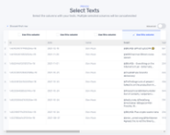
Sentiment Analysis - Model
We used sentiment analysis model to classify whether an EM Tweet is neutral, negative and positive.
We have used https://monkeylearn.com to create model the tweets into sentiments.
Select Model Type
Sentiment Classification Model Generation
Select Classification
Select Data for Model Training

Slide 12
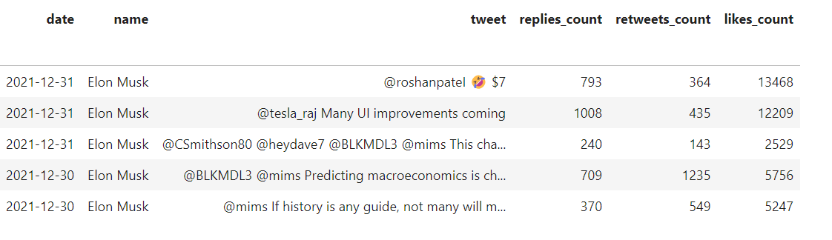
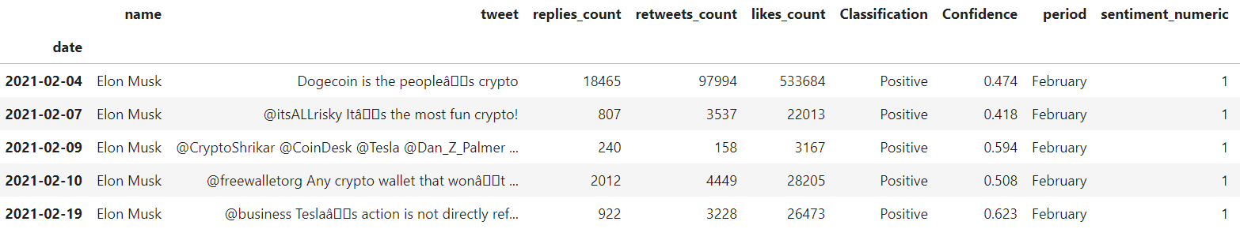
Sentiment Analysis - Data
Sentiment input
Sentiment processed output

Slide 13
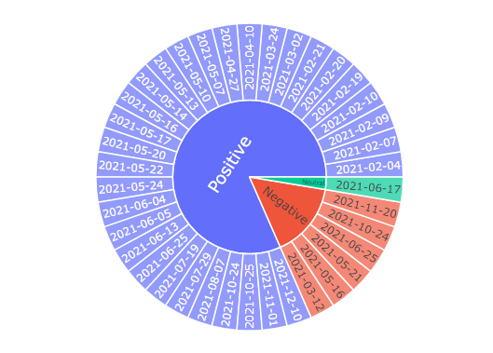
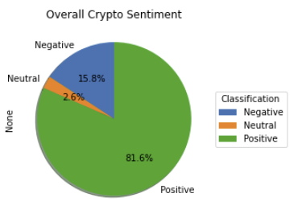
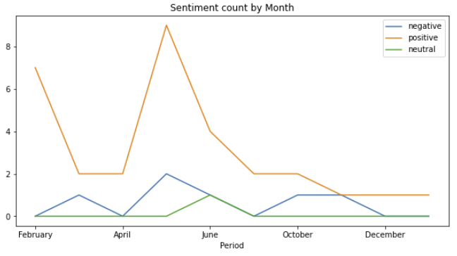
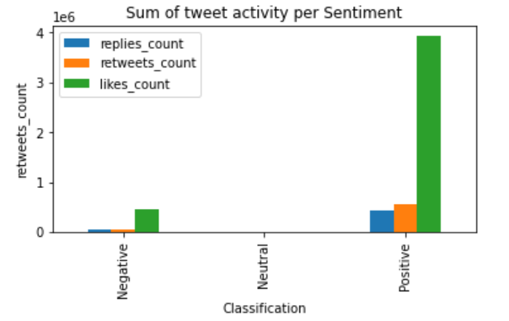
Data Analysis – Tweets
Profile the data to better understand the distribution of EM positive, negative and neutral crypto related Tweets
Understand his monthly crypto related Twitter activity

Slide 14
Bitcoin Analysis

Slide 15
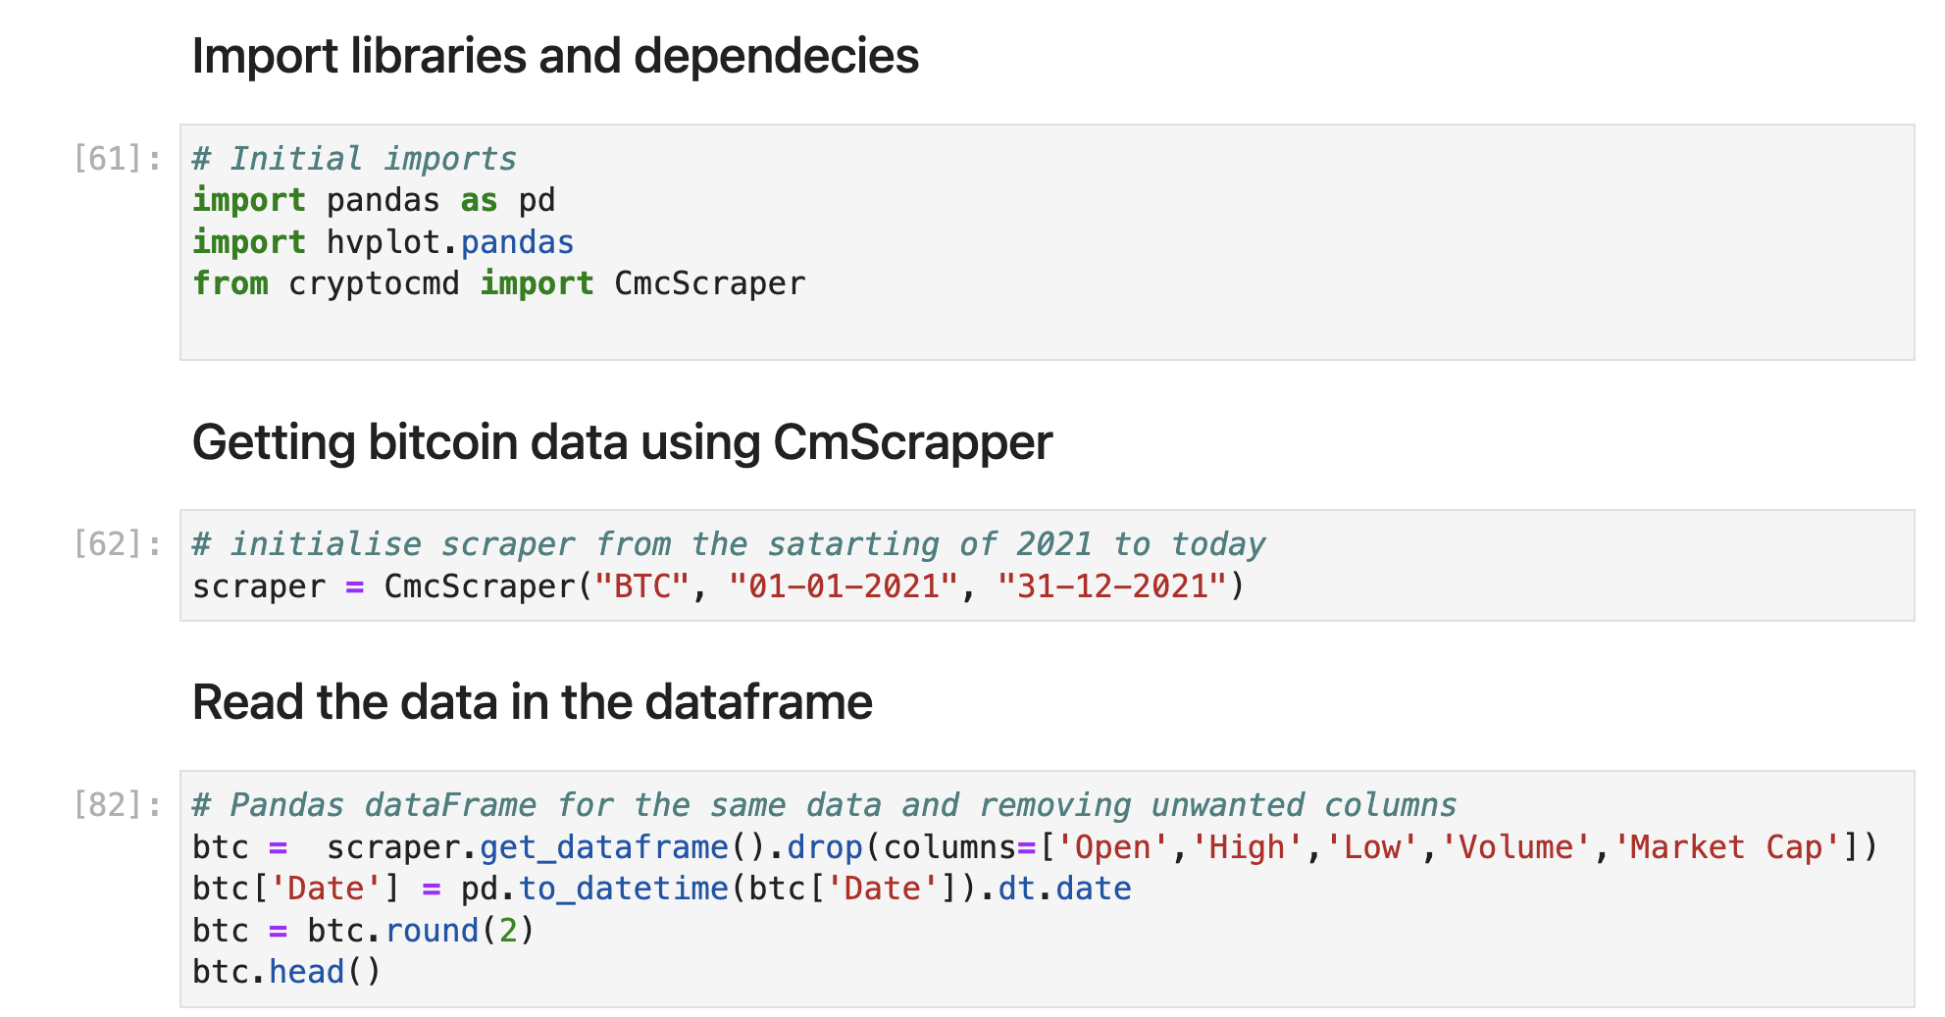
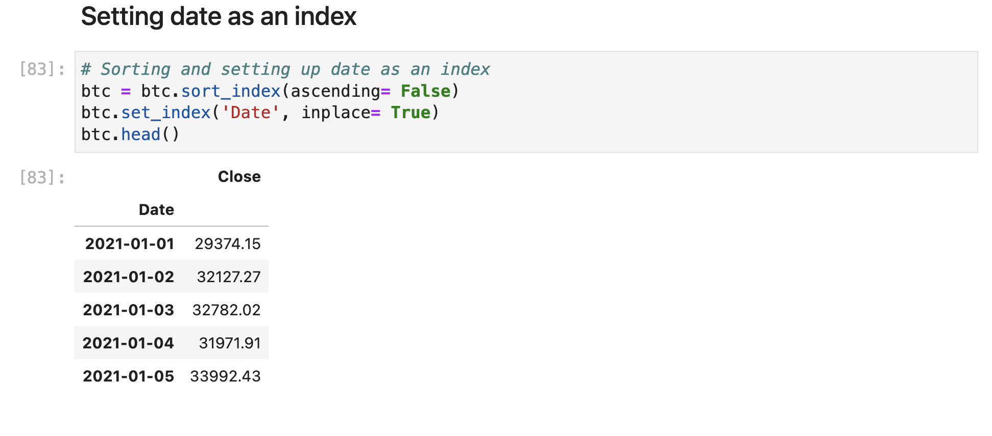
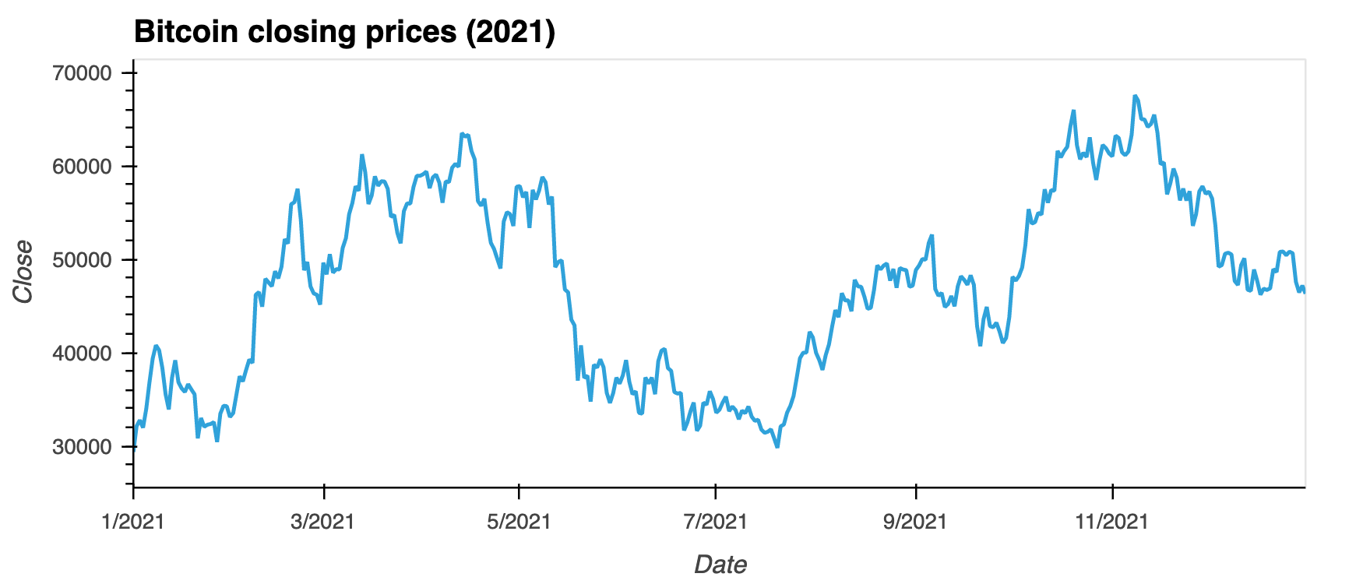
Bitcoin Data Sourcing

Slide 16
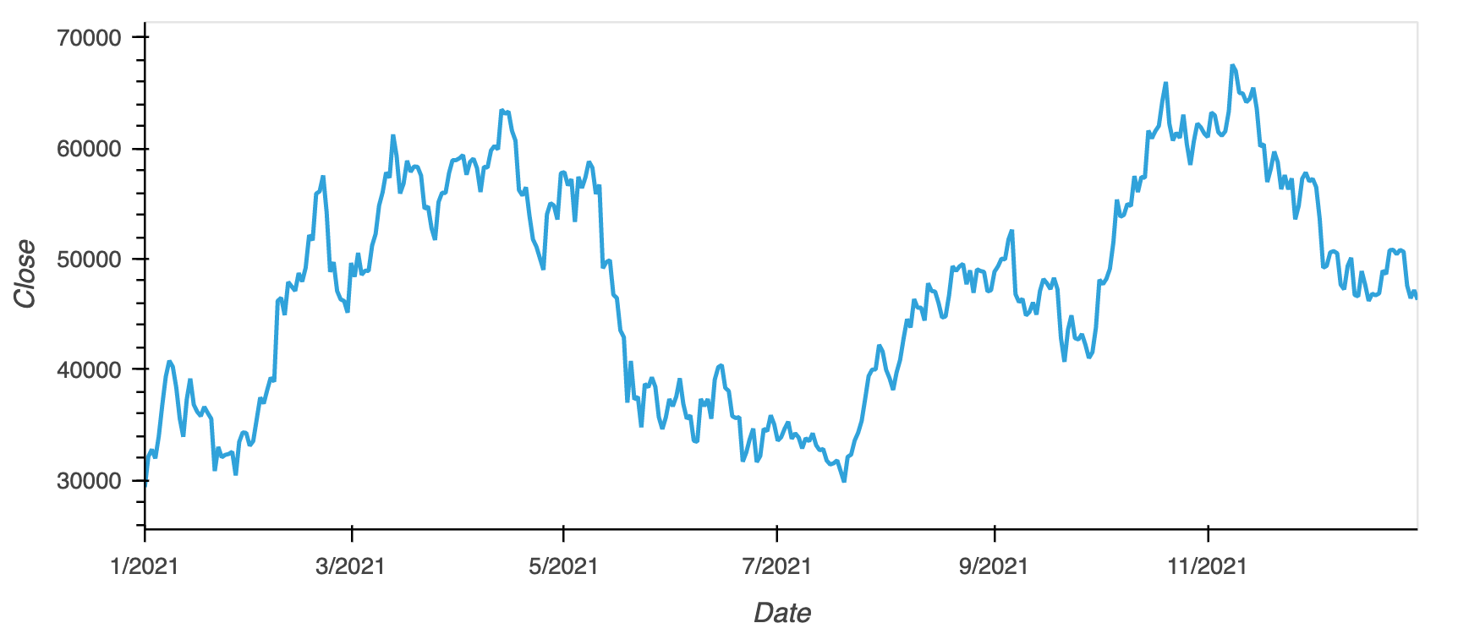
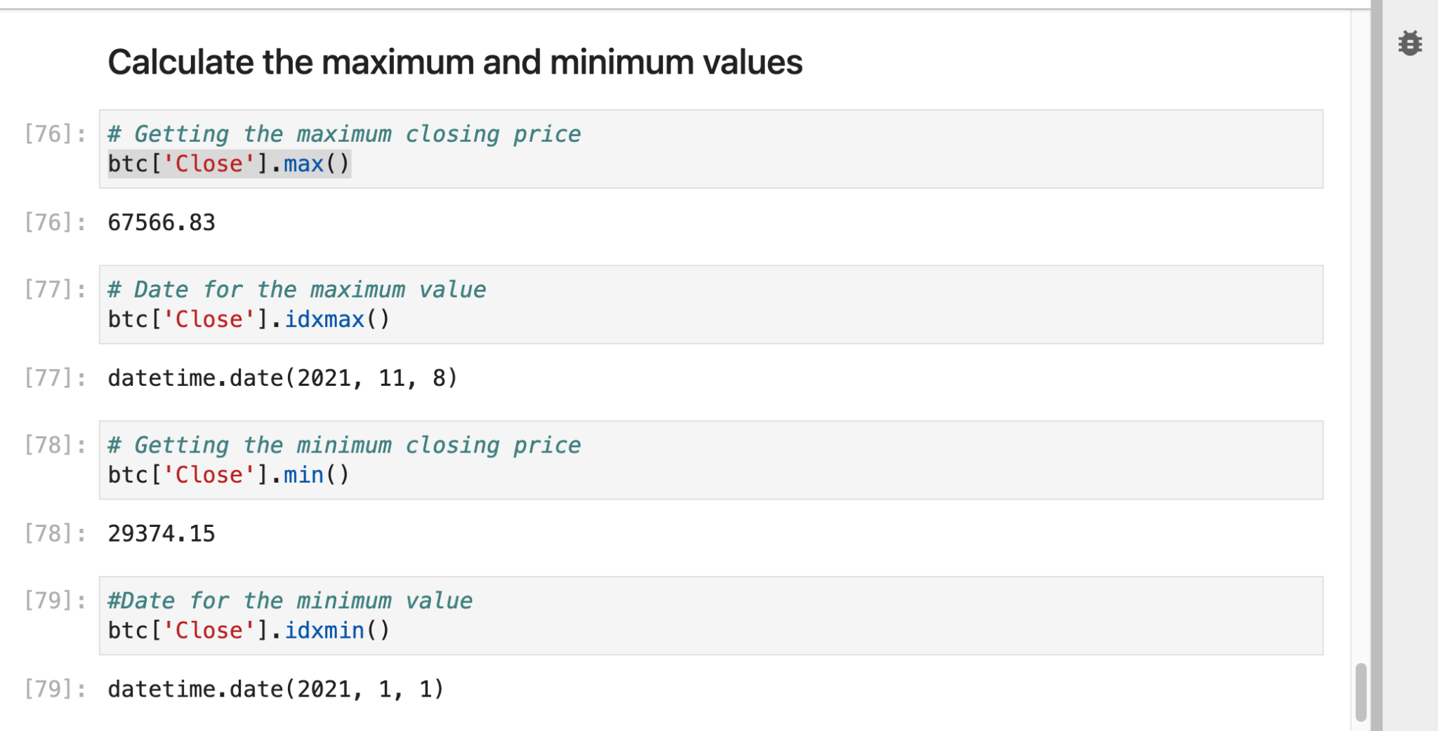
Maximum and Minimum values

Slide 17
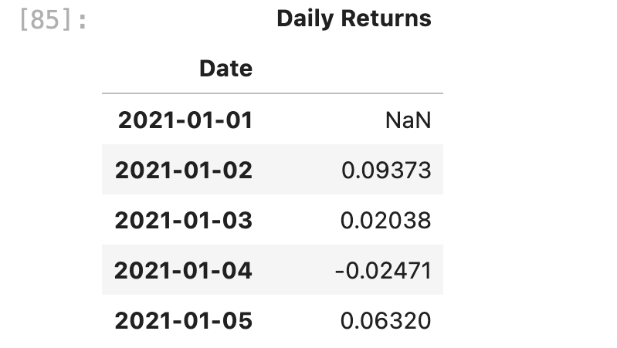
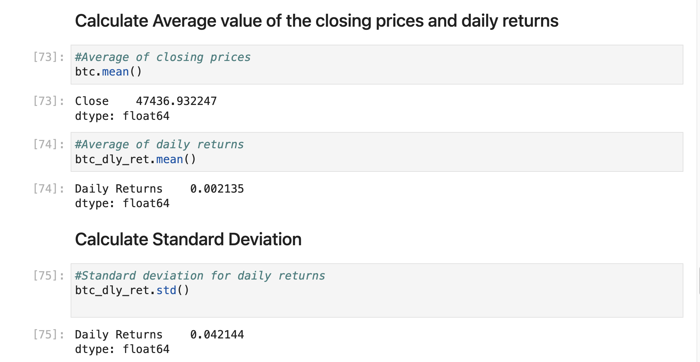
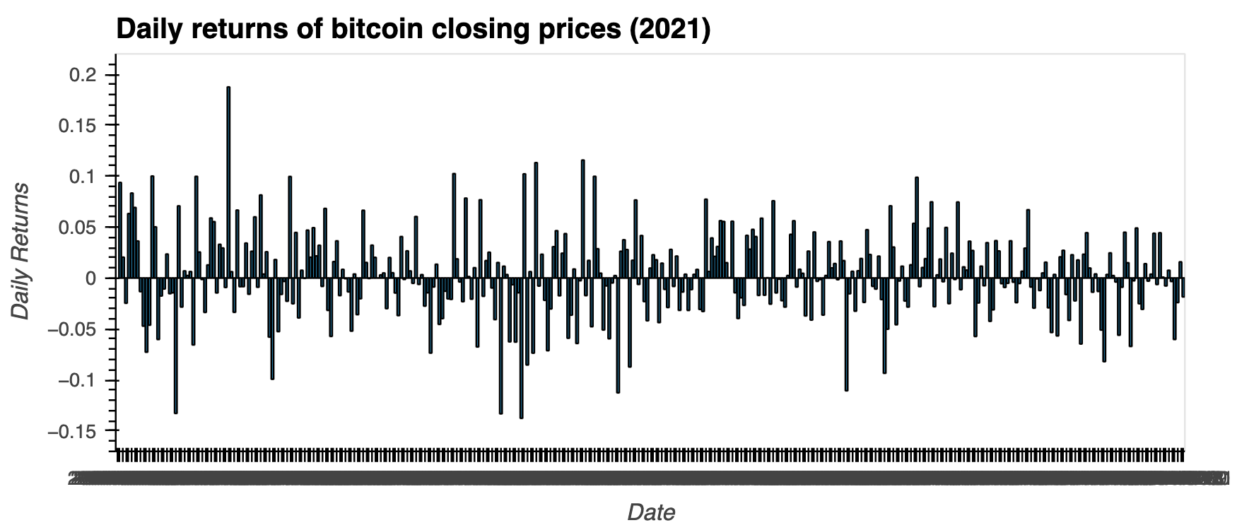
Daily Returns and Standard Deviation

Slide 18
Roadblocks
Limited bitcoin data on Alpaca API
Need a membership for Binance API to access the data

Slide 19
Dashboard

Slide 20
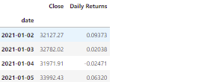
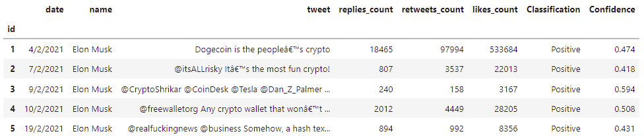
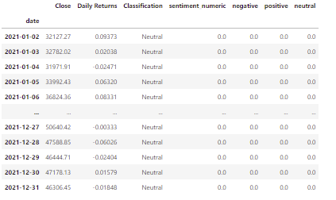

Data Modelling
Bitcoin
Twitter
Combined

Slide 21
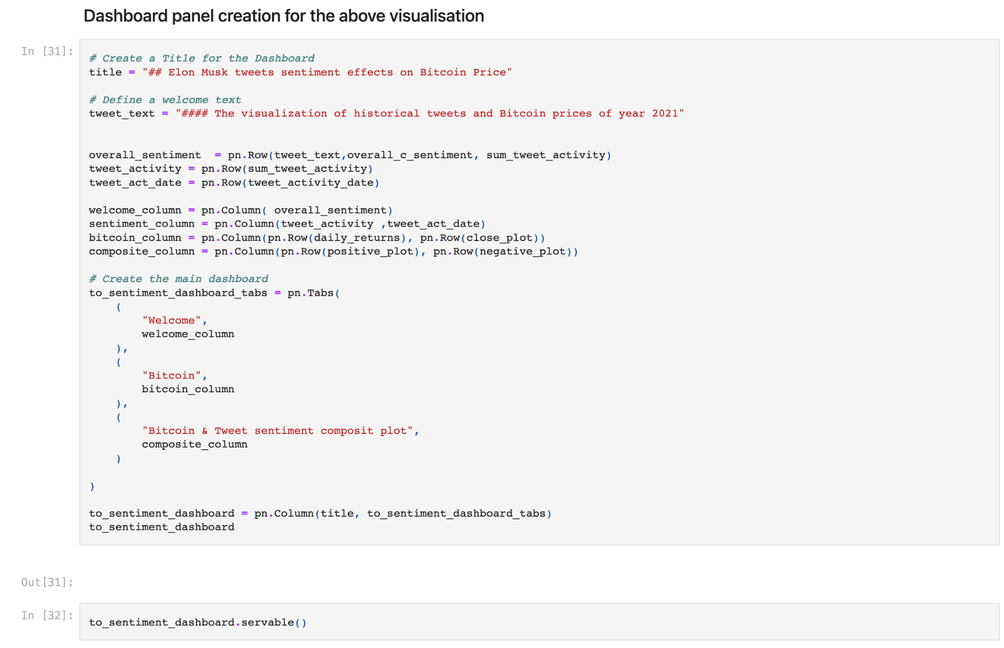
Dashboard

Slide 22
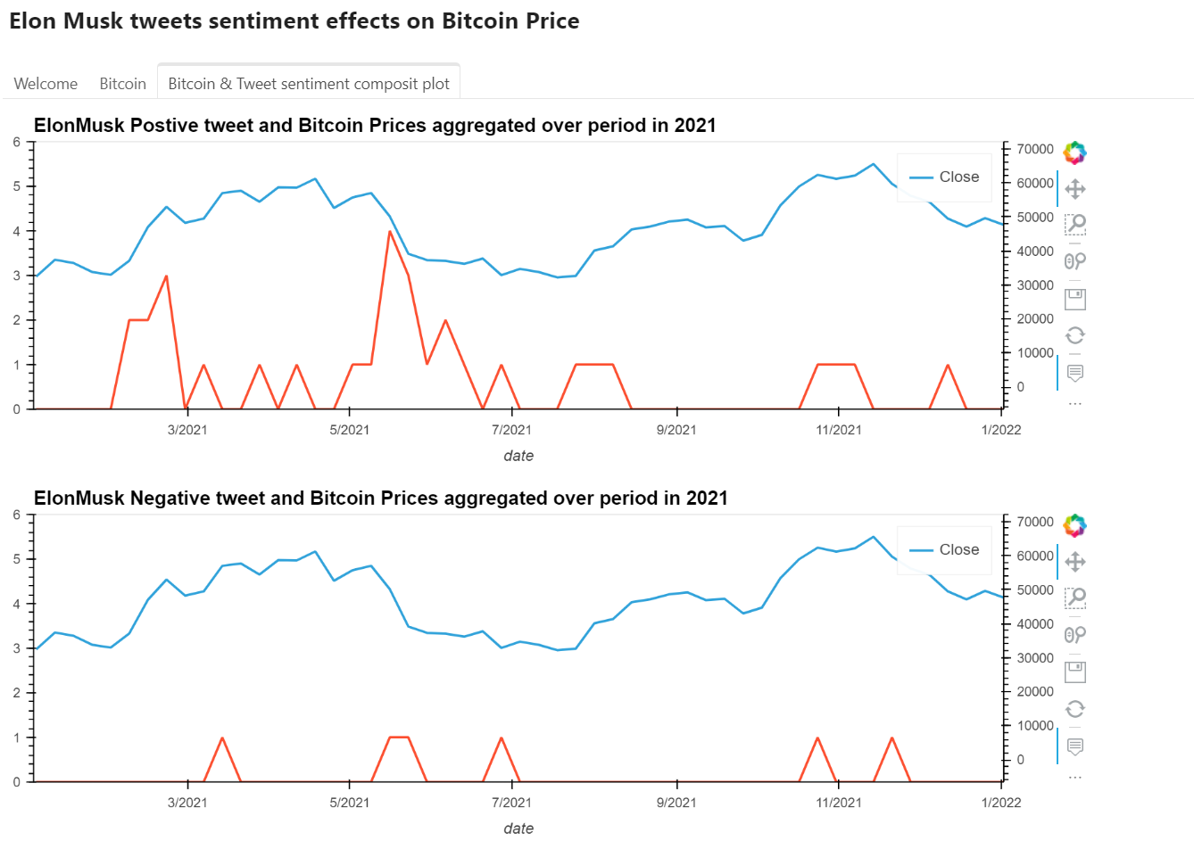
Dashboard

Slide 23
Results

Slide 24
Final Results - Approach
In order to answer our question of whether Elon Musk Tweets has an effect on the Bitcoin price we used the results of our analysis in the following manner:
We generated a composite trend analysis for the Bitcoin price along with his positive and negative crypto sentiment for 2021
We identified period bands during that time he released a flurry/cluster of tweets. This was done for positive and negative crypto tweets
Using trend analysis we identified the incoming trend of the bitcoin price for the band as well as the outgoing trend
Using this we identified the following cases:
The outgoing tweet for the band aligned with the sentiment
The outgoing tweet for the band aligned with the sentiment as well as if the incoming sentiment was different
Depending on the frequency of second case, it should determine his influence

Slide 25
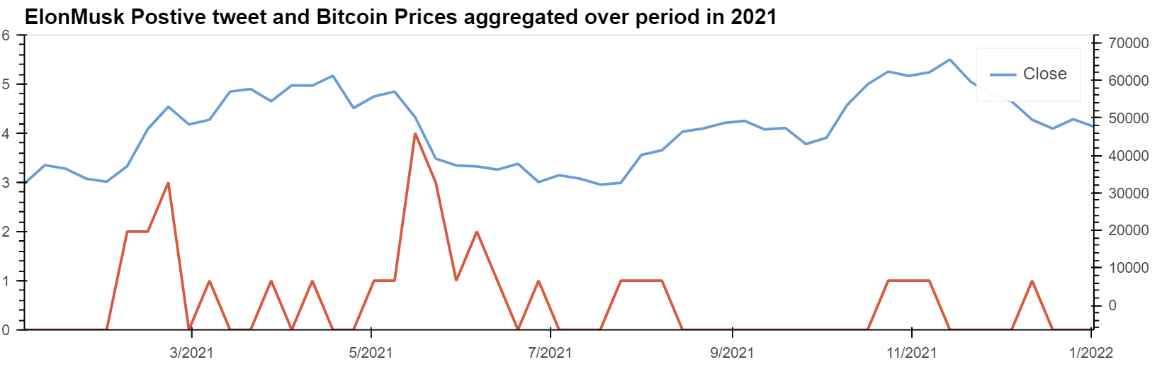
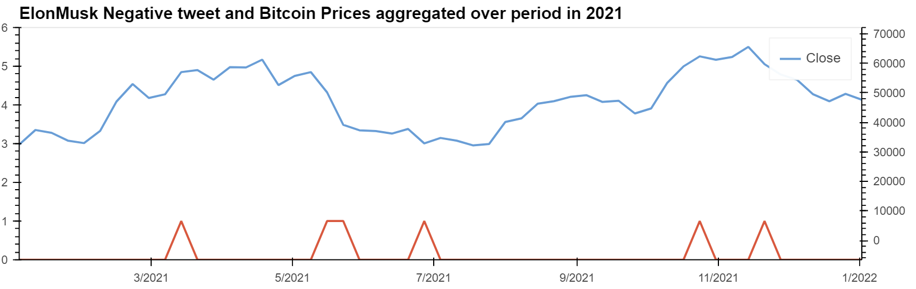
Final Results - Trend Analysis & Banding
1
6
8
3
4
10
12
7
2
5
9
11

Slide 26
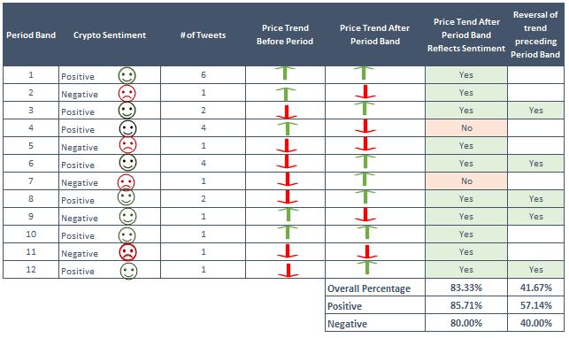
Final Results
We were not able to statistically conclude the Elon Musk crypto related Tweets had a material impact on the price of Bitcoin, but through our rudimentary analysis of his 2021 Tweets and respective closing Bitcoin prices we were able to determine the below:
83.33 % of the period bands during we looked at during 2021 his crypto sentiment reflects the trend of the Bitcoin price following his Tweets
41.67 % of the periods bands during we looked at during 2021 his crypto sentiment reflects the trend of the Bitcoin price following his Tweets as well as being a reversal of the trend preceding the Tweet

Slide 27
QA

