Slide 1
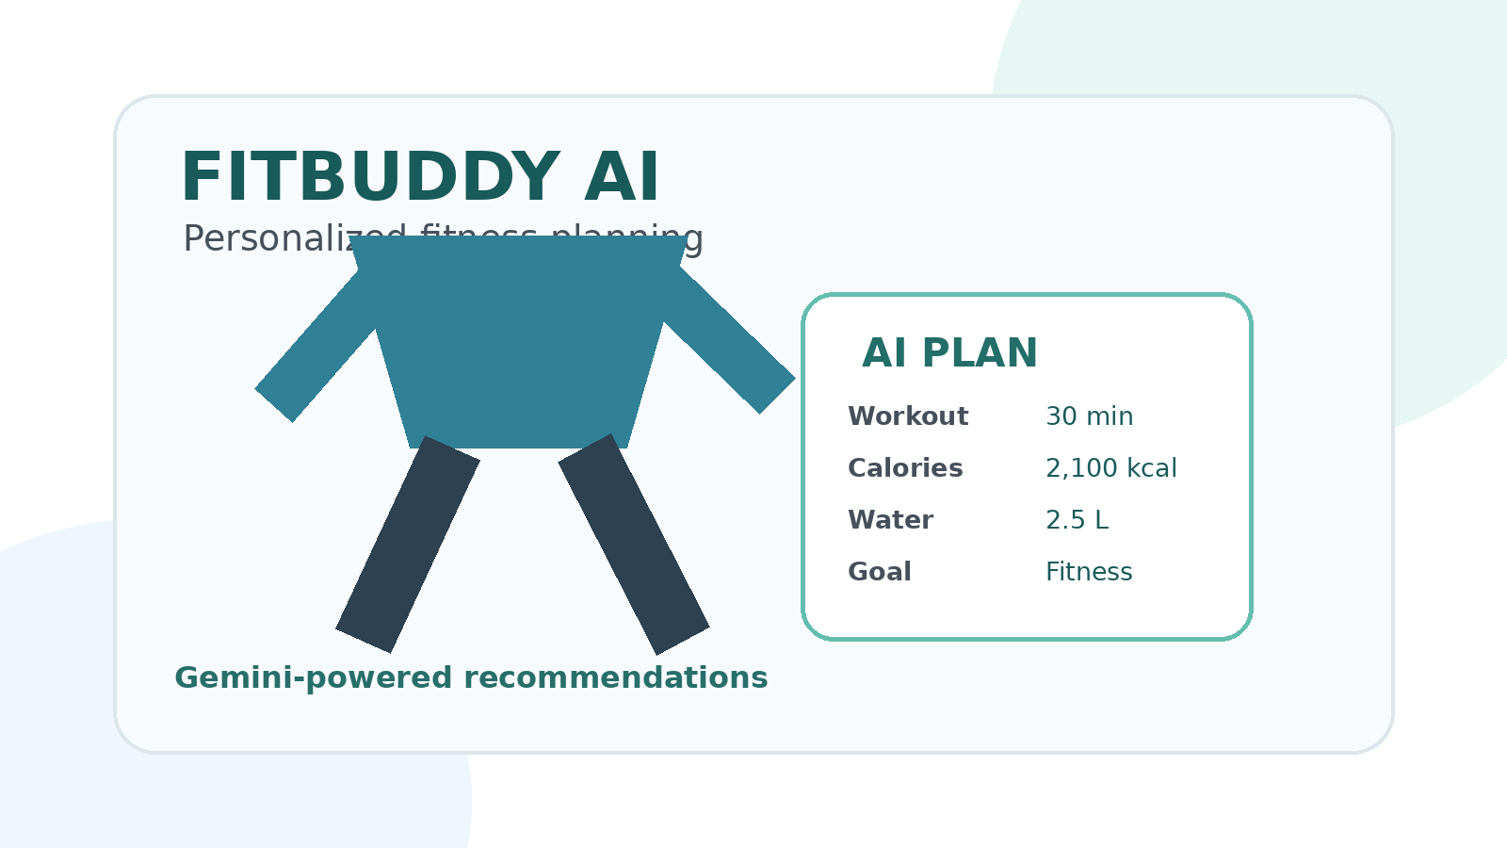
FITBUDDY AI
Plan Generator using
Gemini Models
AI-powered personalized fitness & wellness planning
Team Leader: T. VASANTHA KUMAR
Team Members: S. MANIKANDAN • M. SANJAI • R. PADMASRIYAN

Slide 2
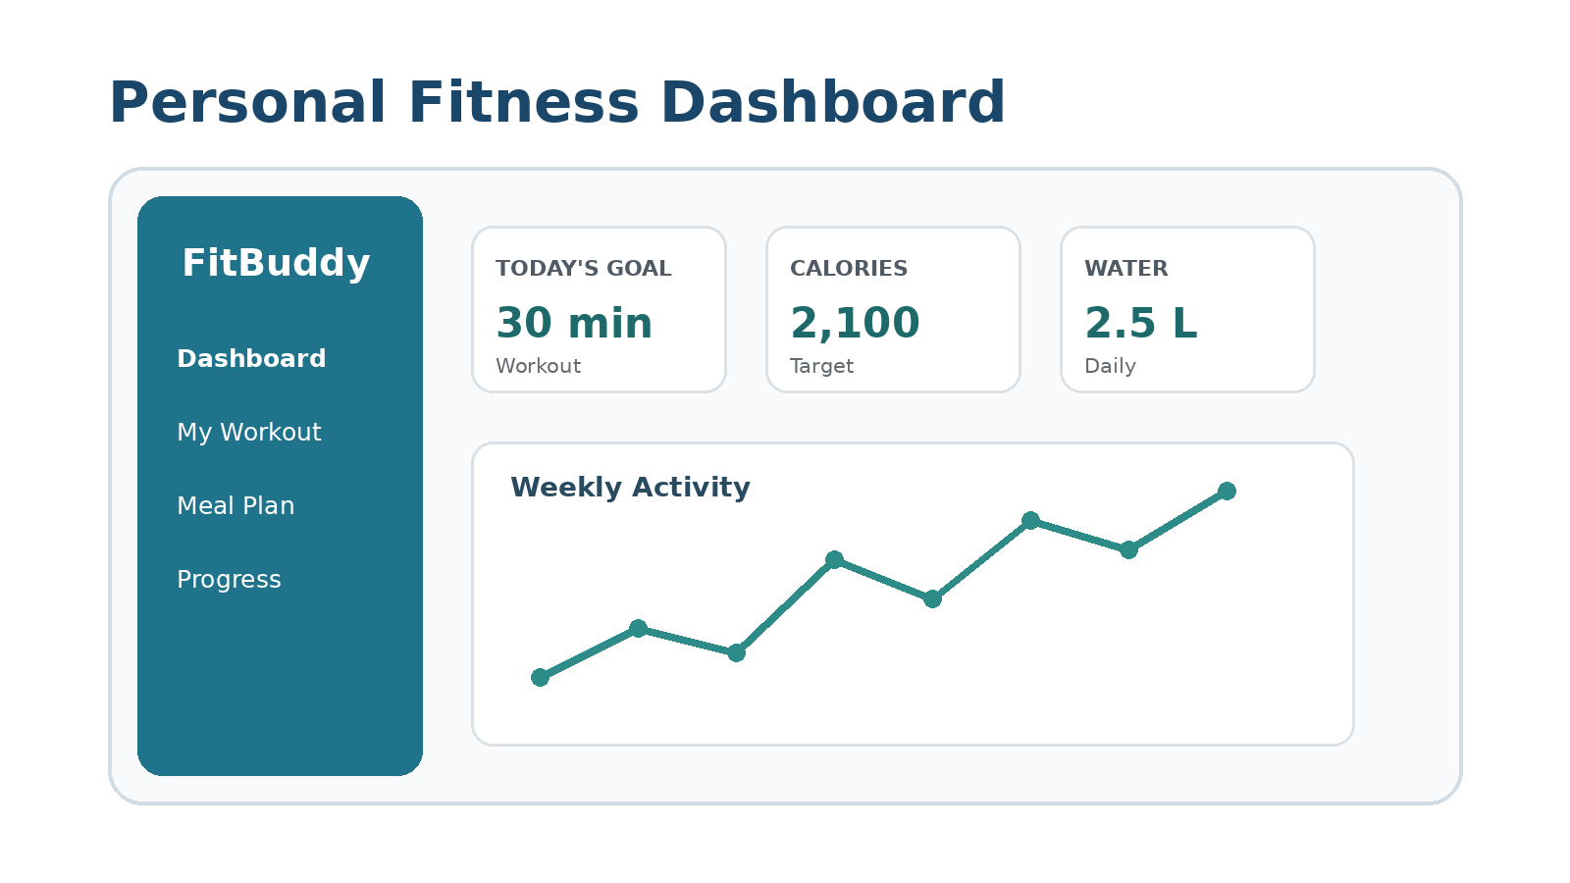
Problem Statement
Why a smart fitness plan generator is useful
• People often struggle to create a consistent workout and daily wellness routine.
• Generic plans may not match a user's goal, experience level, schedule, or preferences.
• Beginners need simple guidance that can be adjusted as their routine changes.
• An AI assistant can turn personal inputs into a structured, easy-to-follow plan.

Slide 3
Proposed Solution
FitBuddy AI creates personalized plans from user inputs
PERSONAL PROFILE
AI PLAN
Goal, fitness level, schedule, preferences
Workout, nutrition guidance and daily routine
ADAPTIVE
EASY TO USE
Plans can be refined from user feedback
Simple interface with clear recommendations
Core idea: Collect → Understand → Generate → Personalize

Slide 4
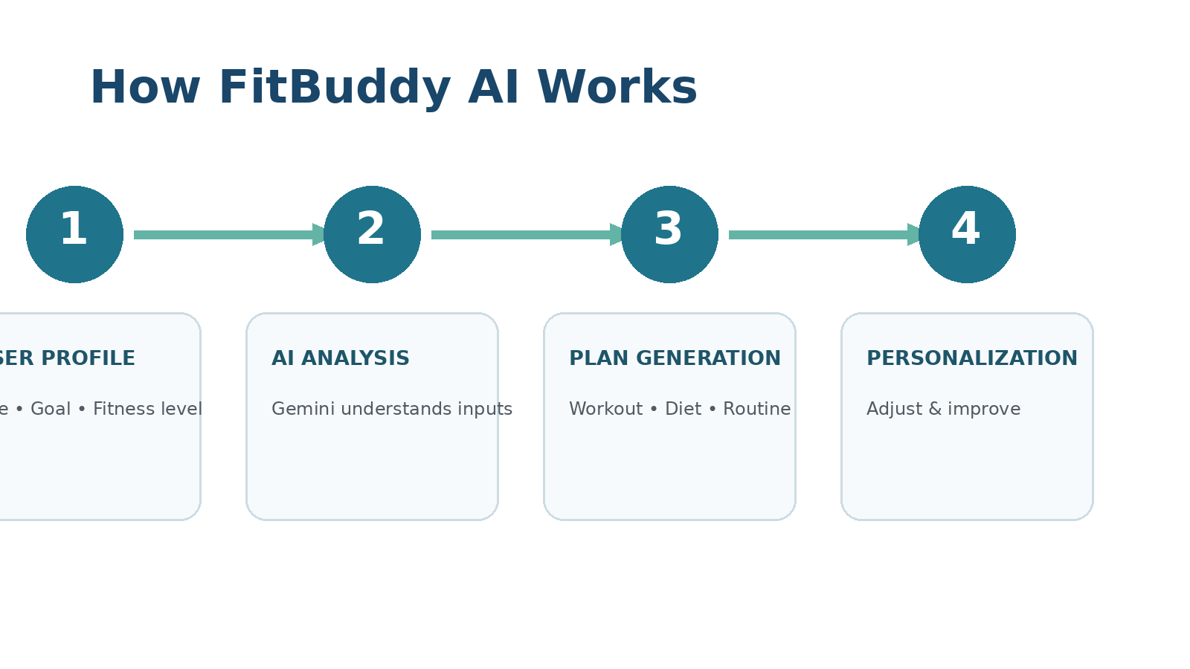
Gemini-Powered Architecture
High-level flow of the FitBuddy AI system
Gemini models process structured user information and generate natural-language recommendations.

Slide 5
Key Features & Benefits
What the application can provide
• Personalized workout plan based on the user's selected goal and fitness level.
• Daily routine with achievable activities and reminders.
• Meal and hydration guidance presented in a simple format.
• Progress-focused recommendations that can be updated with new inputs.
• Conversational AI experience for asking questions and refining the plan.
FITBUDDY
✓ Personalized workout
✓ Daily wellness routine
✓ AI-generated guidance
✓ Easy plan updates

Slide 6
Future Scope & Conclusion
FitBuddy AI as a scalable personal wellness assistant
• Add progress tracking and visual analytics.
• Support more personalized recommendations using feedback and history.
• Integrate wearable or activity data where appropriate.
• Improve multilingual and voice-based interaction.
• Provide safer, evidence-aware guidance with clear boundaries for medical needs.
THANK YOU
Questions?
Team Leader
T. VASANTHA KUMAR
S. MANIKANDAN • M. SANJAI • R. PADMASRIYAN

