Slide 1
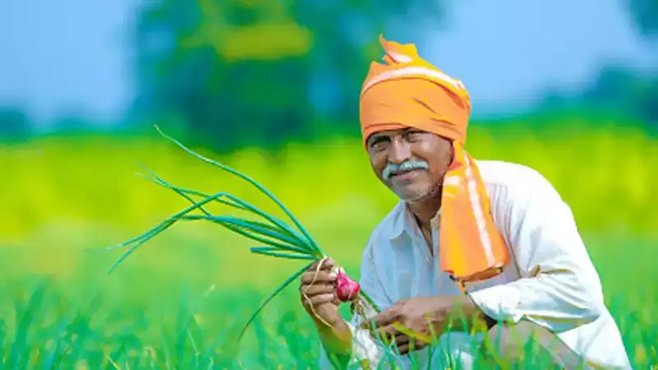
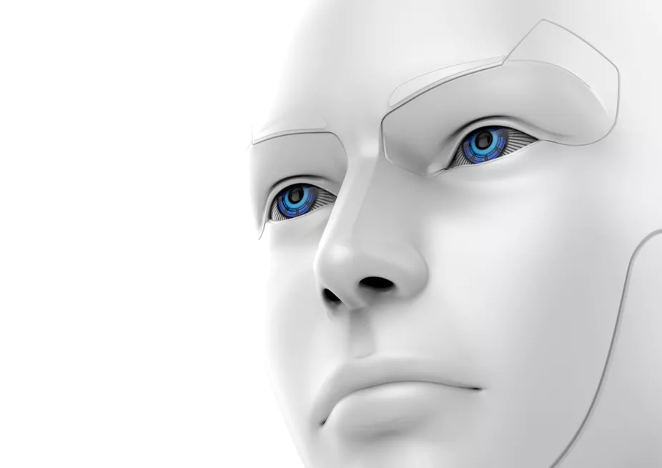
.
AI
based support system for farmers

Slide 2
Why ..??
•70% of respondents said their crops were destroyed because of unseasonal rains, drought, floods and pest attack.
•This concludes to the fact that farmers are having inadequate knowledge about weather, temperature and seasonal rains etc..

Slide 3
•They have repeated losses as they are unaware of the market prices.
Loss due to incorrect disposal of pesticides.

Slide 4
output
•Our system helps farmers to be aware of which crop is going to yield them the maximum profit.
•It also provides them with the market price of that crop. Our system also provides best organic pesticides suitable for the crop.

Slide 5
Factors on which crop is recommended
•Temperature
•Humidity
•Rainfall
•Moisture
•Soil type
•our algorithm is trained on these 5 factors using K-NN algorithm.

Slide 6
How it works ..????

Slide 7
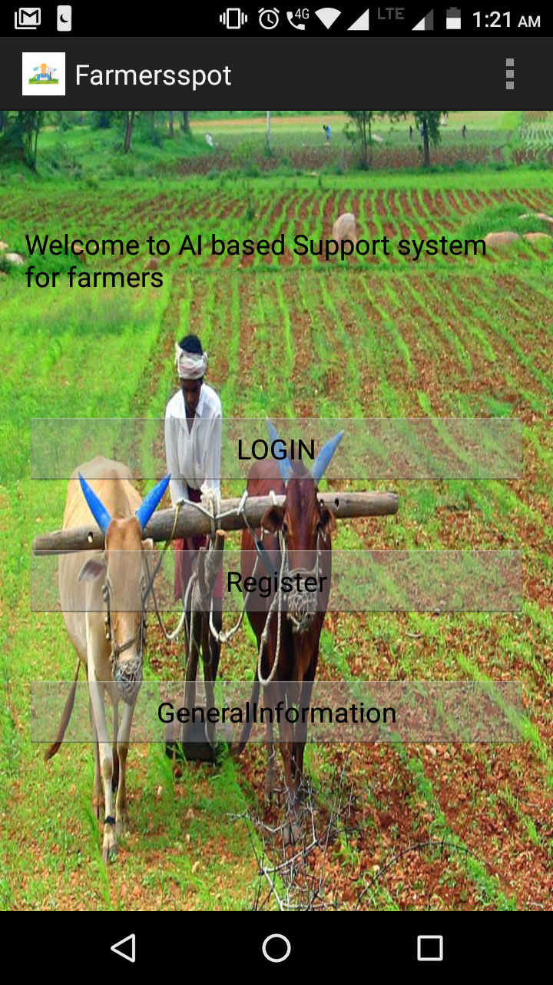
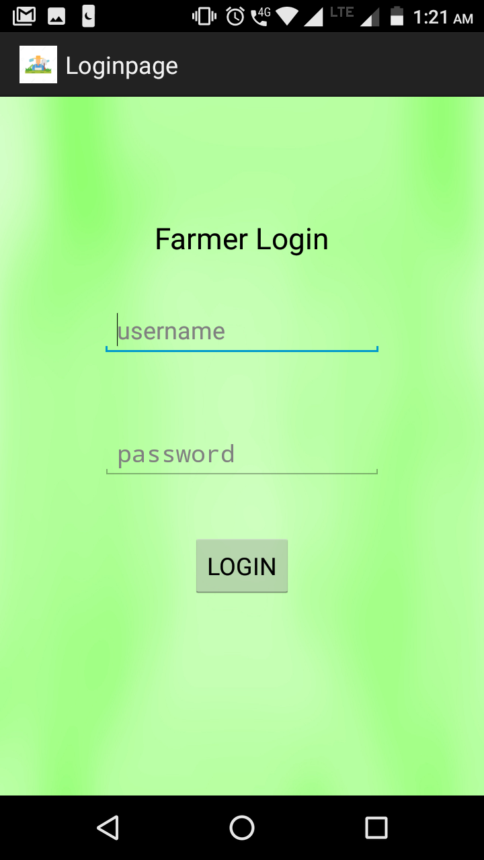

Slide 8
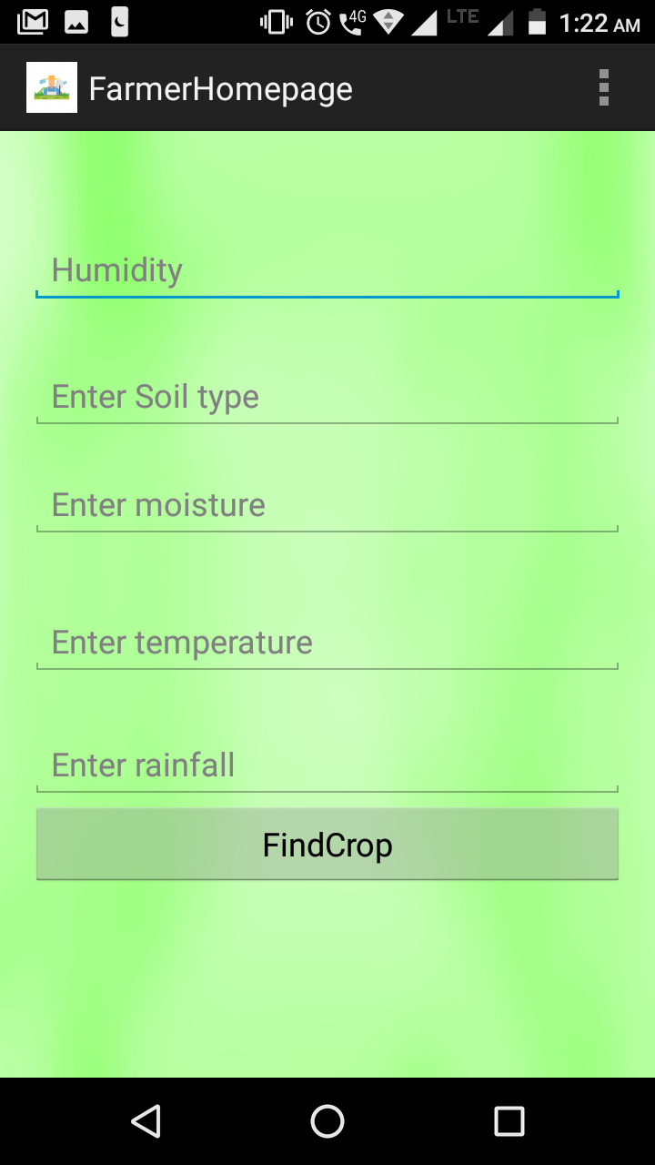
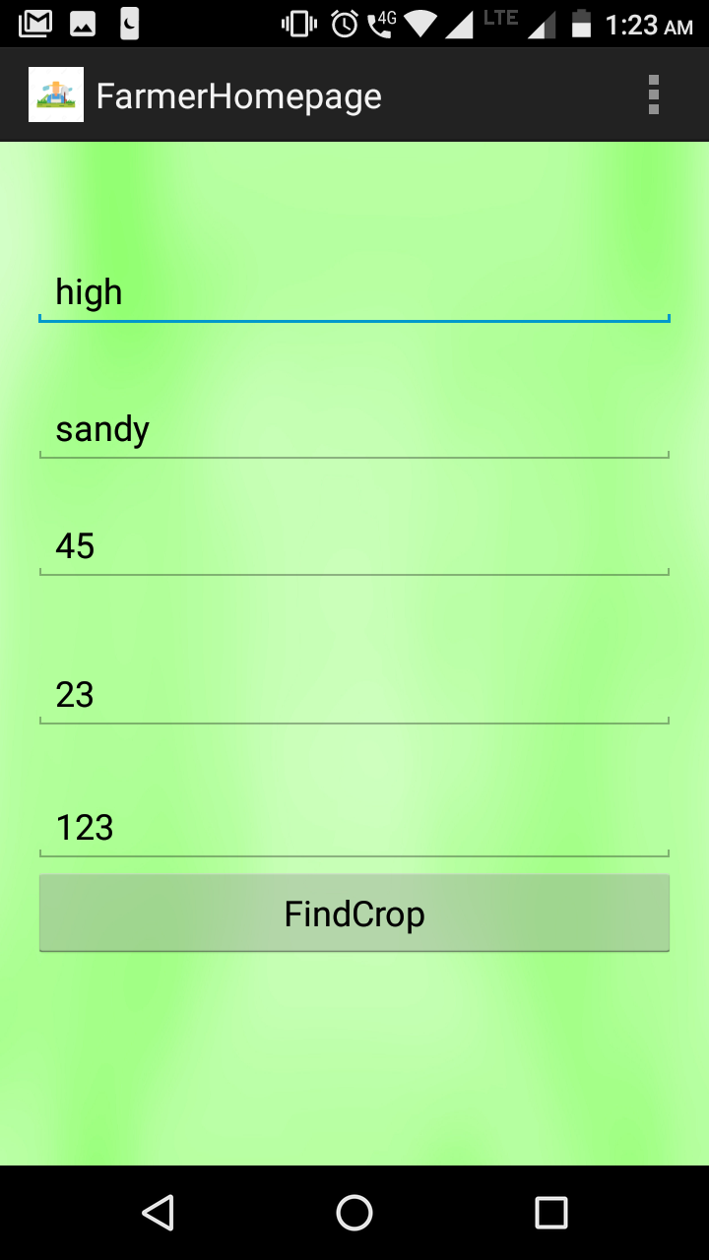

Slide 9
Advantages
•It helps farmers not to have repeated losses in agriculture.
•Increases food production and also improves country’s economy.
•Stability in market price

