Slide 1
AI Timeline- Group 3
Wei-Hua Chiu (Lala)
Haarini Balakrishnan
Uthist Enoch Vayya
Priya Varman
Imad Uddin Sheikh
Carolina Munar
Ganeshapuram Perumalsamy Karthikeyan
Mohan Krishna Chunarkar

Slide 2
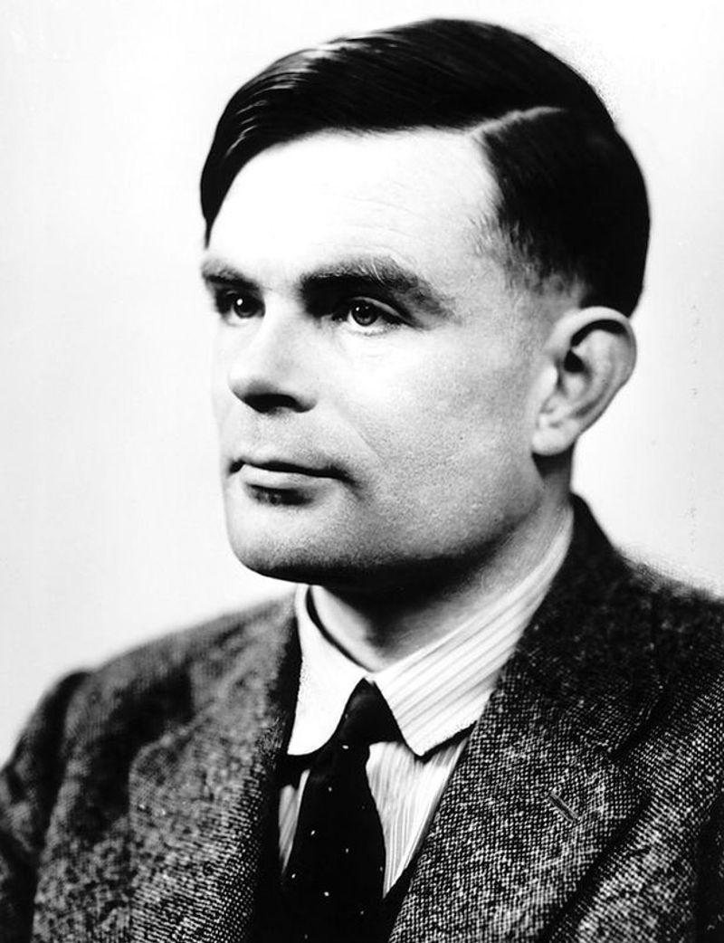
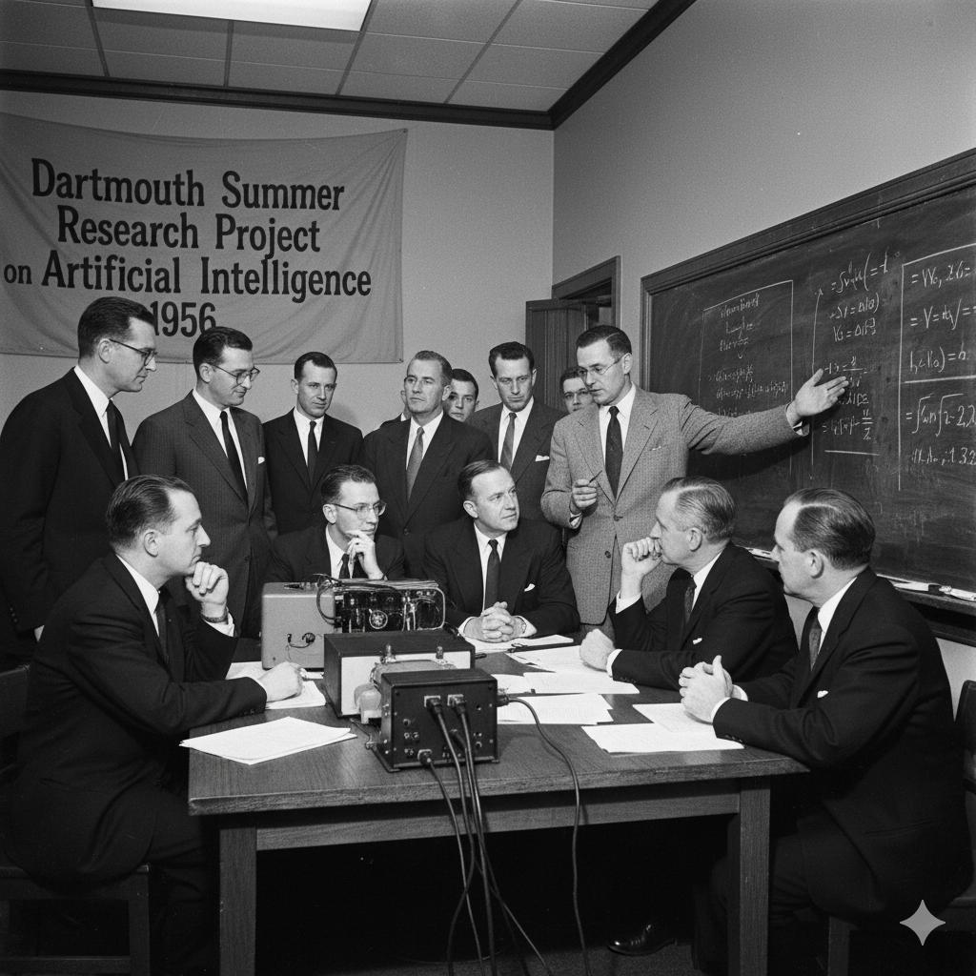
AI Timeline: 1950-1956 (The DReam BeGins)
1950 — Alan Turing and the Turing Test
Alan Turing published Computing Machinery and Intelligence.
Introduced the idea of testing whether a machine could imitate human conversation.
Helped establish the foundation for modern AI research.
1956 — Artificial Intelligence Becomes a Field
The Dartmouth Summer Research Project helped launch AI as an academic field.
John McCarthy, Marvin Minsky, Claude Shannon, and Nathaniel Rochester were key organizers.
Researchers explored whether machines could simulate aspects of human intelligence.

Slide 3
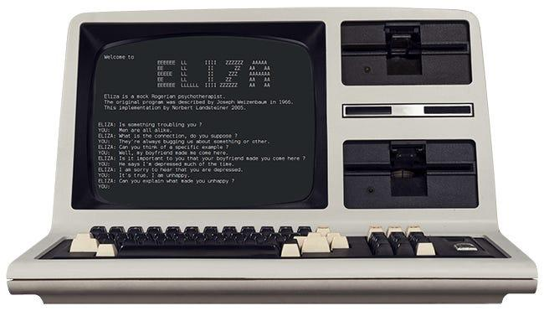
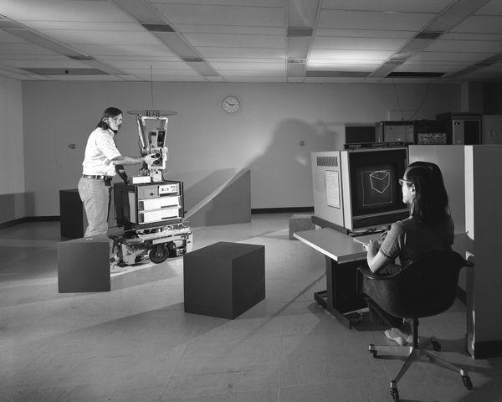
AI
AI Timeline: 1956-1966
1966 — ELIZA: An Early Chatbot
Joseph Weizenbaum created ELIZA at MIT.
The program used pattern matching to simulate conversation.
Demonstrated how computers could appear to communicate with humans.
1966–1972 — Shakey the Robot
Developed at Stanford Research Institute (SRI).
Combined perception, planning, and movement.
Became an important early example of an AI-controlled mobile robot.

Slide 4
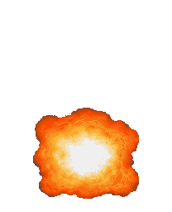
1970-1990 Expansion & Challenges

Slide 5
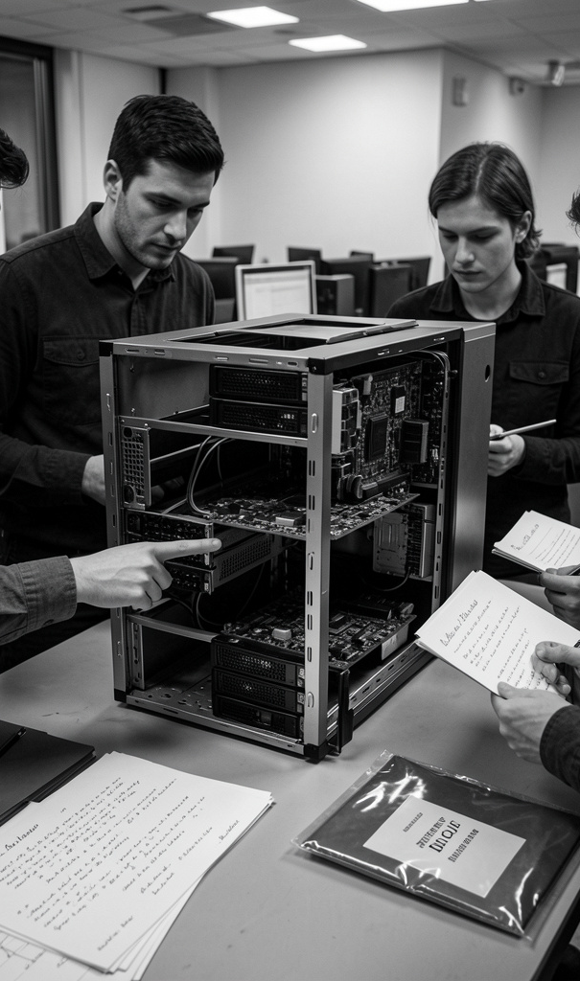
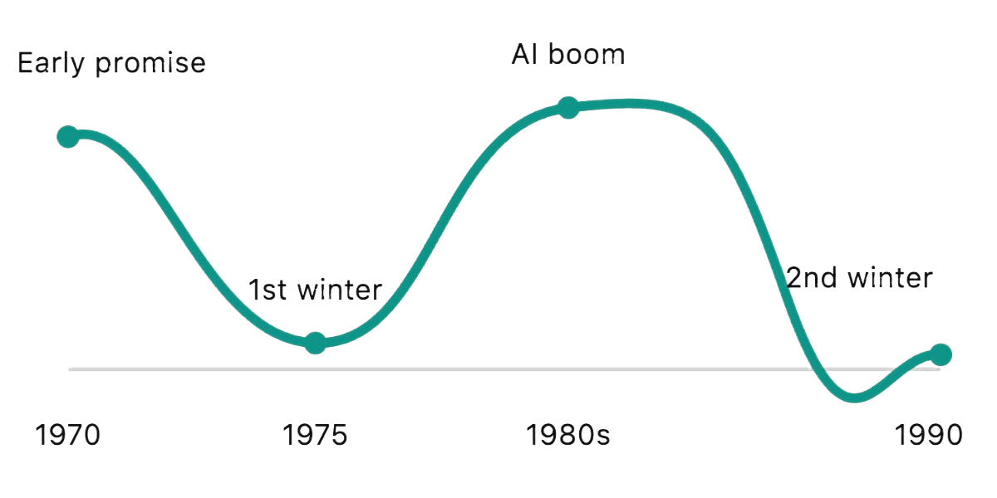
1970-1990 Expansion & Challenges
Programs like MYCIN used rule-based reasoning to assist with medical diagnoses and treatment recommendations.
Limited computing power, unrealistic expectations, and reduced funding slowed AI development.
Companies invested in expert systems to automate tasks and improve business decision-making.
Expensive systems, maintenance difficulties, and disappointing results caused investment to decline.

Slide 6
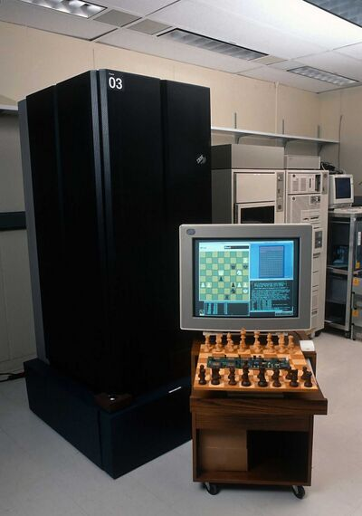
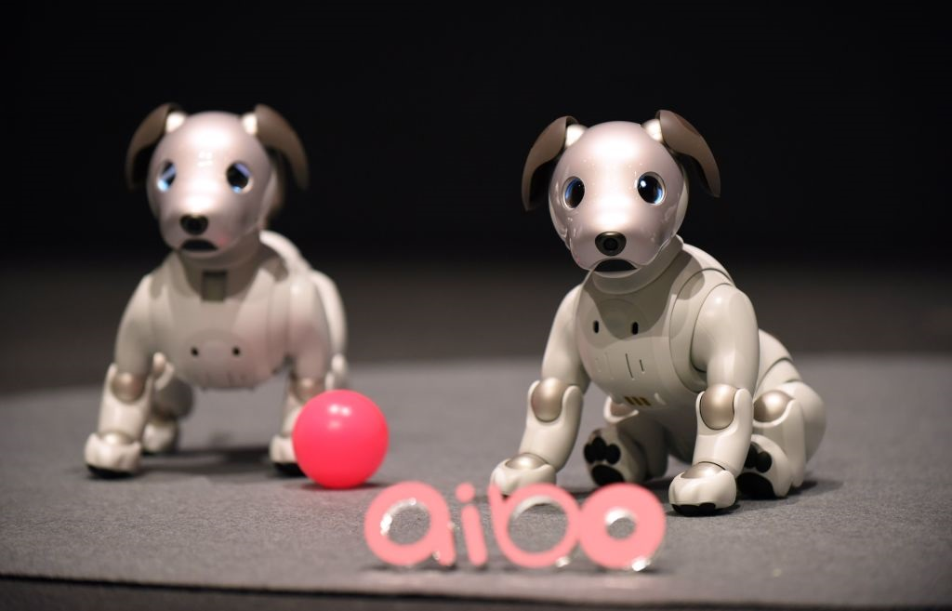
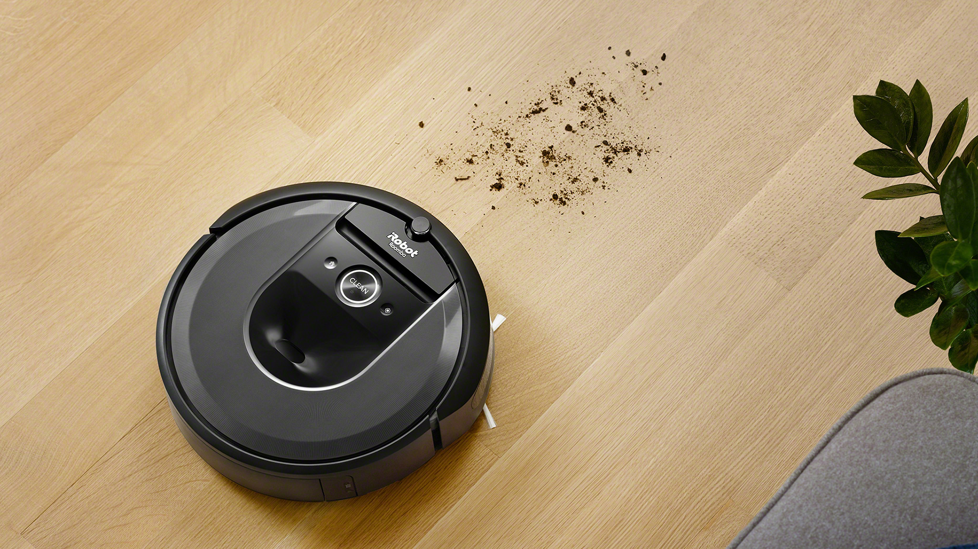
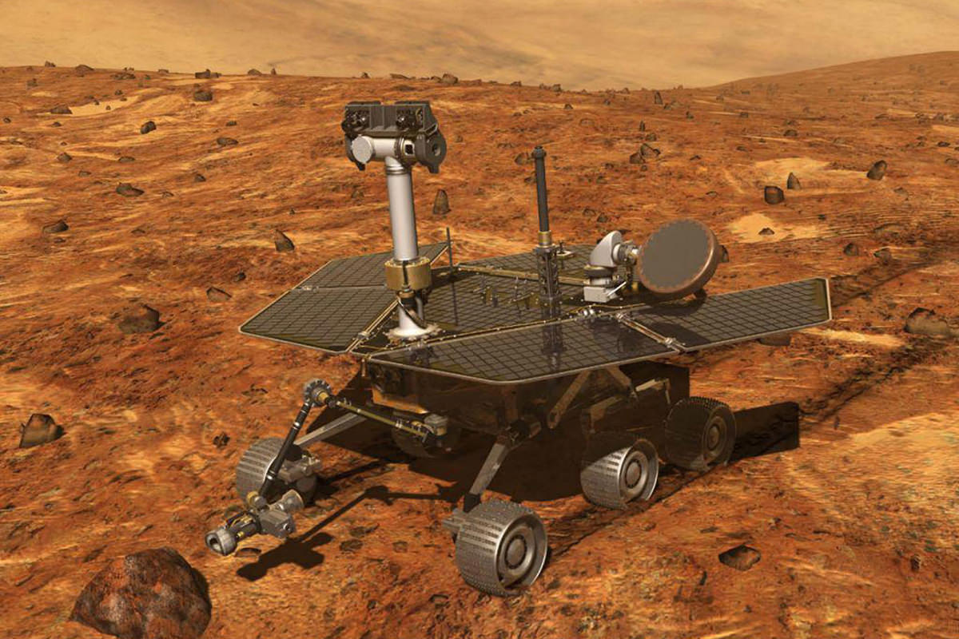
1990 – 2004 Major AI inventions
1997 – IBM Deep Blue: Defeated world chess champion Garry Kasparov, showcasing AI’s ability in strategic games.
1997 – Dragon NaturallySpeaking: Brought continuous speech-to-text dictation to personal computers.
1999 – Sony AIBO: Introduced a robotic pet dog that could sense its surroundings and interact with people at home.
2002 – iRobot Roomba: Brought AI-powered robotic vacuuming into homes, using sensors to clean floors automatically.
2004 – NASA’s Spirit: Used autonomous navigation to avoid obstacles while exploring Mars while working with instructions from Earth.

Slide 7
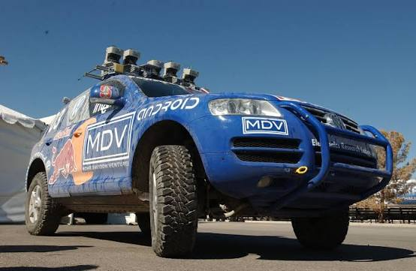
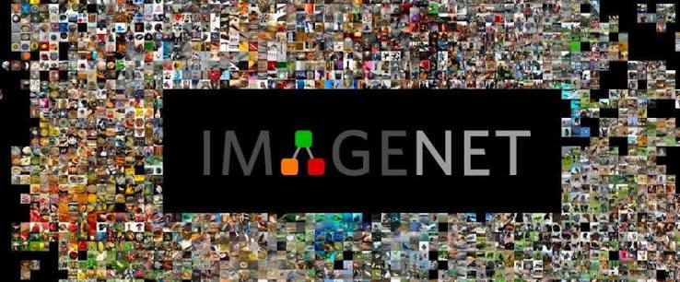
Road to deep learning 2005 - 2012
October 8, 2005: Stanley wins the DARPA Grand Challenge. It showed that machine learning could handle the real world and launched the self-driving car industry.
July 2006: Hinton’s deep belief network paper. It proved deep neural networks could be trained and revived the whole field.
2009: ImageNet is released. It supplied the large-scale labeled data that deep learning needed.
2009: GPUs used for deep learning. Training became up to 70× faster, which made large networks practical. The speech recognition breakthroughs followed soon after.
September 30, 2012: AlexNet wins ImageNet. Data, GPUs, and deep networks came together, and modern AI began.

Slide 8
AI DEVELOPMENT: 2013–2015
January 16, 2013
February 25, 2015
Google’s word2vec model
DeepMind’s Atari breakthrough
Helped computers find relationships between
words improving the way AI processed language.
Showed that AI could learn to play using a
practice and rewards system, helping AI self-learn
June 10, 2014
November 9, 2015
Generative adversarial networks (GANs)
TensorFlow becomes open source
Introduced a way for AI to create new images and
other data. Two networks improve together: one
creates examples, and the other checks them.
More access to tools that help build with AI
December 10, 2015
ResNet research
September 1, 2014
Made it easier for neural networks for many layers
to be trained increasing Image recognition
Attention in machine translation
Helped AI focus on the most useful words in a
sentence. Easier for working with longer
sentences
December 11, 2015
OpenAI announced
Org focused on AI research
Notes:
Read down the left column, then down the right.
Sources:
word2vec: https://arxiv.org/abs/1301.3781
GANs: https://arxiv.org/abs/1406.2661
Attention: https://arxiv.org/abs/1409.0473
Atari: https://research.google/blog/from-pixels-to-actions-human-level-control-through-deep-reinforcement-learning/
TensorFlow: https://blog.google/innovation-and-ai/products/tensorflow-smarter-machine-learning-for/
ResNet: https://arxiv.org/abs/1512.03385
OpenAI: https://openai.com/index/introducing-openai/

Slide 9
AI DEVELOPMENT: 2017–2019
June 12, 2017
October 11, 2018
Transformers
BERT research
Efficient way to process language during training
Helped AI use the words before and after a word
to work out its meaning
December 5, 2017
AlphaZero research
February 14, 2019
AI could learn by playing games with itself
GPT-2 announced
Showed that AI could generate longer, more
connected passages of text.
It also increased discussion about how
AI-generated text could be misused.
June 11, 2018
Original GPT announced
AI could learn patterns from text and then be
trained on that text for tasks.
Notes:
Read down the left column, then down the right.
Sources:
Transformers: https://arxiv.org/abs/1706.03762
AlphaZero: https://arxiv.org/abs/1712.01815
GPT: https://openai.com/index/language-unsupervised/
BERT: https://arxiv.org/abs/1810.04805
GPT-2: https://openai.com/index/better-language-models/

Slide 10
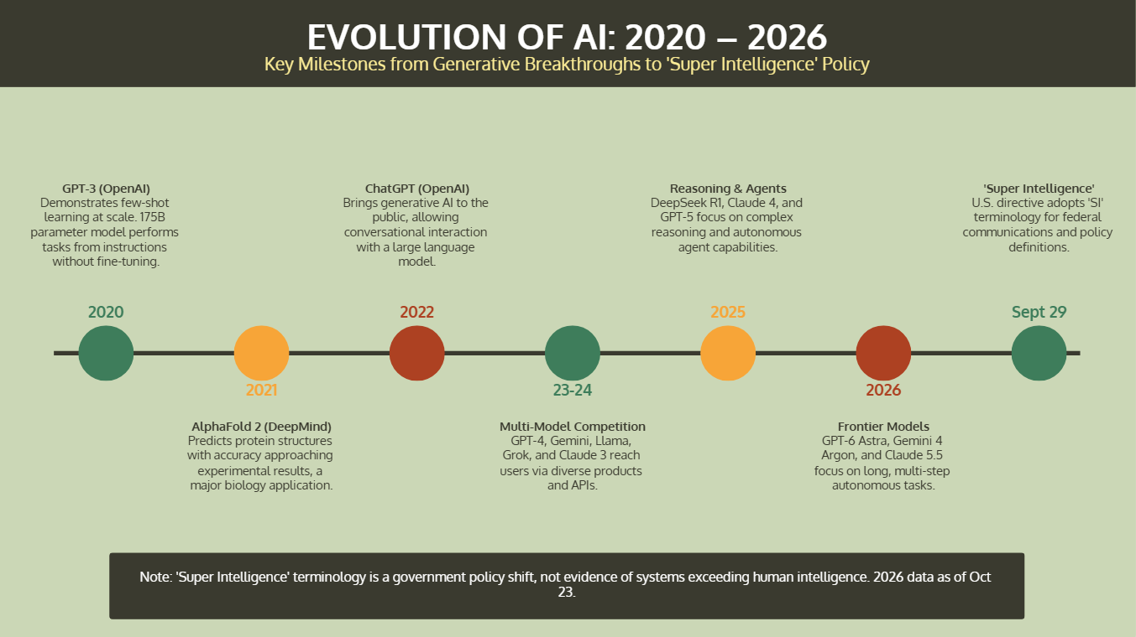

Slide 11
REFERENCES
Anthropic. (2024, March 4). Introducing the next generation of Claude. https://www.anthropic.com/news/claude-3-family
Bahdanau, D., Cho, K., & Bengio, Y. (2014). Neural machine translation by jointly learning to align and translate [Preprint]. arXiv. https://arxiv.org/abs/1409.0473
Barry, A. (2026, September 1). The ECI frontier has advanced by 14 points per year since the introduction of reasoning models. Epoch AI. https://epoch.ai/data-insights/eci-frontier-trend
Brockman, G., Sutskever, I., & OpenAI. (2015, December 11). Introducing OpenAI. https://openai.com/index/introducing-openai/
Center for AI Safety, & Scale AI. (2025). Humanity’s last exam. https://lastexam.ai/
Computer History Museum. (n.d.). Computer History Museum. https://www.computerhistory.org/
DeepSeek. (2025, January 20). DeepSeek-R1 release. https://deepseek.com/en/news/deepseek-r1/
Defense Advanced Research Projects Agency. (2014). Grand Challenge: Ten years later. https://www.darpa.mil/news/2014/grand-challenge-ten-years-later
Devlin, J., Chang, M.-W., Lee, K., & Toutanova, K. (2018). BERT: Pre-training of deep bidirectional transformers for language understanding [Preprint]. arXiv. https://arxiv.org/abs/1810.04805
Epoch AI. (2026, February 5). Trends in AI. https://epoch.ai/trends
Gershgorn, D. (2017, July 26). The data that transformed AI research—and possibly the world. Quartz. https://qz.com/1034972/the-data-that-changed-the-direction-of-ai-research-and-possibly-the-world
Goodfellow, I. J., Pouget-Abadie, J., Mirza, M., Xu, B., Warde-Farley, D., Ozair, S., Courville, A., & Bengio, Y. (2014). Generative adversarial networks [Preprint]. arXiv. https://arxiv.org/abs/1406.2661
Google DeepMind. (2016, March 15). Deep reinforcement learning. https://deepmind.google/blog/deep-reinforcement-learning/

Slide 12
REFERENCES
Google DeepMind. (2021, July 15). AlphaFold. https://deepmind.google/science/alphafold/
He, K., Zhang, X., Ren, S., & Sun, J. (2015). Deep residual learning for image recognition [Preprint]. arXiv. https://arxiv.org/abs/1512.03385
Hendrycks, D., Burns, C., Basart, S., Zou, A., Mazeika, M., Song, D., & Steinhardt, J. (2021). Measuring massive multitask language understanding. International Conference on Learning Representations. https://arxiv.org/abs/2009.03300
Hinton, G. E., Osindero, S., & Teh, Y.-W. (2006). A fast learning algorithm for deep belief nets. Neural Computation, 18(7), 1527–1554. https://doi.org/10.1162/neco.2006.18.7.1527
Hsin. (1999). Voice recognition paper [PDF]. Cornell University. https://ergo.human.cornell.edu/AHProjects/Hsin99/Voice%20Recognition%20Paper.pdf
IBM. (n.d.). Deep Blue. https://www.ibm.com/history/deep-blue
IEEE Spectrum. (n.d.). iRobot Roomba history. https://spectrum.ieee.org/irobot-roomba-history
Krizhevsky, A., Sutskever, I., & Hinton, G. E. (2012). ImageNet classification with deep convolutional neural networks. Advances in Neural Information Processing Systems, 25, 1097–1105. https://papers.nips.cc/paper/2012/hash/c399862d3b9d6b76c8436e924a68c45b-Abstract.html
Kumaran, D., & Hassabis, D. (2015, February 25). From pixels to actions: Human-level control through deep reinforcement learning. Google Research. https://research.google/blog/from-pixels-to-actions-human-level-control-through-deep-reinforcement-learning/
Lighthill, J. (1973). Artificial intelligence: A general survey. Artificial Intelligence, 3(1–3), 251–266. https://doi.org/10.1016/0004-3702(73)90014-5
Linden, E. (1988, March 28). Technology: Putting knowledge to work. Time.
McCarthy, J., Minsky, M. L., Rochester, N., & Shannon, C. E. (2006). A proposal for the Dartmouth Summer Research Project on

Slide 13
REFERENCES
Artificial Intelligence, August 31, 1955. AI Magazine, 27(4), 12. https://doi.org/10.1609/aimag.v27i4.1904
McDermott, J. (1982). R1: A rule-based configurer of computer systems. Artificial Intelligence, 19(1), 39–88. https://doi.org/10.1016/0004-3702(82)90021-2
Mikolov, T., Chen, K., Corrado, G., & Dean, J. (2013). Efficient estimation of word representations in vector space [Preprint]. arXiv. https://arxiv.org/abs/1301.3781
MIT Lincoln Laboratory. (n.d.). History of artificial intelligence. https://www.ll.mit.edu/media/9531
NASA Jet Propulsion Laboratory. (n.d.). Chapter 3 [PDF]. https://robotics.jpl.nasa.gov/media/documents/05_Chapter3_final.pdf
Nilsson, N. J. (1969). A mobile automaton: An application of artificial intelligence techniques. Proceedings of the First International Joint Conference on Artificial Intelligence, 509–520.
OpenAI. (2018, June 11). Improving language understanding with unsupervised learning. https://openai.com/index/language-unsupervised/
OpenAI. (2019, February 14). Better language models and their implications. https://openai.com/index/better-language-models/
OpenAI. (2020, May 28). Language models are few-shot learners. https://openai.com/index/language-models-are-few-shot-learners/
Pichai, S. (2015, November 9). TensorFlow: Smarter machine learning, for everyone. Google. https://blog.google/innovation-and-ai/products/tensorflow-smarter-machine-learning-for/
Rosenblatt, F. (1958). The perceptron: A probabilistic model for information storage and organization in the brain. Psychological Review, 65(6), 386–408. https://doi.org/10.1037/h0042519
Shortliffe, E. H. (1976). Computer-based medical consultations: MYCIN. Elsevier.

Slide 14
REFERENCES
Simonyan, K., & Hassabis, D. (2017). Mastering chess and shogi by self-play with a general reinforcement learning algorithm [Preprint]. arXiv. https://arxiv.org/abs/1712.01815
Turing, A. M. (1950). Computing machinery and intelligence. Mind, 59(236), 433–460. https://doi.org/10.1093/mind/LIX.236.433
Vaswani, A., Shazeer, N., Parmar, N., Uszkoreit, J., Jones, L., Gomez, A. N., Kaiser, Ł., & Polosukhin, I. (2017). Attention is all you need [Preprint]. arXiv. https://arxiv.org/abs/1706.03762
Weizenbaum, J. (1966). ELIZA—A computer program for the study of natural language communication between man and machine. Communications of the ACM, 9(1), 36–45. https://doi.org/10.1145/365153.365168
Wikipedia contributors. (n.d.). Timeline of artificial intelligence. In Wikipedia. Retrieved October 24, 2026, from https://en.wikipedia.org/wiki/Timeline_of_artificial_intelligence

