Slide 1
Deploying Cryptography in internet-scale systems:
A case study on DNSSEC
ISA797
By
Padmavathi dl

Slide 2
Outline
Domain Name System
DNS Security Extensions
DNSSEC implementation
DNSSEC challenges
Approaches to resolve challenges

Slide 3
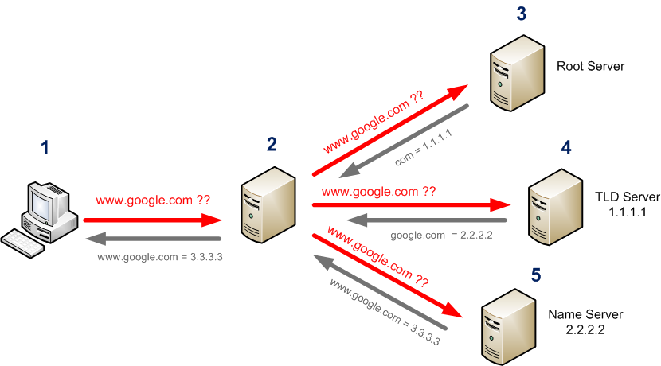
Domain Name System
Hierarchical and decentralized naming system for computers, services or any other resources connected to the internet.

Slide 4
DNS Security Extensions
Why DNSSEC?
  Attacker can inject spoof dns
  Redirect traffic to malicious sites
What goals are needed to defend?
  Data integrity and Origin authenticity
How the goals are achieved?
  Public - key cryptography

Slide 5
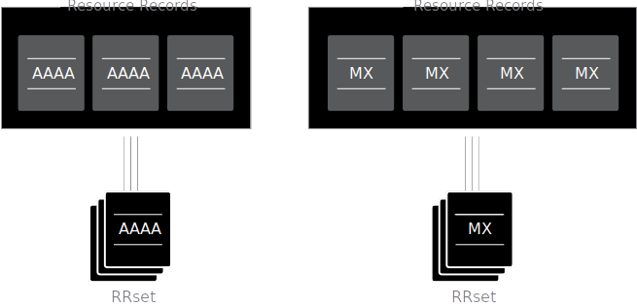
DNSSEC implementation
Child zone
  DNSKEY RR(public key) and RRSIG RR(Records such as NS, A, txt signed by private key)
  NSEC Records
    Existing names are canonically sorted
    How to sign non existing name in a zone
Authenticated proof of non existence

Slide 6
DNSSEC implementation
Any challenge with
this implementation
Parent zone
  Signs the DNSKEY of every child zone and stored in zone
How to avoid replay attacks at cache resolver?
  Expiration time of signatures
  Cache discards the RRset when TTL of it gets expired

Slide 7
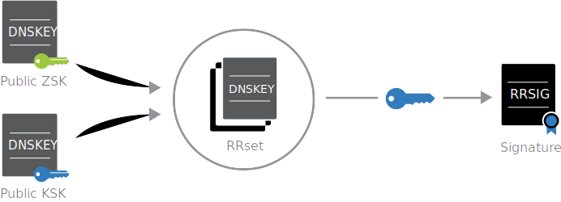
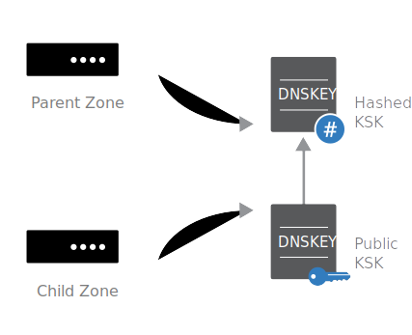
Design Issues with Hierarchical PKI:
Scaling
Both zone’s public key and parent’s signature are stored in zone.
  Every time a parent changes it’s key, it has to update all the child zones.
  Every time a child changes it’s key , it has to contact the parent.
Changes made

Slide 8
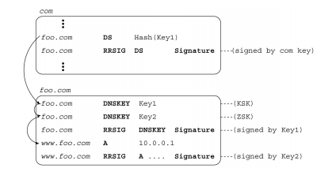
Design Issues with Hierarchical PKI:
Scaling
Advantages of changes made
  DS saves the storage overhead because it’s hash
  ZSK can be frequently changed without updating the KSK hash in the parent

Slide 9
Design Issues with Hierarchical PKI: Boundary Crossing - Unsigned Data
NS and Glue(A) records are present in parent zone without authentication.
What if the child private key compromised?
Signing NS, A records same as DS records.
Protecting infrastructure records or adhering to data ownership rule.
Is this implemented yet?

Slide 10
Design Issues with Hierarchical
PKI: Cross-Domain Coordination
15% of zones suffer from configuration errors b/n parent and child.
Redundant Name servers.
Multiple DS Records(Decrease the cryptography strength)
DS records or NS records need to be updated?
Multiple monitoring tools emerged.

Slide 11
Design Issues with Hierarchical
PKI: Incremental Deployability
Authentication can be verified only when Root to a zone k when every ancestor have deployed DNSSEC.
An Island of security - A sub tree in the DNS hierarchy in which DNSSEC have been deployed.
Trust Anchor – The public key for the root of this sub tree.
Trusted Anchor doesn’t have parent zone to verify it’s key.
DNSSEC look side verification: Have zone’s public key verified by trusted authorities outside the DNSSEC system.
Paper suggests to use a distributed monitoring tool during incremental deployment.
Then what’s the purpose
of having DNSSEC?

Slide 12
Impact of DNS Caches
End hosts implement minimal stub resolver which sends queries to caching resolver.
If the cache doesn’t maintain correct security policies, attacker can poison the cache data.

Slide 13
Impact of DNS Caches: Key Rollover & Key Revocation
Grace period for old keys
Active key and stand by key
The same such operation for updating cryptography algorithms.
Emergency Key rollovers(keys get compromised)
Until the signature expires attacker can make use of older key.(Trade-off)

Slide 14
Impact of DNS Caches: Cache – stub verification policies
Stub resolver doesn’t trust cache resolver.
Stub resolver can enforce it’s own local policy through a check disabled bit in query.
False negatives & False positives.
Caching resolver just forwards the answers.
DNS implicit assumption is stub resolver trust cache resolver.

Slide 15
Impact of DNS Caches: Cache synchronization
TTL expires or the comparison signature expires.
Cache-sync effect.(RRset’s signature gets expired)
Cache-sync effect is high with global popular RR’s.
How to avoid this effect:
  RR TTL expires before the RR signature.

Slide 16
Impact of DNS Caches: Cache synchronization
TTL trimming at cache resolver:
Tr = the time the RRset is received and Te denote the signature expiration time.
If Tr + TTL > Te (i.e., the signature expires first), the caching resolver trims the TTL into a random value in the [0,Te - Tr]. This makes TTL expires at a random time within the signature lifetime.

Slide 17
Impact of Heterogeneous Operations
Non network and physically secured system – signer
Master sends the zone file to the signer which signs using the private key and sends back the singed zone.
Not only signs zone data, but also signs delegations of all child zones.

Slide 18
Impact of Heterogeneous Operations: Handling Dynamic Updates
A host moves to a different location, it obtains a new ip address and can use the dynamic dns to update the A location.
Dynamic updates needs to update several records, for this the key has to be online, so zone signing key is available online to sign records.

Slide 19
Impact of Heterogeneous Operations: Authenticating Denial of Existence
NSEC Records
Zone Walking problem
NSEC scheme incurs high cost
DNS should not protect privacy of data in zone
Attacker can infer network topology.
NSEC3 – stores hashes instead of names ( which makes zone walking difficult), but increases the file size and complexity.

Slide 20
SecSpider
Distributed Monitoring system
Can detect MITM attacks
Pollers in America, Europe and Asia
10,523 Zones enabled DNSSEC
Production zones or Test zones
1000 production zones
730 independent islands of security

Slide 21
Importance of distributed monitoring?
DNSSEC is highly dynamic and continusoly evolving which needs to be monitored.
Monitoring inspired to develop a solution for incremental deployment problem.
SecSpider made available the keys from all the DNSSEC enabled zones.
Each DNSSEC enabled zone can register with SecSpider and periodically checks the correctness.

Slide 22
Importance of distributed monitoring?
SecSpider’s public key is posted on its website and is monitored from many points.
Security through publicity.

Slide 23
Addressing key revocation problem
Revoked flag or REVKEY record(both are signed by private key)
How to convey this information to the cache that hold the old key?
  Periodic key re - validation
  On-Demand data re fetching

Slide 24
Handling Dynamic data
Split the zones.
Manually updated and dynamically updated sub zones.
Dynamic sub zone key is available online.
host.foo.com CNAME host.dyn.foo.com – Adding Alias Name

Slide 25
Conclusion
A simple cryptographic design can face multiple challenges when applied to Internet scale operating system.
Design for scaling
Design for heterogeneity
Design for incremental development
Design for imperfect operations
Design with monitoring as an integral component

Slide 26
      Thank You!

