Slide 1
Zone State Revocation for DNSSEC
ISA797
By
Padmavathi dl

Slide 2
Outline
Introduction
Why ZSR?
Threat Model
Zone State Revocation
Proving Key Compromise
Revoking Data
Notifying Resolvers
Feasibility Analysis
Conclusion

Slide 3
Introduction
Current DNSSEC design lacks key revocation mechanism.
ZSR is Lightweight and Backward compatible.
Explicitly revoke keys.
Inform caching resolvers by control messages.
Work well with global scale DNS operations.

Slide 4
Why ZSR?
DNS data stored at multiple caching resolvers.
Includes Keys and signatures.
Stored at caches even after removing from authoritative servers.
Due to scale of DNS, no way to know how many and which resolvers have the old keys and signatures.

Slide 5
Threat Model
Attack Scenarios:
  End Host Records: Eve can create a new A record such as www.target.sec to point to a malicious host.
  Nameserver Records: Eve can create new NS records to redirect all DNS queries to her own servers, such as target.sec.

Slide 6
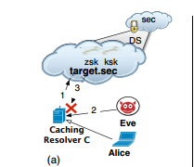
Threat Model (continued..)
Eve, C and Name servers should be on the same network.
Attack Vectors:
  Spoofing Attack :
    Spoof the traffic b/n target.sec and C.
    Eve should guess the query ID of the DNS request packet.

Slide 7
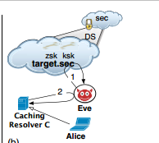
Threat Model (continued..)
  Poisoning Attack :
    Eve receives valid DNS requests for her own data(target.net) from C.
    Replies by forging records of target.sec
    Eve controls a server that C happens to use while resolving names(may be names not related to target.sec).

Slide 8
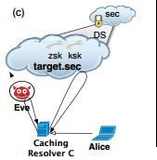
Threat Model (continued..)
  Man-In-The-Middle Attack(1) :
    Eve can snoop, block and insert packets in the communication pipe between C and target.sec.
    She can only control the communication between C and some of the name-servers.

Slide 9
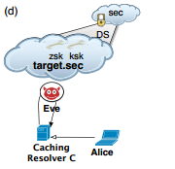
Threat Model (continued..)
Man-In-The-Middle Attack(2) :
Eve can control all the traffic for name-servers of target.sec.

Slide 10
Zone State Revocation
Must be able to prove that a key has been revoked.
Must be able to revoke signatures of the revoked key.
Must be able to rapidly notify resolvers that make use of changed zone’s data.

Slide 11
Proving key compromise
REVKEY
  This identifies the public key to be revoked.
  REVKEY is signed by it’s own private key. (make sure owner is revoking).
  If the REVKEY cannot verify any of the attached signatures, the REVKEY must be ignored.
  DNSKEY Key1 – Generate REVKEY Key1, sign and store in RRSIG.

Slide 12
Revoking Data
Inception time and expiration dates creates a lifetime of signatures.
Lifetime of DNSKEY is dictated by RRSIG’s.
These above two doesn’t provide support for emergency key revocation.
Signing infrequently – vulnerable & Signing frequently – costly.
ZSR augments a numerical lease with RRSIG inception/expiration values.

Slide 13
Revoking Data(continued..)
Lease number is based on SOA record serial number.
Lease simply notes whether the state of zone have been changed or not since the signature is generated.
If the state is not changed RRSIG lifetime is considered.
If the state is changed and exceeded the lease specified by signature, the record must be flushed from cache and re-fetched.
RRSIG record format is changed to include this lease.

Slide 14
Revoking Data(continued..)
To revoke KSK, secure delegation from parent has to be broken.
Include lease for DS records also.
Let us consider present serial number is S, the lease will be S+x.
X will be chosen such that under typical operations serial number will never exceed its current value(S) + x before RRSIG or DS expires.
The paper suggest to use 2power31 based on analysis.

Slide 15
Notifying Resolvers
ZSR embed every DNS response with light weight revocation notifications that is only sent from administrative servers of zones.
Once the caching resolver got this message, caches should query for REVKEYs from zones.
Flush the old records and re fetch affected records.
ZSR uses EDNS0 OPT record.
  Caches are not allowed to cache OPT records.
  Servers can embed arbitrary code/value pairs in them.

Slide 16
Notifying Resolvers(continued..)
OPT Record format:
  <zone_name,serial_number,timestamp,signature>

Slide 17
Feasibility Analysis
Signature Lifetime
  Using Secspider monitoring project.
  DS signature lifetimes average is 17.03 days.
  DNSKEYs are signed with an average of 26.45 days.
  Average lifetime of signatures is several weeks.
  ZSR provides revocation which is directly related to the query traffic.

Slide 18
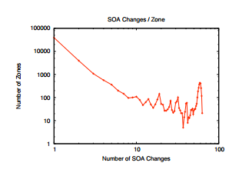
Feasibility Analysis(continued..)
SOA Serial Number Analysis.
  Month-long study.
  50,000 zones out of 2.5 million zones.
  80% of zones didn’t change during monitoring period.

Slide 19
Feasibility Analysis(continued..)
  Small number of zones changes very frequently.
  Average Period is 13.5 hours.
  The total number of changes needed is less than 2 power 31

Slide 20
Feasibility Analysis(continued..)
Zone Access Patterns
  Actual DNS traffic from north-American University
  821 stub resolvers, 117540 different names, 55632 DNS zones.
  Simulated traffic using these trace.
  Simulated effects of adversary(Eve) when the ksk is compromised & can mount all the attacks given in attack vector.

Slide 21
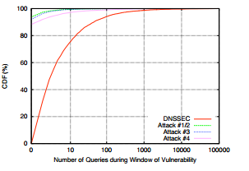
Feasibility Analysis
The window of vulnerability is much shorter if ZSR is deployed with DNSSEC.
No of queries needed to invalidate the signature of compromised keys is very less for ZSR deployed with DNSSEC.

Slide 22
Conclusion
Analysis shows that without ZSR, zone suffer a key compromise are vulnerable for days.
DNSSEC with ZSR is able to revoke keys within minutes to hours.

Slide 23
      Thank You!

