Slide 1

Capstone Battle of neighborhoods project

Slide 2
Business Problem
Determine a suitable location for a Shopping Mall
Selection of an appropriate location makes a business to succeed
Business Question:
What would be the best location for investing in a shopping mall in Chennai,India

Slide 3
DATA
List of Chennai Neighborhoods
Source:
https://en.wikipedia.org/wiki/List_of_neighbourhoods_of_Chennai
Geocoder Package for the Latitudes
And Longitudes for the Chennai City
Four Square API for Venues Data

Slide 4
METHODOLOGY
Webscraping of the Chennai neighborhood data and its lat and longs are done.
Using the Geocoder Package the Lat and Longitude for the Chennai city are obtained.
The Four Square API is used to retrieve the Venues for all the ChennaiNeighborhoods
Perform Clustering Algorithm(Kmeans) on the Dataframe collected.
Use the Folium Map to plot the Clusters and analyse the data to determine a suitable location

Slide 5
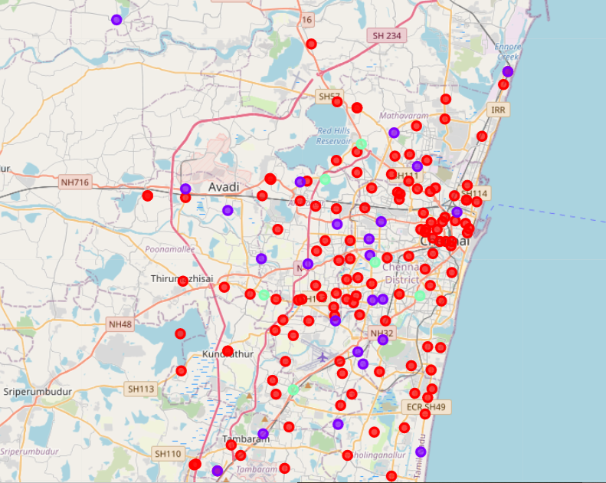
RESULTS
Data is grouped into 3 Clusters
Cluster 0
Cluster 1
Cluster 2
Based on the data it is
Observed that Cluster 0 has 0 shopping malls and hence can be a more appropriate location for the Mall.

Slide 6
Discussion
Cluster 0 has 0 Shopping Malls
Cluster 1 has 26 shopping Malls
Cluster 2 has 17 Shopping Malls
So based on the analysis Cluster 0 covers most
of the center places of Chennai and hence its a very good location to start malls in the Cluster 0 Zones.

