Slide 1


Slide 2
Problem Statement & Objective
Problem
Large volume of mutual fund data is difficult to analyze manually.
Investors need better insights into fund performance and risk.
Objective
Analyze mutual fund performance.
Study investor behaviour.
Build interactive Power BI dashboards.
Generate actionable insights using advanced analytics.

Slide 3
Data Sources
Datasets Used
Fund Master Data
NAV Data
Performance Data
Benchmark Indices
Monthly SIP Inflows
Category Inflows
Portfolio Holdings
Investor Transactions
Industry Folio Count
AUM by Fund House

Slide 4
Project Architecture
Raw Data ↓ Data Cleaning & ETL ↓ EDA & Performance Analytics ↓ Advanced Analytics ↓ Power BI Dashboard ↓ Insights & Recommendations

Slide 5
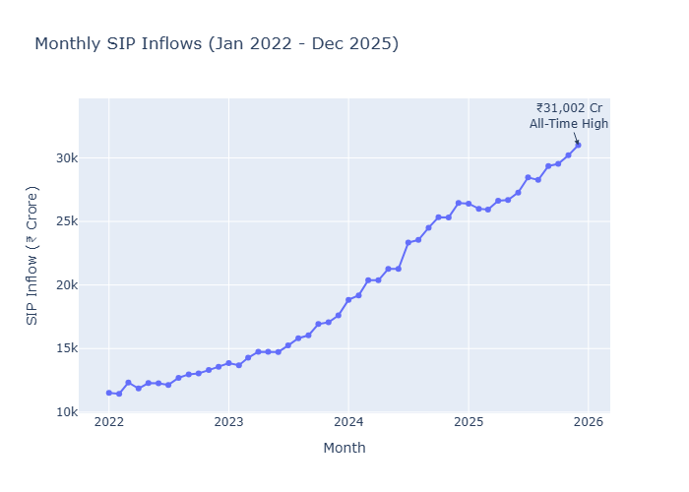
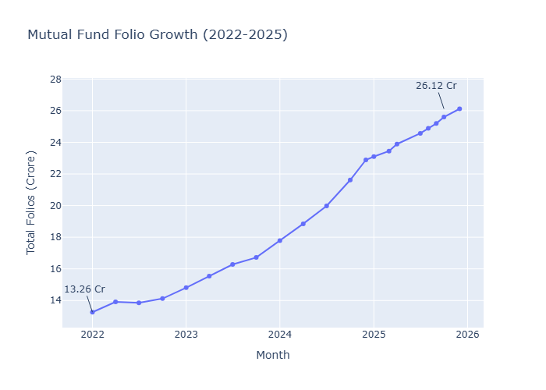
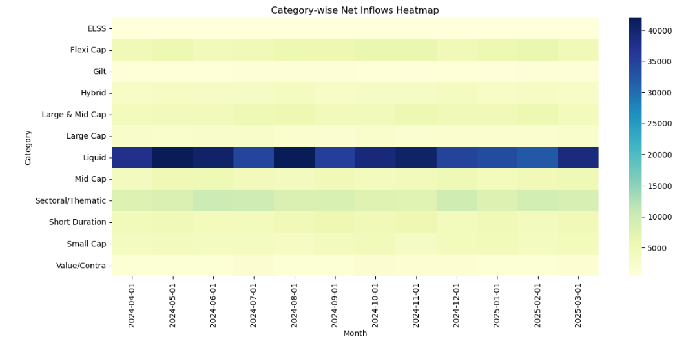
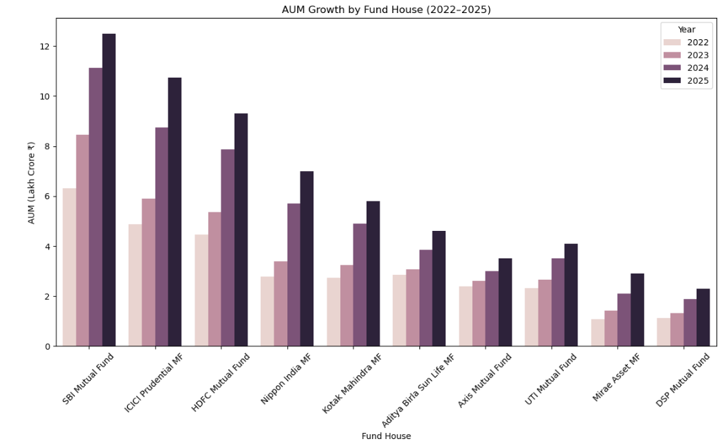
EDA Highlights (Industry Trends)
Growth in SIP inflows over time.
Increase in mutual fund folio counts.
Category-wise investment preferences.
AUM distribution across fund houses.

Slide 6
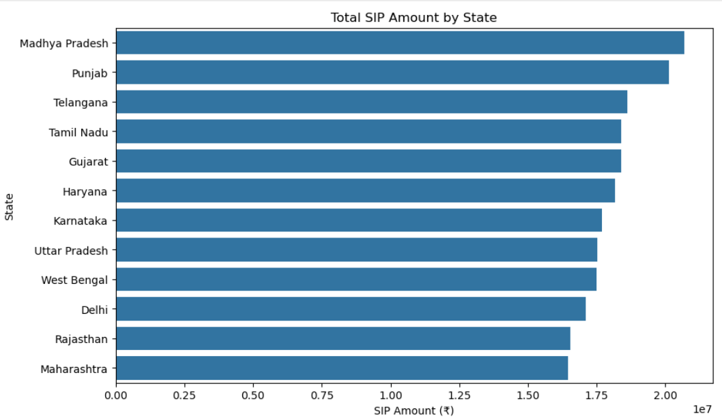
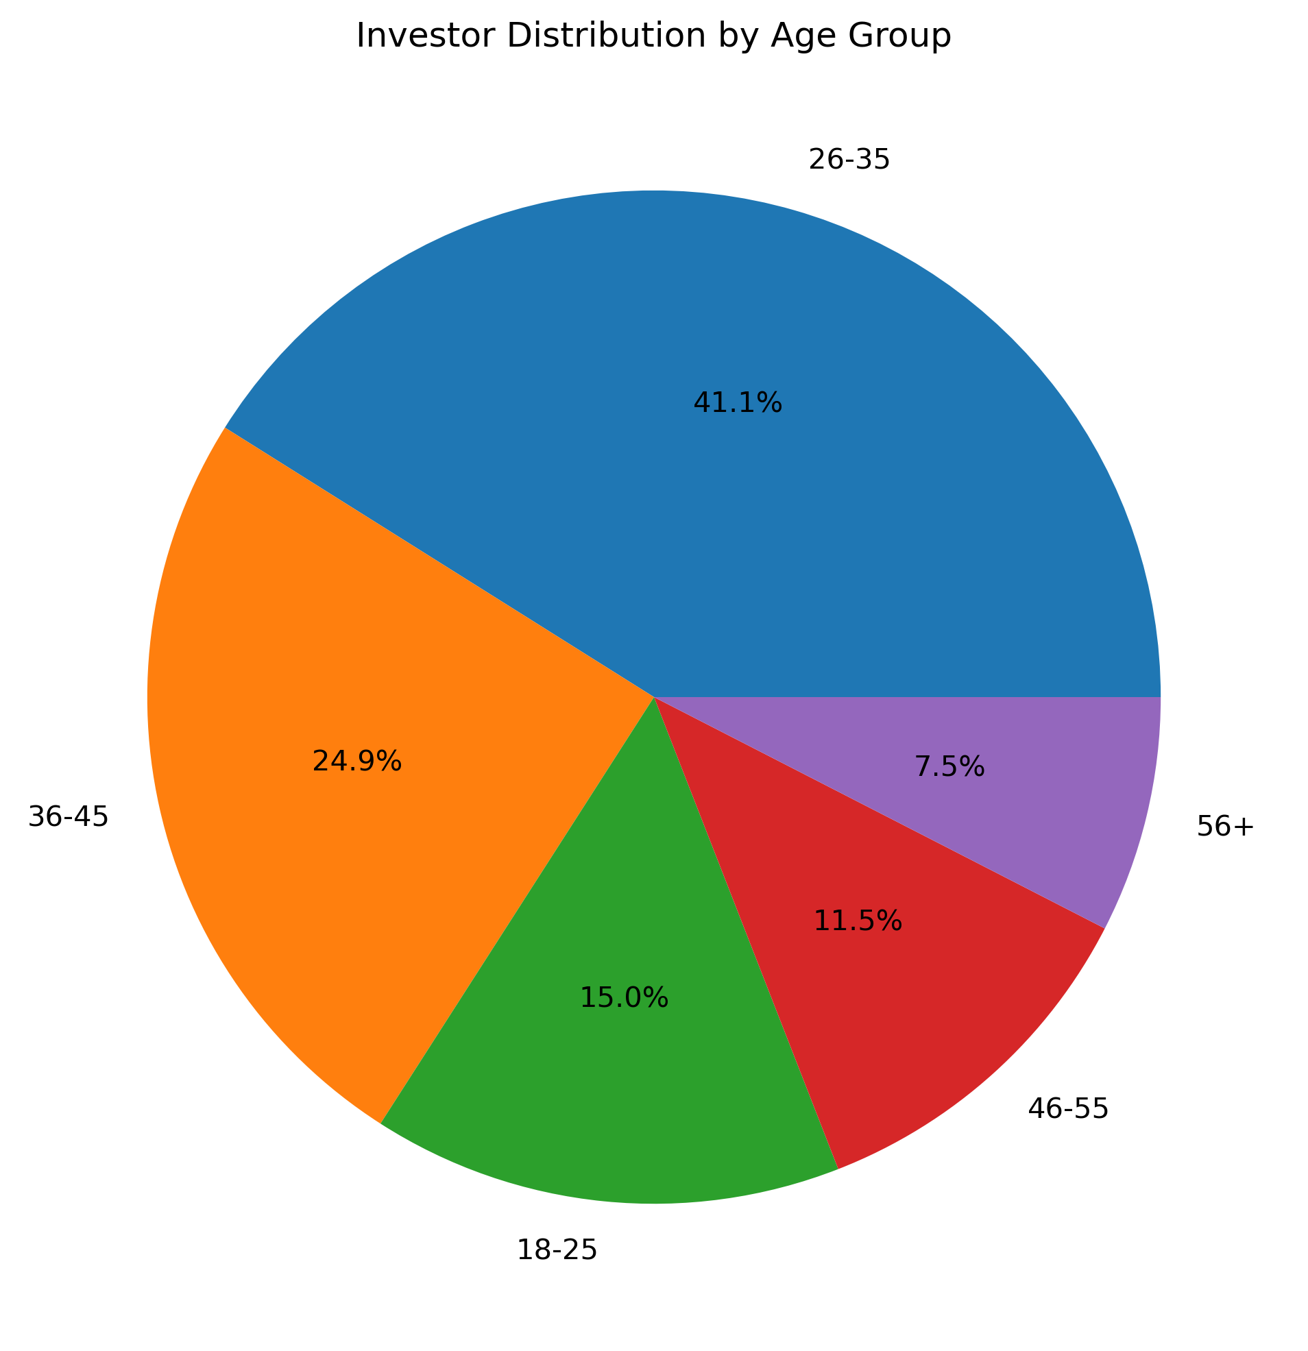
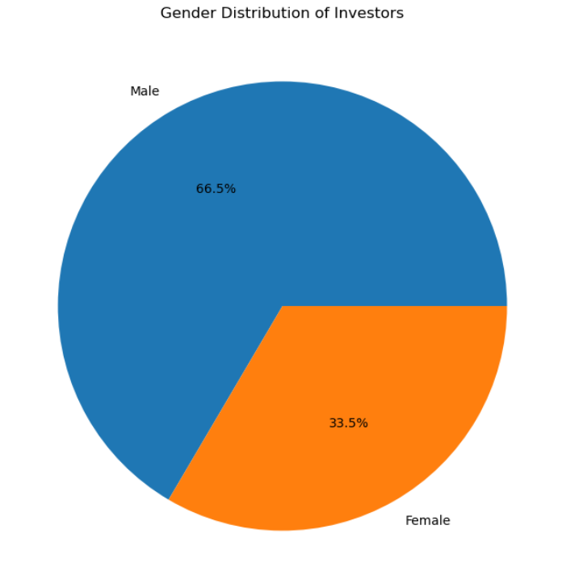
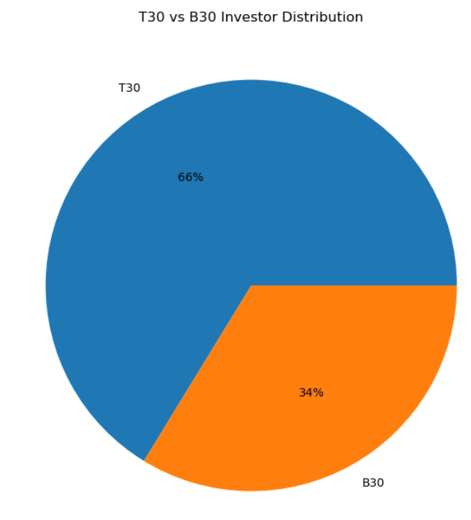
EDA Highlights (Investor Analysis)
Transaction analysis by state.
Age-group investment behaviour.
City-tier participation trends.
Gender investment behaviour

Slide 7
Performance Metrics
Metrics Calculated
CAGR (Compound Annual Growth Rate)
Sharpe Ratio
Sortino Ratio
Alpha
Beta
Tracking Error
Maximum Drawdown
Key Observations
Risk-adjusted performance varied significantly across funds.
Some funds delivered strong returns but also carried higher risk.
Alpha and Beta helped evaluate performance against benchmark indices.
Maximum Drawdown highlighted fund resilience during market declines.

Slide 8
Advanced Analytics
Advanced Analysis Performed
Historical VaR & CVaR
Rolling 90-Day Sharpe Ratio
Investor Cohort Analysis
SIP Continuity Analysis
Fund Recommendation Engine
Sector Concentration Analysis (HHI)
Key Insights
Identified funds with higher downside risk.
Detected investors at risk of SIP discontinuation.
Analyzed investment behaviour across cohorts.
Measured portfolio diversification using HHI.

Slide 9
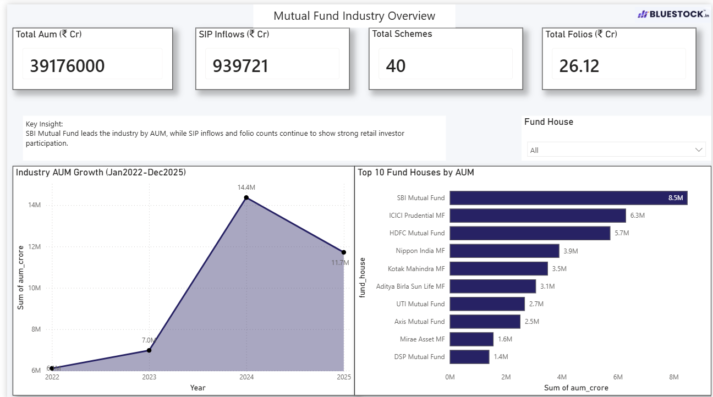
Dashboard Overview
Industry Overview Dashboard
Total AUM
SIP Inflows
Folio Count
Category Inflows

Slide 10
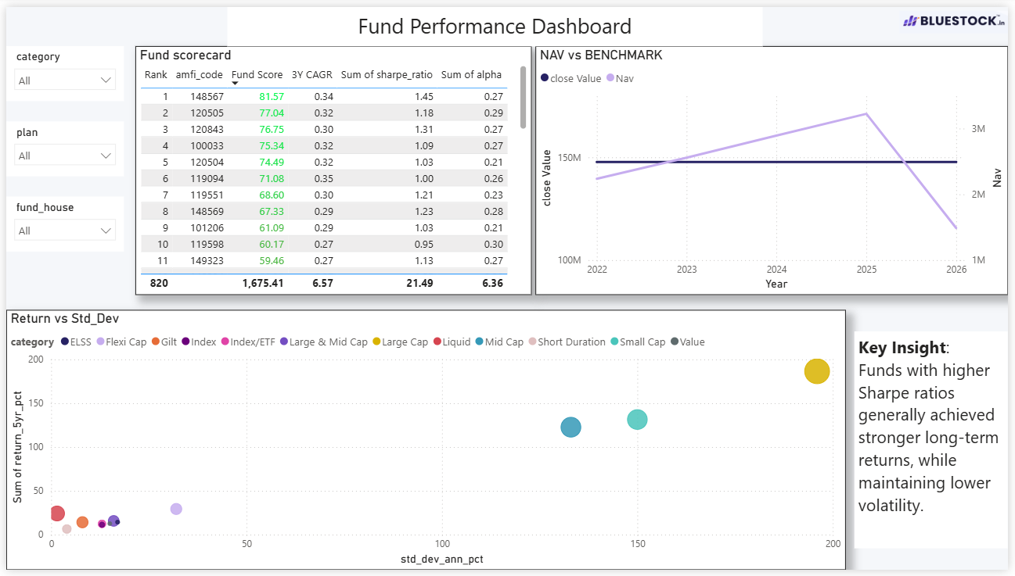
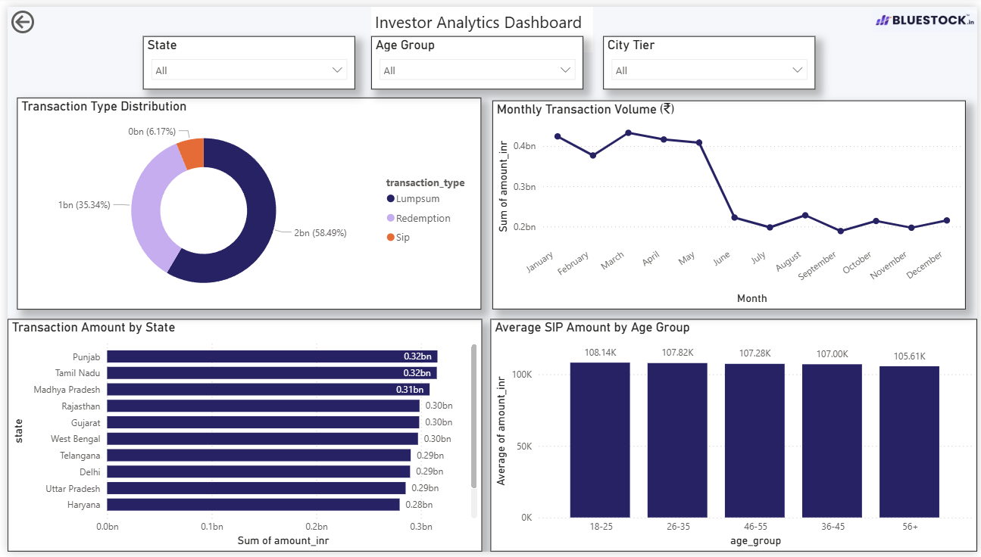
Dashboard Overview
Fund Performance & Investor Analytics
Fund Ranking
Risk vs Return Analysis
Investor Demographics
SIP Trends

Slide 11
Key Findings
Mutual fund industry participation showed steady growth through increasing folio counts and SIP inflows.
Equity-oriented categories attracted a significant share of investor inflows.
Fund performance varied considerably when evaluated using risk-adjusted metrics such as Sharpe Ratio and Sortino Ratio.
Some funds generated positive Alpha, indicating outperformance relative to their benchmarks.
VaR and CVaR analysis identified funds with higher downside risk during adverse market conditions.
Rolling Sharpe Ratio analysis revealed changes in risk-adjusted performance over time.
Investor cohort analysis highlighted differences in investment behaviour across investor groups.
SIP Continuity Analysis identified investors with irregular contribution patterns and higher discontinuation risk.
Sector HHI analysis showed that some funds were highly concentrated in a few sectors, while others maintained better diversification.
Interactive Power BI dashboards enabled effective visualization of fund performance, investor behaviour, and market trends.

Slide 12


