Slide 1
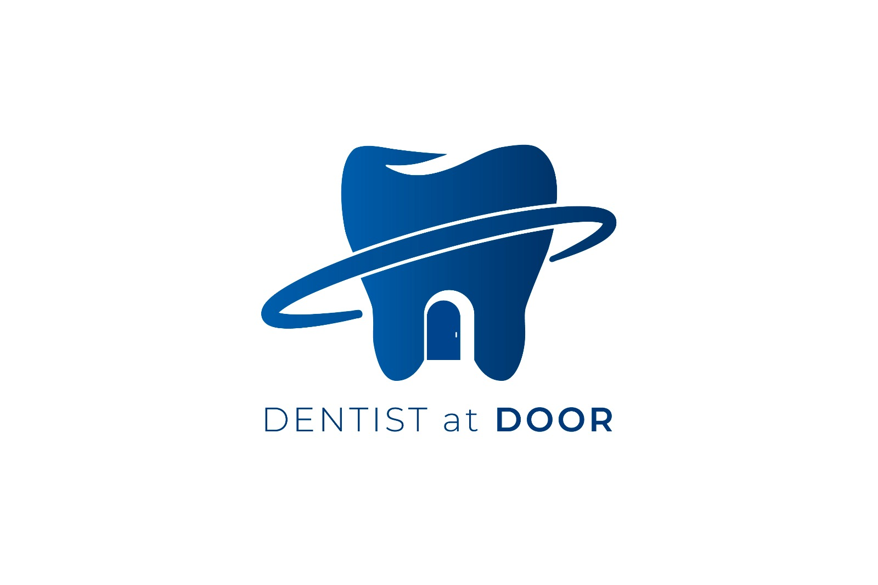
DENTIST AT DOOR

Slide 2
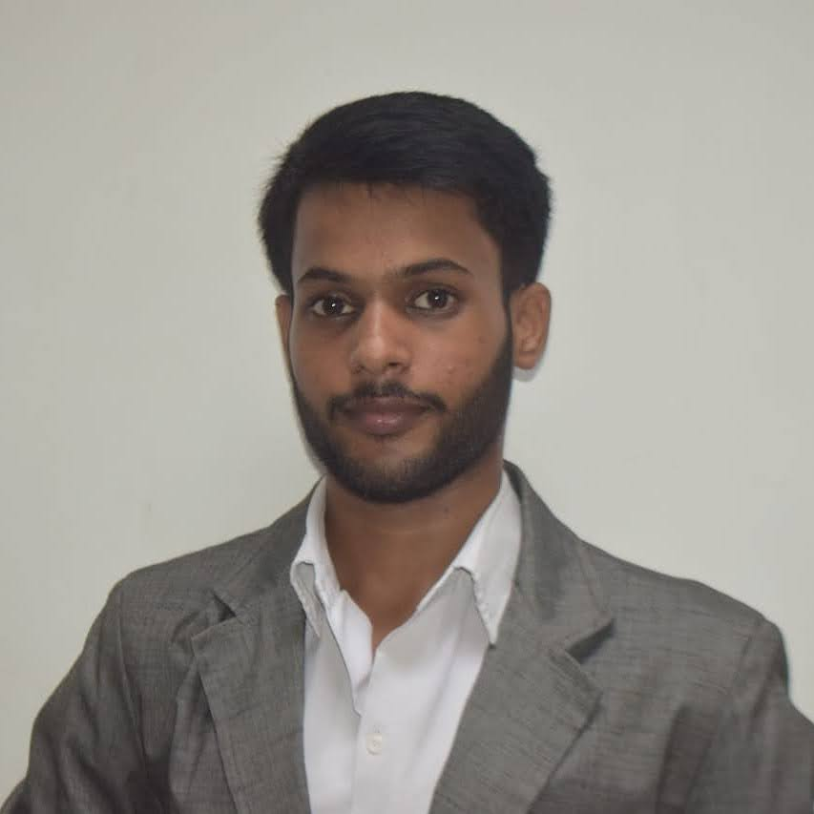
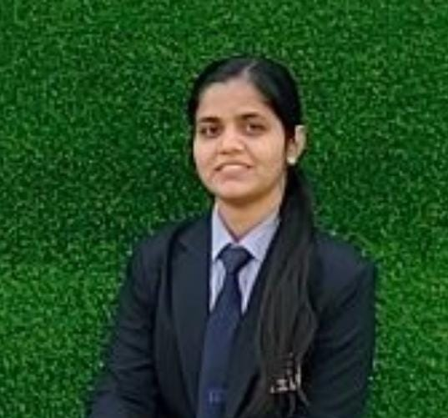
MEET OUR TEAM
Padmesh Kumar Singh
B.tech(CS) – 2nd year
Singhpadmesh90@gmail.com
Manya Upadhyay
B.tech(IT) – 1st year
manyayuv8404@gmail.com

Slide 3
CONTACT:
If you have any query or you want to know about more information, please contact with our team members.
Name – Padmesh Kumar Singh
Contact No. – 7705884551
Email ID- Singhpadmesh90@gmail.com
Name- Manya Upadhyay
Contact No.- 7599171957
Email ID- manyayuv8404@gmail.com

Slide 4
SOLUTION:
Our project, DENTIST AT DOOR offer several benefits ,especially for individuals who may find it challenging to visit a traditional dental clinic.
There are some advantages:-
1. Convenience:
Dentist at Door service bring professional care to your doorstep , eliminating the need to travel to a clinic.
2. Personalized Care:
Dentists can spend more time understanding your specific needs, addressing concerns and tailoring treatments accordingly. This personalized approach enhances patient satisfaction and outcomes.
3. Reduced Anxiety:
Dentist at door service create a familiar environment, reducing anxiety associated with clinic settings. Patients feel more relaxed, leading to better cooperation during procedures.
4. Emergency Care:
Having a dentist visit your home ensures prompt attention during emergencies such as severe toothache , broken crowns or gum infections.

Slide 5
ROADMAP:
Maintaining and extending the advantages of “Dentist At Door” service is crucial for ensuring its continued success. Let’s explore some key strategies to achieve this:
Promote oral Health Education: Provide information about proper hygiene, dietary habits and lifestyle choices that impact oral health. Empower patients to take better care of their teeth and gums.
Emphasize Preventive Care: Encourage Patients to schedule regular dental check-ups and cleanings. Early detection of oral health issues can prevent them from progressing into more severe conditions, saving patients from pain and expensive treatments.
Expand Service Offerings: Consider adding cosmetic dentistry services. Teeth whitening treatments, smile makeovers and dental veneers can enhance patients smiles and boost their confidence.
Personalized Care: Understand each pateint’s unique needs. Customize treatment plans based on their oral health status, age and preferences.

