Slide 1




SMART INDIA HACKATHON 2026
TITLE PAGE
Problem Statement ID – 26153
Problem Statement Title-AI based Network Attack Forecasting from Network Traffic Data
Theme- Blockchain & Cybersecurity
PS Category- Software
Team ID -
Team Name - Sonder

Slide 2
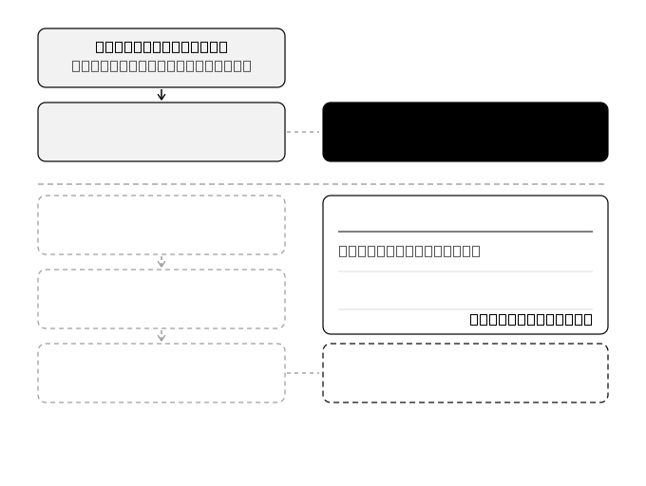


IDEA TITLE
Sonder
Forecasting Attacker Progression from Network Traffic
Most security tools are like a smoke alarm. Ours is a weather forecast.
Existing systems look at network traffic one piece at a time and shout when something is already on fire. But a real cyber attack isn't one bad moment — it's a sequence. The attacker scans, breaks in, spreads sideways, then steals.
Our system watches the whole network and learns what usually happens next. Once it knows the patterns, it can look ahead — running the situation forward in time to see where things are heading.
It tells the security team three things, in plain terms:
How likely an attack is in the next minute
Which stage the attacker is at — scanning, breaking in, spreading, or stealing data
Why it thinks so — the exact activity that raised the alarm
Runs on a normal computer, completely offline, built entirely with open-source tools.
How an attack unfolds, and where we step in
What it conveys
Today's tools alert after the damage.
Ours warns before, with time to act.
Nearly 99% of current security alerts are false, so real threats get ignored.
Ours only alerts when confident. When unsure, it asks a human.
Why this is different
Existing tools recognise attacks. Ours predicts what comes next.
It also says how confident it is, so analysts stop drowning in false alarms.
And it can test a fix before applying it: isolate this host, risk drops 78% to 9%.
@SIH Idea submission- Template
2
Notes:
2

Slide 3
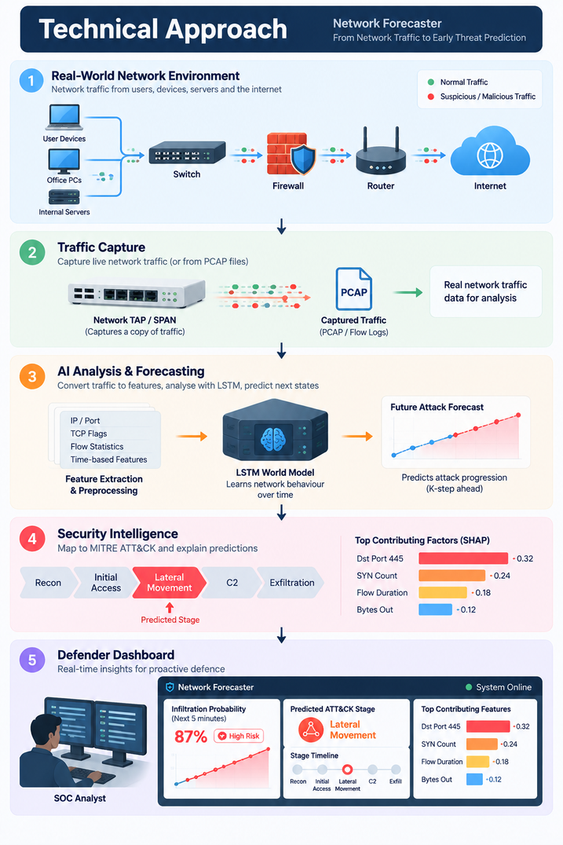

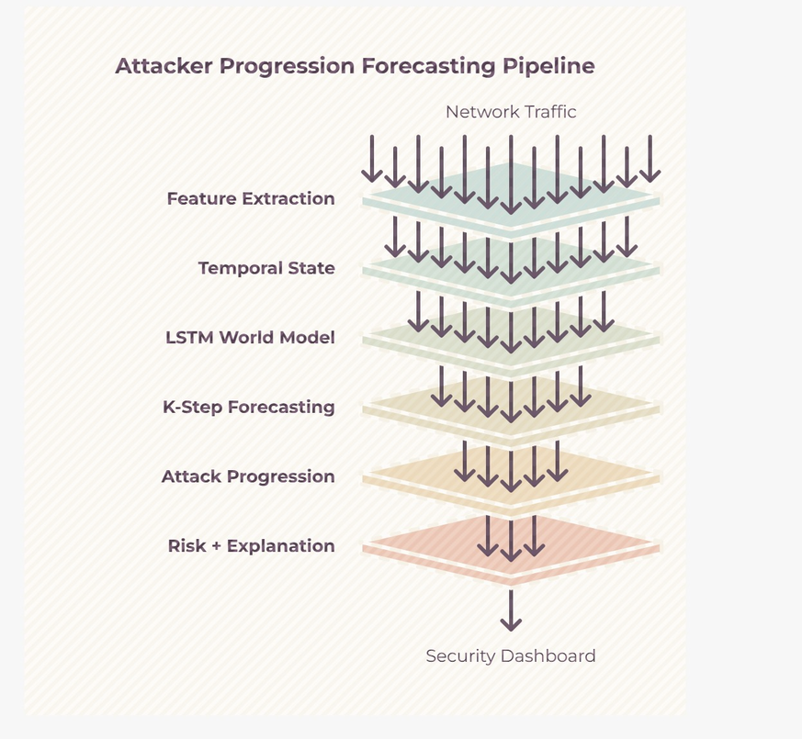




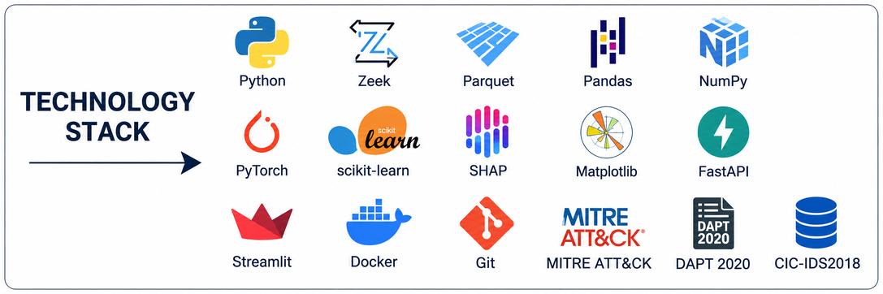

TECHNICAL APPROACH
Sonder
METHODOLOGY & PROCESS OF
IMPLEMENTATION
Reading the traffic
Zeek and CICFlowMeter turn raw network traffic into readable data.
The learning part
PyTorch trains the model that learns how attacks unfold.
Explainability
SHAP explains each alert. Confidence scores show how sure the model is.
Interface
FastAPI and Streamlit display the risk score, stage and timeline.
Deployment
Docker Compose runs the full stack offline and tcpreplay drives the live demo.
@SIH Idea submission- Template
3
Notes:
3

Slide 4








FEASIBILITY AND VIABILITY
Sonder
FEASIBILITY
VIABILITY
Technical Feasibility
Real-World Need
LSTM-based temporal modelling can learn attack progression from time-windowed network traffic.
Predicting multi-stage attack progression addresses the core limitation of reactive intrusion detection systems
Open-Source Technology
Security Teams
Scapy, PyShark, PyTorch, Pandas and SHAP provide the required development and ML capabilities.
Provides breach probability, predicted ATT&CK stage and explainable traffic features to support SOC analysts.
Deployment Feasibility
Government & Enterprises
The system can process PCAP/CSV data locally and operate without cloud services or internet connectivity.
Can support protection of organisational and critical digital infrastructure through earlier threat awareness.
Data Availability
Long-Term Impact
CIC-IDS-2018 and CTU-13 provide labelled attack traffic for training and validation.
Future SIEM integration, automated response and local model fine-tuning can expand practical adoption.
@SIH Idea submission- Template
4
Notes:
4

Slide 5
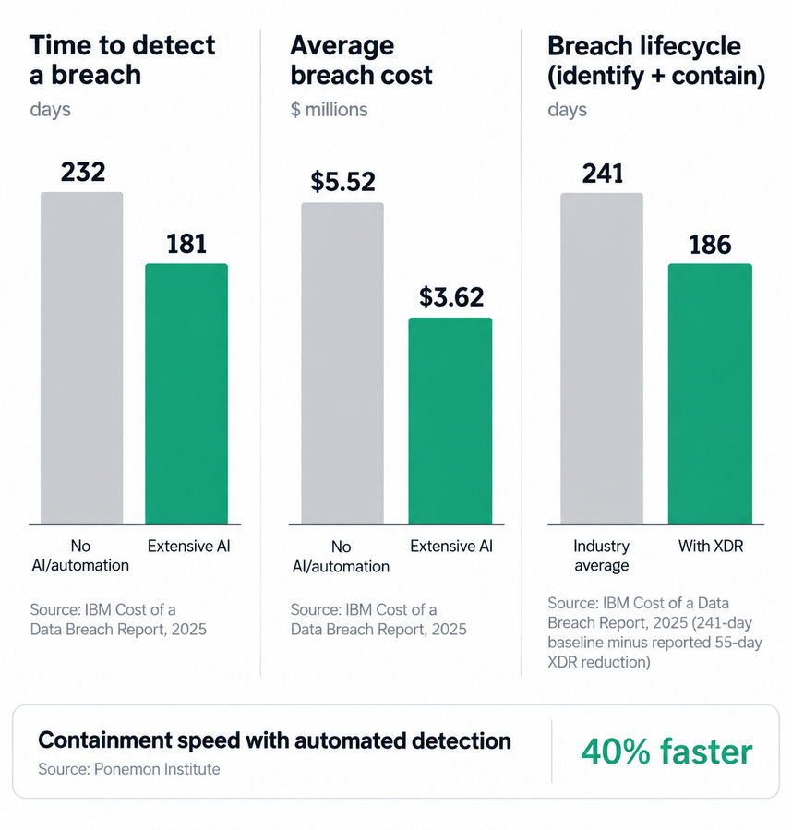
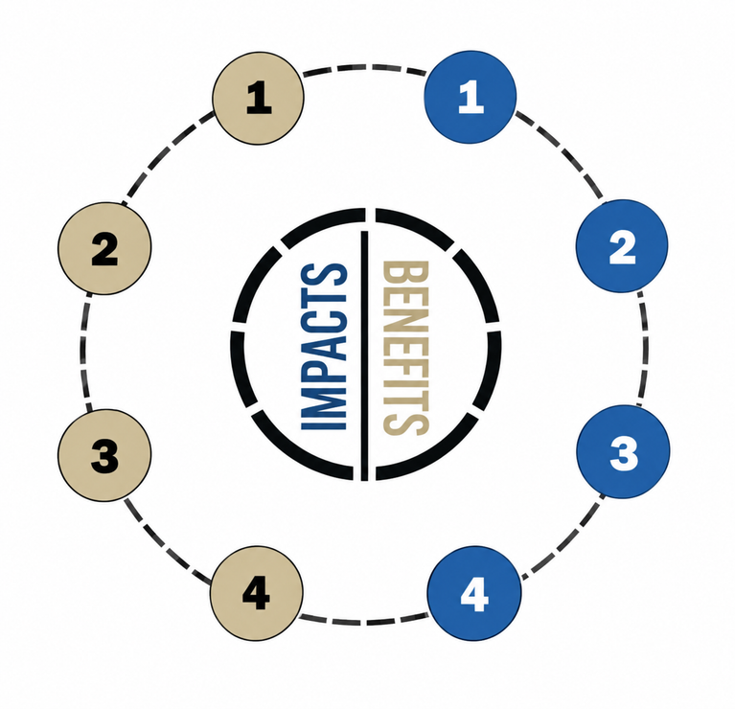
IMPACT AND BENEFITS
Sonder
Early Threat Detection
Predictive Security
Predicts attacks before breach completion.
Forecasts future attack progression.
Faster Incident Response
Explainable Alerts
Provides early warnings to SOC teams.
Highlights features driving predictions.
Reduced Security Risk
Offline Protection
Identifies slow and multi-stage attacks.
Works without cloud or internet dependency.
Improved Cyber Resilience
Cost-Effective Deployment
Enables proactive network defence.
Open-source and standard hardware.
@SIH Idea submission- Template
5
Notes:
5

Slide 6

RESEARCH AND REFERENCES
Sonder
World Models
Link
Attack Forecasting Survey
Kill Chain Inference
Link
Link
CIC-IDS-2018
CTU-13
SHAP
Link
Link
Link
MITRE ATT&CK
DreamerV3
Link
Link
@SIH Idea submission- Template
6
Notes:
6

