Slide 1

Topic :- Introduction to Timestamp-Based Protocols in DBMS
Group Members
Harsal ingle 20
Nikhil Padole 37
Om Mangrulkar 38 Under guidance of
Palak Belbanshi 43 Prof. :- Paritosh Nagarnayak

Slide 2


Timestamp-Based Protocols in DBMS
Timestamp-based protocols are a fundamental concept in concurrency control in database management systems (DBMS). They ensure data consistency and integrity in multi-user environments where simultaneous transactions can occur.

Slide 3

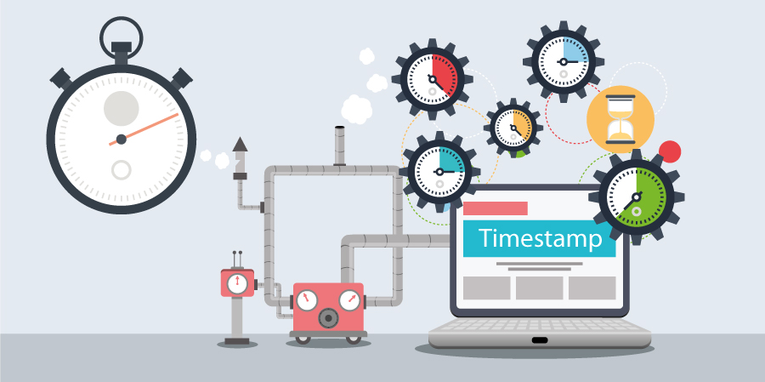
Introduction to Timestamp-Based Protocols
Timestamp-based protocols use timestamps to order transactions and prevent conflicts. Transactions are assigned timestamps based on their initiation time.
1
Timestamp Assignment
2
Transaction Ordering
Transactions are ordered based on their timestamps, ensuring consistency.
Transactions receive a unique timestamp when they begin.
3
Conflict Resolution
If conflicts arise, timestamps help determine which transaction takes precedence.

Slide 4


Timestamp Ordering (TO) Protocol
The Timestamp Ordering (TO) protocol is a widely used timestamp-based concurrency control method.
1
Read Operation
A transaction can read a data item if its timestamp is greater than or equal to the timestamp of the last write operation on that item.
2
Write Operation
A transaction can write to a data item if its timestamp is greater than the timestamp of all other transactions that have read or written to the item.
3
Conflict Resolution
If a transaction attempts an operation that violates the rules, the transaction is aborted and restarted with a new timestamp.

Slide 5
Advantages
Timestamp-based protocols offer several advantages in concurrency control.
Simplicity
High Throughput
Scalability
TO protocols are relatively simple to implement compared to other methods.
They can achieve high transaction throughput in many scenarios.
TO protocols can scale well to handle large numbers of transactions.

Slide 6


Disadvantages
While effective, timestamp-based protocols have certain disadvantages.
Starvation
Deadlock Potential
In some cases, deadlocks can occur, requiring additional mechanisms to resolve them.
Transactions with older timestamps might experience delays, leading to starvation.
Performance Overhead
Maintaining timestamps and checking them for each operation can introduce performance overhead.

Slide 7




Real-Time Example
Imagine an online banking system where multiple users transfer funds simultaneously.
Transaction 1
User A initiates a transfer of $100 from their account to User B's account.
Transaction 2
User B initiates a transfer of $50 from their account to User A's account.
Concurrency Control
Timestamp-based protocols ensure both transfers are processed correctly, preventing inconsistent balances.

Slide 8
Thank You

