Slide 1
Anti-Reversing Techniques
Anti-Reversing <number>

Slide 2
Anti-Reversing
Here, we focus on machine code
  Previously, looked at Java anti-reversing
We consider 4 general ideas
  Eliminate/obfuscate symbolic info
  Obfuscation
  Source code obfuscation
  Anti-debugging
Anti-Reversing <number>

Slide 3
Anti-Reversing
No free obfuscation tool available
  Plenty of free tools for Java
  Why the difference?
EXECryptor --- commercial tool
  Performs “code morphing”
  Apparently, what we call metamorphism
Anti-Reversing <number>

Slide 4
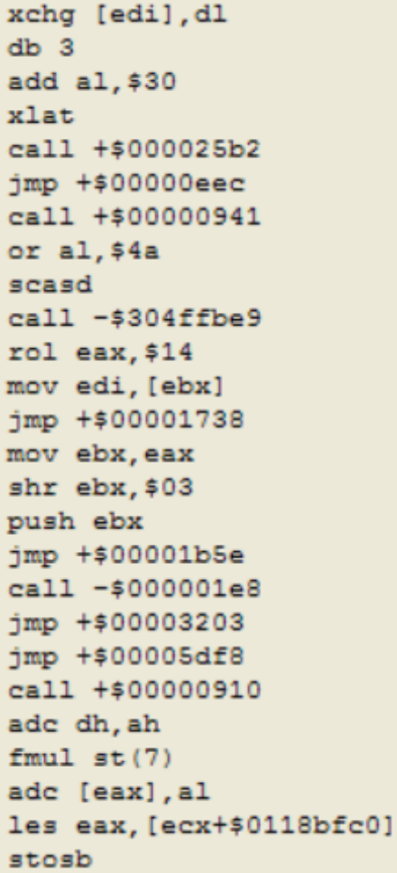
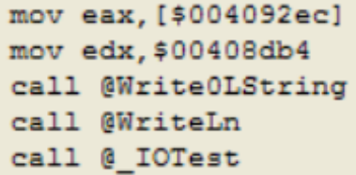
EXECryptor Example
After normal compilation
Using EXECryptor
  partial listing
Anti-Reversing <number>

Slide 5
Anti-Reversing
Anti-reversing might affect program
  Bigger
  More difficult to maintain
  Slower
  Increased memory usage, etc., etc.
Must decide if program worth protecting
  Or which parts of which programs
Anti-Reversing <number>

Slide 6
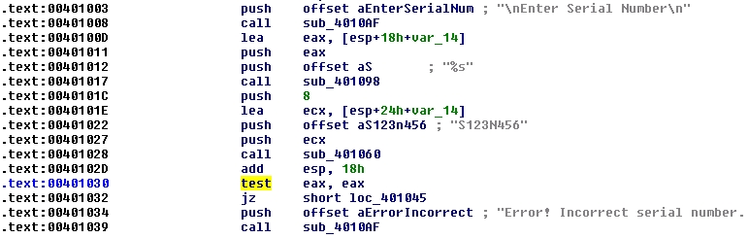
Symbolic Information
What is symbolic info?
  Strings, constants, variable names, etc.
Why is this relevant to SRE?
Anti-Reversing <number>

Slide 7
Symbolic Information
Can we eliminate symbolic info?
  Not really---best we can do is obfuscate
How to obfuscate?
  XOR/simple substitution
  XOR with multiple string(s)
  Strong encryption
  Other?
Anti-Reversing <number>

Slide 8


Symbolic Info
Example: encrypt string literals
Anti-Reversing <number>

Slide 9
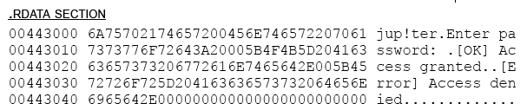
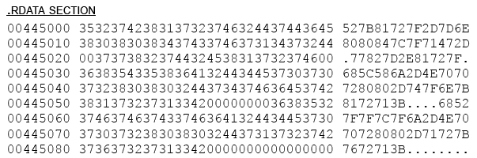
PE File
No encryption
Encrypted with simple substitution
Anti-Reversing <number>

Slide 10
Symbolic Info
Also want to obfuscate constants and other symbolic info
May be helpful to use multiple obfuscation techniques
  Obfuscate the obfuscation?
Parallels here with viruses
  Encrypted, polymorphic, metamorphic
Anti-Reversing <number>

Slide 11
Program Obfuscation
Change code to make it hard to understand
Can be simple…
  Spaghetti code
  Unusual calculations
…or complex
  Control flow obfuscation
  Opaque predicate (more on this later)
Anti-Reversing <number>

Slide 12
Program Obfuscation
First rule
  Do not use debug mode
Debug mode puts lots of info in PE
  Goes in “symbol tables” section of PE
  That is, “.stabs” section for GNU C++
  Not human-friendly, but maybe useful
Anti-Reversing <number>

Slide 13
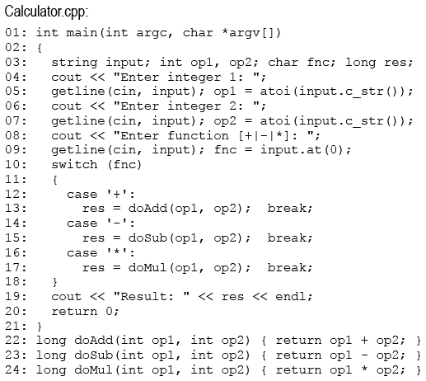
Debug Mode
Source code
Anti-Reversing <number>

Slide 14
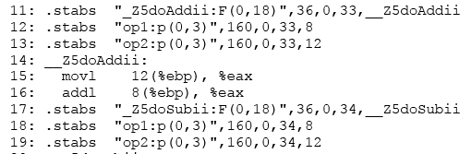
Debug Mode
.stabs section
Anti-Reversing <number>

Slide 15
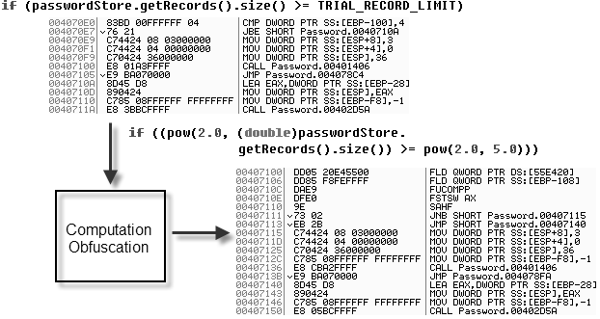
Program Obfuscation
Simple example --- obfuscate numeric check
Anti-Reversing <number>

Slide 16
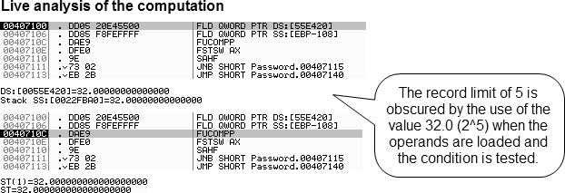
Program Obfuscation
Obfuscate numeric check, continued
Anti-Reversing <number>

Slide 17
Control Flow Obfuscation
Example: obfuscate method that does password limit check
We use randomized and recursive logic
  Recursion grows stack…
  …so stepping thru code is difficult
  Randomize so execution is unpredictable…
  …e.g., breakpoints not consistent between runs
Use a custom algorithm
  Since no general-purpose tool available for this
Anti-Reversing <number>

Slide 18
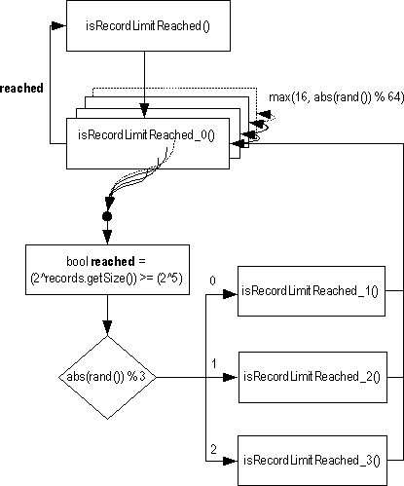
Control Flow Obfuscation
Depth of the recursion is randomized on each check of the limit.
Random procedure call targets generate and return a number that is added to an instance variable, preventing the procedures from being identified as NOPs by a code optimizer.
Anti-Reversing <number>

Slide 19
Control Flow Obfuscation
To measure effectiveness, consider three execution traces
Levenshtein Distance (LD) computed between each of the three traces
  LD is “edit distance”, i.e., minimum number of edit operations to transform one into the other
  Of course, it depends on allowed edits
  Here, applied to each line, not each character
Anti-Reversing <number>

Slide 20
Control Flow Obfuscation
Execution traces
  Collected using OllyDbg
  Cleaned of disassembly artifacts such as line numbers, addresses, etc.
  Ensures that LD calculation is “fair”
Anti-Reversing <number>

Slide 21
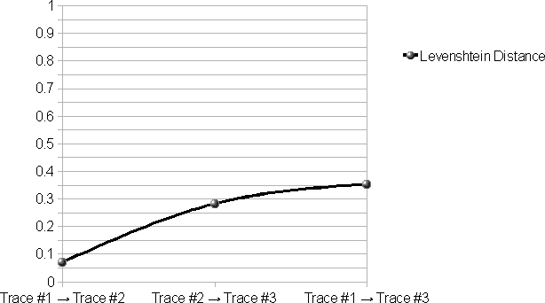
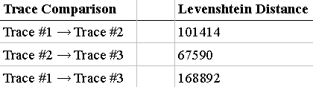
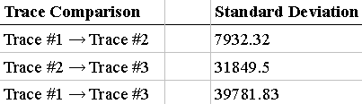
Control Flow Obfuscation
Anti-Reversing <number>

Slide 22
Source Code Obfuscation
Apply anti-reversing to source code…
Why do this?
May be necessary to ship application source code
  E.g., so machine code can be generated on the end user’s computer
A weak form of intellectual property protection
Note this could also be used as watermark
Anti-Reversing <number>

Slide 23
Source Code Obfuscation
As always, care must be taken
  Any compiler will have pathological cases that it cannot compile correctly
Obfuscated code may not be like anything any human would write
  Compiler test cases written by humans
Anti-Reversing <number>

Slide 24
Source Code Obfuscation
In some cases, might want exe to change
  Metamorphic code --- different instances look different, but all do the same thing
In some cases, might want exe structure and functionality to change
  In some small and controlled way
Here, we transform source code
  So that no change to resulting executable
Anti-Reversing <number>

Slide 25
COBF
“Code Obfuscator”
Free C/C++ source code obfuscator
Claims
  Results “aren’t readable by human beings”
  …“but they remain compilable”
No claim that program is the same…
Anti-Reversing <number>

Slide 26
COBF Example
Original source code
VerifyPassword.cpp:
01: int main(int argc, char *argv[])
02: {
03: const char *password = "jup!ter";
04: string specified;
05: cout << "Enter password: ";
06: getline(cin, specified);
07: if (specified.compare(password) == 0)
08: {
09: cout << "[OK] Access granted." << endl;
10: } else
11: {
12: cout << "[Error] Access denied." << endl;
13: }
14: }
COBF invocation:
01: C:\cobf_1.06\src\win32\release\cobf.exe
02: @C:\cobf_1.06\src\setup_cpp_tokens.inv -o cobfoutput -b -p C:
03: \cobf_1.06\etc\pp_eng_msvc.bat VerifyPassword.cpp
Anti-Reversing <number>

Slide 27
Source Code Obfuscation
COBF obfuscated source for VerifyPassword.cpp:
01: #include"cobf.h"
02: ls lp lk;lf lo(lf ln,ld*lj[]){ll ld*lc="\x6a\x75\x70\x21\x74
03: \x65\x72";lh la;lb<<"\x45\x6e\x74\x65\x72\x20\x70\x61\x73\x73
04: \x77\x6f\x72\x64""\x3a\x20";li(lq,la);lm(la.lg(lc)==0){lb<<"\x5b
05: \x4f\x4b\x5d\x20\x41" "\x63\x63\x65\x73\x73\x20\x67\x72\x61\x6e
06: \x74\x65\x64\x2e"<<le;}lr{lb<<"\x5b\x45\x72\x72\x6f\x72\x5d
07: \x20\x41\x63\x63\x65\x73\x73\x20\x64" "\x65\x6e\x69\x65
08: \x64\x2e"<<le;}}
COBF generated header (cobf.h):
01: #define ls using 02: #define lp namespace
03: #define lk std 04: #define lf int
05: #define lo main 06: #define ld char
07: #define ll const 08: #define lh string
09: #define lb cout 10: #define li getline
11: #define lq cin 12: #define lm if
13: #define lg compare 14: #define le endl 15: #define lr else
Anti-Reversing <number>

Slide 28
Anti-Reversing Techniques: Take 2
Anti-Reversing <number>

Slide 29
Introduction
This material comes from Reversing: Secrets of Reverse Engineering, by E. Eilam
As we know, it’s not possible to prevent SRE
  But, can “hinder and obstruct reversers by wearing them out and making the process so slow and painful that they just give up”
  Reverser’s success depends on skill & motivation
Here, we focus on native code, not bytecode
Recall, every anti-reversing approach has a cost
  CPU usage, code size, reliability, robustness, …
Anti-Reversing <number>

Slide 30
Why Anti-Reversing?
Anti-reversing “almost always makes sense”
  Unless code is for internal use only, open source, or very simple
Copy protection, DRM, and similar, has a “special need” for anti-reversing
Anti-reversing especially important for Bytecode, .NET, etc.
  Since it’s so easy to decompile
Anti-Reversing <number>

Slide 31
Basic Approaches
Three basic approaches
  Each approach has plusses and minuses
Eliminate “symbolic info”
  Hide variable names, function names, …
Obfuscate the program
  Make static analysis difficult
Use anti-debugger tricks
  Make dynamic analysis difficult
  Often platform and/or debugger specific
Anti-Reversing <number>

Slide 32
Eliminate Symbolic Info
The author is referring to things like variable names, function names, etc.
  Not strings and such
For C/C++, almost all “symbolic info” eliminated automatically
  However, this is not the case for bytecode
Recall PE import/export tables
  Contains names of DLLs and function names
  So, good idea to export all functions by ordinals
Anti-Reversing <number>

Slide 33
Code Encryption
Also known as packing or shelling
Why encrypt?
  Static analysis of encrypted code is impossible
  Also known as anti-disassemblymentarianism
How/when to encrypt code?
  Encrypt after code is compiled
  Bundle encrypted code with decryptor and key
Then key is embedded in the code…
  At best, like playing hide and seek with a key
Alternatives to embedding key in the code?
Anti-Reversing <number>

Slide 34
Code Encryption
Standard packers/encryptors do exist
If standard packer/encryptor is used, it can be unpacked automatically
  Then encryption is of little use
Best approach?
  Custom encryption/decryptor
  Key calculated at runtime
  I.e., no static key stored in the code
  Makes it difficult to automatically extract key
Anti-Reversing <number>

Slide 35
Anti-Debugging
Encryption aimed at static analysis
What about dynamic analysis/debugging
How to make dynamic analysis difficult?
  Of course, anti-debugging techniques
  Not known as anti-debuggingmentarianism
Encrypted binary combined with anti-debugging can be effective combination
Why?
Anti-Reversing <number>

Slide 36
Debugger Basics
When breakpoint is set
  Instruction replaced with int 3
  An int 3 is “breakpoint interrupt”
  Signals debugger of a breakpoint
  Debugger replaces int 3 with original instruction and freezes execution
Also possible to have hardware breakpoint
  E.g., processor breaks at specific address
Anti-Reversing <number>

Slide 37
Debugger Basics
When breakpoint is reached, often single step thru code
Single stepping uses trap flag (TF) and EFLAGS registers
  When TF is set, interrupt generated after each instruction
Anti-Reversing <number>

Slide 38
IsDebuggerPresent API
IsDebuggerPresent --- Windows API to detect user mode debuggers
  Such as OllyDbg
But, if you call IsDebuggerPresent, easy for reverser to simply skip over it
Less obvious to include the checking code that IsDebuggerPresent uses
  Only 4 lines of assembly code
Anti-Reversing <number>

Slide 39
IsDebuggerPresent API
IsDebuggerPresent:
  mov eax, fs:[00000018]
  mov eax, [eax+0x30]
  cmp byte ptr [eax+0x2], 0
  je SomewhereElse
  ; terminate program here
But there are some concerns…
  E.g., hardcoded offset of 0x30 might change in future versions of Windows
Anti-Reversing <number>

Slide 40
SystemKernelDebuggerInformation
This one tells you if kernel mode debugger is attached
Risky, since user might have legitimate use for such a debugger
This will not detect SoftICE…
  Can modify it to specifically check whether SoftICE is present
Anti-Reversing <number>

Slide 41
Detecting SoftICE
SoftICE uses int 1 for single-step interrupt
SoftICE defines its own handler for int 1
  Appears in Interrupt Descriptor Table (IDT)
  Check whether exception code in IDT has changed
  Not very effective against experienced user
In general, author suggests to “avoid any debugger-specific approach”
  Since several needed, high risk of false positives
Anti-Reversing <number>

Slide 42
Trap Flag
A trick to detect any debugger…
  Enable trap flag
  Check whether an exception is raised
  If not, it was “swallowed” by a debugger
However, this uses uncommon instructions
  pushfd and popfd
  Making it fairly easy to detect
Anti-Reversing <number>

Slide 43
Code Checksums
Compute checksum/hash on code
  Then verify randomly/repeatedly at runtime
Why is this useful?
  Debugger modifies code for breakpoints
  Also a defense against patching
Downside?
  May be costly to compute
  Not effective against hardware breakpoints
Anti-Reversing <number>

Slide 44
Disassembler Basics
Two common approaches to disassembly
Linear sweep
  Disassemble “instructions” as they appear
  SoftICE and WinDbg use linear sweep
Recursive traversal
  Follows the control flow of the program
  More intelligent approach
  Much harder to trick than linear sweep
  OllyDbg and IDAPro use recursive traversal
Anti-Reversing <number>

Slide 45
Confusing a Disassembler
Trying to confuse disassemblers
  Not a strong defense, but popular
Example --- insert a byte of junk
  jmp After
  _emit 0x0f
  After:
  mov eax, [SomeVariable]
  push eax
  call Afunction
Confuses linear sweep, but not recursive
Anti-Reversing <number>

Slide 46
Confusing a Disassembler
How to confuse a recursive traversal?
Use an opaque predicate…
  Conditional that is, say, always true
…and make “dead” branch nonsense
Then actual program ignores dead code, but disassembler cannot
Anti-Reversing <number>

Slide 47
Confusing a Disassembler
Example --- nonsense “else” clause
  mov eax, 2
  cmp eax, 2
  je After
  _emit 0xf
  After:
  mov eax, [SomeVariable]
  push eax
  call Afunction
This confuses IDAPro but not OllyDbg!
Anti-Reversing <number>

Slide 48
Confusing a Disassembler
Similar example…
  mov eax, 2
  cmp eax, 3
  je Junk
  jne After
  Junk:
  _emit 0xf
  After:
  mov eax, [SomeVariable]
  push eax
  call Afunction
Confuses OllyDbg but not PEBrowse!
Anti-Reversing <number>

Slide 49
Confusing a Disassembler
Example…
  mov eax, 2
  cmp eax, 3
  je Junk
  mov eax, After
  jmp eax
  Junk:
  _emit 0xf
  After:
  mov eax, [SomeVariable]
  push eax
  call Afunction
Confuses “every disassembler tested”
Anti-Reversing <number>

Slide 50
Confusing a Disassembler
Based on previous examples, author concludes
  Windows disassemblers are “dumb enough that you can fool them”
  After all, how hard is it to tell 2 == 2 (always)?
But, you can always fool a disassembler
  For example, fetch jump address from data structure computed at runtime
  Disassembler would have to run the program to know that it’s dealing with opaque predicate
Anti-Reversing <number>

Slide 51
Disassembler Confusing App
Insert disassembler-confusing code several places in program
  See example in Eilam’s book
Anti-Reversing <number>

Slide 52
Code Obfuscation
Examples up to this point…
  Platform-specific tricks
  Only increases attacker’s “annoyance factor”
Next we consider real obfuscation
Potency --- amount of complexity added
  Measured by increase in number of predicates, depth of nesting, etc.
Resilience --- work needed to remove it
  I.e., how resistant to de-obfuscation?
Anti-Reversing <number>

Slide 53
Code Obfuscation
Obfuscation carries a cost
  Decreased performance, increased size, …
When is obfuscation applied?
  As code is written?
  Or automatically after code is completed?
  Which is better and why?
Next, common obfuscating transformation
Anti-Reversing <number>

Slide 54
Control Flow Transformations
According to Collberg, Thomborson, Low, there are 3 types of these
  Computation transformations --- reduced readability
  Aggregation transformations --- break high-level abstractions present in high-level language
  Ordering transformations --- randomize the order as much as possible (considered weaker)
Anti-Reversing <number>

Slide 55
Opaque Predicates
“Conditional”, but not really
For example
  if (x == x + 1) …
This “if” is never true
But this one is too easy to detect
  So it’s not resilient
Examples of potent and resilient opaque predicates?
Anti-Reversing <number>

Slide 56
Opaque Predicates
A simple example
Any math identity will work
if (x*x + y*y >= 2*x*y) …
  …is always true, but not so obvious
In assembly, this would be even less obvious
Anti-Reversing <number>

Slide 57
Opaque Predicates
A more complex example
One thread puts random numbers > n into global data structure
Another thread assigns x one of these numbers
Then conditional
  if (x < n) …
is an opaque predicate
Anti-Reversing <number>

Slide 58
Table Transformation
Increment, say, ecx register after each “stage”, so that next (logical) stage follows
  Loop thru decision code after each stage
  Jump determined based on previous stage
  Jump addresses taken from a “switch table”
This leaves no sense of structure
  Same code could do something completely different by simply changing switch table
Anti-Reversing <number>

Slide 59
Table Transformation
Any code can be converted into a table
  Table is sorta like a customized virtual machine
  May be a performance penalty
Can be made stronger by…
  Including obfuscation, anti-disassembly, anti-debugger, etc., in various stages
  Compute switch addresses at runtime, etc.
This is a powerful anti-reversing technique
  Breaks any connection to higher-level structure
Anti-Reversing <number>

Slide 60
Inlining and Outlining
Inlining --- functions are duplicated “in line” instead of being called
  A common optimization technique
  Useful obfuscation, since it breaks abstraction
  But, increases size of code
Outlining --- make function where none exists
  If done often and randomly, can be a strong obfuscation tool
  Like a strong form of spaghetti code
Anti-Reversing <number>

Slide 61
Interleaving Code
Interleave code segments of two or more functions
  And use opaque predicate to jump between segments
Creates spaghetti effect while hiding the functions
Anti-Reversing <number>

Slide 62
Ordering Transformations
Reverser relies on locality
  That is, there is an assumed logical order
  And “nearby” code is usually related
Find code segments that are independent and re-order them
  This breaks reverser’s sense of locality
  Good approach for automated tools
Anti-Reversing <number>

Slide 63
Data Transformations
Understanding data structures can be a crucial step in reversing
  So, obfuscating data is a good idea
Many, many possible ways to do this
Here, we briefly consider just two…
  Modify variable encodings
  Restructuring arrays
Anti-Reversing <number>

Slide 64
Modifying Variable Encoding
Many ways to do this
For example, instead of
  for (i = 0; i < 10; i++) …
Use
  for (i = 1; i < 20; i += 2) …
Then use “i << 1” instead of “i”
Anti-Reversing <number>

Slide 65
Restructuring Arrays
Goal is to obscure purpose of array
For example
  Merge two arrays into one
  Split one array into many
  Change number of dimensions of array
Not particularly strong obfuscation
  May be detected/fixed automatically
Anti-Reversing <number>

Slide 66
Conclusion
More details on most of these techniques in Eilam’s book
For “anti-reversing, take 3”, see
  http://www.securityfocus.com/infocus/1893
Anti-Reversing <number>

