Slide 1
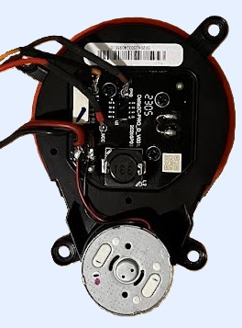
TX
GND_M
GND_L
V_M
V_L

