Slide 1
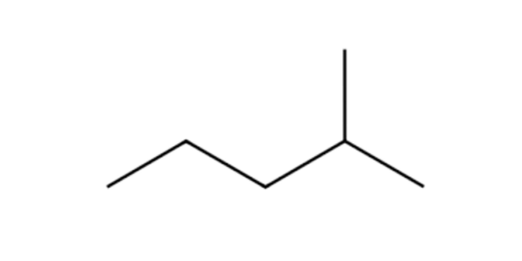
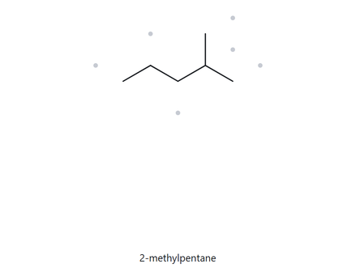
A01 — STRUCTURE → NAME
Level: FOUNDATION MOLECULAR FORMULA: C6H14
NUMBERED PARENT
NAMING TRAIL
PARENT: 5C so pentane
NUMBERING: 2 since 2 is much closer in substituent than 4
SUBSTITUENT: methyl
4
3
2
5
1
MY NAME
THE ALKINE CHECK
2-methylpentane

Slide 2
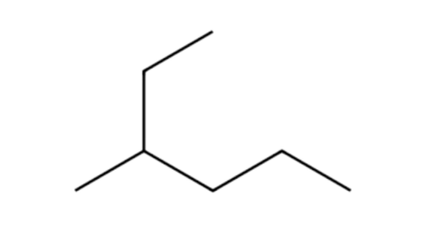
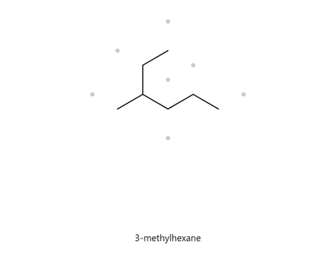
A02 — STRUCTURE → NAME
Level: FOUNDATION MOLECULAR FORMULA: C7H16
NUMBERED PARENT
NAMING TRAIL
PARENT: 6C so HEXANE
NUMBERING: 3 since 3 is much closer in substituent than 4
SUBSTITUENT: methyl
2
3
4
5
6
MY NAME
THE ALKINE CHECK
3-methylhexane

Slide 3
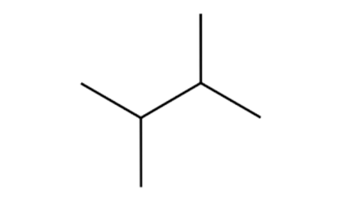
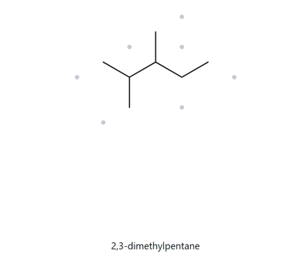
A03 — STRUCTURE → NAME
Level: FOUNDATION MOLECULAR FORMULA: C6H14
NUMBERED PARENT
NAMING TRAIL
PARENT: 4C so PENTANE
NUMBERING: it is from right to left
SUBSTITUENT: methyl
4
2
3
1
MY NAME
THE ALKINE CHECK
2,3-dimethylpentane

Slide 4
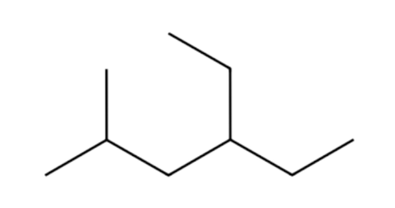
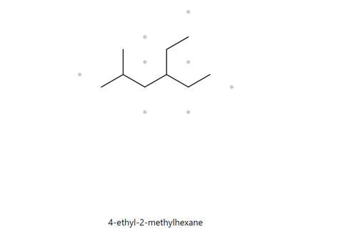
A04 — STRUCTURE → NAME
Level: DEVELOPING MOLECULAR FORMULA: C9H20
NUMBERED PARENT
NAMING TRAIL
PARENT: 6C so HEXANE
NUMBERING: it is from left to right
SUBSTITUENT: methyl is on C2 and ethyl on C4
4
6
2
3
5
1
MY NAME
THE ALKINE CHECK
4-ethyl-2-methylhexane

Slide 5
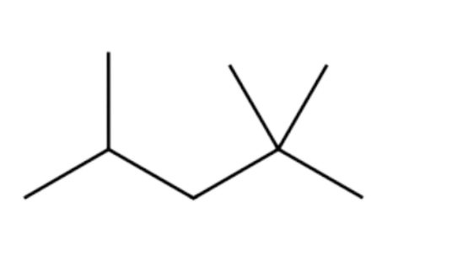
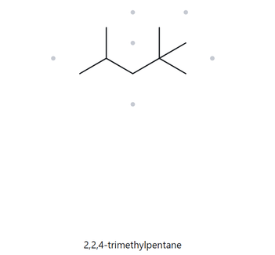
A05 — STRUCTURE → NAME
Level: DEVELOPING MOLECULAR FORMULA: C8H18
NUMBERED PARENT
NAMING TRAIL
PARENT: 5C so pentane
NUMBERING: it is from right to left
SUBSTITUENT: there are 2 methyl on C2 and 1 on C4
4
3
2
5
MY NAME
THE ALKINE CHECK
2,2,4-trimethylpentane

Slide 6
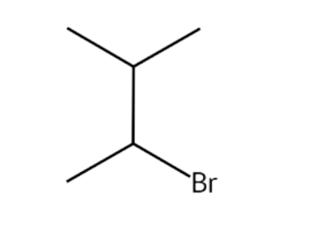
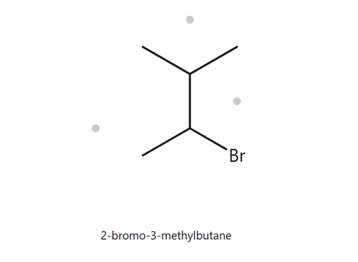
A06 — STRUCTURE → NAME
Level: DEVELOPING MOLECULAR FORMULA: C5H11Br
NUMBERED PARENT
NAMING TRAIL
4
PARENT: 4C so butane
NUMBERING: both directions give the same so doing it alphabetically Br gets lowest
SUBSTITUENT: methyl at C3 and Br at C2
3
2
1
MY NAME
THE ALKINE CHECK
2-bromo-3-methylbutane

Slide 7
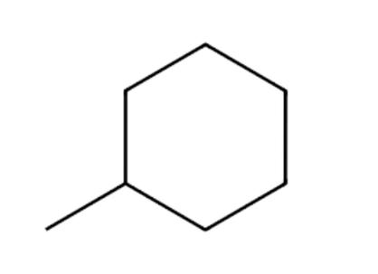
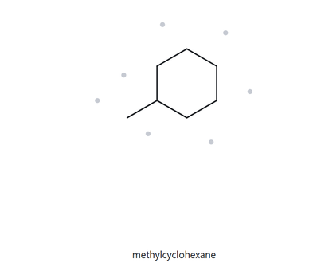
A07 — STRUCTURE → NAME
Level: DEVELOPING MOLECULAR FORMULA: C7H14
NUMBERED PARENT
NAMING TRAIL
3
PARENT: 6C so cyclohexane
NUMBERING: not required since ring
SUBSTITUENT: methyl
2
4
1
5
6
MY NAME
THE ALKINE CHECK
methylcyclohexane

Slide 8
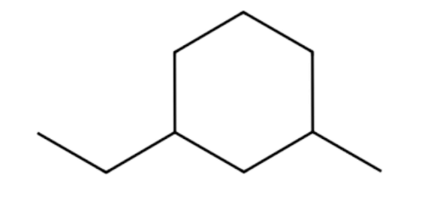
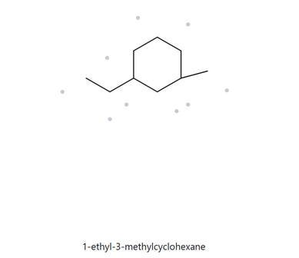
A08 — STRUCTURE → NAME
Level: CHALLENGE MOLECULAR FORMULA: C9H18
NUMBERED PARENT
NAMING TRAIL
5
PARENT: 6C so cyclohexane
NUMBERING: they are opposite so alphabetically ethyl is first
SUBSTITUENT: ethyl is at C1 and methyl is at C4
6
4
1
3
2
MY NAME
THE ALKINE CHECK
1-ethyl-3-methylcyclohexane

Slide 9
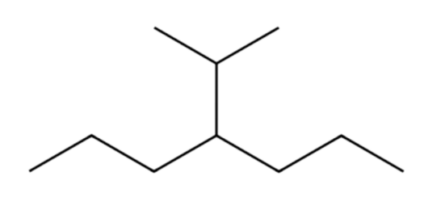
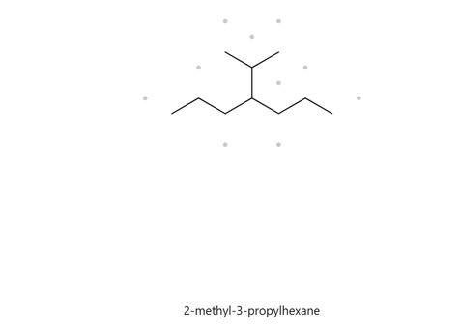
A09 — STRUCTURE → NAME
Level: CHALLENGE MOLECULAR FORMULA: C10H22
NUMBERED PARENT
NAMING TRAIL
PARENT: 7C so heptane
NUMBERING: either direction
SUBSTITUENT: methyl is at C2 and isoprophyl is at C4
2
3
4
5
6
7
1
MY NAME
THE ALKINE CHECK
2-methyl-3-propylhexane

Slide 10
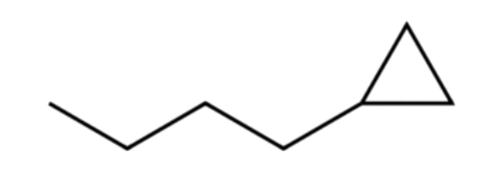
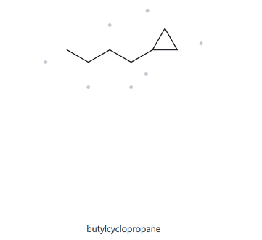
A10 — STRUCTURE → NAME
Level: CHALLENGE MOLECULAR FORMULA: C8H16
NUMBERED PARENT
NAMING TRAIL
PARENT: 3C so cyclopropane
NUMBERING: not required a locant
SUBSTITUENT: pentyl group
5
4
3
2
1
MY NAME
THE ALKINE CHECK
butylcyclopropane

Slide 11
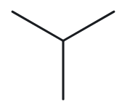
CARD B01 — NAME → STRUCTURE
Level: FOUNDATION Given name: 2-methylpropane
NAME DECODED
BOND-LINE STRUCTURE
PARENT: propane means a 3 carbon chain
SUBSTITUENT: methyl on C1
EXPECTED FORMULA: 4 carbons since 3 from parent and 1 from chain and 10H since 3 carbons has 3 each and 1 carbon has 1H=10
C4H10
FORMULA CHECK
BACK-CHECK
COUNTED FROM DRAWING: C4H10
CHECKING: CNH2N+2 = C4H2(4)+2 =
C4H10
RETURNED BY THE ALKANE: 2-methylpropane

Slide 12
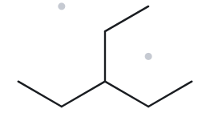
CARD B02 — NAME → STRUCTURE
Level: FOUNDATION Given name: 3-ethylpentane
NAME DECODED
BOND-LINE STRUCTURE
PARENT: pentane means a 5 carbon chain
SUBSTITUENT: ethyl on C3
EXPECTED FORMULA: 7 carbons since 7 chains and 16H since 2(7)+2=16
C7H16
FORMULA CHECK
BACK-CHECK
COUNTED FROM DRAWING: C7H16
CHECKING: CNH2N+2 = C7H2(7)+2 =
C7H16
RETURNED BY THE ALKANE: 3-ethylpentane

Slide 13
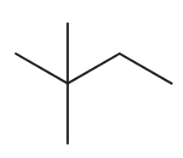
CARD B03 — NAME → STRUCTURE
Level: FOUNDATION Given name: 2,2-dimethylbutane
NAME DECODED
BOND-LINE STRUCTURE
PARENT: butane means a 4 carbon chain
SUBSTITUENT: methyl on C2 and di so it means 2 methyl branch
EXPECTED FORMULA: 6 carbons since 6 chains and 14H since 2(6)+2=14
C6H14
FORMULA CHECK
BACK-CHECK
COUNTED FROM DRAWING: C6H14
CHECKING: CNH2N+2 = C6H2(6)+2 =
C6H14
RETURNED BY THE ALKANE: 2,2-dimethylbutane

Slide 14
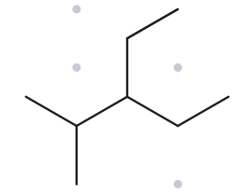
CARD B04 — NAME → STRUCTURE
Level: DEVELOPING Given name: 3-ethyl-2-methylpentane
NAME DECODED
BOND-LINE STRUCTURE
PARENT: pentane means a 5 carbon chain
SUBSTITUENT: methyl on C2 and ethyl on C3
EXPECTED FORMULA: 8 carbons since 8 chains and 14H since 2(8)+2=18
C8H18
FORMULA CHECK
BACK-CHECK
COUNTED FROM DRAWING: C8H18
CHECKING: CNH2N+2 = C8H2(8)+2 =
C8H18
RETURNED BY THE ALKANE: 2,2-dimethylbutane

Slide 15
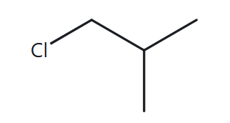
CARD B05 — NAME → STRUCTURE
Level: DEVELOPING Given name: 1-chloro-2-methylpropane
NAME DECODED
BOND-LINE STRUCTURE
PARENT: propane means a 3 carbon chain
SUBSTITUENT: methyl on C2 and chlorine on C1
EXPECTED FORMULA: 4 carbons since 4 chains Cl not included and 10H since 2(4)+2=10
C4H10
FORMULA CHECK
BACK-CHECK
COUNTED FROM DRAWING: C4H10
CHECKING: CNH2N+2 = C4H2(4)+2 =
C4H10
RETURNED BY THE ALKANE: 1-chloro-2-methylpropane

Slide 16
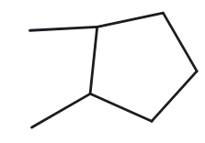
CARD B06 — NAME → STRUCTURE
Level: DEVELOPING Given name: 1,2-dimethylcyclopentane
NAME DECODED
BOND-LINE STRUCTURE
PARENT: cyclopentane means a ring containing 5 carbons
SUBSTITUENT: methyl on C2 and C1
EXPECTED FORMULA: 7 carbons since 5 on the ring and 2 on methyl and 14H since 2(7)=14
C7H14
FORMULA CHECK
BACK-CHECK
COUNTED FROM DRAWING: C7H14
CHECKING: CNH2N = C7H2(7) =
C7H14
RETURNED BY THE ALKANE: 1,2-dimethylcyclopentane

Slide 17
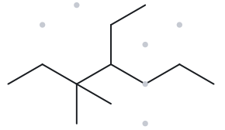
CARD B07 — NAME → STRUCTURE
Level: DEVELOPING Given name: 4-ethyl-3,3-dimethylheptane
NAME DECODED
BOND-LINE STRUCTURE
PARENT: heptane means a 7 carbon chain
SUBSTITUENT: 2 methyl on C3 so di- and ethyl on C4
EXPECTED FORMULA: 11 carbons since 11 chains and 24H since 2(11)+2=24
C11H24
FORMULA CHECK
BACK-CHECK
COUNTED FROM DRAWING: C11H24
CHECKING: CNH2N+2 = C11H2(11)+2 =
C11H24
RETURNED BY THE ALKANE: 4-ethyl-3,3-dimethylheptane

Slide 18
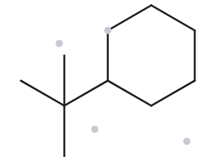
CARD B08 — NAME → STRUCTURE
Level: CHALLENGE Given name: tert-butylcyclohexane
NAME DECODED
BOND-LINE STRUCTURE
PARENT: cyclohexane means a ring containing 6 carbons
SUBSTITUENT: turt-butyl
EXPECTED FORMULA: 10 carbons since 6 on the ring and 4 on turt-butyl and 20H since 2(10)=20
C10H20
FORMULA CHECK
BACK-CHECK
COUNTED FROM DRAWING: C10H20
CHECKING: CNH2N = C10H2(10) =
C10H20
RETURNED BY THE ALKANE: (1,1-dimethylethyl)cyclohexane or tert-butylcyclohexane

Slide 19
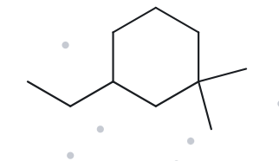
CARD B09 — NAME → STRUCTURE
Level: CHALLENGE Given name: 3-ethyl-1,1-dimethylcyclohexane
NAME DECODED
BOND-LINE STRUCTURE
PARENT: cyclohexane means a ring containing 6 carbons
SUBSTITUENT: 2 methyl in C1 so di- and ethyl in C3
EXPECTED FORMULA: 10 carbons since 6 on the ring and 4 from both metyl and ethyl and 20H since 2(10)=20 C10H20
FORMULA CHECK
BACK-CHECK
COUNTED FROM DRAWING: C10H20
CHECKING: CNH2N = C10H2(10) =
C10H20
RETURNED BY THE ALKANE: 3-ethyl-1,1-dimethylcyclohexane

Slide 20
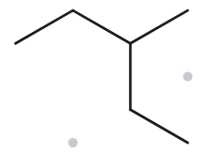
CARD B10 — NAME → STRUCTURE
Level: CHALLENGE Given name: 2-ethylbutane
NAME DECODED
BOND-LINE STRUCTURE
PARENT: pentane means a 5 carbon chain
SUBSTITUENT: methyl on C3
EXPECTED FORMULA: 6 carbons since 6 chains and 14H since 2(6)+2=14
C6H14
FORMULA CHECK
BACK-CHECK
COUNTED FROM DRAWING: C6H14
CHECKING: CNH2N+2 = C6H2(6)+2 =
C6H14
RETURNED BY THE ALKANE: 3-methylpentane

