Slide 1
1-Propane
MOLECULAR FORMULA
LEWIS STRUCTURE
C₃H₈
H
H
H
H
C
C
C
H
H
H
H
CONDENSED STRUCTURE FORMULA
BOND-LINE FORMULA
CH₃CH₂CH₃

Slide 2

2-Ethanol
MOLECULAR FORMULA
LEWIS STRUCTURE
H
H
C₂H₆O
..
H
C
C
O
H
..
H
H
CONDENSED STRUCTURE FORMULA
BOND-LINE FORMULA
CH₃CH₂OH

Slide 3

3-Acetone
C₃H₆O
MOLECULAR FORMULA
LEWIS STRUCTURE
H
O
H
..
..
H
C
C
C
H
H
H
CONDENSED STRUCTURE FORMULA
BOND-LINE FORMULA
CH₃COCH₃

Slide 4

4-Acetic acid
MOLECULAR FORMULA
LEWIS STRUCTURE
H
O
C₂H₄O₂
..
..
..
H
C
C
O
H
..
H
CONDENSED STRUCTURE FORMULA
BOND-LINE FORMULA
CH₃COOH

Slide 5

5-Ethyl Acetate
C₄H₈O₂
MOLECULAR FORMULA
LEWIS STRUCTURE
H
O
H
H
..
..
..
H
C
C
O
C
C
H
..
H
H
H
CONDENSED STRUCTURE FORMULA
BOND-LINE FORMULA
CH₃COOCH₂CH₃

Slide 6
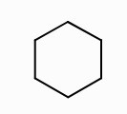
6-Cyclohexane
MOLECULAR FORMULA
LEWIS STRUCTURE
C₆H₁₂
H
H
H
C
H
H
C
C
H
H
H
H
C
C
H
C
H
H
CONDENSED STRUCTURE FORMULA
BOND-LINE FORMULA
(CH₂)₆

Slide 7
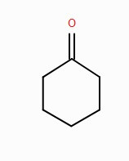
7-Cyclohexanone
MOLECULAR FORMULA
LEWIS STRUCTURE
O
..
..
C₆H₁₀O
H
C
H
H
C
C
H
H
H
H
C
C
H
C
H
H
CONDENSED STRUCTURE FORMULA
BOND-LINE FORMULA
(CH2)5CO

Slide 8
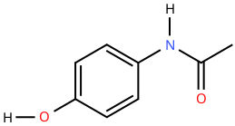
8-Acetaminophen
MOLECULAR FORMULA
LEWIS STRUCTURE
H
C₈H₉NO₂
H
H
H
C
C
C
N
C
C
H
..
..
..
H
..
C
C
O
H
O
C
H
..
H
CONDENSED STRUCTURE FORMULA
BOND-LINE FORMULA
HOC6H4NHCOCH3

Slide 9
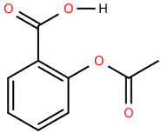
9-Aspirin
MOLECULAR FORMULA
LEWIS STRUCTURE
..
..
C₉H₈O₄
O
C
O
H
..
..
H
H
C
..
C
C
O
C
C
H
..
..
..
H
C
C
O
H
C
H
H
CONDENSED STRUCTURE FORMULA
BOND-LINE FORMULA
CH3COOC6H4COOH

Slide 10
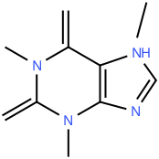
10-Caffeine
MOLECULAR FORMULA
LEWIS STRUCTURE
H
C₈H₁₀N₄O₂
..
O
..
H
..
C
H
..
C
N
H
C
N
C
H
C
H
H
C
..
C
..
..
O
N
N
..
H
C
H
H
CONDENSED STRUCTURE FORMULA
BOND-LINE FORMULA
CH3N(C=O)N(CH3)
C(=O)C=CN(CH3)C=N

