Slide 1


MENTORNESS
Fraud
Detection
- MANAV PADWAL

Slide 2


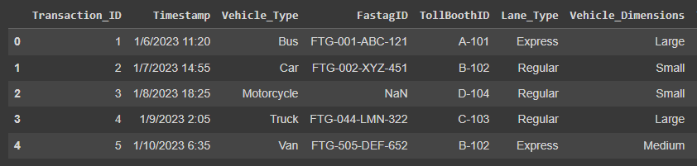
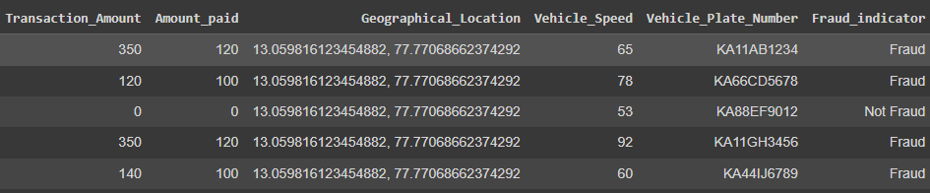
DATASET

Slide 3

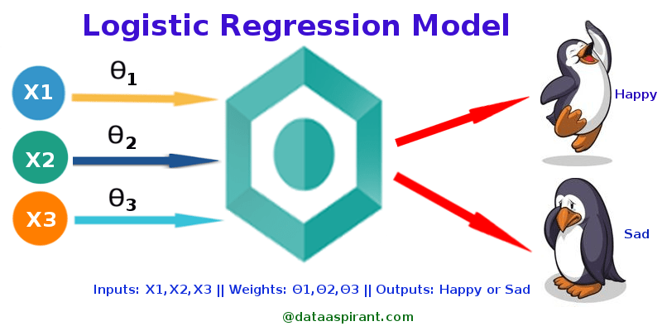
Type of Task

Slide 4

THANK YOU

