Slide 1



www.pwc.com/unlockdatapossibilities
Apache Hadoop Summit ‘ 2016
The Future of Apache Hadoop An Enterprise Architecture View
PwC Advisory

Slide 2


Presenters
Oliver Halter
Partner, Information Strategy and Big Data
oliver.halter@pwc.com
Ritesh Ramesh
Chief Technologist, Global Data and Analytics
ritesh.ramesh@pwc.com

Slide 3
Contents
1
2
3
4
5
Trends
Challenges
Opportunities
Accelerating adoption through a Capability Driven Approach
Real life Case Studies/Lessons Learnt

Slide 4
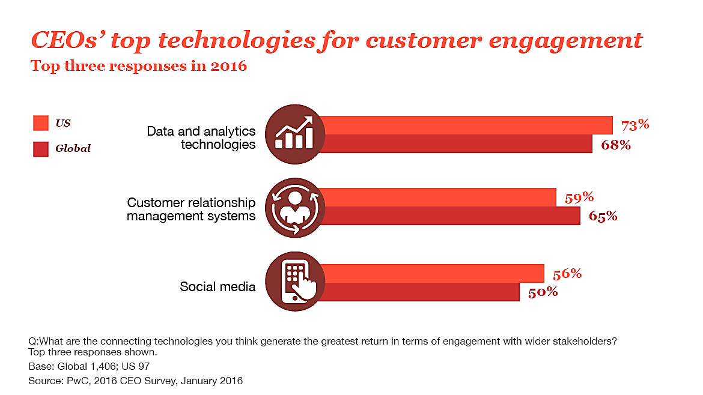
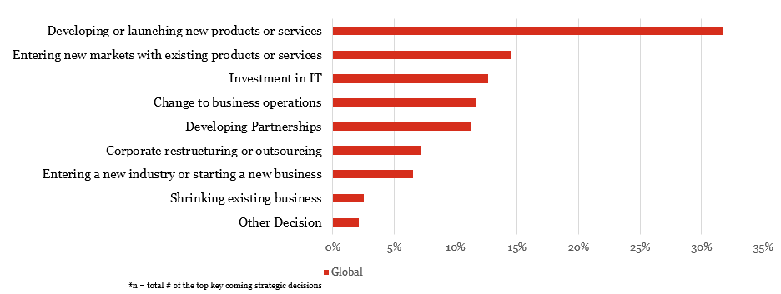
PwC's global data & analytics surveys & trends
PwC, 2016 Global CEO Survey, January 2016
PwC, Global Data and Analytics Survey: 2016 Big Decisions™
73% Data and Analytics Technologies generate the greatest return in terms of engagement with wider stakeholders
32% Nearly one in three said developing or launching new products and services is their leading ‘big decision’. Does your data & analytics effectively support you?

Slide 5
Although we are increasingly seeing the use of Hadoop among mainstream companies key barriers still remain for its holistic success and adoption as an enterprise platform
Adoption Barriers
Incoherent Enterprise View
Lack of User Centricity
People & Talent
Data Assets
An enterprise is a complex
system of components
Organization/ Business Unit
Legacy Systems/ Technologies
1
2
3
4
Business Function
Economics
Capabilities
Overcrowded technology ecosystem
Siloed Ownership

Slide 6
We believe external market forces will propel enterprises to embrace the Data Lake as a foundation of their data, analytics and emerging technology strategies
Grow the Business
Optimize Spend
Innovate
Mitigate Risks
Connecting the dots between various strategic technology initiatives within the enterprise is going to be critical to capitalize on the opportunity....
Emerging Technology Platforms
Internet of Things
Artificial Intelligence
Digital
Modern Data Management
Analytics
Cyber Security
Enterprise Data Lake

Slide 7
There are lots of opportunities to innovate and accelerate enterprise adoption of Hadoop by abstracting sophistication with simplicity and superior end user experience
Existing Innovations enabling Acceleration
Opportunities to close the gaps
1
Cloud based Marketplaces and Solutions
1
Data extraction and semantic text analytics libraries for complex data structures – Nested XML’s, PDF’s and Unstructured Data
Third Party on-demand, ‘Smart’ Data Wrangling solutions leveraging high performance components in Hadoop
2
2
Model Management and integration tools facilitating seamless interoperability or migration from existing technology investments ( data warehouses and applications)
3
3
Open Source Analytics and AI Libraries
Bringing Visualization to the data stored with Hadoop with native libraries and third party tools
4
4
Third Party ‘Hadoop in a Box’ integrated solutions
Adaptive & Dynamic Workload Management
5
Vendor distributions and developer communities – well established
5
Native Data Masking and Encryption Features

Slide 8
Jumpstart/accelerate Hadoop journey with these 4 core tenets
Innovation Platform
Third Party Tool Integration
1
Capability Driven
Monetization
Cloud Interoperability
Analytics Application Development
1
Flexible Operating Model
2
Right Fit
Heterogeneous
Legacy Integration
2
Capability Driven
Heterogenous
Enterprise Data Mnagemnet
Data Migration
PwC’s Next Generation Information Architecture
3
Business Adoption
On-Premise
Right Fit
Services Catalog
Cloud
4
3
4
Use Cases/ Demad Intake
In-Memory
Flexible Operating Model
Training
Disk based
Support Model
NoSQL types
*https://www.pwc.com/us/infoarchitecture

Slide 9
Tenet 1: Capability Driven
Focus on capturing the current and future information and analytics needs of every business function and external partners to drive the architecture
Ability to ingest data in batch & real time modes in various forms –Databases, Files, Streams and Queues
Modern data management technologies (ELT based, Data wrangling etc.) used for cleansing, standardizing and integrating the data from multiple internal and external sources leveraging the scalable computing platform
1
2
Data Ingestion
Data Quality/ Integration
Centralized and coordinated management of projects/activities, managing change and communication of key milestones and business benefits
8
3
Ability to manage and store data in normalized or denormalized structures on disk, in-memory, row vs. columnar vs. column family based data stores (Hive, Spark, HBase, RDBMS etc.) in depending on the use cases
Governance/ Organization
PwC’s Data Lake Capability Framework
Data Architecture
Capabilities to secure personally identifiable information in the next generation platform and create role based access to business users
4
Ability to track data sources ingested into the data lake, track data lineage and provenance of storage and processing activities
7
Security
Metadata Management
Data Access
Analytics/ Reporting/ Visualization
Ability to access stored data from the Platform through a consistent & secure API
Metrics, Tools and processes required to visualize and comprehend data stored in the data stores in form of reports, dashboards and scorecards for business users
6
5

Slide 10
Tenet 2: Heterogeneous
Hybrid set of both traditional and emerging technologies and platforms to acquire, store, interlock and analyze internal and external data will be the norm going forward. Design for simplicity and iteratively build your modular architecture with transition states towards the target
Sources of
Known Value
Data Ingestion Layer
ETL
ELT
Data Analytics/ Visualization
Sales Transactions
ETL Connectors
Match-Merge Services
Enterprise Data warehouse
Standardized Reporting
Customer
Relational Schemas
Product
On-Demand/ Adhoc
Physical Assets
Metadata Management
Data Exchange
Sources of
Unproven Value
Sqoop
Data Wrangling
Hive (Parquet)
Analytics Modeling
Call Center
Kafka
Social Media
HDFS
Enterprise Data Lake
API based Apps.
Web Clickstream
Flume
Spark
RDD
HBase
Mobile Interactions
Illustrative model from a national retailer
Emerging – Open Source
Emerging – Licensed
Traditional – Licensed
Licensed+Open Source

Slide 11
Tenet 3: Right Fit
Enterprises need to develop a decision model which identifies the mix of ‘right fit’ open source as well as commercial solution components, either hosted on the cloud or On Premise, based on functionality and business needs
Illustrative
On Premise
Cloud
Build ?
Buy ?
Cloud Vendor ?
Build ?
Buy ?
Vendor Dist. ?
Constraints ?
Base Platform ?
End-End Stack ?
Vendor Dist. (IaaS)?
Which Native Services (PaaS)?
Security?
3rd party Cloud/Tools?
Cloud integration?
Security?
3rd party Cloud/Tools?
On Premise Integration?
Pre-Requisites
Pre-Requisites
(Hardware, Drivers, Software Interoperability)
(Hardware, Drivers, Software Interoperability)

Slide 12
Tenet 4: Flexible Operating Model
Recognizes the sophistication and analytics maturity at a business function level and enables the required capabilities with the necessary skills, processes, tools and support
Business Operating Model
Technology Operating Model
Business alignment on how Haddoop environment will operate. This includes defining
Services Catalog
Service level Agreements
Tracking Usage, Benefits and Costs
User Onboarding & training
Technology Alignment on how the Hadoop environment will operate. This includes defining:
Access Model (Self service vs. Controlled)
Data acquisition and classification strategy
Organization (Develop vs. Support)
Technical Skills Training
Defining the Business architecture
Identify capability areas and opportunities to inform the Big Data Strategy
Use Case Evaluation (risk, feasibility and business case)
Prioritization criteria
Demand / Intake process
Business Roadmap
Defining the Technology architecture
Architecture Guiding Principles
Leading practices for data acquisition, management and delivery
Reference Architecture with solution patterns for the various use cases
Storage and infrastructure Planning
Security Model

Slide 13
Five step strategic approach to build a strong data lake foundation
Recognizes the sophistication and analytics maturity at a business function level and enables the required capabilities with the necessary skills, processes, tools and support
Capabilities
Leveraging client’s stated capabilities and PwC’s Capability framework with business interviews, analytical capabilities are captured and documented
1
Use Case Specifications
Define success criteria, information sources, dimensionality and information delivery mechanism for each use case. Each Use Case must be mapped to a set of Capabilities
2
Platform Architecture & Operating Model
Define end-end architecture components (‘lego blocks’) mapped to the capabilities identified with leading practices for ingestion, management , analytics and visualization. Identifies the organization, process and support structure required for agility
3
Architecture Patterns
Depict the architecture pattern at the use case level , leverages the logical architecture ‘lego blocks’ and also shows the information flow, respective technology component and integration touch point with client’s systems
4
Strategic Roadmap for Execution
Organize the initiatives in a sequenced roadmap with scope, duration and dependencies under various themes
5

Slide 14
Case Study # 1 – Financial Services Provider – Risk Modeling for their Loans Portfolio
Current Process – Adhoc Analysis – 8-10 hours
Current State
Lack of an integrated architecture and scalable technology infrastructure contributed to data management challenges
The business analytics and modeling teams were looking for more self-sufficiency and process agility
Lacked program leadership and program management discipline specifically for third party services and solution providers
Data Acquisition and management processes lacked a consistent design and architecture and were heavily siloed on an application – application basis
Future Process – Adhoc Analysis – < 30 minutes
Future State
The client developed a next generation information management and analytics platform which was more business centric with an operating model that enables agility, self service, faster data management and deep analytics for the business stakeholders
Data processing window was reduced from 8-10 hours to less than 30 minutes
Business Users were able to access more granular historical data for ad hoc analysis and analytics models
Any trademarks included are trademarks of their respective owners and are not affiliated with, nor endorsed by, PricewaterhouseCoopers LLP, its subsidiaries or affiliates.

Slide 15
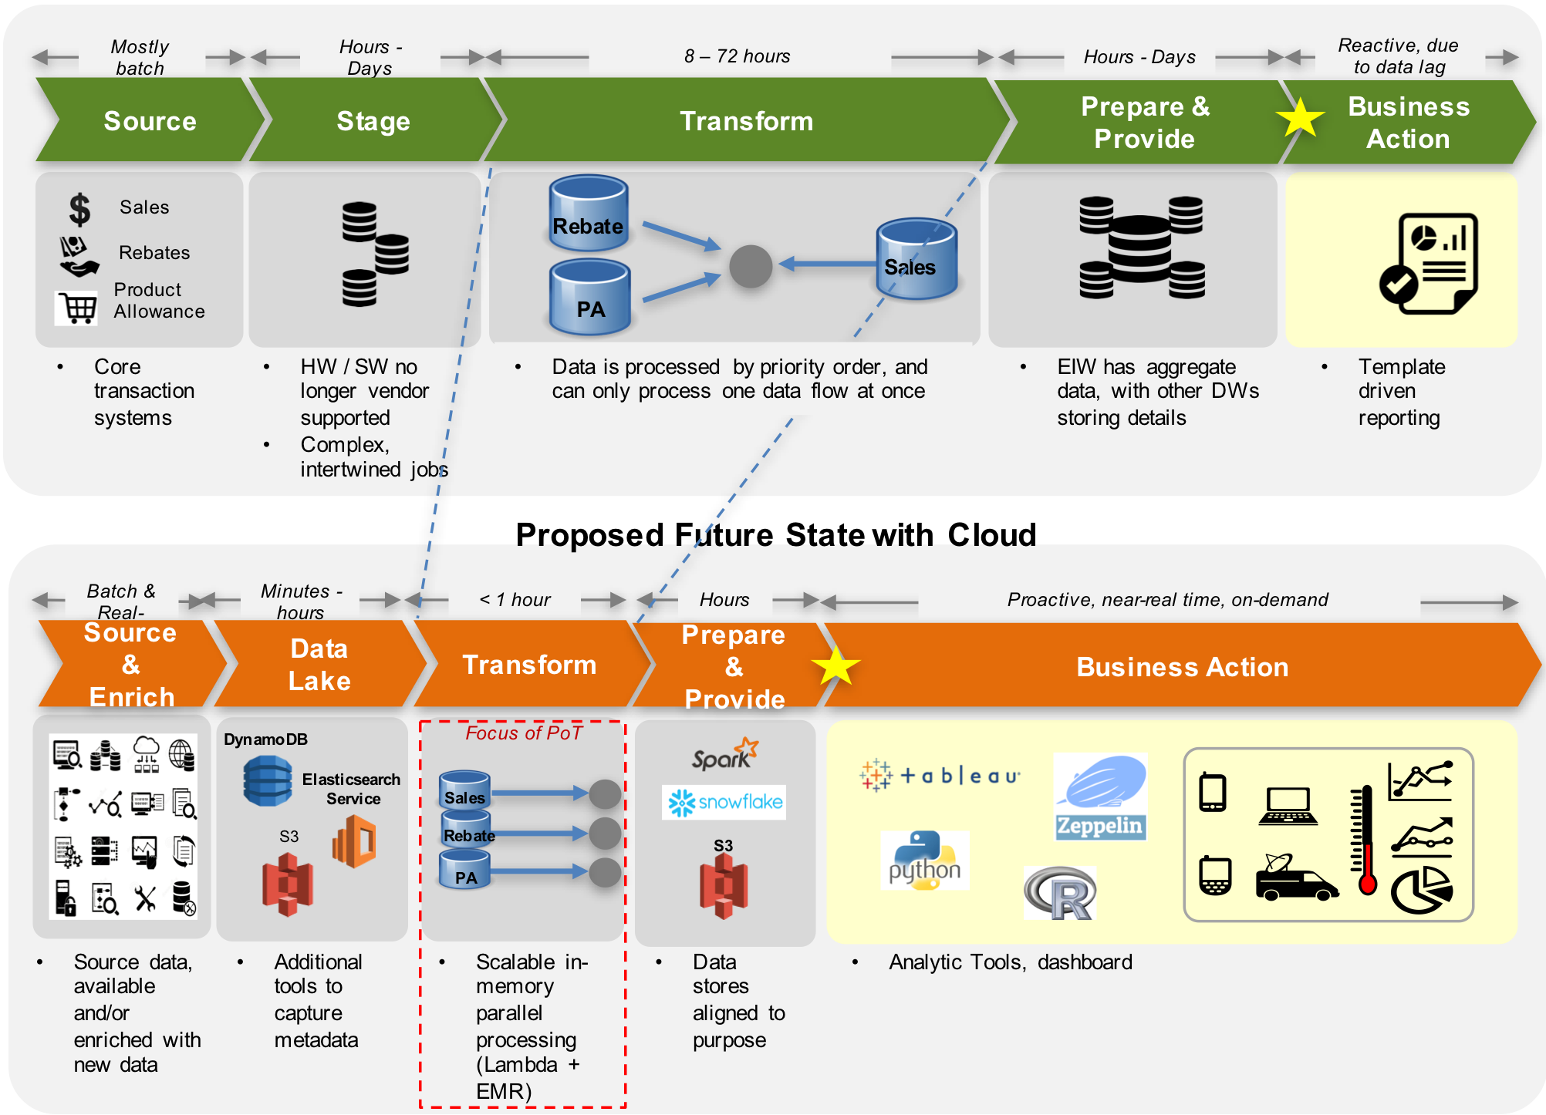
Case Study # 2 – Leading Retail Distribution Company – Trade Promotion Effectiveness
500k SKU’s, 250k customers, 5k suppliers, 6k Fleets
Current State
On-premise, rigid infrastructure with serial data processing and limited capacity
Delayed data availability reducing applicability to impactful business decisions
No integration with 3rd party data is causing pain points with vendor collaboration and data access
Future State
Flexible, scalable, cloud-based infrastructure enabling multi-stream data processing
Near real-time data availability via Apache Spark data processing providing valuable insights for decision making
Easily supported visualization and reporting platforms accessible by internal and vendors with simple access controls
Any trademarks included are trademarks of their respective owners and are not affiliated with, nor endorsed by, PricewaterhouseCoopers LLP, its subsidiaries or affiliates.

Slide 16
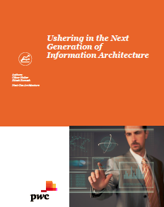
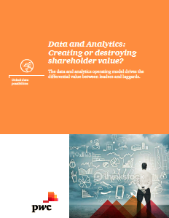
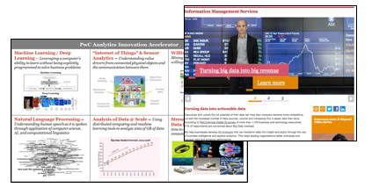
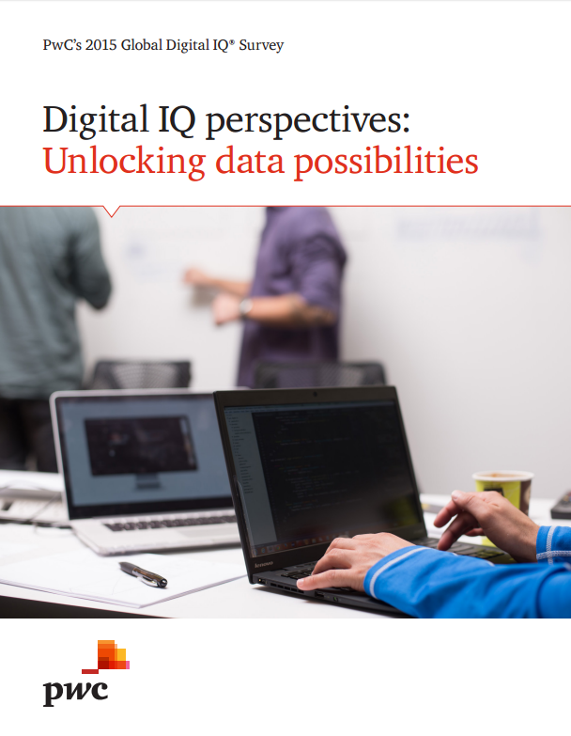

How is PwC Creating Awareness and Driving Adoption in the Market
Thought Leadership / Independent Research
Strategic Alliances
Google
Microsoft
Oracle
SAP
Data & Analytics @Scale - Client Delivery

Slide 17
Closing Thoughts…....
We believe external market forces will propel enterprises to embrace the Data Lake as a foundation of their data, analytics and emerging technology strategies
Although barriers remain for adoption by mainstream enterprises, there are ample opportunities for innovation and acceleration by abstracting sophistication with simplicity and superior end user experience
Enterprises should follow 4 core tenets* while developing their Next Generation Information Architecture Platform
Keep the 5 step strategic ‘capability driven’ approach in mind!!
Thanks for attending the session – please contact us with any questions!

Slide 18
© 2016 PwC. All rights reserved. PwC refers to the US member firm or one of its subsidiaries or affiliates, and may sometimes refer to the PwC network. Each member firm is a separate legal entity. Please see www.pwc.com/structure for further details.

