Slide 1



Fun or Fraud
Patricia Geppert

Slide 2
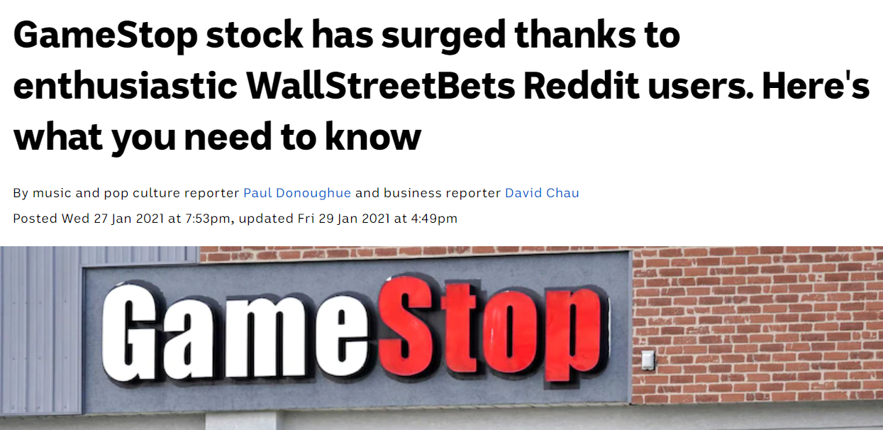
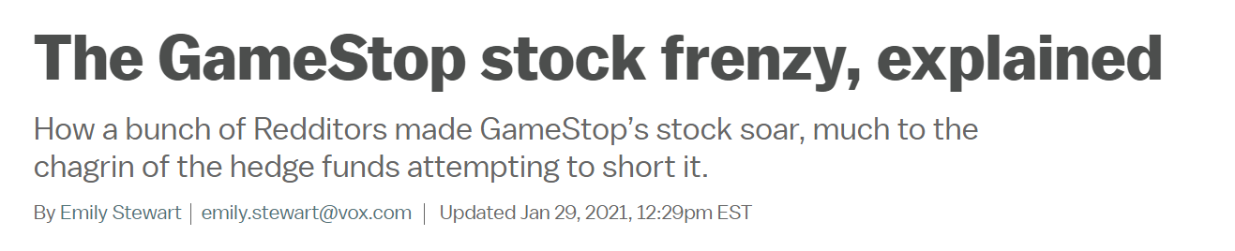
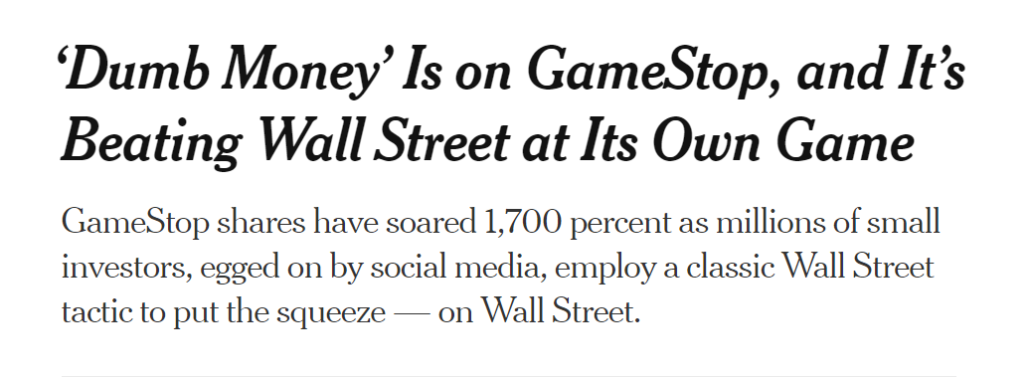
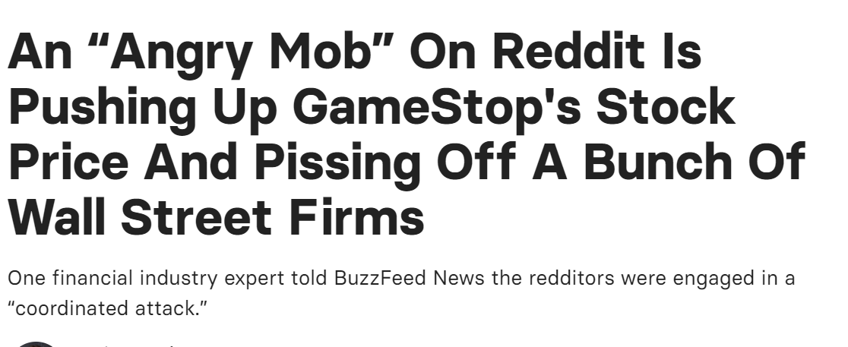
Notes:
There is controversy surrounding the Reddit WallStreetBets influence over driving up the stock price of GameStop (NYSE: GME) and causing Wall Street Hedge Fund short sellers to lose over $13 billion. The SEC is investigating potential fraud (pump-and-dump) by social media influencers.
On April 1, 2020 GME closed at $3.25 per share- DeepFuckingValue posted on reddit Wallstreet Betsthat he had a $50,000 position.
Between April and Aug 1, 2020- the price per share ranged between $4-6. By Oct. 1, share price was climbing to around $10/share, By Dec.1, $16/share, but on Jan. 12, 2021 share prices started to rise dramatically
What do call options do to stock price? Apparently more WallStreetBets purchased options than

Slide 3
Is there evidence of fraud?
What is securities fraud?
“pump-and-dump’
‘short-squeeze’
Hallmarks:
Deceptive information
Intention to manipulate
Power to manipulate
Providing Evidence of Fraud:
Look at timing of volume of chatter (posts and comments) compared to share volume and price
Look for influencers (authors that have high karma scores)
Notes:
There is controversy surrounding the Reddit WallStreetBets influence over driving up the stock price of GameStop (NYSE: GME) and causing Wall Street Hedge Fund short sellers to lose over $13 billion. The SEC is investigating potential fraud (pump-and-dump) by social media influencers. GameStop is not the only stock that has been touted by Reddit WallStreetBets influencers, others include: AMC Entertainment (NYSE: AMC), Blackberry (NYSE: BB) and Nokia (NYSE: NOK). These stocks have not enjoyed the dramatic increase in stock price realized by GameStop. Some critics suggest that GameStop was poised for a breakout even before the r/WallStreetBets posts. My hypothesis: GameStop stock prices were not unduly influenced by r/WallStreetBets.

Slide 4
Methods-Data Acquisition
Reddit WallstreetBets API’s
PRAW: Python Reddit API Wrapper
Limits of data rate
PushShift- limited to 100 records
PushShift wrapper for timed data scrapping
https://github.com/Watchful1/Sketchpad/blob/master/postDownloader.py
Unlimited data scrapping
Altered the data request parameters
Data: Submission and comment data:
Keyword “GME” anywhere in the text (title or body of text)
Submission: Karma score of the author (influencer), date posted, author name, text of submission
Comments: Karma score of author, date posted, text of comment
GME stock prices and trade volume down loaded from Yahoo Finance

Slide 5
Methods-data munging
All data was scraped as unstructured data into a text file:
Post Date
Karma Score
1 : 2021-02-21
Crumblestilskin
Im not sure of the whole story, I know DFV was in GME over a year ago, but where did the whole thing gain traction? What was the video that started it all, and what made it spike on the 26th of January?
-------------------------------
Post:
Over 89,451 posts
3/10/2013-2/20/2021
Author
Delimiter
Comment:
Over 642,109 comments
2/1/2014-2/20/2021
1 : 2021-02-20
WSB has already become a hive mind in regards to GME and DFV.
-------------------------------

Slide 6
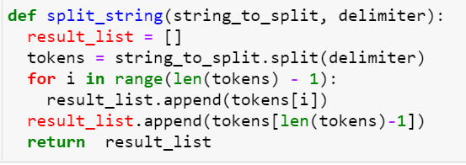
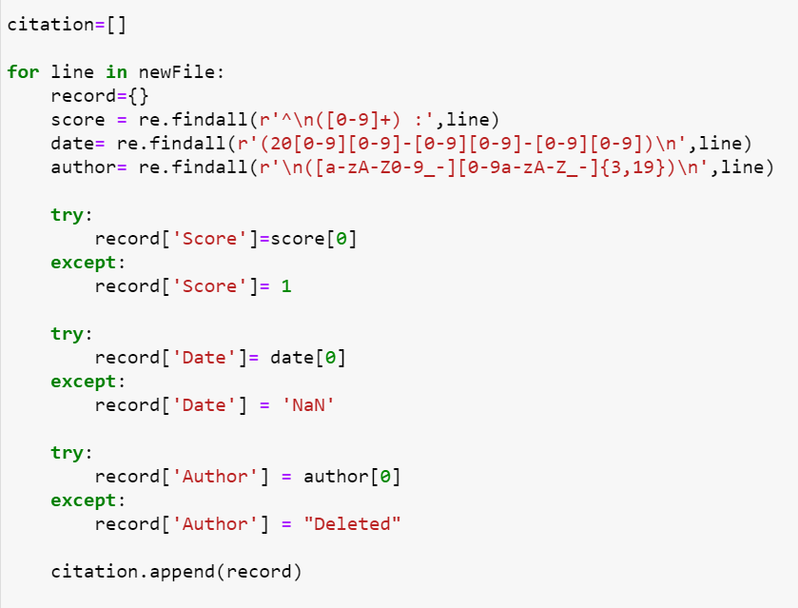
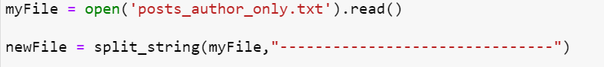
Data Munging
Challenge: data in text file is not divided into records or labeled
1. Splitting unstructured text into “records”
2. Labeling the data and saving in a json file

Slide 7
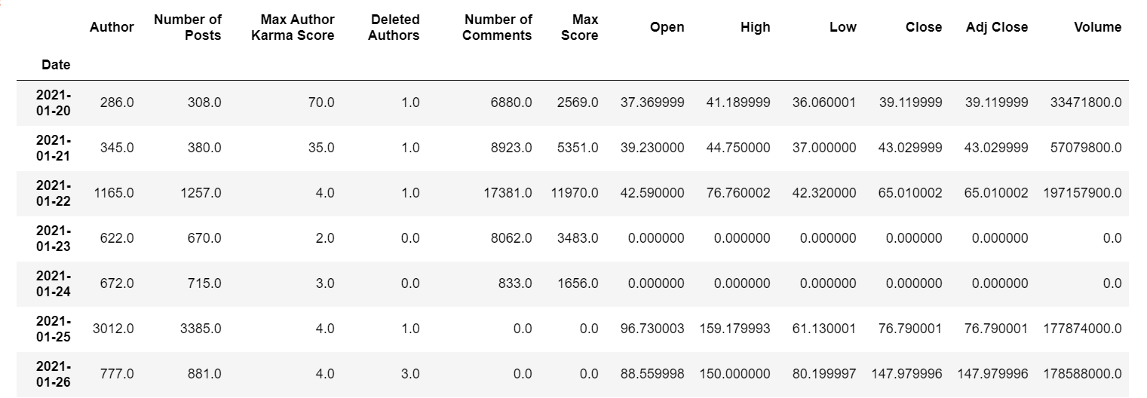
Methods-Data Preprocessing
Loaded json file into Pandas Dataframe
Removed rows that didn’t have a date:
Posts: 117 rows
Comments: 100 rows
Grouped by Date
Joined Posts, Comments and GME Stock Dataframes

Slide 8
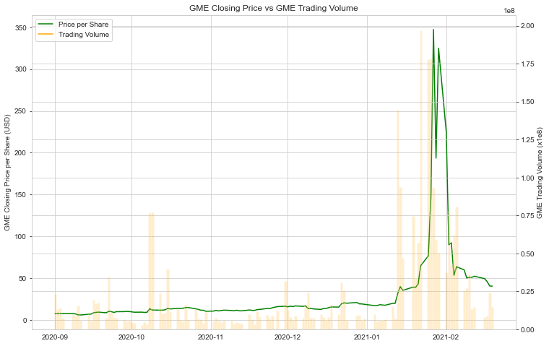
Jan. 12, 2021

Slide 9
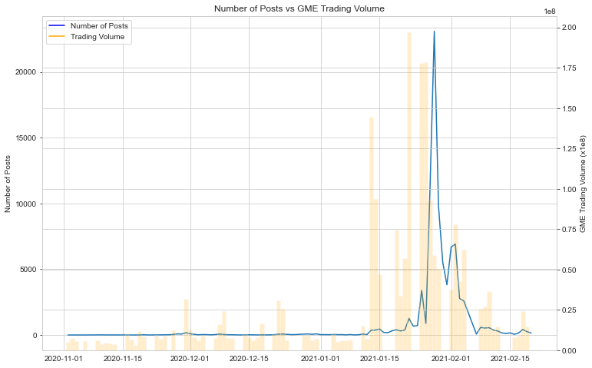
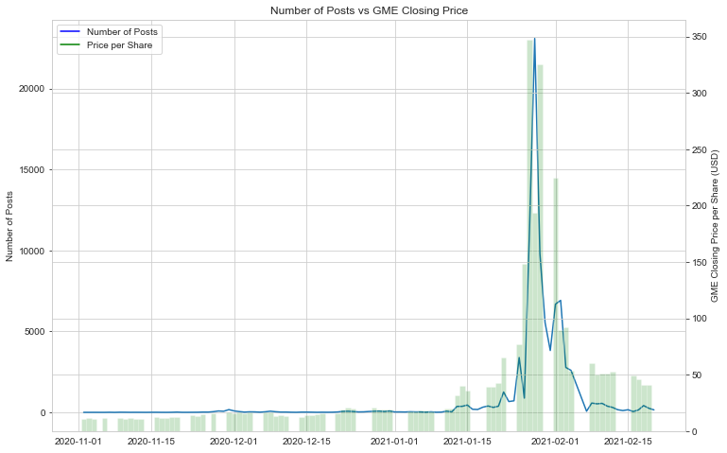
Number of Posts Correlate with Price not Volume
Jan. 12, 2021
Jan. 12, 2021

Slide 10
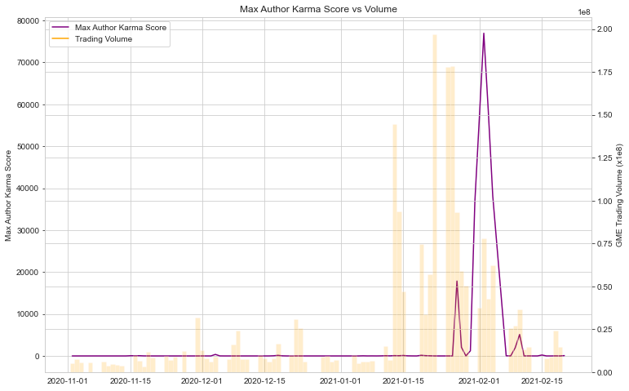
Power of Influencers
Jan. 12, 2021

Slide 11
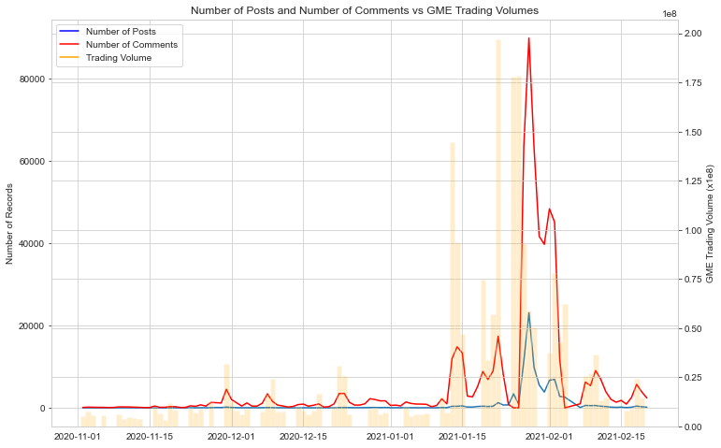
Commentors Amplified Posts
Jan. 12, 2021

Slide 12
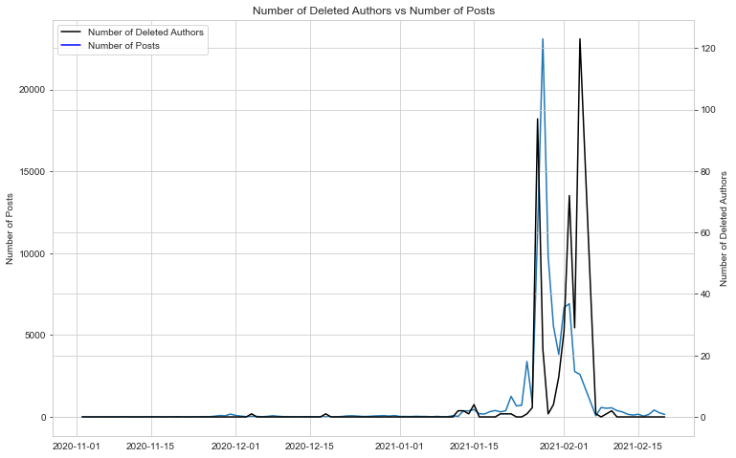
Deleted Authors
Jan. 12, 2021

Slide 13
Conclusions and Other Considerations
Hard to believe that WallStreetBets was organized enough to motivate the run up
Posts correlate with price not volume
Other considerations:
Didn’t consider options trades-very popular with WallStreetBets
Didn’t look at sentiment of comments or posts-that is next step
Comments amplified the posts and seem to have same pattern as GME Trading Volume

