Slide 1

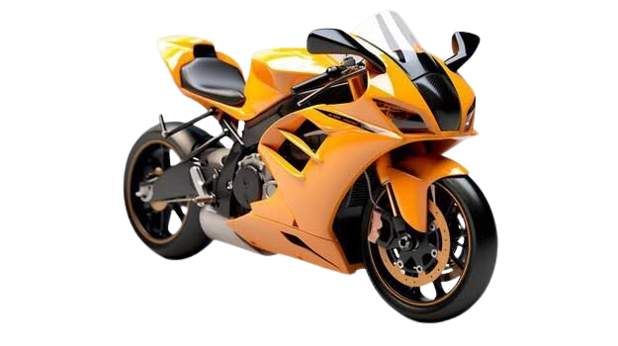
BIKE MARKET ANALYSIS Web Scraping & Exploratory Data Analysis
Data Analytics Program | Innomatics Research Labs

Slide 2



About Us
LinkedIn
Kurivella Bala Venkata Mani Kanta,(Team Leader)
Completed B-Tech (CSE)
Data Science Trainee - Innomatics Research Labs, Hyderabad
Skills: Python, SQL, Power BI, Excel, Web Scraping
GitHub
Sankara P Manohar
Completed BTech (AI&DS)
Data Science Trainee - Innomatics Research Labs, Hyderabad
Skills: Python, SQL, Power BI, Excel, Web Scraping
LinkedIn
GitHub

Slide 3

Agenda
Objective of the Project
Business Problem
Website & Data Collection
Web Scraping Approach
Raw Dataset Overview
Data Cleaning
Feature Engineering
Final Dataset
Business Questions
Exploratory Data Analysis
Business Insights
Recommendations
Challenges Faced
Conclusion
Q & A

Slide 4
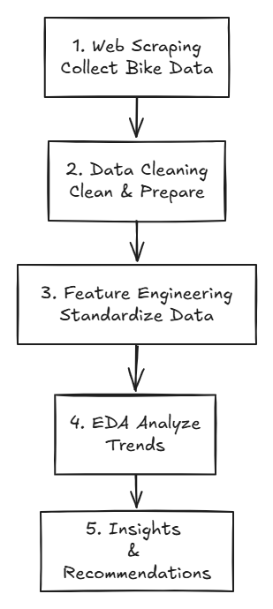
Objective of the Project
Collect real-world bike data through web scraping.
Extract key bike details such as price, brand, rating, engine and power.
Clean and preprocess the scraped data.
Standardize power values into BHP.
Analyze bike pricing, performance and customer ratings.
Identify relationships between important bike features.
Generate business insights and recommendations.

Slide 5
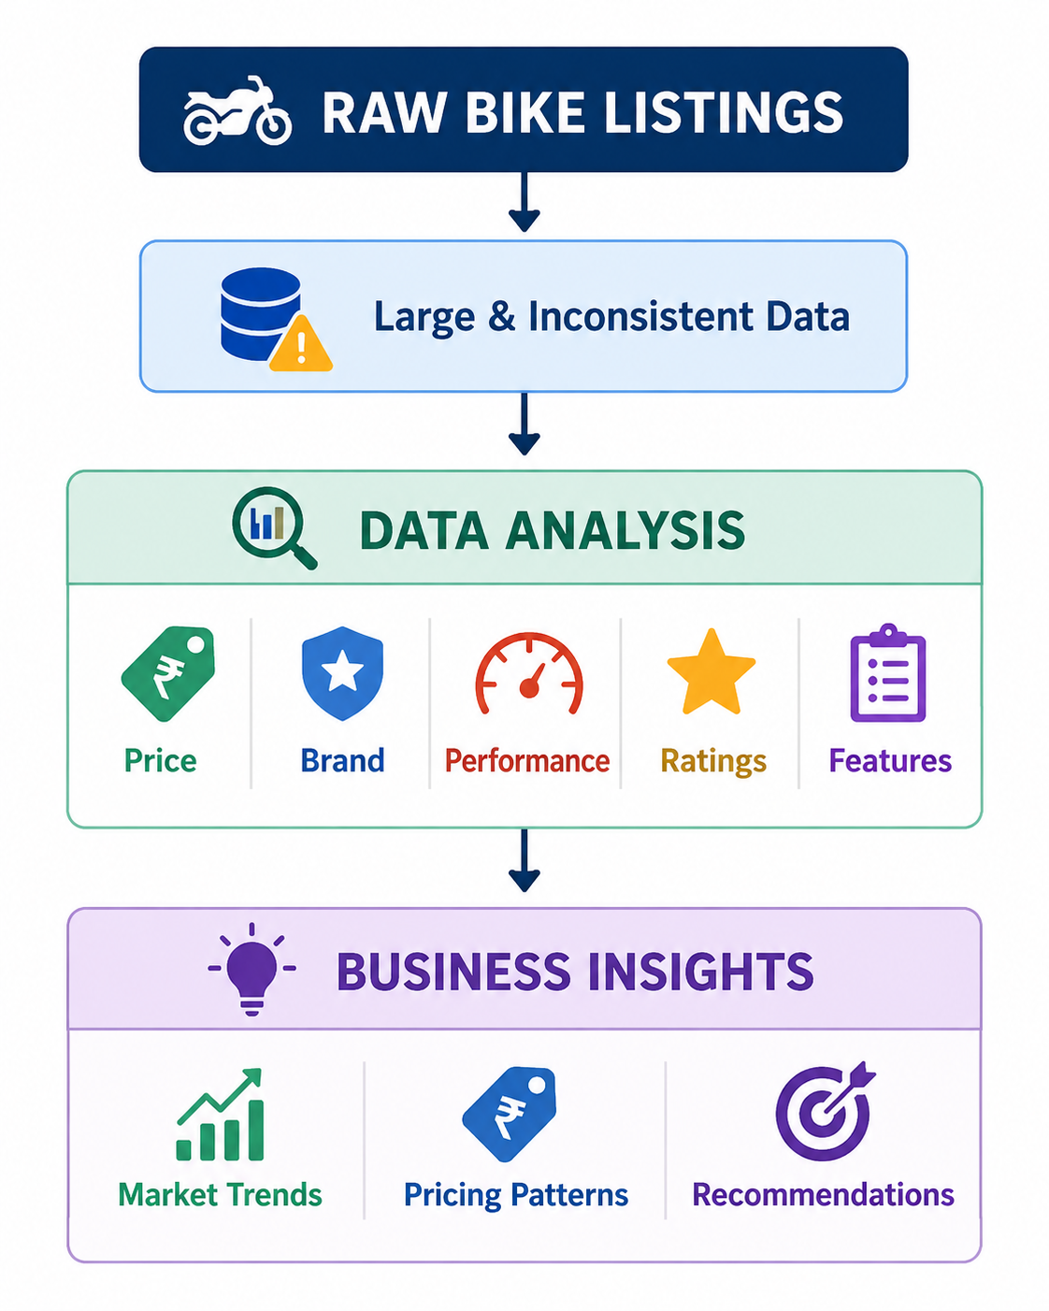
Business Problem
Online bike listings contain large amounts of information about price, brands, performance, customer ratings, and features, but this raw data is difficult to interpret for market analysis.
The project aims to:
Identify brand and pricing trends
Understand engine & performance patterns
Analyze customer ratings and reviews
Compare bike features and specifications
Discover relationships between price and performance
Generate data-driven market insights

Slide 6
Website & Scope
Website : Flipkart
Website Link : flipkart.com
Data Category : Non-Electric Motorcycles
Final Dataset : 263 Bike Records
Features Used : 11 Columns
Project Scope :
Bike product details
Price analysis
Customer ratings & reviews
Engine & power specifications
Bike features and specifications

Slide 7
Fields Extracted
Key attributes collected from Flipkart for Bike Market Analysis
Field | Description
Product Name | Bike model name
Brand | Manufacturer
Price | Bike price in INR
Rating | Customer rating
Total Ratings | Number of customer ratings
Total Reviews | Number of customer reviews
Engine Capacity | Engine size in CC
Maximum Power | Engine power
Front Brake | Brake type
Console Type | Instrument console
Tire Type | Type of tire

Slide 8
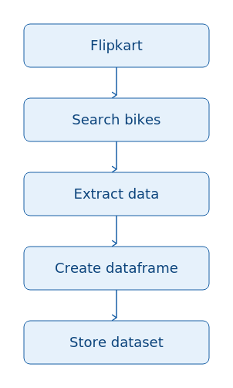
Web Scraping Approach
Step | Content
🌐 1. Website | Flipkart
🔍 2. Search | Search bike listings
📄 3. Extraction | Extract required fields
🐼 4. DataFrame | Store data using Pandas
💾 5. Dataset | Save scraped data
Note :
The final dataset contains 263 bike records and 11 features after preprocessing.

Slide 9
Data Cleaning & Feature Engineering
RAW SCRAPED DATA
Missing Values
Inconsistent Formats
Mixed Data Types
Irrelevant Columns
DATA CLEANING
Handle Missing Values
Correct Data Types
Standardize Categories
Remove Unnecessary Columns
FEATURE ENGINEERING
Extract Power Values
Convert Power → BHP
Create Analysis-Ready Feature
FINAL DATASET
263 Records
11 Features
Analysis-Ready Data
Power Standardization
RAW VALUE 8.68 kW (11.8 PS) @ 8500 rpm
↓
CLEAN FEATURE 11.8 BHP

Slide 10
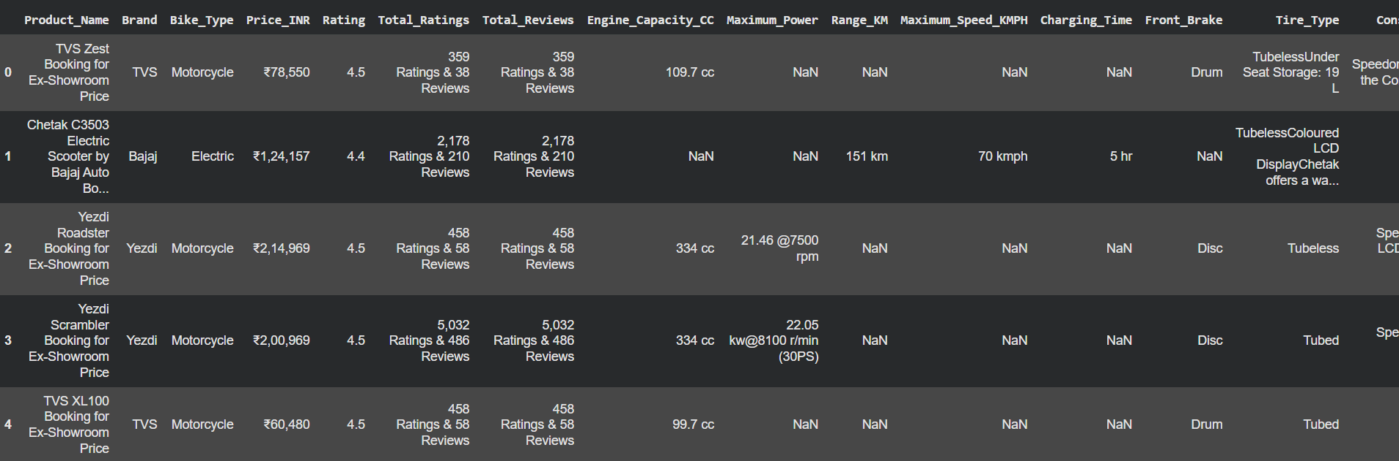
Before Data Cleaning And Feature Engineering

Slide 11
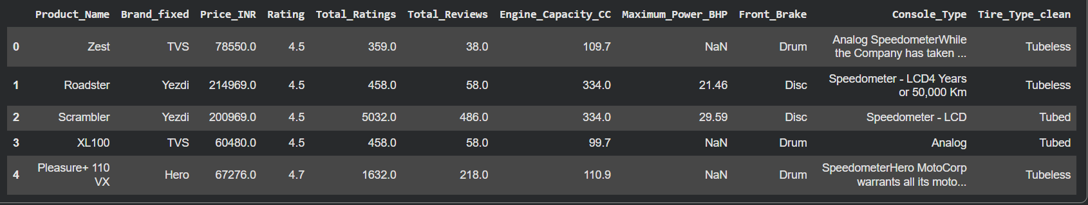
After Data Cleaning And Feature Engineering

Slide 12
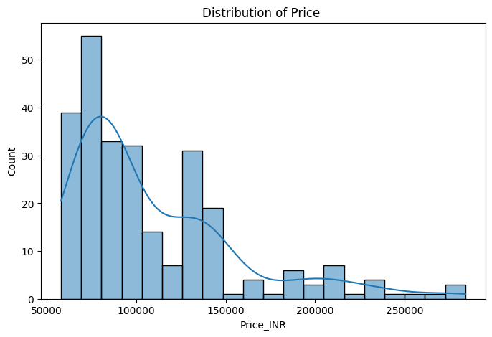
Q1. What is the overall price distribution of bikes?
Output / Chart :
output
Code :
analysis.py
plt.figure(figsize=(8,5))
sns.histplot(df["Price_INR"], bins=20, kde=True)
plt.title("Distribution of Price ")
plt.show() # Right Skew
[ paste your chart / output screenshot here ]
Key Insight :-
The bike market is largely concentrated in the lower-to-mid price segment, with relatively fewer premium-priced models.

Slide 13
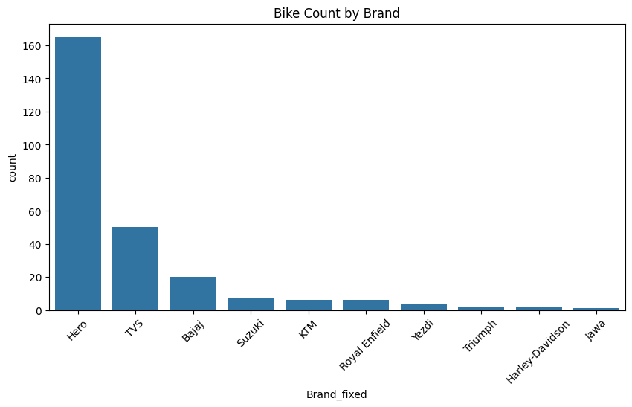
Q2. Brand Market Presence - Which brands have the highest number of bike models in the dataset?
Output / Chart :
Code :
output
analysis.py
plt.figure(figsize=(10,5))
sns.countplot(
data=df,
x="Brand_fixed",
order=df["Brand_fixed"].value_counts().index
)
plt.xticks(rotation=45)
plt.title("Bike Count by Brand")
plt.show()
[ paste your chart / output screenshot here ]
Key Insight :-
Hero has the highest number of bike models in the dataset, indicating the strongest product presence among the analyzed brands.

Slide 14
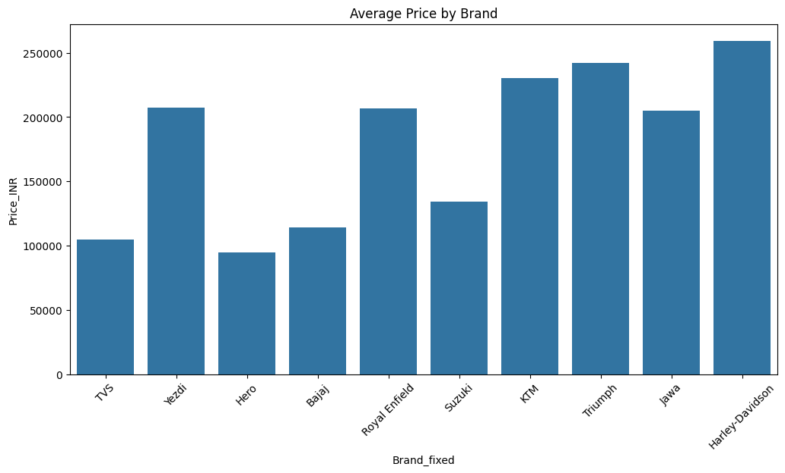
Q3. Brand-wise Price Analysis- Which brands have the highest average bike prices?
Code :
Output / Chart :
analysis.py
output
plt.figure(figsize=(12,6))
sns.barplot(
data=df,
x="Brand_fixed",
y="Price_INR",
estimator="mean",
errorbar=None
)
plt.xticks(rotation=45)
plt.title("Average Price by Brand“)
plt.show()
[ paste your chart / output screenshot here ]
Key Insight :-
Harley Davidson has the highest average bike price among the analyzed brands, indicating a stronger presence in the premium-price segment.

Slide 15
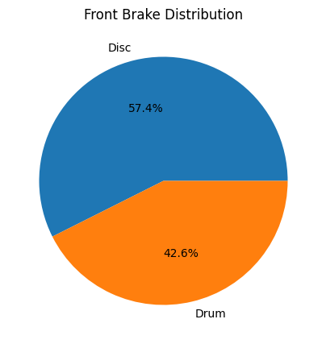
Q4. Front Brake Distribution - Which front braking system is most commonly used among the bikes?
Output / Chart :
Code :
output
df["Front_Brake"].value_counts().plot(
df["Front_Brake"].value_counts().plot(
kind="pie",
autopct="%1.1f%%",
figsize=(5,5)
)
plt.ylabel("")
plt.title("Front Brake Distribution")
plt.show()
analysis.py
[ paste your chart / output screenshot here ]
Key Insight :-
Disc brakes dominate the dataset, accounting for approximately 57.4% of the analyzed bikes, indicating their widespread adoption among modern motorcycles.

Slide 16
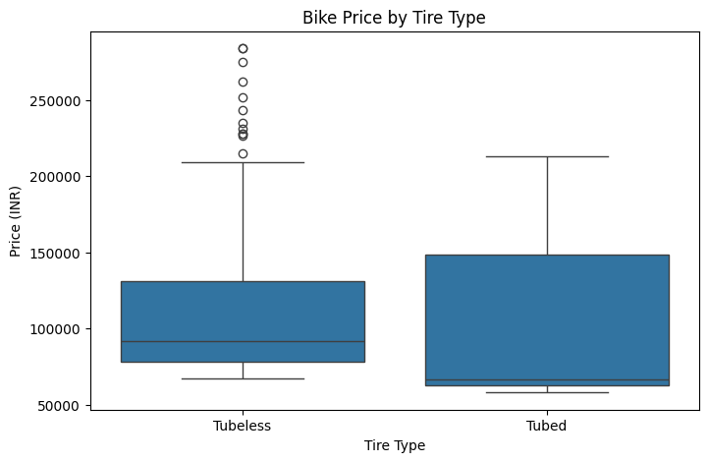
Q5. How does bike price vary across different tire types?
Code :
Output / Chart :
analysis.py
output
plt.figure(figsize=(8, 5))
sns.boxplot(
data=df_eda,
x="Tire_Type_clean",
y="Price_INR"
)
plt.title("Bike Price by Tire Type")
plt.xlabel("Tire Type")
plt.ylabel("Price (INR)")
plt.show()
[ paste your chart / output screenshot here ]
Key Insight :-
Bikes with tubeless tires generally have higher median prices and a wider price distribution compared with tubed bikes, indicating that tubeless tires are more prevalent among higher-priced models.

Slide 17
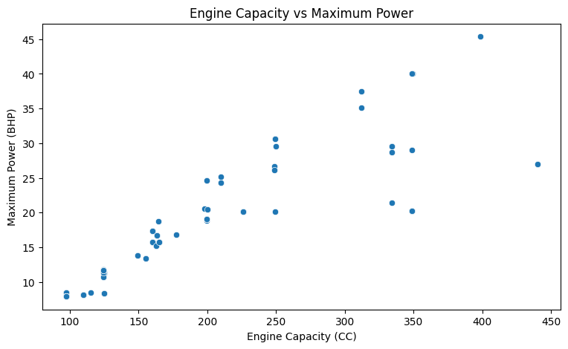
Q6. Engine Capacity vs Maximum Power - Does a higher engine capacity generally result in higher maximum power?
Code :
Output / Chart :
analysis.py
output
plt.figure(figsize=(9, 5))
sns.scatterplot(
data=df,
x="Engine_Capacity_CC",
y="Maximum_Power_BHP"
)
plt.title("Engine Capacity vs Maximum Power")
plt.xlabel("Engine Capacity (CC)")
plt.ylabel("Maximum Power (BHP)")
plt.show()
[ paste your chart / output screenshot here ]
Key Insight :-
Engine capacity and maximum power show a strong positive correlation, indicating that engine size is an important factor associated with motorcycle performance.

Slide 18
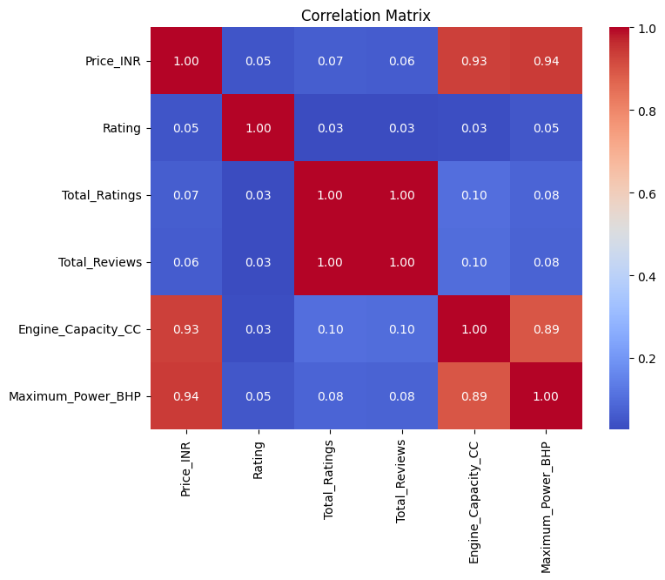
Q9. Correlation Analysis - How strongly are the key numerical variables related to each other?
Output / Chart :
Code :
output
analysis.py
plt.figure(figsize=(8,6))
corr = df[numerical_cols].corr()
sns.heatmap(
corr,
annot=True,
cmap="coolwarm",
fmt=".2f"
)
plt.title("Correlation Matrix")
plt.show()
[ paste your chart / output screenshot here ]
Key Insight :-
Price and Maximum Power also show a positive relationship, suggesting that higher-performance bikes tend to be positioned at higher price points.

Slide 19
Business Questions - Answers
1. Brand Market Presence Hero has the highest number of bike listings, indicating strong product presence in the analyzed dataset.
2. Premium Brand Harley Davidson has the highest average bike price, suggesting a stronger focus on the premium segment.
3. Dominant Engine Segment 100-200 CC bikes are is the most commonly represented engine capacity among the analyzed bikes.
4. Performance Relationship Engine capacity and maximum power show a positive relationship, indicating that higher-CC bikes generally produce greater power.
5. Price–Performance Relationship Higher-powered bikes generally command higher prices, showing an association between performance and pricing.
6. Braking System Disc Break is the most commonly listed front braking system, showing its widespread presence across the analyzed models.
7. Tire & Price Pattern Disc bikes show a higher median price compared with Drum bikes in the dataset.

Slide 20
Recommendations
Focus on the dominant price segment Target the largest market segment.
Strengthen mid-range models Balance price, performance, and features.
Improve performance-to-price value Offer better performance at competitive prices.
Promote highly rated bikes Give more visibility to top-rated models.
Enhance modern features Improve safety and technology features.
Maintain competitive pricing Provide strong value compared with competitors.

Slide 21
Challenges Faced
Dynamic Web Data Website content and structure can change.
Inconsistent Data Formats Bike specifications were available in different formats.
Missing Values Some specifications were not available for all bikes.
Power Standardization Maximum power was available in different units and formats.
Data Cleaning Brand names, categories, and specifications required standardization.
Electric Bike Filtering Electric-specific records and attributes had to be excluded from the final analysis.

Slide 22
Conclusion
Successfully collected 263 bike listings from Flipkart.
Cleaned and transformed the scraped data into 11 analysis-ready features.
Analyzed pricing, brands, performance, ratings, and bike features.
Identified relationships between engine capacity, power, and price.
Generated data-driven business insights and recommendations.
Real-world bike data → Meaningful market insights

Slide 23

THANK YOU
Questions & Discussion Welcome

