Slide 2
SCG 007C – 14th November 2019
Vehicle setup for simulations
Ride heights vs speed
Straight line braking
Constant speed cornering

Slide 3
Introduction
A vehicle setup (stiffnesses and damping) has been hypothesized by considering the following constraints/assumptions:
  Given hypothesis of static ride heights (70mm front, 90mm rear)
  Exploit all the available static rake to reduce stiffness at rear (flat car at top speed)
  Hypothesis of kinematic roll gradient 0.4deg/g (2deg of maximum total, with tires, achieved)
  Top speed skid clearance 8mm front and rear (was 5, increased for braking necessities)
  No need for rear anti-roll bar
  60% front elastic roll distribution
  Minimize heave bump-stop force (oscillation in high speed braking or higher heave damping needed)
  All others: specifications document agreed parameters

Slide 4
Vehicle setup for simulations
Element | Front | Rear | Unit
Corner spring | 150 | 130 | N/mm
1-dof natural frequency | 3.80 | 3.23 | Hz
2-dof natural frequency
ARB | 1000 | 0 | Nm/deg of roll
Elastic roll stiffness | 60% | 40% | F/R ratio
3rd spring | None | None | N/mm
3rd bump-stop | 2000N (KW RD60 20mm) | 1400N (KW RD60 20mm) | N @ top speed
Corner damper LS (<200mm/s) | 1.2 bump 0.7 rebound | 1.2 bump 0.7 rebound | Damping ratio
Corner damper HS (200<>1000m/s) | 0.35 bump 0.35 rebound | 0.35 bump 0.35 rebound | Damping ratio
Center damper | None | None | -
Static RH | 70 | 90 | mm
Static skid clearance | 45 | 65 | mm
Tire vertical stiffness | 350 | 350 | N/mm

Slide 5
Damping hypothesis
Damping coefficients obtained by fitting damper curve of best setup of 003C
Bilinear damper approximation
Front [u.m. 245kg, s.m. 45kg, k 150N/mm]
Low Speed |  | Bypass Velocity [m/s] | ζ (Damping Ratio) | C (Damping Coeff.) [N/(m/s)] | Force [N]
 | LS-Bump | -0.200 | 1.2 | 29610 | -5922
 | LS-Rebound | 0.200 | 0.7 | 7388 | 1478
High Speed |  | Max. Velocity [m/s] | ζ (Damping Ratio) | C (Damping Coeff.) [N/(m/s)] | Force [N]
 | HS-Bump | -1.000 | 0.35 | 8636 | -12831
 | HS-Rebound | 1.000 | 0.35 | 3694 | 4433
Rear [u.m. 265kg, s.m. 50kg, k 130N/mm]
Low Speed |  | Bypass Velocity [m/s] | ζ (Damping Ratio) | C (Damping Coeff.) [N/(m/s)] | Force [N]
 | LS-Bump | -0.200 | 1.2 | 31065 | -6213
 | LS-Rebound | 0.200 | 0.7 | 7504 | 1501
High Speed |  | Max. Velocity [m/s] | ζ (Damping Ratio) | C (Damping Coeff.) [N/(m/s)] | Force [N]
 | HS-Bump | -1.000 | 0.35 | 9061 | -13462
 | HS-Rebound | 1.000 | 0.35 | 3752 | 4503

Slide 6
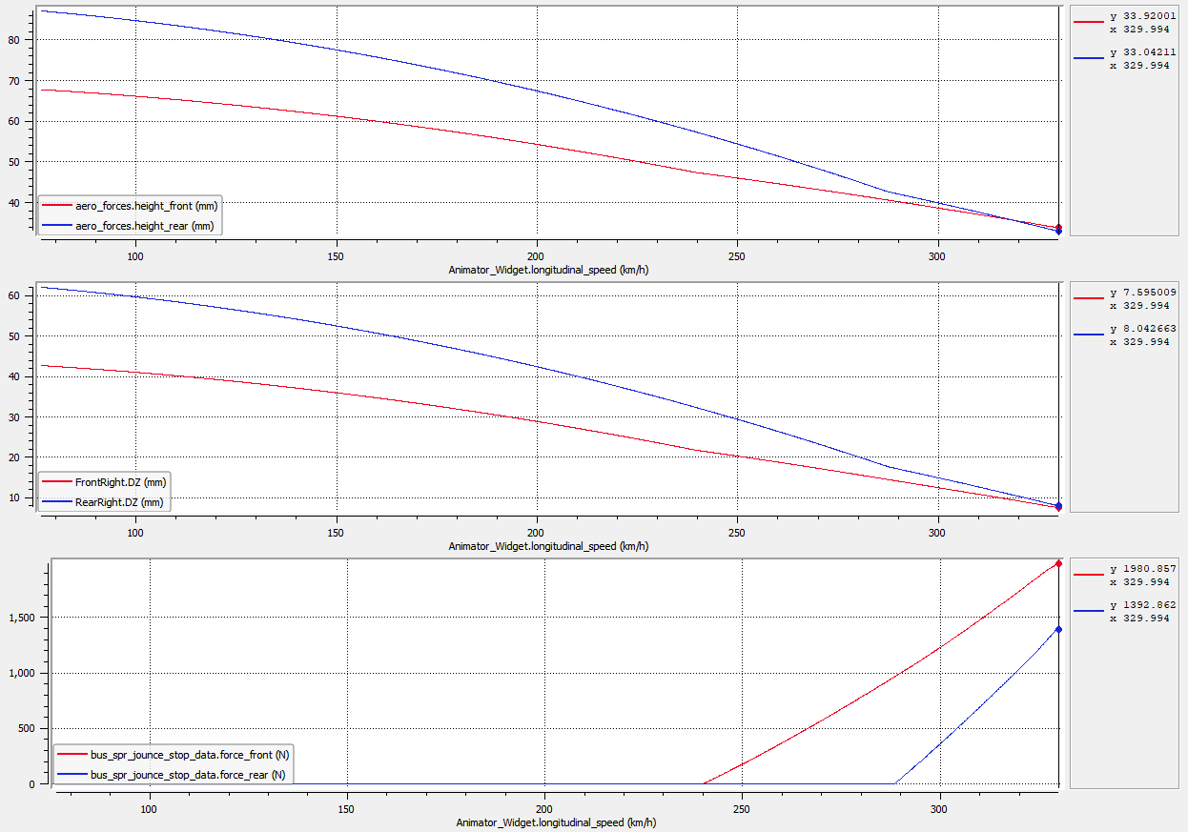
Straight Line Coasting
 | Front | Rear | Unit
Top speed RH | 34 | 33 | mm
Top speed skid clearance | 8 | 8 | mm
Top speed tire deflection | 12.6 | 16.7 | mm
Max. suspension travel | 22.9 | 39.8 | mm
Max. bump-stop travel | 7.4 | 5.4 | mm
Top speed bump-stop force | 2000 | 1400 | N
Bump-stop engage speed | 240 | 290 | km/h
Average bump-stop rate | 270 | 260 | N/mm
Max. suspension travel
Max. bump-stop travel

Slide 7
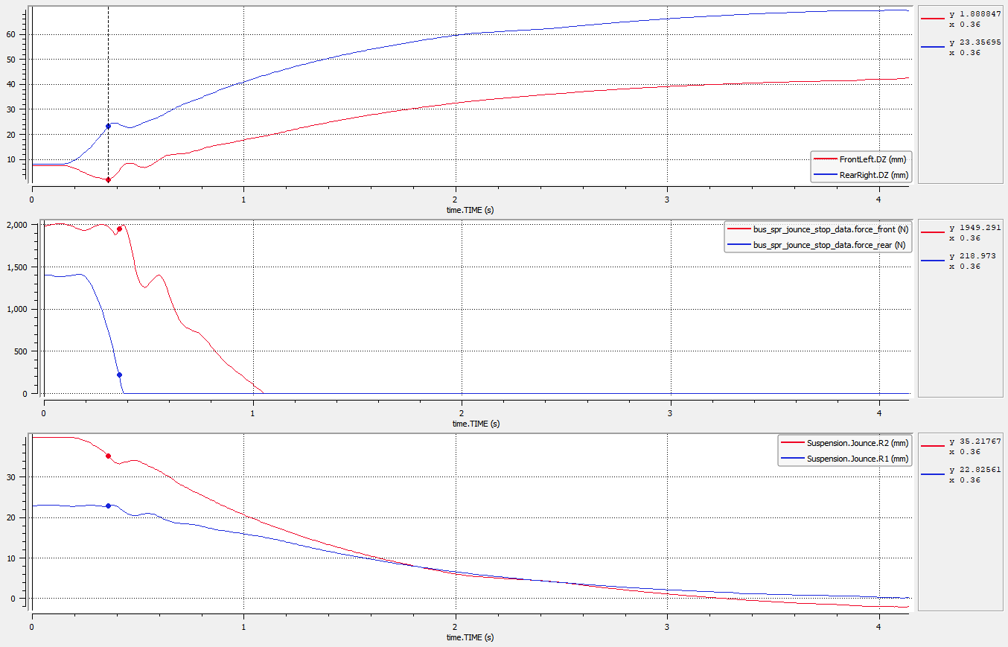
Maximum Speed Braking
 | Front | Rear | Unit
Maximum deceleration | 4.54 |  | g
Maximum tire deflection (wrt static) | 19.9 | 5.9 | mm
Maximum tire deflection (wrt top speed not braking) | 7.3 | -10.8 | mm
Minimum skid clearance | 2 | 23 | mm
Ride Heights at max. decel. | 27 | 49 | mm
Fx brake balance | 0.62 | 0.58 | ratio
Peak Fx | 16.5 | 10.0 | kN
Skid clearance
Bump-stop force
Suspension travel (positive bump)

Slide 8
Constant Speed Steer Ramp
Speed [km/h] | ay,max [g] | Max Susp. Roll [deg] | Max Total Roll [deg] | Kin. Roll Gradient | Total Roll Gradient |  | Suspension Travel |  |  |  | Minimum skid clearance
 |  |  |  |  |  |  | FL | FR | RL | RR | FL | FR | RL | RR
80 | 1.63 | 0.71 | 1.1 | 0.44 | 0.67 |  | -11.4 | 10.1 | -11.2 | 11.1 |  | 41.4 |  | 61.7
160 | 1.94 | 0.83 | 1.3 | 0.43 | 0.67 |  | -8.5 | 16.3 | -3.4 | 22.8 |  | 34.0 |  | 49.1
240 | 2.41 | 1.05 | 1.6 | 0.44 | 0.66 |  | -3.9 | 27.1 | 8.6 | 42.2 |  | 21.5 |  | 28.0
320 | 2.92 | 1.29 | 1.9 | 0.44 | 0.65 |  | 2.2 | 40.2 | 19.8 | 61.8 |  | 5.5 |  | 4.5
Notes:
Kinematic models of SCG 004C (R07), modified front LCA inboard points to match RCH 50mm (rear left at 95mm)
Draft front kinematic of SCG007C shows higher roll center height VS bump movement (140% against 180%), further investigation needed, as higher roll/outside wheel bump travel may be expected.
Also important to check is matching of the front and rear roll center / jacking forces trends in bump.

Slide 9
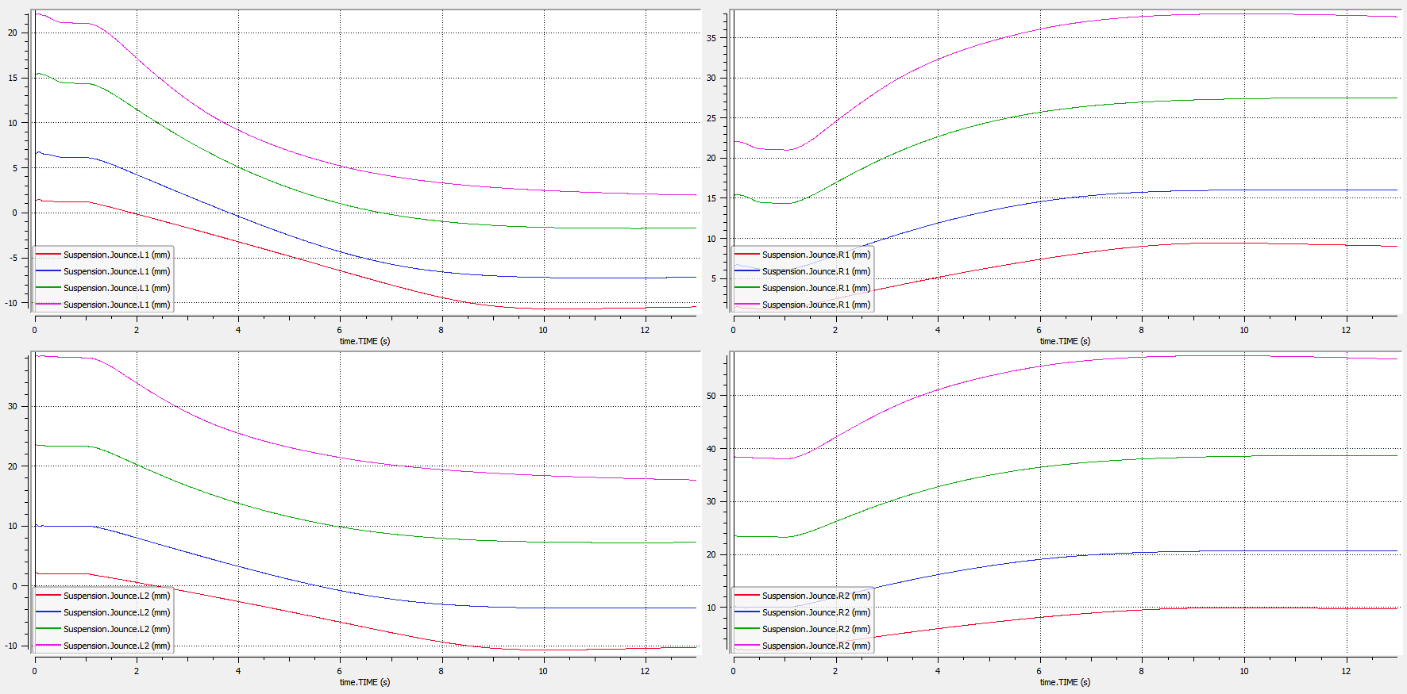
Constant Speed Steer Ramp - Plots
Suspension Jounce
FL FR
RL RR
- Positive bump
- Left corner
- Colors
80km/h
160km/h
240km/h
320km/h

