Slide 2
Suspension Kinematics Review
Front suspension V03

Slide 3
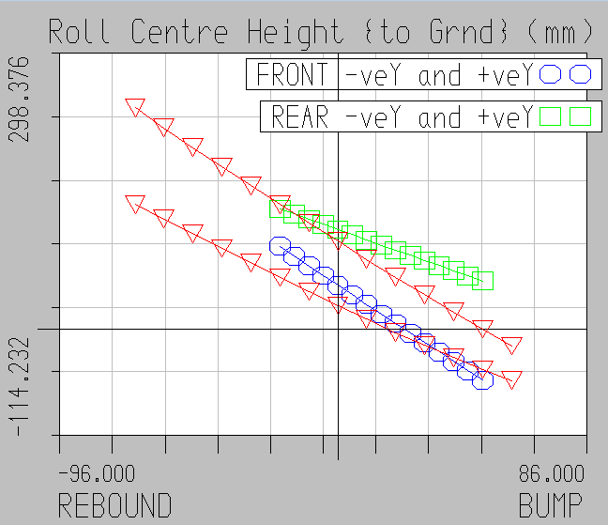
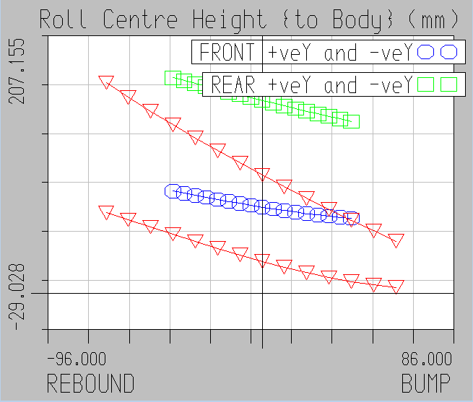
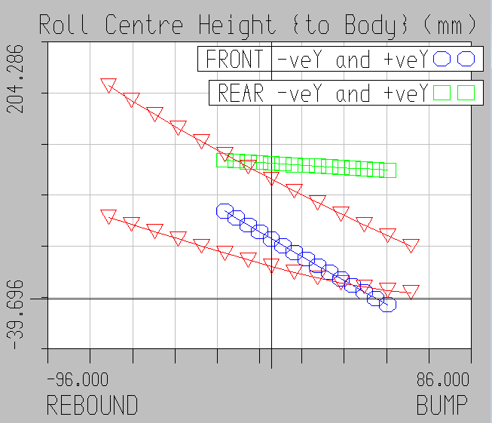
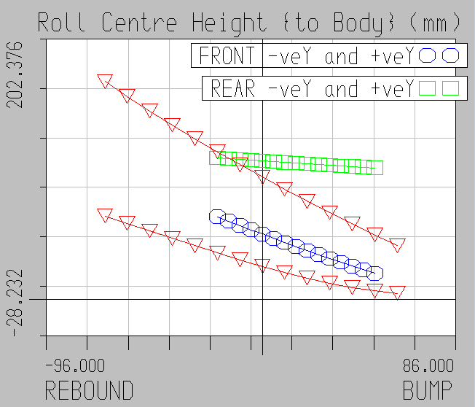
Roll center height
 |  | 007 FR V03 | 007 V04? | 004C Front | 007 RR V01
Camber change | deg/cm | 0.158 | 0.174 | 0.290
RCH Δz {ground} | mm/cm | 20.8 | 16.5 | 14.8
RCH Δz {body} | mm/cm | 10.8 | 6.5 | 4.8
Jacking F. gain [static] | Fz/Fy | 0.058 | 0.062 | 0.030
Jack. F. [30mm bump] | Fz/Fy | -0.018 | -0.002 | -0.020
AR outer (mu 1.3) [static] | % | 22.5% | 23.9% | 10.7%
AR outer (mu 1.3) [30mm] | % | -7.2% | 0.8% | -7.6%
V03
Red 004C
003C
V03
V04?

Slide 4
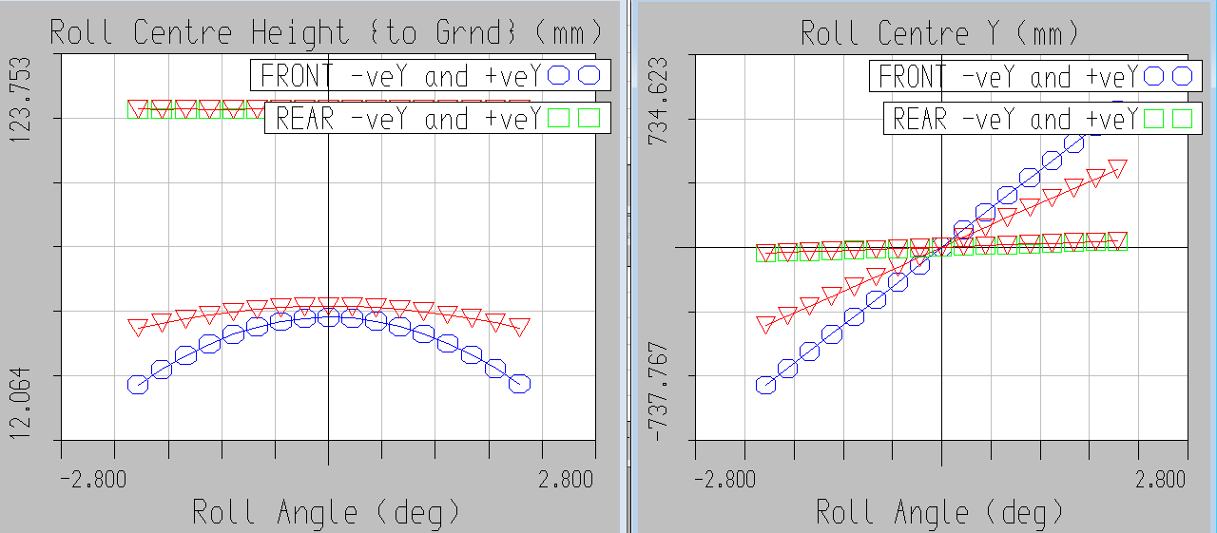
V04 (red) vs V03

